Slide 1

MIRЯOЯ
An AI Powered Memory and Emotional Analytics System
Project
Presented by:
Prabhu Teja Pamula
24EMCA1237
Project Guide:
Dr. Brijendra Singh
Associate Professor
Second Review
09 June 2026

Slide 2
Outline
Data Collection Progress
Analysis & Interpretation (Preliminary)
Consistency with Objectives

Slide 3
Data Collection Progress
Authenticity of Data:
Mirror Captures real time user reflections through our frontend using two natural input methods:
Direct text typing
Built in speech to text processing (Voice recording)

Slide 4
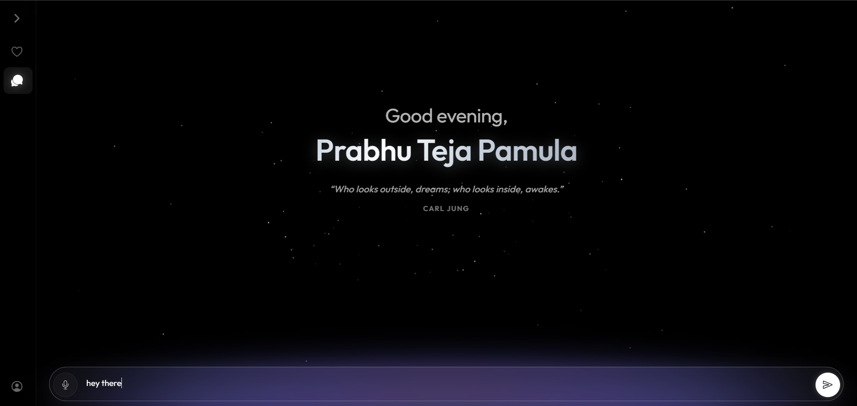

Slide 5
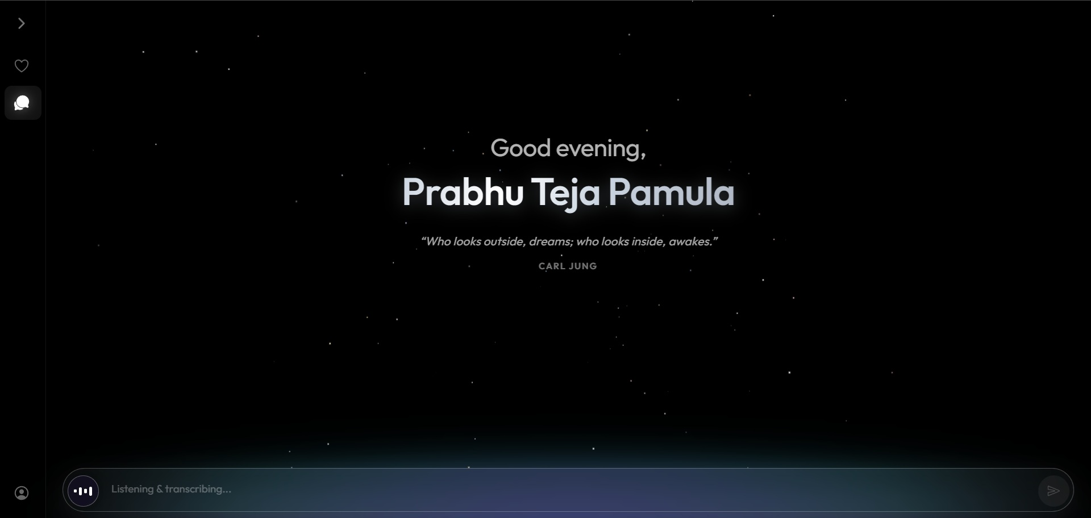

Slide 6
Data Collection Progress
Adequacy of Data Collected:
Ensures no information is lost by storing all 7 key details needed for the AI to work properly:
id: Unique database identifier.
content: The actual journal text.
created_at: The exact time the entry was saved.
emotion: The dynamically generated mood tag.
sender: Identifies who spoke (the user or mirror).
user_id: Securely links the entry to the logged in user.
embedding: The mathematical vector used by the AI to find patterns.

Slide 7
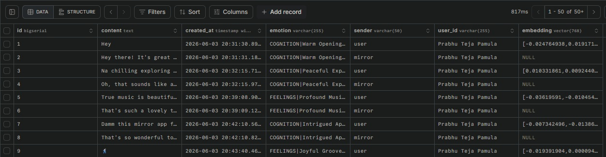

Slide 8
Data Collection Progress
Proper Tools Used (Relational Architecture):
Neon Serverless PostgreSQL:
A modern cloud database that securely manages user accounts and active sessions.
pgvector Extension:
A powerful tool that allows us to store the AI's mathematical vectors natively inside our SQL tables.

Slide 9
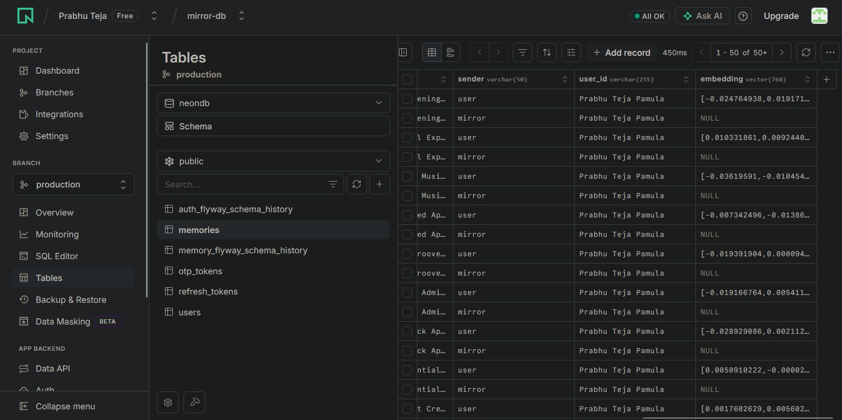

Slide 10
Analysis & Interpretation (Preliminary)
Use of Appropriate Analytical Tools:
Microservices Architecture:
The backend is split into independent services (api-gateway, auth-service, memory-service) to process user data rapidly and keep the code organized.
Asynchronous Processing:
Uses RabbitMQ to handle heavy AI and emotion tagging tasks in the background so the app never freezes while processing text.
High Speed Caching:
Uses an Upstash Redis cache database to store computed text embeddings instantly, ensuring lightning fast search responses.

Slide 11
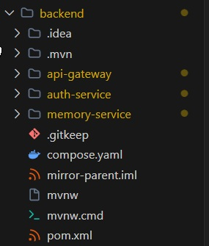

Slide 12
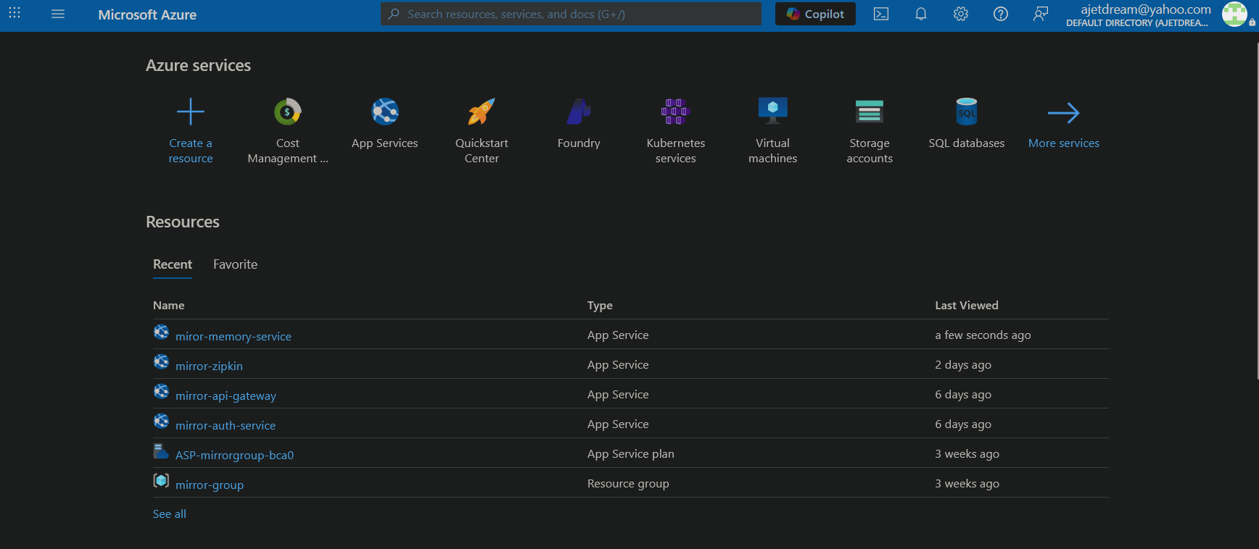

Slide 13
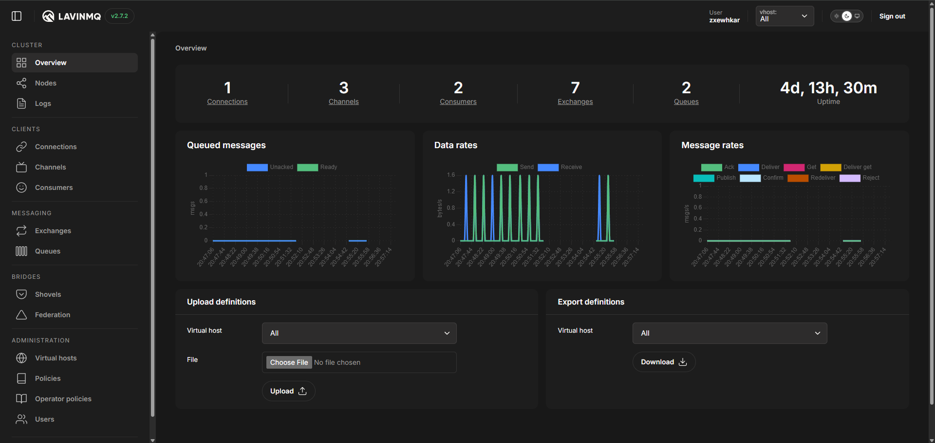

Slide 14
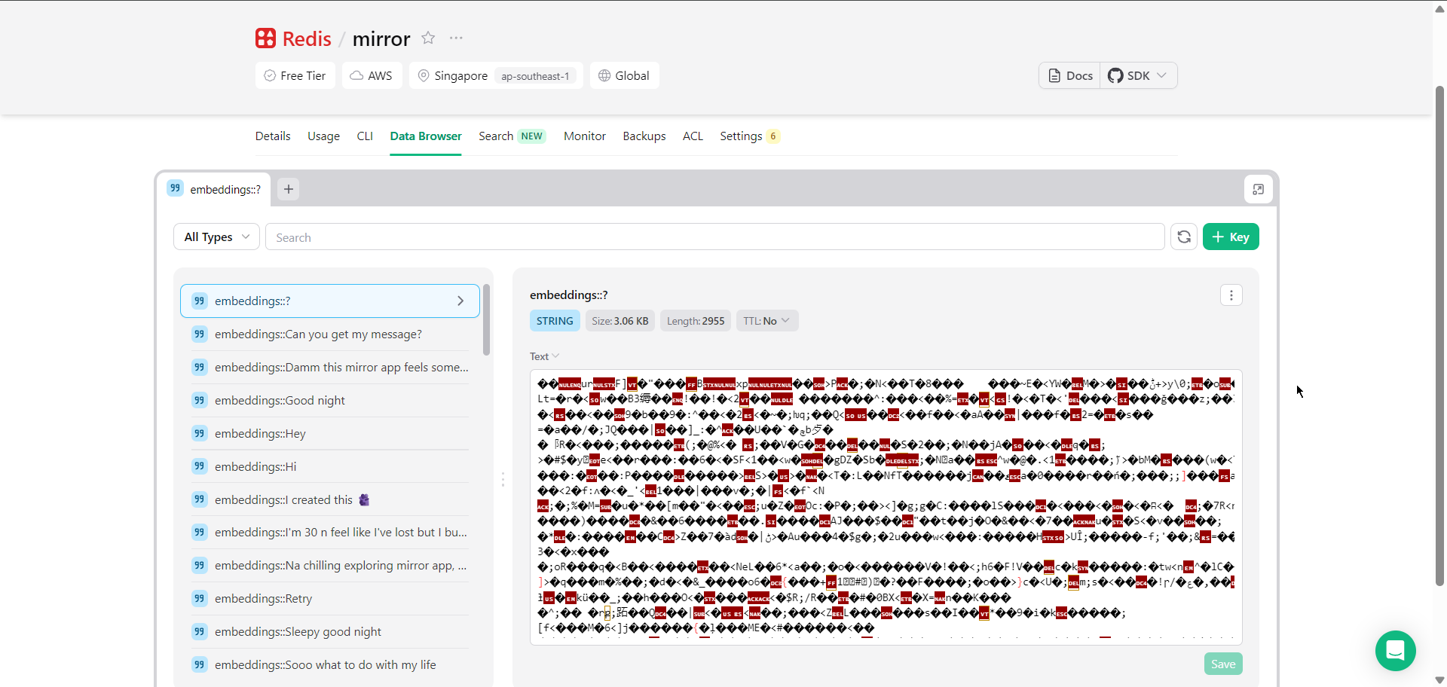

Slide 15
Analysis & Interpretation (Preliminary)
Logical Interpretations:
Smart Emotion Tagging:
Mirror doesn't rely on a fixed list of basic emotions. Instead, it analyzes the entry and instantly creates a custom emotion tag that captures the user's exact mood.
Interactive Visualizer:
Takes the complex AI data from the backend and turns it into easy to read, dynamic graphs right on the user's screen.
Finding Past Patterns:
Logically connects older journal entries to show clear trends in how the user's emotions and mindset are developing over time.

Slide 16
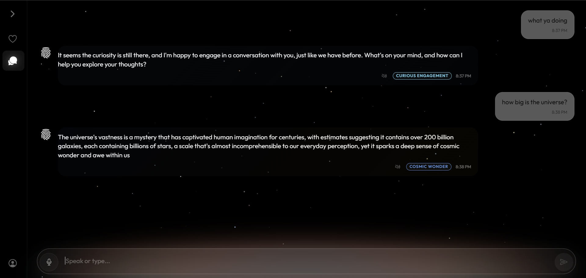

Slide 17
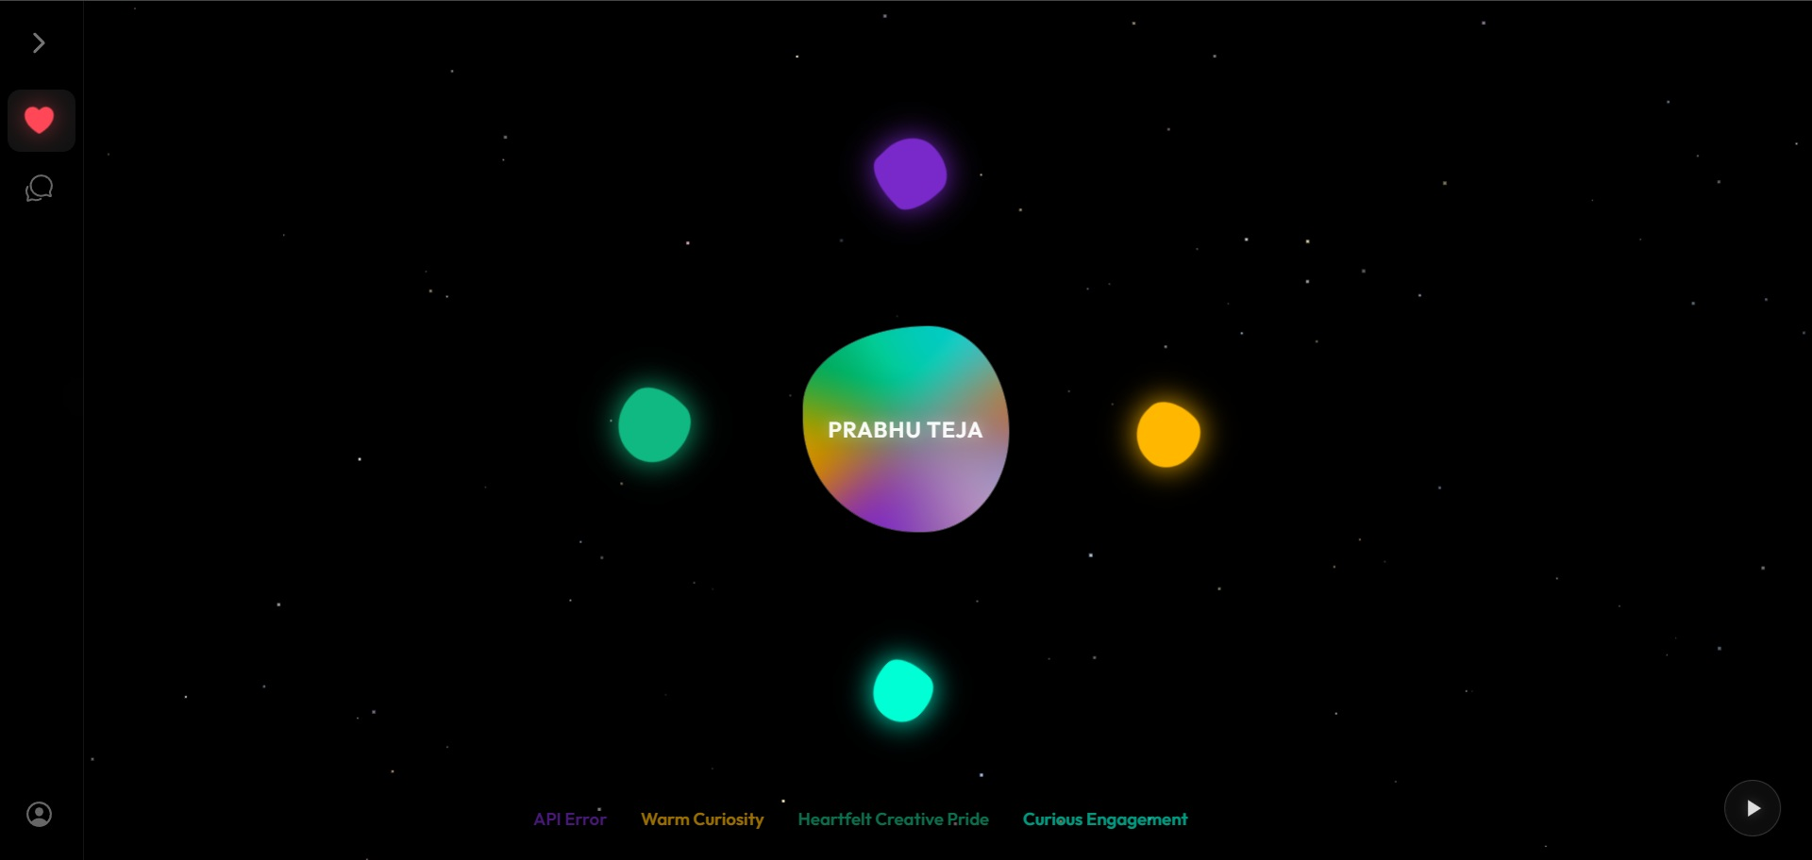

Slide 18
Consistency with Objectives
Work Progress Aligned with Original Objectives:
One App for All Platforms:
Successfully built the core screens (Login, Chat, You Profile) to work perfectly and look consistent on both Web and Android.
Strict Privacy Focus:
The database and secure login (JWT) are designed to keep user data completely private. The project stays true to its original goal of being a purely personal journal, avoiding any public social features.

Slide 19
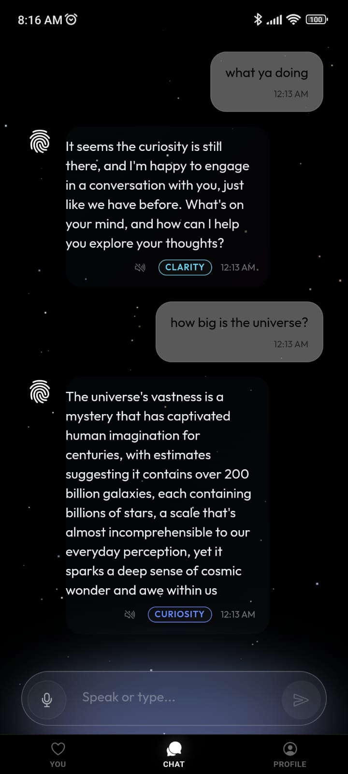

Slide 20
Consistency with Objectives
Adherence to Scope:
Low Friction User Experience:
Built a clean, intuitive interface using Ionic and Angular, allowing users to effortlessly log their daily reflections through both text and voice inputs.
Cloud Native Distributed Architecture:
The application stack is fully deployed across a distributed cloud environment. The core microservices and Zipkin are hosted on Azure, while Redis is hosted on Upstash and RabbitMQ on CloudAMQP, proving the system is a highly scalable, production ready product.

Slide 21
Thank You
Questions and Feedback
Repository: | https://github.com/prabhu-tejaa/MIRROR
Web Interface: | https://projectmirror.tech/
Android Build: | https://github.com/prabhu-tejaa/MIRROR/releases
MIRЯOЯ
Prabhu Teja Pamula | 24EMCA1237

