Slide 1

MIRЯOЯ
An AI Powered Memory and Emotional Analytics System
Project
Project Guide:
Dr. Brijendra Singh
Associate Professor
Presented by:
Prabhu Teja Pamula
24EMCA1237
Zeroth Review
28 March 2026

Slide 2
Outline
Problem Identification
Problem Relevance
Project Objective
Project Scope
Methodology/Approach
Proposed System Architecture

Slide 3
Problem Identification
The Core Problem:
Every day we hit a win, feel a pain or learn a lesson that could change our lives. But because our brains are built to move on, these moments fade away within days. Without a way to look back at what we have been through, we lose the ability to see the patterns in our own lives, making it difficult to build on our experiences and move forward with clarity.
A Real World Example:
The Moment: You have a massive "Aha!" moment at 2:00 AM about your career, a relationship or a bad habit. You feel 100% certain you will improve on it.
The Fade: By next afternoon, the "feeling" of that insight is gone. You remember the idea, but you can no longer feel the truth or the urgency of it.
The Result: Because there was no system for active reflection, the insight never gets reinforced. You naturally return to your old defaults, losing weeks or months of potential progress simply because the lesson wasn't integrated into your daily life.

Slide 4
Project Relevance
The "Passive Silos" Problem: Whether using physical journals, WhatsApp "Message Yourself" or notes apps (Notion/Keep), these are Static Systems. Information is recorded but stays isolated.
The Contextual Gap in AI: While tools like ChatGPT/Claude/Gemini have "Memory" for basic facts, they lack Long term Personal Context. They don't track a user’s emotional journey or connect a lesson learned months ago to a struggle happening today.
The "Why" Gap: Existing tracking methods show what happened, but they fail to connect the dots. They can record a moment of frustration or a missed habit, but they cannot explain the underlying patterns or life cycles that lead to those moments.
Lack of Active Reinforcement: There is no mainstream system designed to proactively mirror past breakthroughs back to the user. This makes it difficult to turn a temporary "Aha!" moment into a permanent habit.

Slide 5
Project Objectives
Cross Platform Interface: Develop a unified application architecture to provide a consistent, mobile first experience across both Web and Android platforms, ensuring the tool is accessible regardless of the user's device.
Secure Authentication System: Implement a robust JWT based authentication system to ensure strict privacy for all personal data. By utilizing persistent sessions, the system balances high level security with instant access, removing the need for repeated login prompts.
Multimodal Data Capture: Develop a low friction interface that supports both voice to text and direct text input. This ensures users can input their thoughts, reflections or general chat whenever they want, in their preferred format.
Context Memory Storage: Develop a backend architecture that integrates emotional metadata and chronological context into every entry. This creates a continuous thread of the user’s journey, allowing the system to reference past reflections as a connected narrative instead of isolated notes.
Automated Insight Synthesis: Integrate a Large Language Model (LLM) to correlate current inputs with historical data. This system identifies recurring behavioral patterns and surfaces relevant past breakthroughs to the user, reinforcing growth through proactive mirroring of the user's own history.

Slide 6
Project Scope
MIRROR is strictly scoped as a single user personal reflection tool. It does not support multi user collaboration, real time professional consultation or external data sources. Within these boundaries, the system covers:
Cross platform application (Web + Android)
Microservices backend (Auth, Speech, Data, AI)
Automated emotional metadata tagging
AI driven pattern synthesis from personal history only
Interactive Growth Dashboard
Admin panel for system level oversight and user management

Slide 7
Methodology/Approach
Frontend Framework: Ionic with Angular for a unified, reactive UI across Web and Android platforms.
Backend Architecture: Java with Spring Boot, utilizing a Microservices pattern for modularity and scalability.
Security Layer: Spring Security + JWT for robust, stateless user authentication and data privacy.
Data Persistence: PostgreSQL for centralized storage of user credentials, emotional metadata and historical reflections.
Vector Search: Utilizing the pgvector extension within PostgreSQL to store and query AI generated embeddings for pattern recognition
Speech Processing: Faster Whisper / VOSK for local, low latency voice to text conversion.
AI Logic Engine: Integration with Large Language Models (LLM) via OpenAI, Google Gemini or Anthropic Claude APIs to perform proactive behavioral synthesis and historical pattern recognition.
Proposed Methodology: Agile (Scrum) framework, iterative sprints from April to June, covering System Design → Development → Testing → Deployment, with milestone reviews aligned to each evaluation cycle.

Slide 8
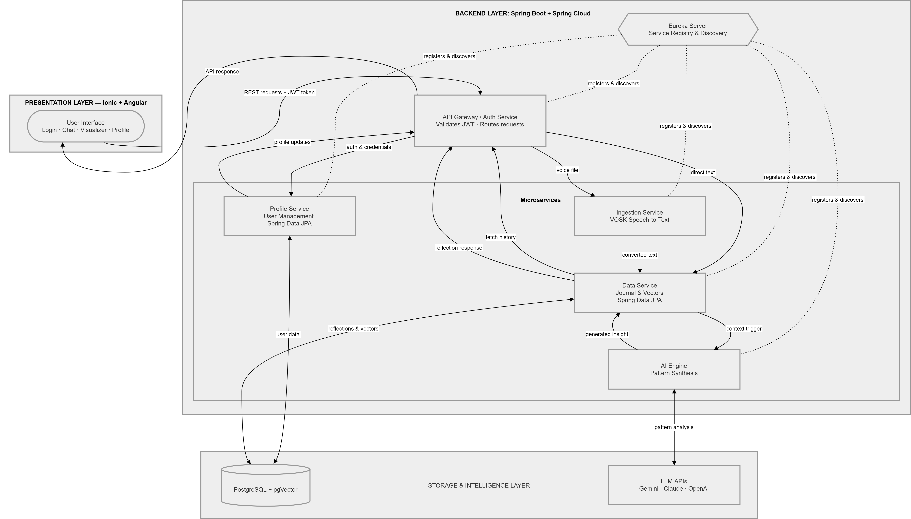
Proposed System Architecture

Slide 9
Thank You
Questions and Feedback
MIRЯOЯ
Prabhu Teja Pamula | 24EMCA1237

