Slide 1
Data Encryption Using Advanced Encryption Standard (AES) Algorithm

Slide 2
Features of AES:
AES is a block cipher with a block length of 128 bits.
AES allows for three different key lengths: 128, 192, or 256 bits.
Encryption consists of 10 rounds of processing for 128-bit keys, 12 rounds for 192-bit keys, and 14 rounds for 256-bit keys.
To appreciate the processing steps used in a single round, it is best to think of a 128-bit block as consisting of a 4×4 matrix of bytes.

Slide 3
Encryption
During each round, the following operations are applied on the state:
Sub Bytes: every byte in the state is replaced by another one, using the Rijndael S-box.
Shift Row: every row in the 4x4 array is shifted a certain amount to the left.
Mix Column: a linear transformation on the columns of the state.
AddRoundKey: each byte of the state is combined with a round key, which is a different key for each round and derived from the key schedule.

Slide 4
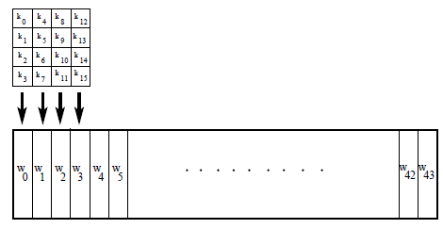
Key Schedule
Assuming a 128-bit key, the key is also arranged in the form of a matrix of 4 × 4 bytes. As with the input block, the first word from the key fills the first column of the matrix, and so on.

Slide 5
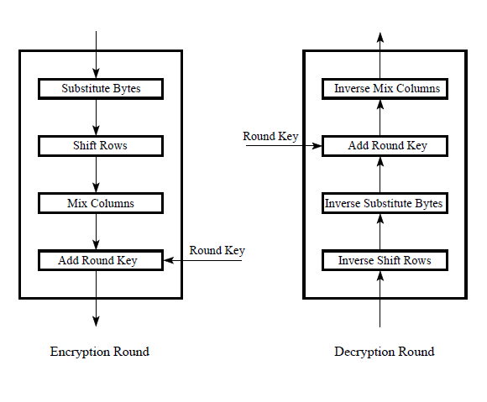
Decryption

Slide 6
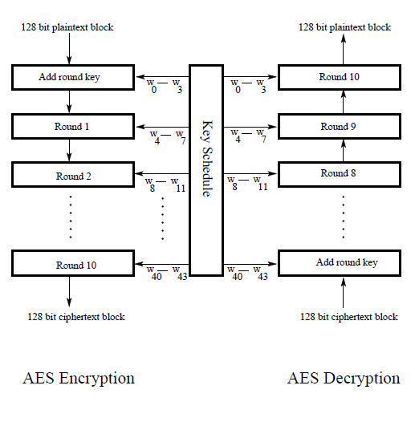

Slide 7
THANK YOU

