Slide 1

GLOBAL ACADEMY OF TECHNOLOGY DEPARTMENT OF COMPUTER SCIENCE AND ENGINEERING
Subject Name | M ajor Project Work Phase I Final Review : Literature Survey and Design | Subject Code | 22CSEP65
Student Name | Kruthi NL | USN | 1GA22CS089
 | Mohan Kumar M |  | 1GA22CS106
 | Prabhu Gouda |  | 1GA22CS119
 | Puneeth M |  | 1GA22CS123
Domain | AI and IoT | Group No: | G36
Project Title | “Enhancing Prehospital Care Through AI and IoT: Automated Dispatch, Vitals Tracking, and Dynamic Hospital Routing. ”
Undertaken at | Global Academy Of Technology
Guide Name | Prof Sowmya B.K

Slide 2
Introduction
Problem Statement
Objectives
Literature Survey
Architecture
Methodology ms
References

Slide 3
Introduction
In rapidly urbanizing regions like Bangalore, emergency medical services face critical delays due to traffic congestion, poor coordination, and inadequate infrastructure.
These issues are exacerbated in surrounding rural areas where the lack of nearby hospitals and ambulance availability results in the loss of precious time known as the “golden hour”—the first hour after a traumatic injury during which prompt medical treatment can significantly increase survival chances.
The system aims to bridge these gaps through an intelligent, tech-driven approach.
The project is an innovative solution leveraging Artificial Intelligence (AI) and the Internet of Things (IoT) to create a seamless emergency response ecosystem.

Slide 4
Introduction
By integrating live ambulance tracking, AI-based hospital selection, real-time patient data transmission, and automated traffic signal management, it ensures faster ambulance dispatch and better hospital preparedness, ultimately aiming to reduce mortality and improve outcomes.

Slide 5
Problem Statement
Inefficient Dispatch: Manual ambulance allocation leads to delayed emergency response times.
Lack of Real-Time Data: Hospitals receive patients without vital signs or medical history during transit.
Traffic Delays: Static traffic systems fail to prioritize ambulances, increasing transport time.
Suboptimal Hospital Selection: Ambulances choose hospitals based only on proximity, ignoring specialization/bed availability.
Rural Disadvantage: Limited infrastructure and distance amplify these challenges in non-urban areas.

Slide 6
Objectives
Develop an AI and IoT-enabled system that ensures immediate dispatch of the nearest available ambulance to accident locations.
Use IoT-integrated medical devices inside ambulances to continuously monitor and transmit patient vitals (like heart rate, BP, SpO2) to the destination hospital in real time.
Design a dynamic traffic management system that can automatically control traffic signals, creating green corridors for ambulances to pass through congested city routes without delay.
Leverage AI-based decision-making algorithms to recommend the most suitable hospital based on factors like distance, specialization, hospital capacity, and patient condition, while also sending advance alerts to hospitals for timely preparation before the patient arrives.

Slide 7
Literature Survey
Sl. # | Title and Author | Scopus/SCI Date of Publication | Dataset and Methodology Used | Research Gap Identified/Limitation
1 | Ambulance route optimization in a mobile ambulance dispatch system using deep neural network (DNN) Authors: C. Selvan, Basha H. Anwar, Soumyalatha Naveen, Shaik Thasleem Bhanu | Published in Scientific Reports, a well-known SCI-indexed journal (Springer Nature) Published : April 23, 2025 | Kaggle Ambulance Dataset. Decision Tree Support Vector Machine (SVM) CRNN (Convolutional Recurrent Neural Network) | Existing models do not adapt in real-time to traffic or emergencies Traditional methods fail to handle large-scale dynamic routing Limitation of Dataset: The Kaggle dataset might not generalize well across geographic regions due to road, traffic, and infrastructure differences
2 | Real-Time Health Monitoring Using 5G Networks: A Deep Learning Based Architecture for Remote Patient Care | Published in arXiv. Published : 2 Jan 2025 | Hybrid CNN-LSTM with attention mechanism; deployed over 5G network | Performance validated in controlled clinical settings only; lacks deployment in real-world unstable networks

Slide 8
Literature Survey
Sl. # | Title and Author | Scopus/SCI Date of Publication | Dataset and Methodology Used | Research Gap Identified/Limitation
3 | Optimization-Augmented Machine Learning for Vehicle Operations in Emergency Medical Services. Author:Maximiliane Rautenstrauß & Maximilian Schiffer | Published in arXiv. Published : 14 Mar 2025 | San Francisco 911 call data (Jan–Jun 2023) MCLP model + ML augmentation | Prior models ignored real-time constraints and anticipatory planning; addresses generalization gap
4 | AI-Based Response Emergency Response Systems: A Systematic Literature Review On Smart Infrastructure Safety. Author:Ammar Bajwa | American Journal of Advanced Tech. & Engineering Solutions. Published : March 2025 | 424 studies reviewed; no dataset used directly; PRISMA method | Ethical, regulatory, and algorithmic bias concerns hinder real-world AI adoption in emergencies

Slide 9
Literature Survey
Sl. # | Title and Author | Scopus/SCI Date of Publication | Dataset and Methodology Used | Research Gap Identified/Limitation
5 | Accurate AI-Driven Emergency Vehicle Location Tracking in Healthcare ITS Digital Twin. Authors:Sarah Al-Shareeda, Yasar Celik, Bilge Bilgili, Ahmed Al-Dubai and Berk Canberk | Published in arXiv. Published : Feb 2025 | DNN & SVR models trained on historical ambulance GPS data; simulated Digital Twin in Docker | Models tested in mock scenarios; potential generalization issues with small datasets
6 | IOT Smart Ambulance: Revolutionizing Emergency Response & Patient Care. Author: Sakthidevi, S Megha,G Hindhushree,U Abarna ,V Ruba | International Journal Of Creative Research Thoughts.(IJCRT). Published : March 2024 | Conceptual study with no explicit dataset; discusses real-time monitoring via IoT | Lacks real-world implementation and empirical validation

Slide 10
Literature Survey
Sl. # | Title and Author | Scopus/SCI Date of Publication | Dataset and Methodology Used | Research Gap Identified/Limitation
7 | AI-Driven Traffic Management System for Emergency Vehicle Prioritization Using YOLO Authors: Lokesh Pagare, Kaivalya Pagrut, Labhesh Pahade, Suyash Pahare, Prathmesh Paigude, Sanika Pakhare. | Published in International Journal for Research in Applied Science & Engineering Technology (IJRASET) Published : November 2024 | Custom image and video dataset of ambulances at intersections. Curated, annotated, and augmented via Roboflow with classes “Ambulance” and “Non-Emergency Vehicles” - YOLOv8 model trained via Ultralytics in Python for real-time ambulance detection - OpenCV + NumPy for video feed processing - PushBullet, Plyer, PyAudio for notification & audio alert systems - Modbus Protocol + MCU + GPIO for traffic signal automation | Most traditional traffic systems lack automated emergency vehicle detection Prior approaches were not robust to real-time conditions like occlusion, low light, or congestion Hardware integration poses practical deployment challenges Broader acceptance, legal framework, and privacy compliance.
8 | A Cloud-Based Ambulance Detection System Using YOLOv8 for Minimizing Ambulance Response Time. Authors:Ayman Noor,Ziad AlgrafiandMajedAlwateer, Basil Alharbi, Talal H. Noor, Abdullah Alsaeedi, Reyadh | Published in Applied Sciences, MDPI (Scopus indexed) Published : 19 March 2024 | Custom dataset of 3000 images from 10 countries; YOLOv8 detection models | Lacks universal ambulance detection due to country-specific designs; limitation in real-world deployment generalization

Slide 11
Literature Survey
Sl. # | Title and Author | Scopus/SCI Date of Publication | Dataset and Methodology Used | Research Gap Identified/Limitation
9 | RTAIAED: A Real-Time Ambulance in an Emergency Detector with a Pyramidal Part-Based Model Composed of MFCCs and YOLOv8 Author:Alessandro Mecocci * and Claudio Grassi | Published in Sensors (MDPI) – an SCI-indexed journal with reputable indexing in Scopus and Web of Science. Published : April 5, 2024 | Custom-built image and audio datasets: Images: 2172 labeled images from diverse conditions Audio: 1240 siren and 4805 non-siren .wav files + 52 synthetic mixes. YOLOv8 custom-trained object detectors. MFCC-based neural network for siren detection. Part-Based Model architecture. RTAIAED system tested on Jetson Nano and Raspberry Pi 5 with LoRa wireless communication to traffic signals | Prior systems detect emergency vehicles using either audio or video but not both. Existing models lacked directional awareness and emergency context. Limited prior focus on one-way traffic regulation and double-red phases.
10 | Remote patient monitoring using artificial intelligence: Current state, applications, and challenges. Author:Thanveer Shaik,Xiaohui Tao,Niall Higgins,Lin Li Raj Gururajan, Xujuan Zhou. U. Rajendra Acharya. | Scopus indexed. Published : 17 Jan 2023 | Survey of AI techniques (SMOTE, KNN, SVM, RL, etc.); no new dataset | Focused only on physical vital signs, excludes EEG/neurological systems; lacks empirical dataset for new model validation

Slide 12
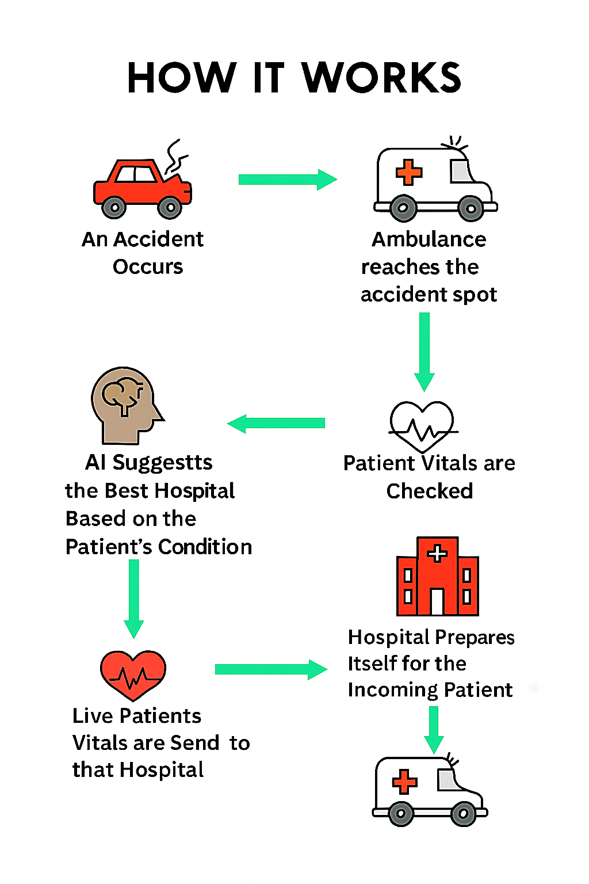
Architecture

Slide 13
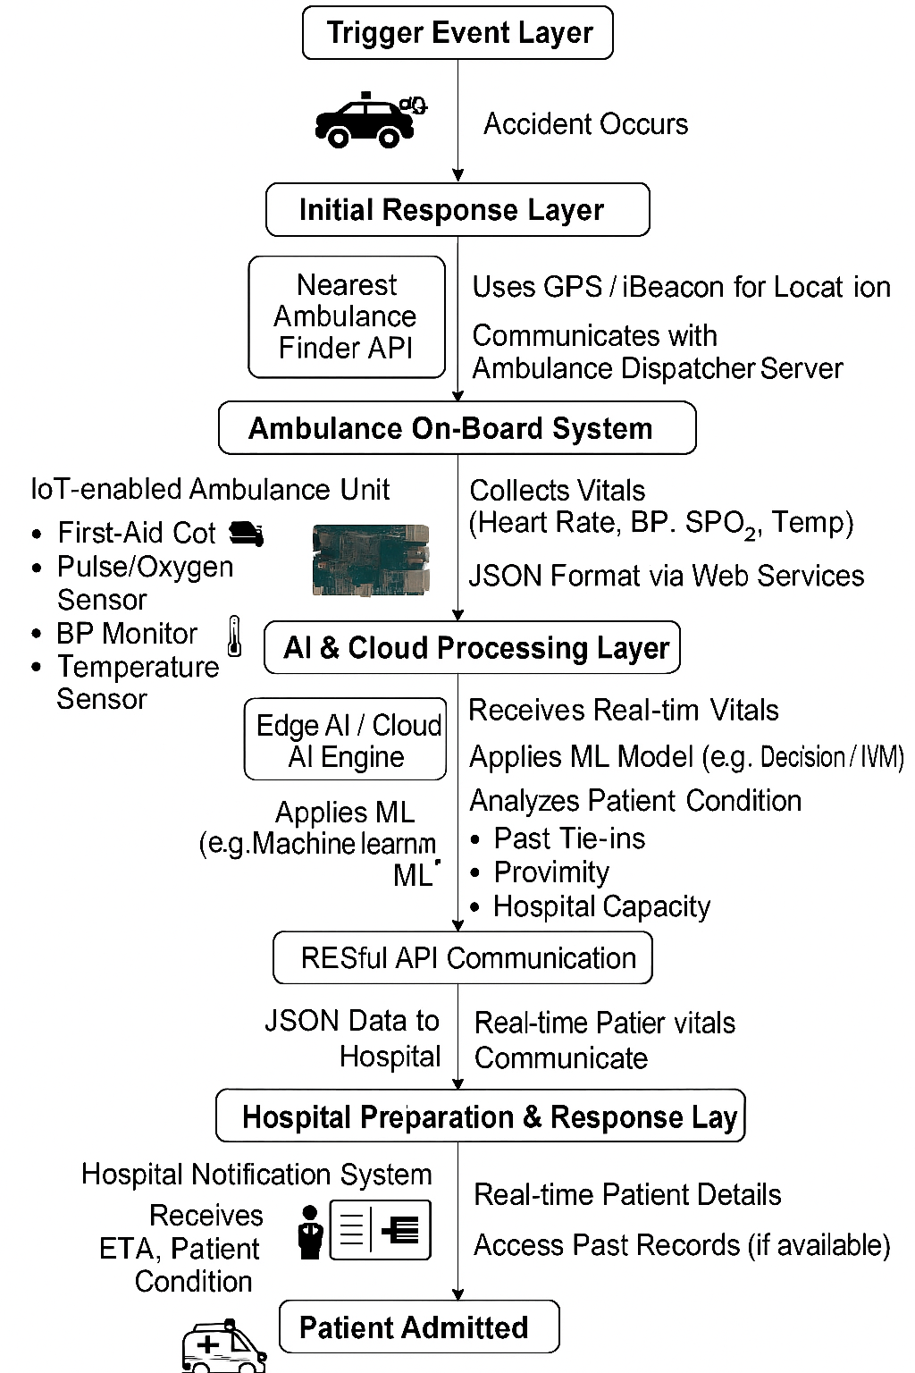
Sample Architecture

Slide 14
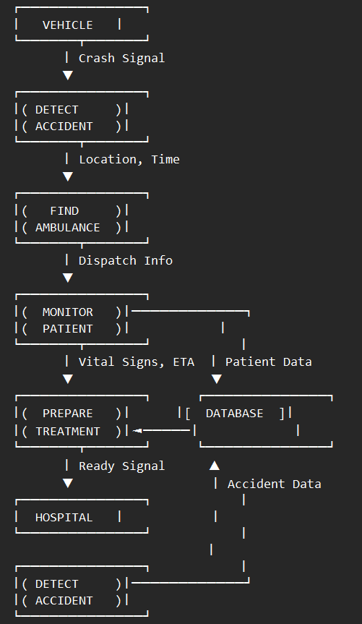
Data Flow Diagram

Slide 15
Algorithm designed for the Complete work
1. Accident Detection Module
Algorithm : Convolutional Neural Networks (CNN) combined with Support Vector Machines (SVM)
2. Ambulance Route Optimization
Algorithm: Deep Reinforcement Learning with Q-Networks
3. Patient Vital Signs Monitoring
Algorithm: Long Short-Term Memory networks with Attention layers

Slide 16
4. Hospital Resource Allocation
Algorithm: NSGA-II (Non-dominated Sorting Genetic Algorithm)
5. Overall System Integration
Algorithm: Stacked Ensemble with Meta-Learner
Components:
Level 1: Specialized models for each subsystem
Level 2: Meta-learner combines predictions
Integration: Bayesian Networks for uncertainty handling

Slide 17
References

Slide 18
Thank You

Slide 19
Q & A

