Slide 1
ABHIVRIDDHI
Farmstead Forward
Project Name:

Slide 2
Team Advaya
J A Archith
Niroop N R
Ananth Prabhu T
Sumedha Hiremath
Nagashree S
Sinchana H G
Inchara Hegde
Sahana M

Slide 3
TIMELINE
July 15th-19th
July 20th-29th
July 30th-31st
Design Thinking and Prototyping
HTML, CSS and JavaScript
Testing and Deployment

Slide 4
Empowering Rural Communities: Bridging the Digital Divide
Objective: Our team project aims to create a user-friendly website targeting individuals in rural areas.
Comprehensive Information: The website will provide comprehensive information across various domains, including education, healthcare, government services, employment, and more.
Relevant Data Sources: We will leverage relevant data sources to ensure the accuracy and up-to-date information presented on the website.
Socio-Economic Upliftment: The project's ultimate goal is to contribute to the socio-economic upliftment of rural communities.

Slide 5
Future Scope of Project Abhivriddhi
Fostering Partnerships: Collaborating with various organisations and institutions to provide better assistance to society.
AI-powered Personalization: Implementing AI algorithms to analyze user preferences and behavior can enable personalized content recommendations, tailoring the website's information to individual user needs.
Voice Interface: Integrating AI-powered voice recognition technology can allow users to access information through voice commands, catering to individuals with low digital literacy and making the platform more accessible.
Predictive Analytics: By leveraging AI-driven predictive analytics, the website can anticipate user needs and trends in rural communities, enabling proactive updates and service recommendations.
Virtual Assistants: Developing virtual assistants or chatbots using Natural Language Processing (NLP) can provide real-time assistance to users, answering their queries and guiding them through various processes on the website.

Slide 6
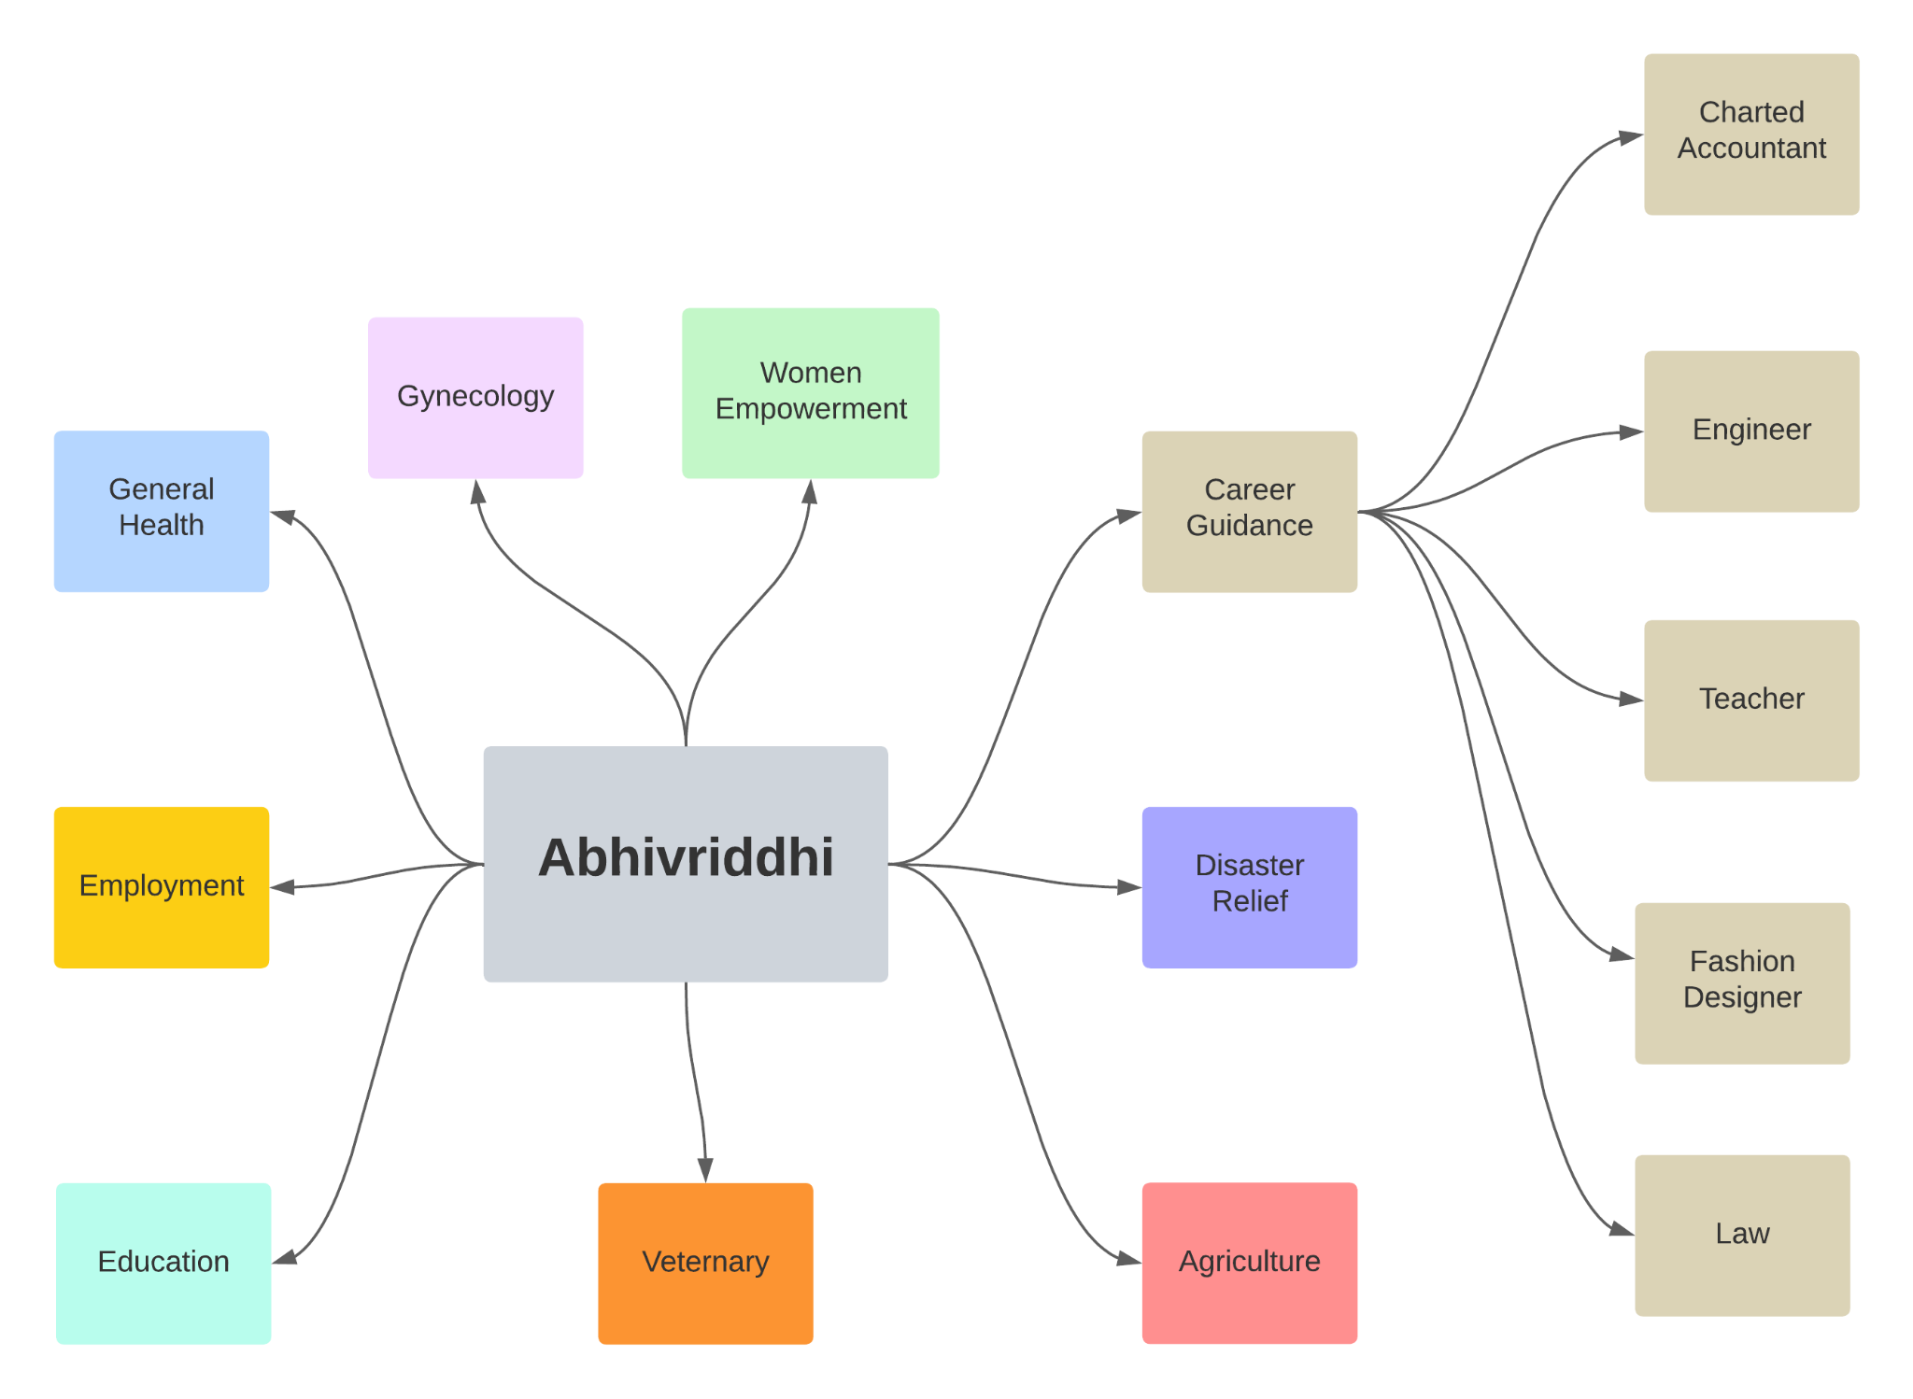
Website Structure

Slide 7
Thank
You

