Slide 1
LEARNING MANAGEMENT SYSTEM
G. Jyothi(Y23CA019)
P. Prabhudaya(Y23CA039)
N. Chaitanya(Y23CA032)
Under the guidance of: Dr.Karteeka Pavan
Notes:
LEA

Slide 2
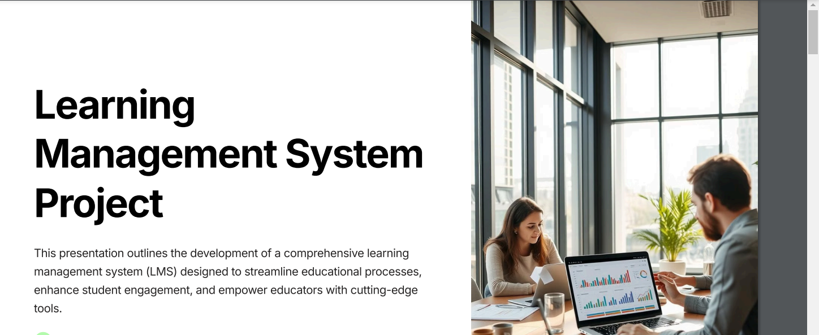

Slide 3
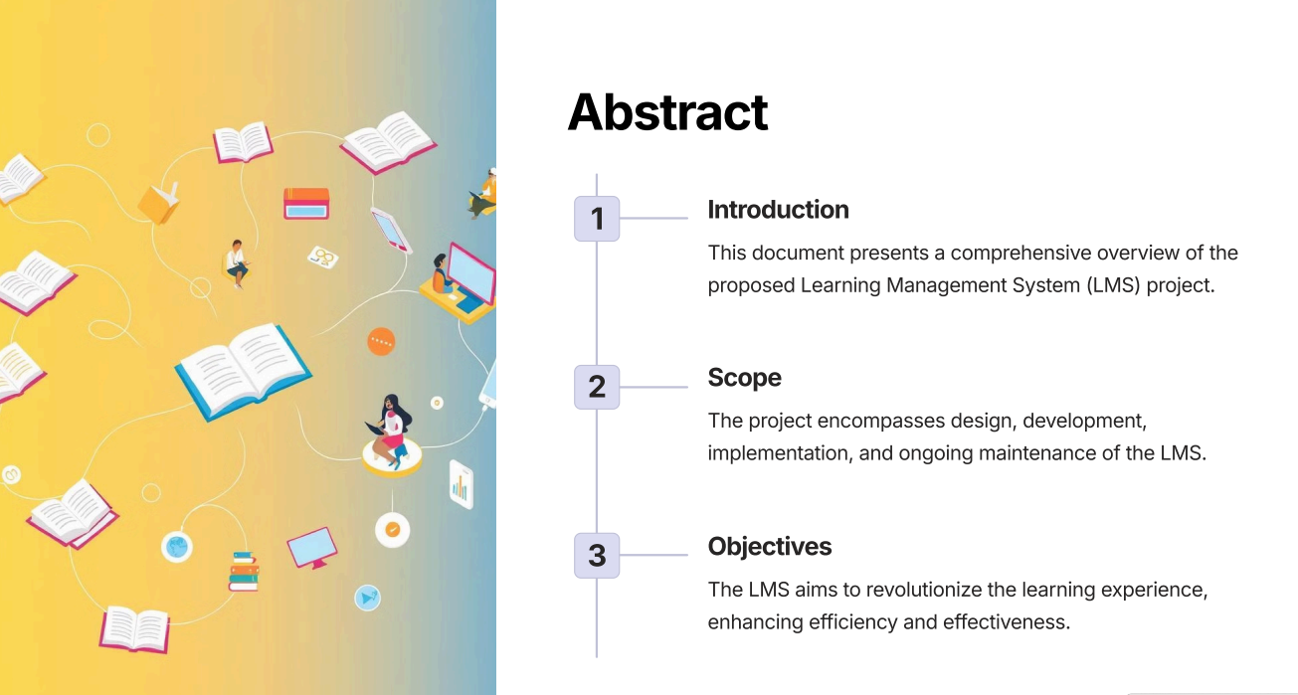
Abstract
.

Slide 4
Problem Statement

Slide 5
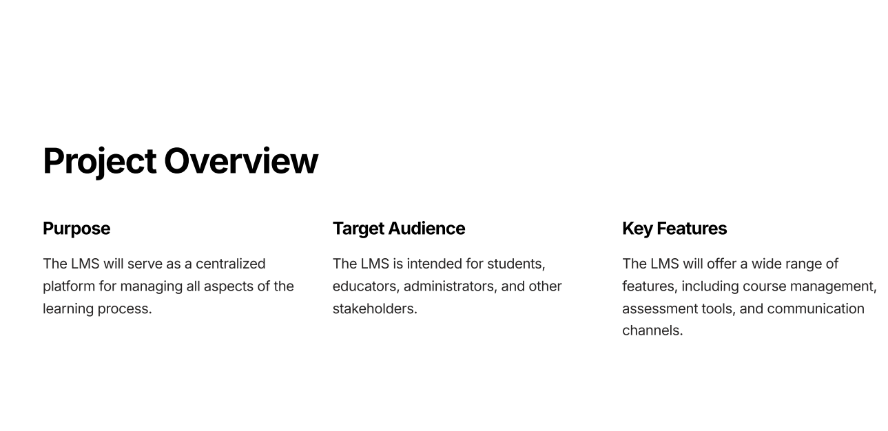
Existing System

Slide 6
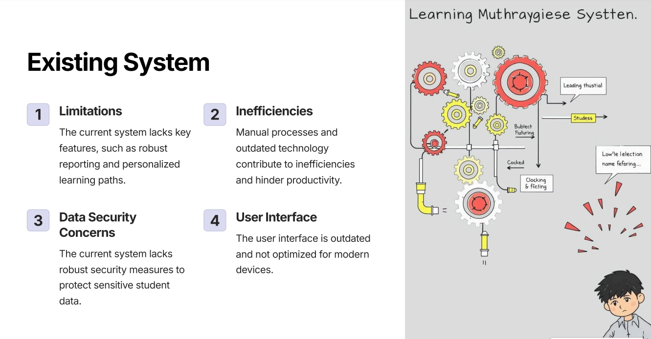

Slide 7
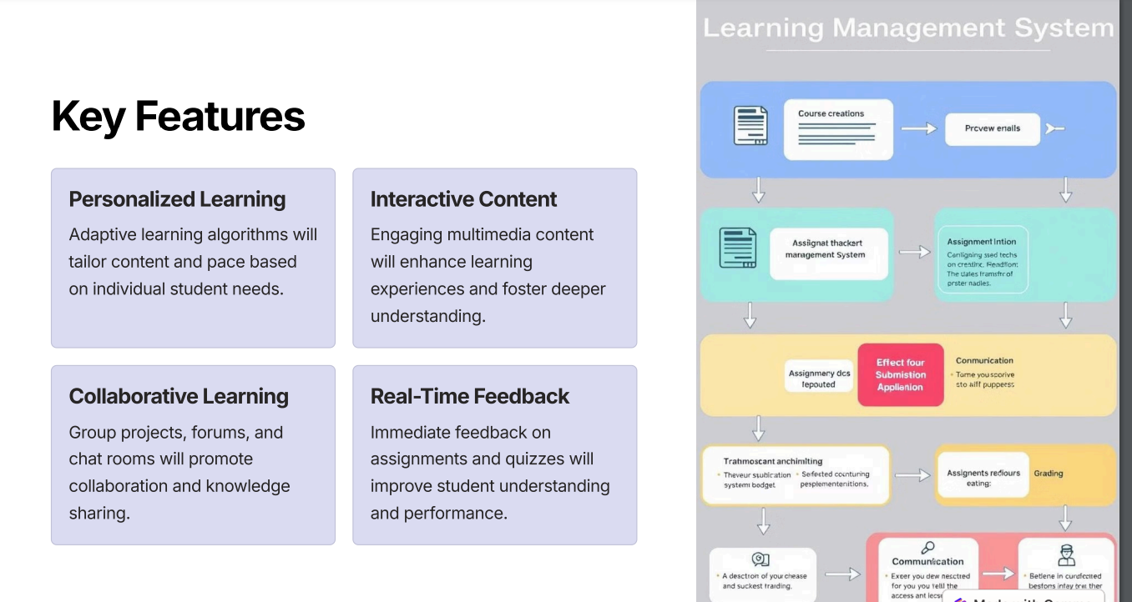
Proposed System

Slide 8
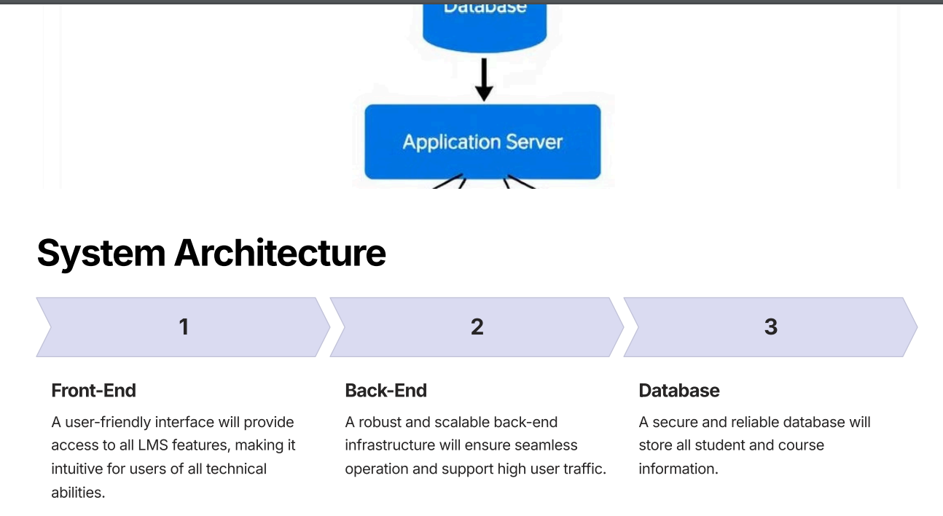

Slide 9
Technologies Used:
Database Management System (DBMS): MySQL or SQLite
Languages:
HTML: For structuring the pages
CSS: For styling and responsive design
JavaScript: For client-side interactions and validations
Bootstrap:front-end framework used for designing the user interface and ensuring responsiveness across devices
Django:back-end web framework in Python for building the server-side logic
SQL: For database management and queries

Slide 10
