Slide 1
Agent Simulation Evaluation
A rigorous method to know when our generative agents can be trusted
BEAUTY & WELLBEING
CEO & HEAD OF CONSUMER INSIGHTS BRIEFING

Slide 2

Why Evaluation of Agent Simulations Matters Now
Business Context
We are building AI agents from in-depth interviews with young business professionals who are a priority growth segment that works long hours and travels frequently.
Intended Uses
Early consumer hypotheses
Product & channel exploration
Faster research cycles
The Commercial Risk
A fluent agent that invents bulk-buying, erases indifference, or misses a home-vs-travel constraint can lead to the wrong product, assortment, or messaging decision. Polished answers that sound like the target consumer while changing the consumer's real decision logic.

Slide 3
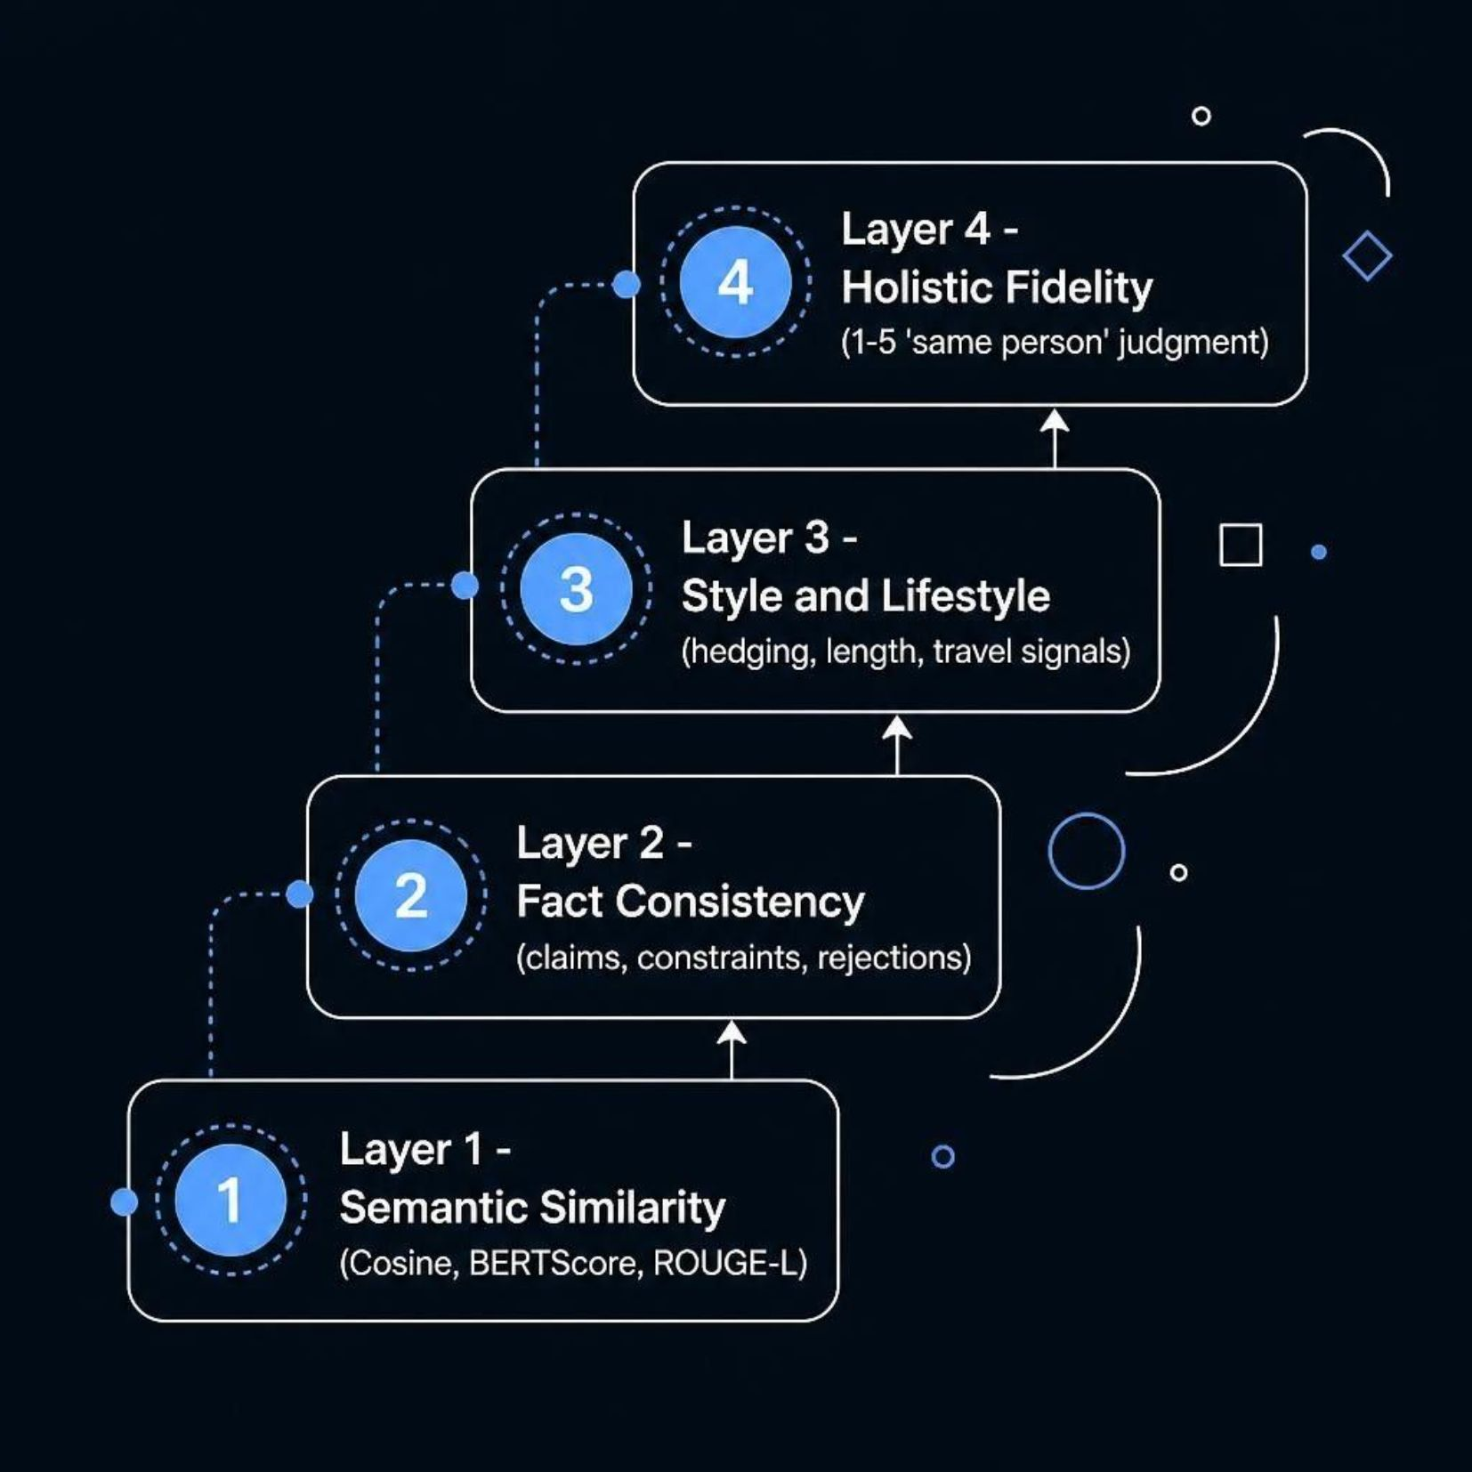
Why a Multi-Layer Evaluation Is Required
The Risk of Incorrect Evaluation
Traditional methods capture only semantic patterns and not consumer behavioral patterns. This can lead to incorrect user preferences, erases constraints, or fabricates values the real consumer never expressed.

Slide 4
What the Evaluation Revealed on 30 Held-Out Pairs
0.86
2.9
+75%
BERTScore F1
Holistic Fidelity
Length Inflation
Strong topical coverage
Out of 5 — only moderate
AI answers far more verbose
Where Agents Work
Where Agents Fail
High-involvement profiles with distinctive product knowledge (e.g., specific Korean skincare stack and channels) are reproduced with good fidelity — holistic 3.7/5.
Low-involvement, convenience-driven profiles are systematically rewritten: bulk-buying invented, uncertainty erased, travel constraints ignored — holistic 2.3–2.6/5.

Slide 5



Recommendation: Adopt This Evaluation Standard
Adopt the four-layer evaluation as the firm's quality gate for all human simulations before they inform product, messaging, or assortment decisions.
Immediate
Next 60 Days
Ongoing
Apply the method to the current agent cohort. Flag any profile scoring <3.0 on holistic fidelity for human review.
Enrich grounding interviews with bulk, travel, and indifference probes. Add generation constraints that preserve uncertainty.
Require multi-layer evaluation scores in every simulation release. Track fidelity by involvement segment.

Slide 6

Appendix Available on Request
Full Quantitative Tables
Qualitative Coding Notes
Technical Report (2 pages)
Detailed Person-Level Examples
This evaluation method turns "the agent sounds human" into "we know exactly where the agent can and cannot be trusted."

