Slide 1

Getting started with python
Introductory session on python
Prabhupad Pradhan
SW Test Engineer

Slide 2
Agenda
1. “Hello World!!”
2. Strings
3. Lists
4. Tuples
5. Dicts and Files
6. Live demo: Query database to check prerequisites.
7. Online resources to follow

Slide 3
print(‘Hello world!!!’)
Features of python programming language
One of the most popular programming language
Easy to learn and use
Free and open source, growing and evolving community
Large Standard Library
Well maintained documentation
Cloud community(AWS, GCP, Microsoft Azure, etc.)
Notes:
1 . Python is the most popular programming language these days, used in the field of data intelligence, full stack development, data analytics, automation testing etc..
2. Its simplicity and human readable syntax are the reasons why it is so popular, easy to learn and use.
3. Communities such as stackoverflow, gihub, google dev, reddit etc.
4. Extensive dev friendly standard library provides rich set of modules and functions.
5. Well maintained documentation for every release..latest one is 3.8.0

Slide 4
<class ‘str’>
Python strings as immutable
String Methods
Characters in a string can be accessed using the standard [ ] syntax
String concatenation
Use of ‘*’ operator on string
String slices
String % - %d, %s, %f
F- string
Conditional statements
Notes:
Means they cannot be changed once they are created, they can be enclose in double quotes or single.
Strip(),split(),isupper(),upper(),lower(),find(),join()
A = ‘this is a text’ , A[0] -> t
‘hello’ + ‘there’ -> hellothere
‘text’*2 -> texttext
A[:5]

Slide 5
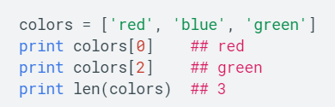
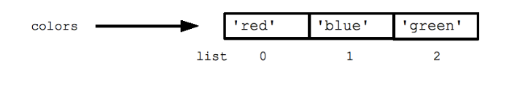
<class ‘list’>
Many languages only have one built-in complex type, commonly referred to as an array
Déclaration of List
Iteration in list (for and while loops)
List methods
List comprehension
Notes:
3. Use of range function
4. Append(elem), insert(index,elem), extend(), sort()*, sort(), reverse()
5. List comprehension : [x for x in range(10) if x%2 ==0]

Slide 6
<class ‘tuple’>
Immutable lists, cannot be changed once declared.
Déclaration of tuple
Concatenation
There is no single element tuples
Tuples are memory efficient

Slide 7
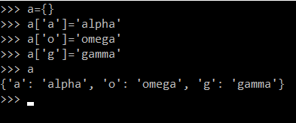
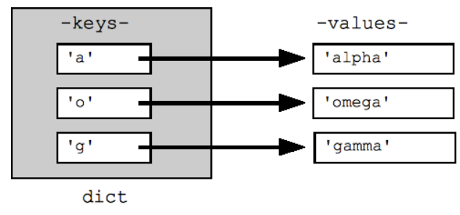
<class ‘dict’>
Python's efficient key/value hash table structure is called a dictionary.
Iteration in a dict
Dict methods
Notes:
Keys(),values(), pop(), clear()

Slide 8
Demo: Query database to check prerequisites.
Create the required files(env info, validation queries)
Read env info and store in a list/dict
Read the validation queries and store in a list
Initiate connection with cx_Oracle - A wrapper for oracle database connection - https://cx-oracle.readthedocs.io/en/latest/
Execute query
Store and display the result.

Slide 9
Online resources for learning
https://developers.google.com
https://realpython.com/
https://www.codecademy.com/
https://youtube.com
https://www.reddit.com/r/Python/
Practice : https://www.hackerrank.com/
python documentation : https://docs.python.org/3/

