Slide 1
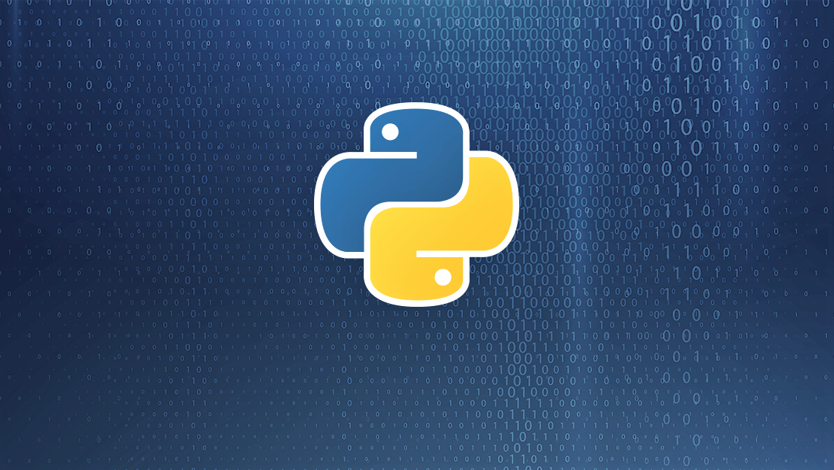
Getting started with python part 2
Introductory session on python
Prabhupad Pradhan
SW Test Engineer

Slide 2
Agenda
1. Stdlib functions
2. Error handling
3. File handling
4. Object oriented programming (Classes/Objects)

Slide 3
Stdlib functions
Some basic standard library function in python
Lambda function
Filter function
Map function
Filter vs map
Zip function
Enumerate

Slide 4
Error Handling
Syntax
Common exception errors
Try–Except-else clause
‘raise’ exception
Notes:
Common exception:
IOError, ImportError, Value Error, KeyboardInterrupt

Slide 5
File Handling
os module in python
Dir listing and basic operations
Try–Except-else clause
‘raise’ exception

Slide 6
Object oriented programming
Python is a multi-paradigm programming language. Meaning, it supports different programming approach.
One of the popular approach to solve a programming problem is by creating objects. This is known as Object-Oriented Programming (OOP).
Object have 2 characteristics : attributes and behavior

