Slide 1

Analysis of Used Car Listings
BY
Priya

Slide 2
Introduction
*Aim of the project is to analyze the data collected from Craigslist postings for used cars
*Effect on price based on the odometer reading, year of the make
*Finding the listing with outlied odometer reading
*Average price based on the year of make and outlied odometer reading
*Car listing available based on different manufactures, types and color
The Data used for analysis is taken from Kaggle.com. The original data set had more 500,000 observations which is time consuming to process. So, the dataset is modified and reduced to 1085 records for faster processing. The records are chosen randomly. Also, the data not applicable or considered for the analysis are removed.

Slide 3
Data

Slide 4
Main attributes of the data set
*Id * Region * price * year *manufacturer *model *condition
*Cylinders * fuel *odometer *title_status *transmission
*Vin * drive *size * type * paint_color * image_url * description
* County * State *lat * long

Slide 5
 | id <dbl> | region <chr> | price <int> | year <int> | manufacturer <chr>
1 | 7034441763 | salt lake city | 17899 | 2012 | volkswagen
2 | 7034440588 | salt lake city | 46463 | 2015 | gmc
3 | 7049133161 | st george | 21500 | 2015 | gmc
4 | 7050068262 | st george | 3700 | 2005 | mazda
5 | 7050019663 | st george | 34495 | 2012 | chevrolet
6 | 7050005015 | st george | 17500 | 2018 | toyota

Slide 6
model <chr> | condition <chr> | cylinders <chr> | fuel <chr> | odometer <int>
golf r | excellent | 4 cylinders | gas | 63500
sierra 1500 | excellent |  | gas | 7554
sierra 1500 | excellent | 8 cylinders | gas | 126520
3 hatchback | excellent | 4 cylinders | gas | NA
silverado 3500 hd crew cab |  | 8 cylinders | diesel | 108437
c-hr | like new | 4 cylinders | gas | 33565

Slide 7
title_status <chr> | transmission <chr> | vin <chr> | drive <chr> | size <chr> | type <chr>
clean | manual | WVWPF7AJ6CW316713 | 4wd | compact | hatchback
clean | automatic | 3GTU2WEC6FG228025 | 4wd
clean | automatic |  | fwd
clean | automatic | upon request | fwd | mid-size | hatchback
clean | automatic | 1GC4K1C88CF116535 | 4wd |  | pickup
clean | automatic | NMTKHMBX1JR028387 | fwd |  | SUV

Slide 8
paint_color <chr> | image_url <chr>
black | https://images.craigslist.org/00G0G_fTLDWM5XyvJ_600x450.jpg
white | https://images.craigslist.org/01515_lPvJ9bfbdYT_600x450.jpg
white | https://images.craigslist.org/01313_boOL03Z3mR6_600x450.jpg
silver | https://images.craigslist.org/00R0R_1MSV75ygYoU_600x450.jpg
black | https://images.craigslist.org/00z0z_ivEuxWUguBV_600x450.jpg
red | https://images.craigslist.org/00b0b_eVDQjFcmut7_600x450.jpg

Slide 9
description <chr>
PRICE REDUCED! -Garage kept -Low Miles (63K) -Clean title -AWD | 4 Door Hatch -Good condition
Drive it home today. Call (Or Text) us now !!Call (or text) Ã¢Â\230Â\217 (855) 526Ã¢Â\210Â’3131
2015 Sierra 1500 crew cab 5.3l 4x4
I have a really nice 2005 Mazda3 Hatchback for sale that is in excellent shape
This Chevrolet Silverado 3500 HD Crew Cab can be yours today!If you have excellent, good, bad
2018 Toyota C-HR XLE, Ruby Red exterior with black interior. - Just over 33K miles. - Original owner,

Slide 10
state <chr> | lat <dbl> | long <dbl>
ut | 40.7372 | -111.858
ut | 40.5881 | -111.884
ut | 38.6578 | -112.126
ut | 37.0831 | -113.558
ut | 37.1756 | -113.608
ut | 37.6775 | -113.062

Slide 11
Data Analysis

Slide 12
Summary of the attributes year, price and odometer
year price odometer
Min. :1952 Min. : 0 Min. : 0
1st Qu.:2007 1st Qu.: 5500 1st Qu.: 51856
Median :2012 Median : 11950 Median : 94468
Mean :2010 Mean : 14651 Mean : 100134
3rd Qu.:2015 3rd Qu.: 19957 3rd Qu.: 134038
Max. :2020 Max. :109888 Max. :1350000
NA's :161
The mean value of the attributes price and odometer
price odometer
14650.610 100133.599
Summary

Slide 13
Average price of cars in excellent condition with odometer reading < 10000 miles and fuel type = gas
23891.8333333333
region <chr> | price <int> | year <int> | manufacturer <chr> | condition <chr> | odometer <int> | fuel <chr>
salt lake city | 46463 | 2015 | gmc | excellent | 7554 | gas
charlottesville | 49100 | 2019 | mercedes-benz | excellent | 8859 | gas
new river valley | 41850 | 2019 | mercedes-benz | excellent | 8902 | gas
richmond | 49100 | 2019 | mercedes-benz | excellent | 8859 | gas
winchester | 3995 | 2010 | mazda | excellent | 168 | gas
winchester | 4200 | 2007 | infiniti | excellent | 185 | gas
seattle-tacoma | 16995 | 2015 | ford | excellent | 75 | gas
seattle-tacoma | 13500 | 2013 | ford | excellent | 129 | gas
milwaukee | 4800 | 2005 | chevrolet | excellent | 175 | gas
wyoming | 50004 | 2019 | mercedes-benz | excellent | 8598 | gas
The average price is : 23891.8333
The range of price is : 2495 50004

Slide 14
Car listings with outlier mileage/odometer values
region <chr> | year <int> | manufacturer <chr> | odometer <int> | price <int>
st george | 2012 | ram | 314464 | 25495
vermont | 2008 | mazda | 1350000 | 2900
danville | 2001 | ford | 264000 | 4900
jacksonville | 2002 | toyota | 313000 | 4000
SF bay area | 2006 | ram | 329000 | 11000
north dakota | 2005 | chevrolet | 263455 | 17500
oklahoma city | 2009 | toyota | 331000 | 2000
columbia | 1999 | ford | 276789 | 12852
columbia | 1997 | honda | 276109 | 2600
florence | 2017 |  | 361349 | 74500
south dakota | 2012 | chevrolet | 262016 | 7895
austin | 2003 | gmc | 350000 | 750
Total number of listings with outlied mileage/odometer values : 12

Slide 15
The oldest and latest model car available in listing
region <chr> | price <int> | year <int> | manufacturer <chr> | odometer <int> | fuel <chr> | transmission <chr>
jacksonville | 27950 | 1953 | ford | 0 | gas | manual
region <chr> | price <int> | year <int> | manufacturer <chr> | odometer <int> | fuel <chr> | transmission <chr>
seattle-tacoma | 57999 | 2020 | jeep | 3623 | gas | automatic

Slide 16
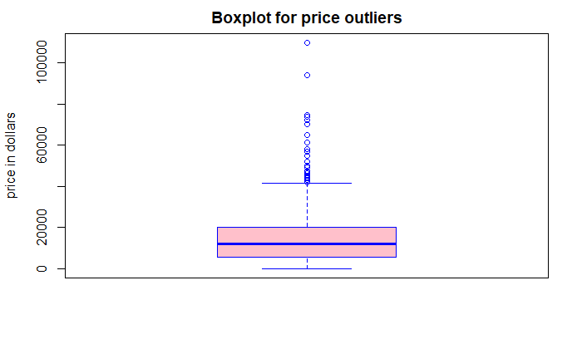

Slide 17
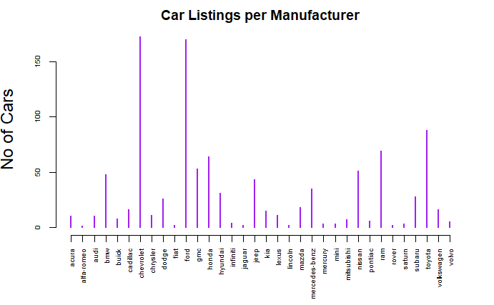

Slide 18
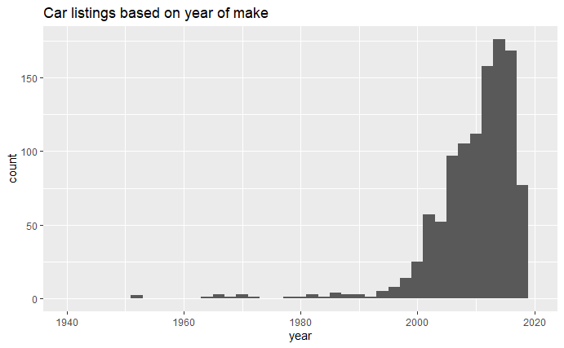

Slide 19
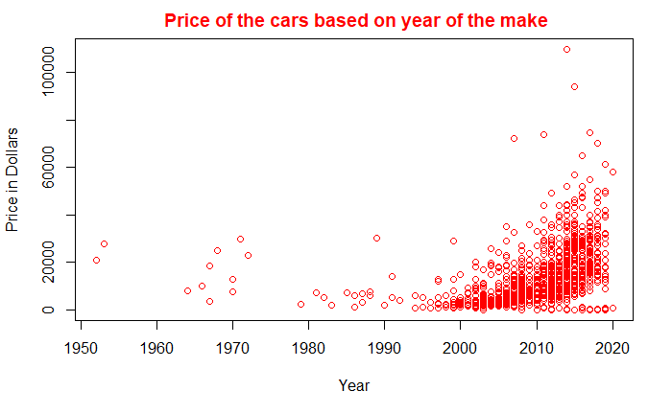

Slide 20
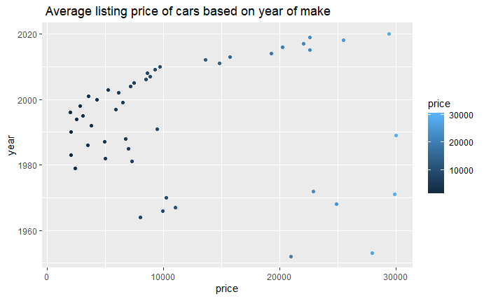

Slide 21
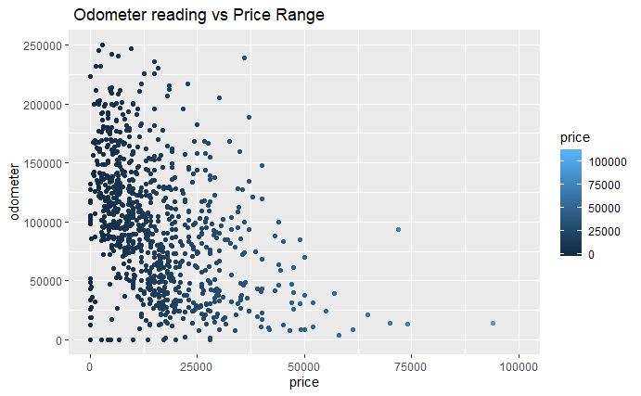

Slide 22
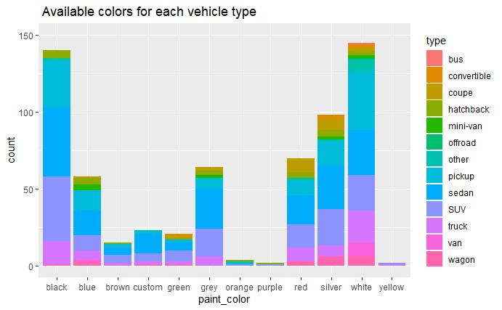

Slide 23
Conclusion
Analysis was done based on the most common or important search criteria In the collected data, there are other multiple attributes as well, which can be used to do further analysis Example – Analysis based on cars available in a particular region or state, etc

Slide 24
Thank you

