Slide 1
DAta-driven support system of art regiment for cost-effective hiv treatment
Selflytics
Team B2
Notes:
Good afternoon Dr.Wei and my fellow classmates
My name is Anmol and along with me are _____ and ____. We request that you keep all questions to the end.
Our project is called Relief or Grief? A Sentiment Analysis on Painkillers.

Slide 2
ANALYSIS FLOW
Problem Definition
Data Overview
Patient-regiment Distribution
Regiment effectiveness
Predictive models
Business value
Implementation and recommendation
Notes:
Anmol:
We took the following steps to analyze our data in R studio
We converted all of our text to lowercase
We remove stop words and remove punctation
For spare threshold we used 0.80
0.80 means that we're only keeping words that appear in 20% or more of reviews. when you run it, you can see that the terms count is 19 therefore 19 word appears in 20% or more of the terms.
In addtion,
We spilt our dataset 70% - 30%
And did a 5 fold cross validation so our testing dataset will rotate 5 times.
Train: 2772 records
Test: 750 records
I'm handing this over to my team member raheela.

Slide 3
Problem statement
Background
Approximately 1.2 million people in the U.S have HIV
Only 65% of People with HIV (PWH) achieve viral suppression
High treatment costs (up to $4,500/month for ART).
Huge economic impacts:
Lifetime cost per patient: $510,000.
Objective
Develop a data driven regiment-patient distribution to study the regiment effectiveness
Develop predictive models to optimize ART selection
Reduce the economic impact on the patients, hospitals, and the society
Notes:
Anmol
Let me give you a little back ground on our project:
We obtained our dataset from kaggle, this dataset reviews various drugs and we filter out painkillers.
We aim to find keyword to predict if a customer is satisfied with their painkillers.

Slide 4
Data overview
Dataset
Over 13 millions records over 60 months study time
Features includes ART Regimes, Viral load, CD4 count, and demographic
Total number of unique patients: 123000
Total unique regiments: 135
Outcome (target variables)
Viral load: VL ≤ 250 and VL ≤ 50 copies/mL
Immune recovery: CD4 count ≥ 500 cells/mm³
Notes:
Anmol
Let's review our dataset first
We had 2,500 records and 19 variables after preprocessing.
The painkillers in our dataset include:
Tylenol
Advil
Aleve
Tramadol
Aspirin
Postive reviews were coded as 1
Negative reviews were coded as 0

Slide 5
TASK 1 – PATIENT-REGIMEN DISTRIBUTION
Base_Drug_Combo | Comp_INI | Comp_NNRTI | ExtraPI | ExtraPk_En | Avg_Time_VL_250 | Avg_Time_VL_50 | Avg_Time_CD4_500 | Patient_Count
i64 | i64 | i64 | i64 | i64 | f64 | f64 | f64 | u32
1 | 3 | 3 | 3 | 0 | 0.026217 | 0.862493 | 3.286893 | 567
5 | 3 | 0 | 0 | 0 | 1.5 | 3 | 5 | 63
1 | 3 | 3 | 4 | 0 | 1.660466 | 3.213638 | 2.7643 | 4725
5 | 3 | 2 | 0 | 0 | 3.022501 | 3.252747 | 11.118421 | 147
1 | 3 | 3 | 2 | 0 | 2.841571 | 4.003611 | 1.191388 | 1365
Notes:
Anmol:
We took the following steps to analyze our data in R studio
We converted all of our text to lowercase
We remove stop words and remove punctation
For spare threshold we used 0.80
0.80 means that we're only keeping words that appear in 20% or more of reviews. when you run it, you can see that the terms count is 19 therefore 19 word appears in 20% or more of the terms.
In addtion,
We spilt our dataset 70% - 30%
And did a 5 fold cross validation so our testing dataset will rotate 5 times.
Train: 2772 records
Test: 750 records
I'm handing this over to my team member raheela.

Slide 6
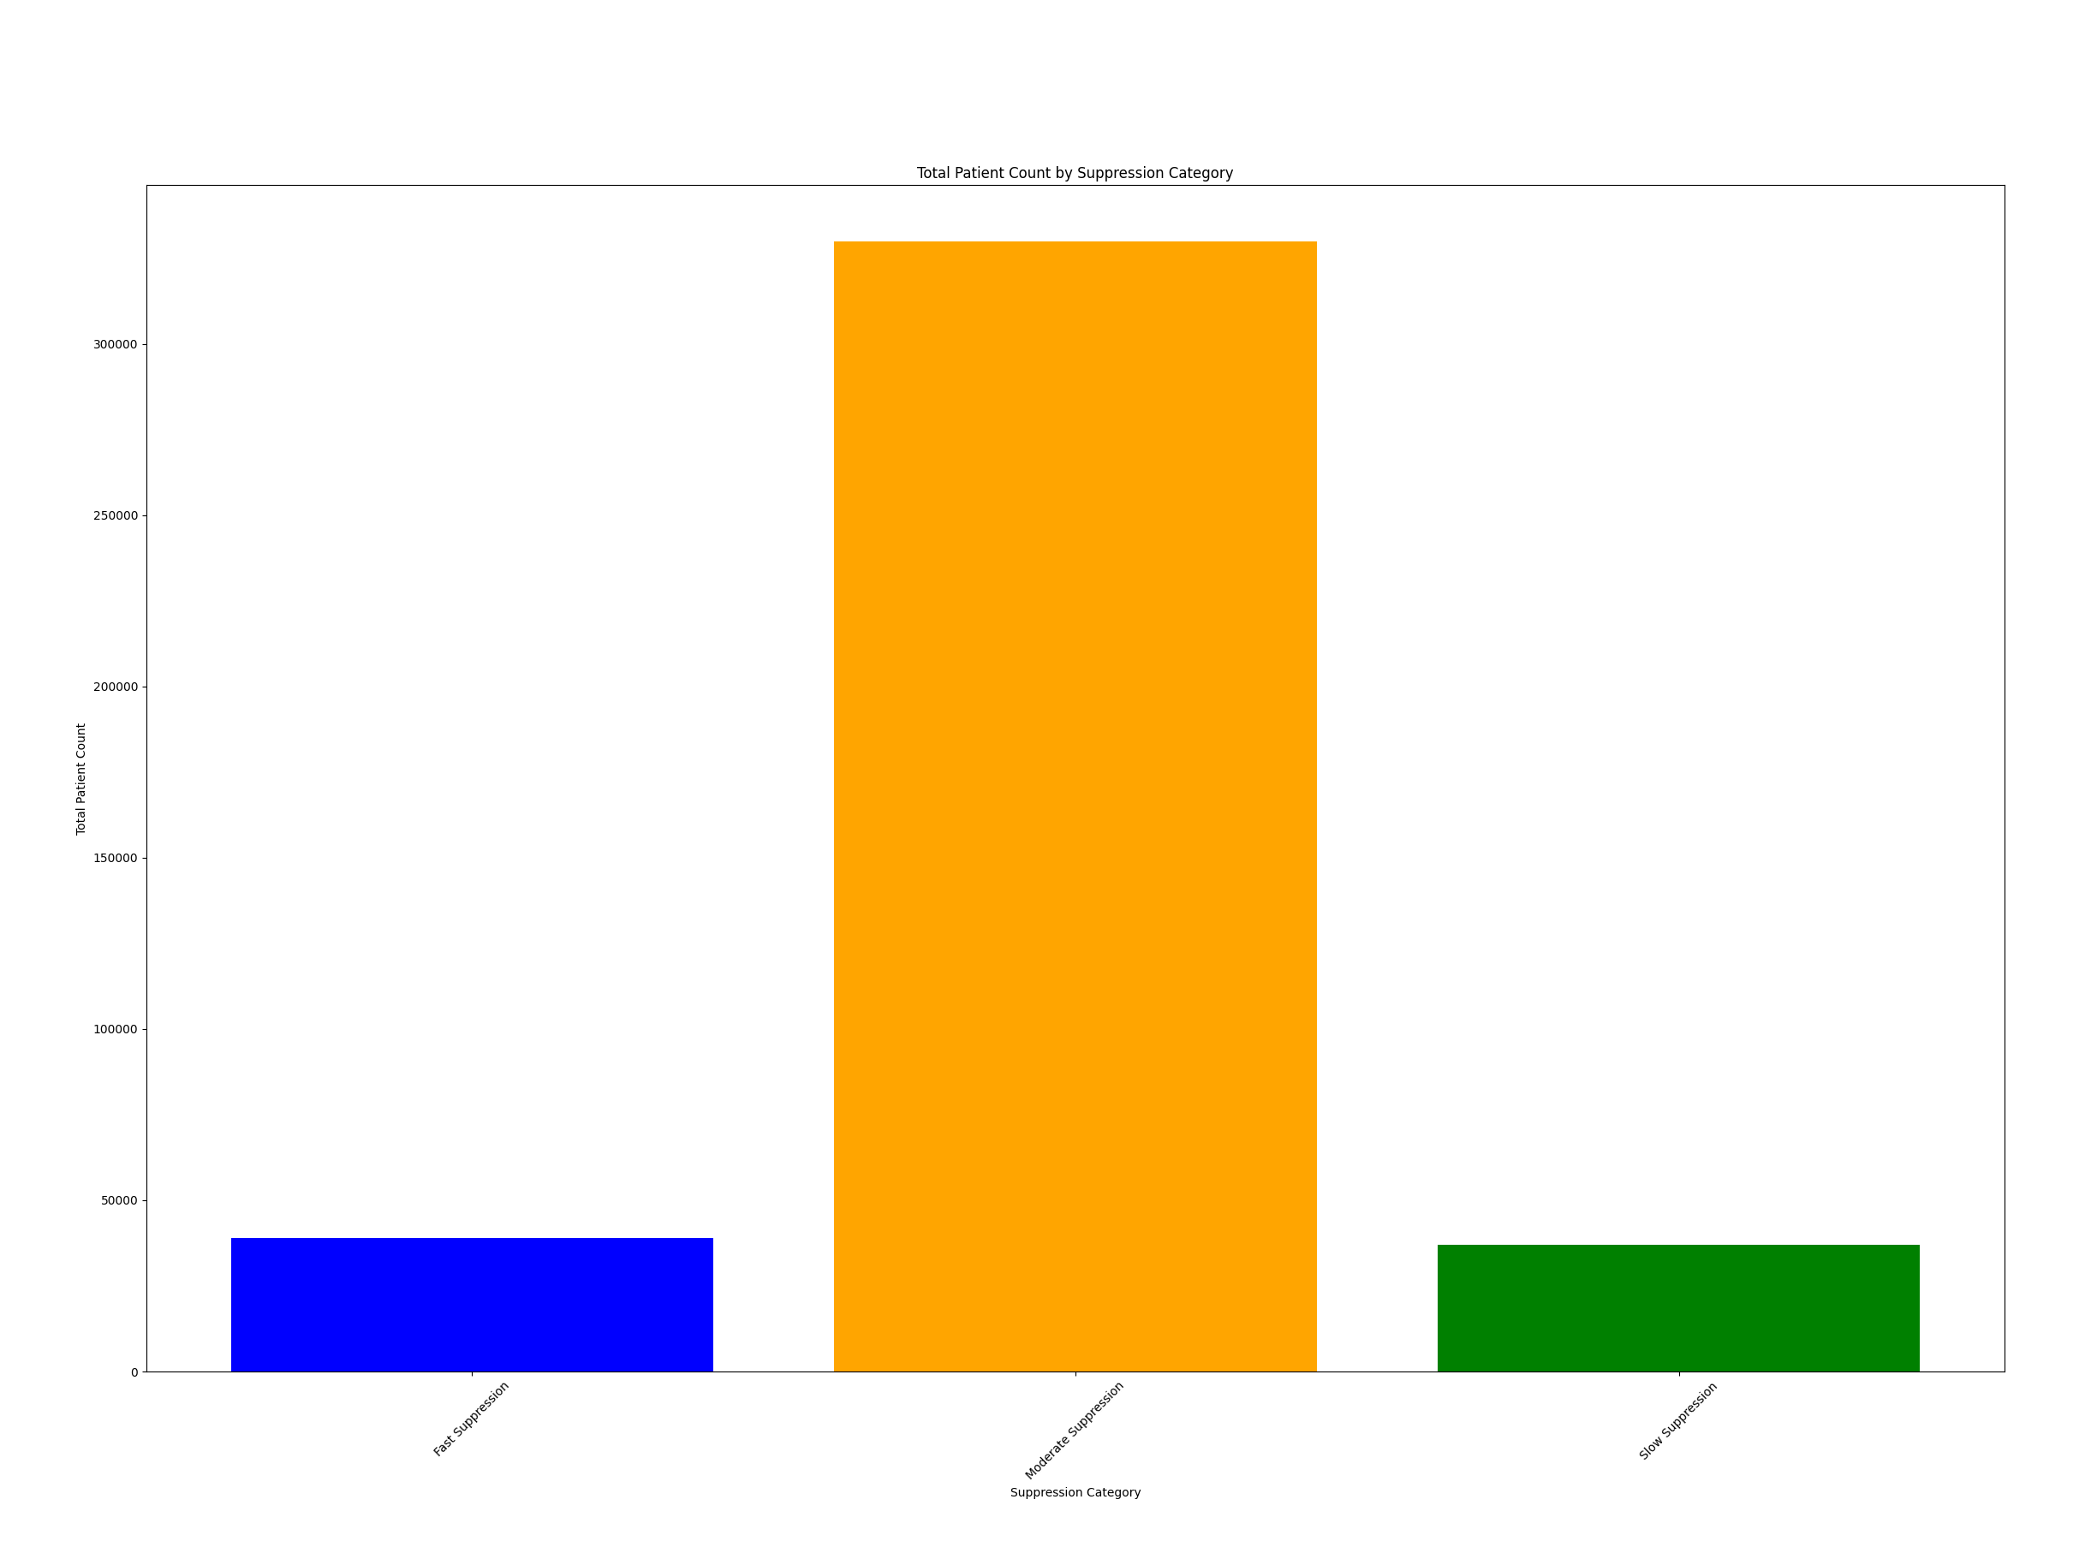
TASK 1- RECOVERY SPEED CATEGORIES
Assumptions:
Avg_Time_VL_50 <= 6 ~ "Fast Suppression",
Avg_Time_VL_50 <= 24 ~ "Moderate Suppression",
Avg_Time_VL_50 >24 "Slow Suppression"
Base_Drug_Combo | Comp_INI | Comp_NNRTI | ExtraPI | ExtraPk_En | Avg_Time_VL_250 | Avg_Time_VL_50 | Avg_Time_CD4_500 | Patient_Count | Suppression_Category
i64 | i64 | i64 | i64 | i64 | f64 | f64 | f64 | u32 | str
1 | 3 | 3 | 3 | 0 | 0.02 | 0.86 | 3.23 | 567 | "Fast "
5 | 3 | 0 | 0 | 0 | 1.5 | 3 | 5 | 63 | "Fast "
1 | 3 | 3 | 4 | 0 | 1.66 | 3.21 | 2.76 | 4725 | "Fast "
5 | 3 | 2 | 0 | 0 | 3.02 | 3.25 | 11.11 | 147 | "Fast "
1 | 3 | 3 | 2 | 0 | 2.8 | 4.00 | 1.19 | 1365 | "Fast"
Notes:
Thank you Anmol
The first regression we ran was the logistic regression. We ran a forward, backward and stepwise selection to determine the best model and chose the model output from the stepwise selection method since it had the lowest A – eye - C. Here you can see the variables that were significant within the model. The AUC was 60.03%. The AUC measures how well a model can distinguish between the two classes, positive or negative in this case
We also looked at the IDF values to determine which terms is rare in the document since rare terms are more significant for
In total we had 10 variables in the model
Logistic regression is a widely used statistical model for binary classification. The model was trained on the balanced training dataset and evaluated on the test dataset.

Slide 7
Task 2- predictive model
Step 1: we assumed a conservative scenario where a patient is recovered if all the following requirement are meet:
First_VL<=250 within 6 months
First_VL<=50 within 12 month
First_CD4>=500 within 24 months
Step 2: Accordingly, we created unique patient-regiment dataset including the binary value for the above criteria
Step 3: We developed predictive models using Random Forest and Logistic Regression
Step 4: Considering the ethnicity is impacted the results significantly, we develop separate random forest models for each ethnicity.
Notes:
Here are the two models together. As you can see the AUC is higher for the logistic regression so that is a better model for our dataset. It has a better predicting power between determining whether the review is positive or negative.
And now Emmanuel will go over the business recommendations.

Slide 8
Task 2- predictive model accuracy
Model | Accuracy (%)
Random forest with Asian ethnicity | 91.78
Random forest with Black ethnicity | 76.05
Random forest with White ethnicity | 70.08
Random forest with Other ethnicity | 81.8
Logistic Regression with all data | 69.86
Notes:
Here are the two models together. As you can see the AUC is higher for the logistic regression so that is a better model for our dataset. It has a better predicting power between determining whether the review is positive or negative.
And now Emmanuel will go over the business recommendations.

Slide 9
Economic Impact
Optimized Resource Allocation: Using the models created, we can help recognize patients that are at risk. In return we can administer more effective regimens.
Decreased Monthly Expenses: On a monthly average a newly diagnosed patient spends around ($2,567/month ) Art costs between $1,800 to $4,500/month. With new model we could potentially lower the monthly cost for patients.
Prevention of Loss to Follow-Up: The model ensures long term care with patients in return prevents costly disease progression and hospital visits.
Tailored Treatment: Created a treatment tailored to each patient based on ethnicity and this can lead to targeted, data driven research that incorporates patient characteristics in the future
Notes:
Emmanuel

Slide 10
Economic Impact
A simple rough economic analysis for a 10,000 patients (if we save 20 percent for each patients)
Category | Current regiments | Optimized using the data driven models (around 20 percent reduction)
Lifetime cost per patient | $510,000 | $410,000
Annual healthcare cost | $31,884 | $26000
ART cost per month | 4500 | $3600
Lifetime saving | $0 | $30,000 for 30 years period
Saving for 10,000 patients | 0 | $300,000,000
Notes:
Emmanuel

Slide 11
recommendations
Use the predictive models to match patients with the best ART Regimen
Separate the regiment based on the patient ethnicity
Adjust coverage policies based on cost-effective regimens.
Use insights to optimize ART pricing while ensuring early suppression goals are met
Try regiment change of the initial regiment does not work
Notes:
Emmanuel

Slide 12
Thank you! Questions?

