Slide 1

Operation Optimization: The Future of Patient Placement
Raheela Charania
Rajivini Tiruveedhula
Prabhu Shankar

Slide 2
Background
Dataset Description
Exploratory Data Analysis
Models
Simulation
Cost Analysis
Conclusion

Slide 3
Background
Objective: Enhance efficiency in Montanaro Hospital’s Observation Unit.
Issue: High patient transfer rates from observation to inpatient care.
Approach: Utilize predictive analytics to improve decision-making.
Data: Electronic health records (EHR) – patient demographics, diagnoses and vitals.
Outcome: Optimized bed usage, reduced emergency department congestion, improved patient flow, and increased revenue.

Slide 4
Dataset Description
Data Dictionary
DRG Code | Description
276 | Dehydration
428 | Congestive Heart Failure
486 | Pneumonia
558 | Colitis
577 | Pancreatitis
578 | Gl Bleeding
599 | Urinary Tract Infection
780 | Syncope
782 | Edema
786 | Chest Pain
787 | Nausea
789 | Abdominal Pain
Patient records from the observation unit at Montanaro Hospital
Dataset overview​
~1,100 records ​
13 variables after preprocessing
Target Variable: Flipped​

Slide 5
DATA DICTIONARY
Variable | Description
Age | Age of patient (Years)
Gender | Male/Female
PrimaryInsuranceCategory | Patient’s Insurance Provider
Flipped | Binary variable 1 = Flipped from Observation Unit to Inpatient Unit 0 = Patient stayed in Observation Unit
OU_LOS_hrs | Length of Stay in OU (Hours)
DRG01 | Diagnosis-related code based on patient’s complaint
BloodPressureLower | Diastolic BP (mmHg)
BloodPressureUpper | Systolic BP (mmHg)
BloodPressureDiff | Systolic - Diastolic
Pulse | Patient’s Heartrate
Pulse Oximetry | Patient’s Oxygen Saturation Level (%)
Respirations | # Breaths per Minute
Temperature | Patient’s Body Temperature (°F)

Slide 6
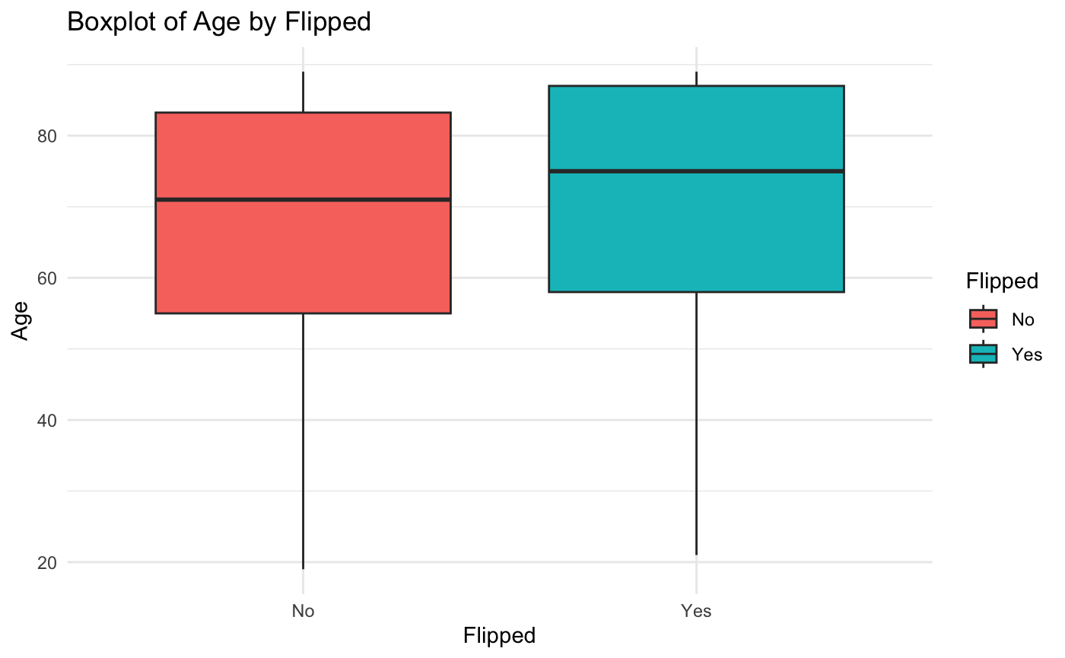
Exploratory Data Analysis
Average age of Flipped is 75 years.

Slide 7
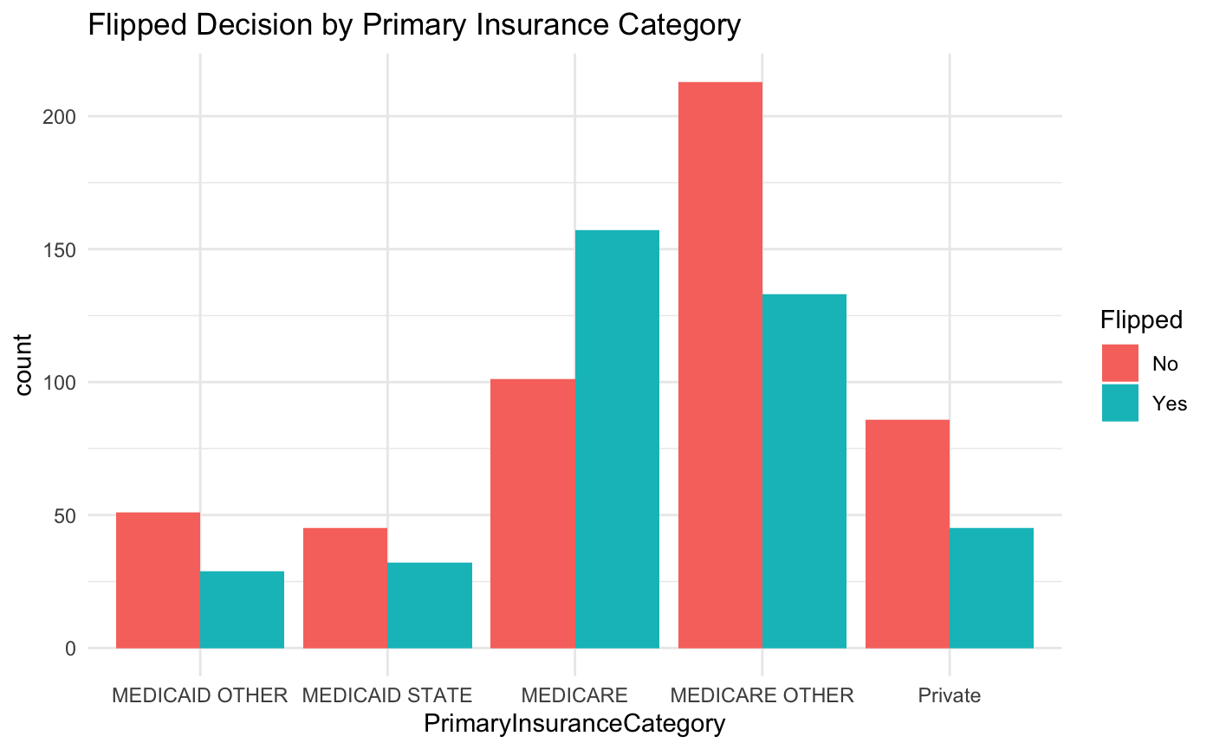
Exploratory Data Analysis
Majority of Flipped have Medicare followed by Medicare Other Insurance.
Private and Medicaid Other Insurances have the least amount of flipped cases.

Slide 8
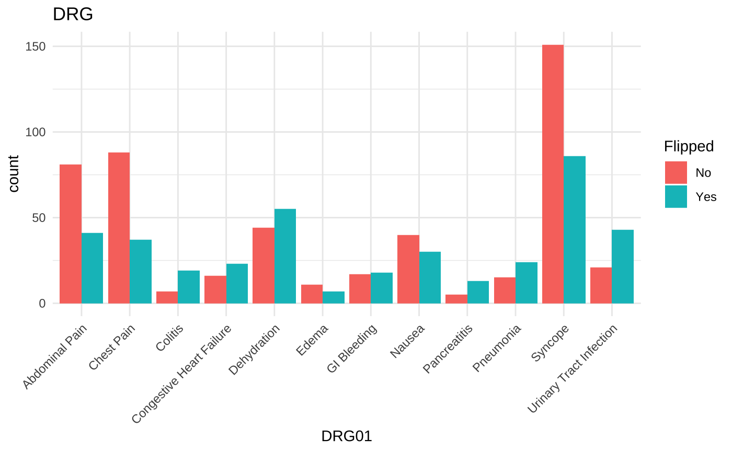
Exploratory Data Analysis
DRG01- 780 had the most flipped cases.
DRG01-782 had the least flipped cases.

Slide 9
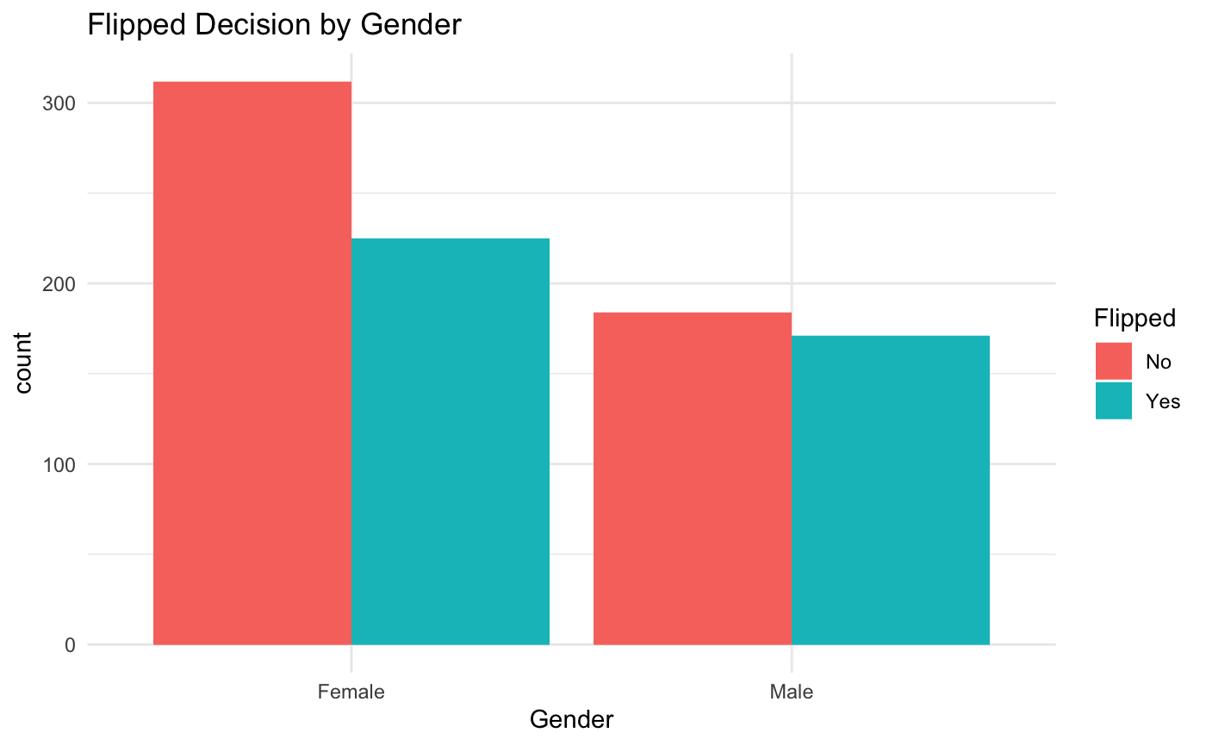
Exploratory Data Analysis
Females had more flipped cases compared to males.

Slide 10
Exploratory Data Analysis

Slide 11
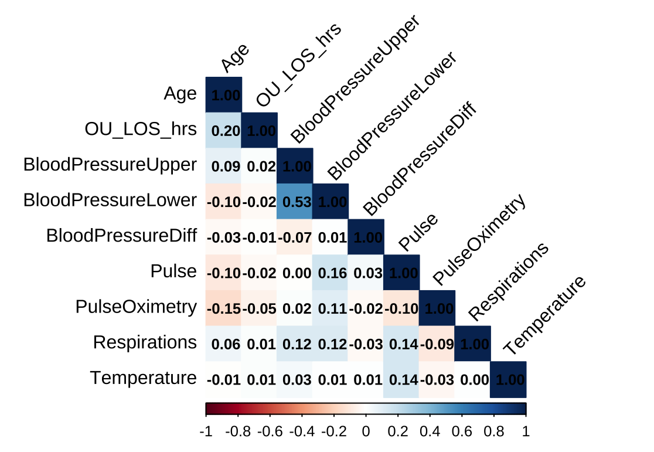
HeatMap
Notes:
Multicollinearity in BP upper, BP lower and BP diff. we decided to closely linked to heart disease, stroke, and overall cardiovascular risk

Slide 12
Data Prep
Data Prep​
Changed data type to Categorical or Numerical
Data Partitioning​
80% training​
20% testing​
Data Cleaning
Imputed missing values via average
Removed outliers​
Notes:
DRG Code and # of pts
More closely linked to heart disease, stroke, and overall cardiovascular risk

Slide 13
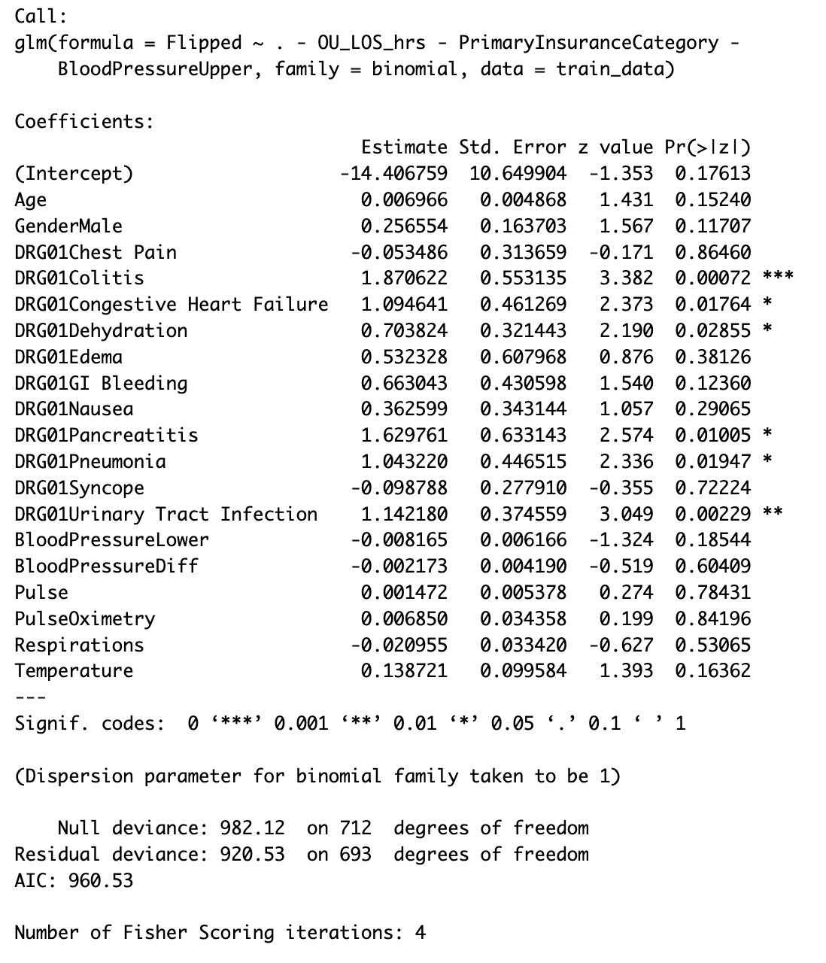
Full Logistic Model
Model Performance:
AIC: 960.53
Model Performance on Test Dataset:
Accuracy: 64.80%
Sensitivity : 76.42%
Specificity : 47.95%
Significant Variables:
DRG01Colitis
DRG01Congestive Heart Failure
DRG01Dehydration
DRG01Pancreatitis
DRG01Pneumonia
DRG01Urinary Tract Infection
Notes:
Say: Explain model then say although model performs at an accuracy of 65.36%, we decided to see if we could make it more concise.

Slide 14
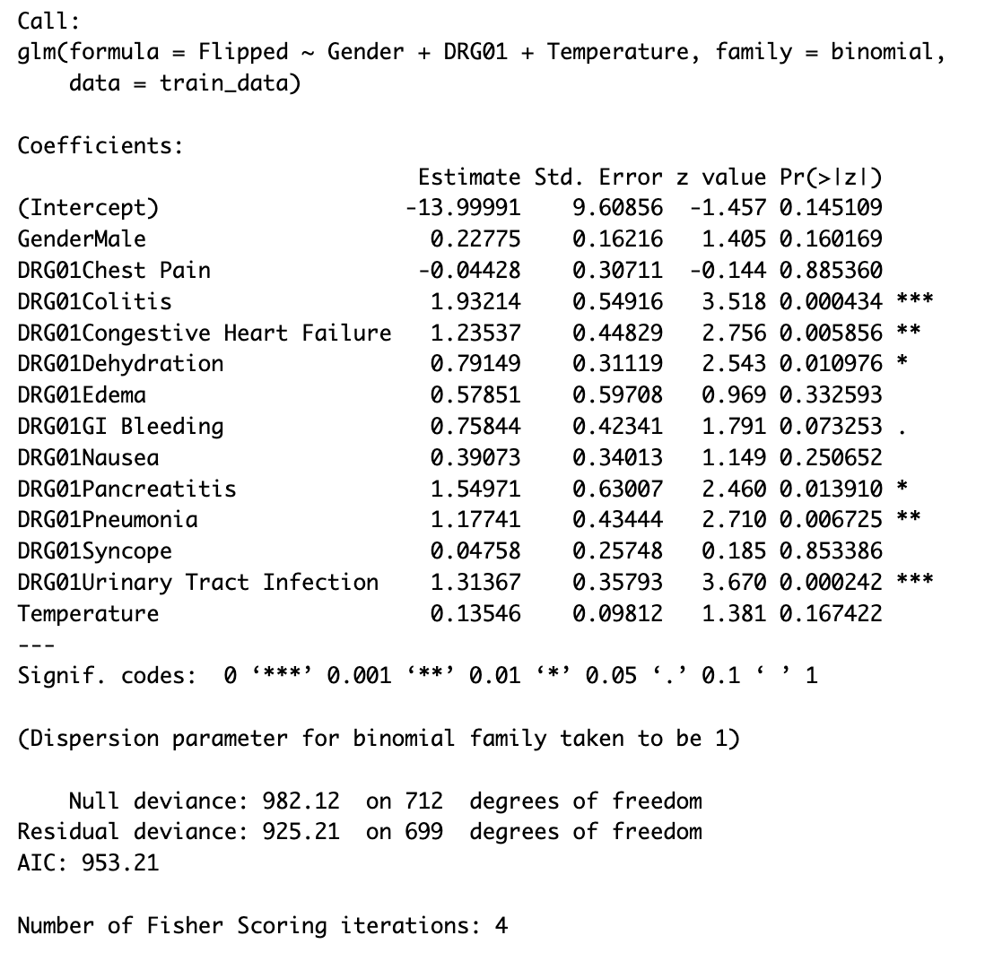
Logistic Model II
Model Performance:
AIC: 953.21
Model Performance on Test Dataset:
Accuracy: 63.69%
Sensitivity : 74.53%
Specificity : 47.95%
Significant Variables:
DRG01Colitis
DRG01Congestive Heart Failure
DRG01Dehydration
DRG01GI Bleeding
DRG01Pancreatitis
DRG01Pneumonia
DRG01Urinary Tract Infection
Notes:
Say: This is the second logistic model we came up with. Here, our accuracy is now 66.70% and our sensitivity is 76.41% and specificity is 54.55%.

Slide 15
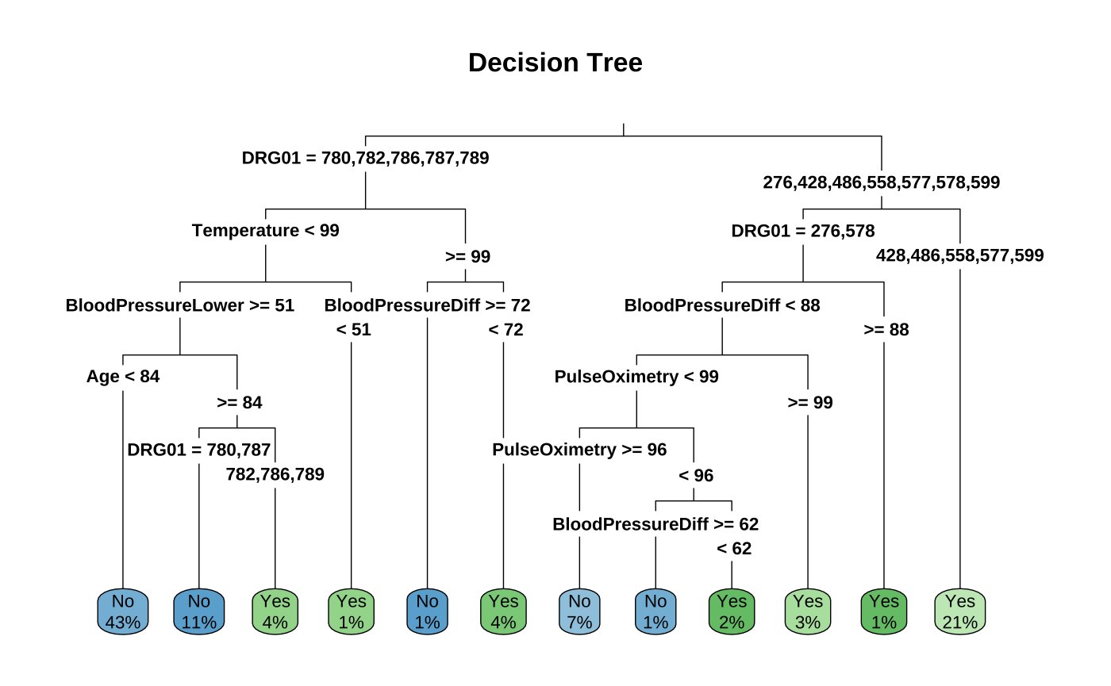
Decision Tree Model
Model Performance on Test Dataset:
Accuracy : 65.36%
Sensitivity: 74.53%
Specificity: 52.05%
Notes:
Say: We then created a decision tree model. Here we can see which variables and decisions affect the outcome vs. in logistic, we can’t see how each variable affects the outcome. However, here we can’t quantify the variables.
Model performs moderately well
Sensitivity (Ability to predict “No” correctly)
Specificity (Ability to predict “Yes” correctly)

Slide 16
Random Forest Model
Model Description: A Random Forest model was created with 100 trees to predict whether the patient flipped based on Gender, Primary Insurance Category and DRG01.
Out of Bag Error Rate: 38.85%
About 39% of the predictions made on new data are expected to be incorrect.
Model Performance:
Accuracy: 61.45%
Sensitivity : 70.75%
Specificity : 47.95%
Notes:
Say: Next we created a random forest model.
Model performs moderately well

Slide 17
Model Selection
Model | Accuracy | Sensitivity | Specificity
Logistic Regression | 64.80% | 76.42% | 47.95%
Logistic Regression II | 63.69% | 74.53% | 47.95%
Decision Tree | 65.36% | 74.53% | 52.95%
Random Forest | 61.45% | 70.75% | 47.95%

Slide 18
Final Model: Full Logistic Model
Logodds_of_Flipped =
-14.407 + 0.007*Age + 0.257*GenderMale - 0.053*ChestPain + 1.871*Colitis + 1.095*CongestiveHeartFailure + 0.704*Dehydration + 0.532*Edema + 0.663*GIBleeding + 0.363*Nausea + 1.630*Pancreatitis +1.043*Pneumonia - 0.099*Syncope + 1.142*UrinaryTractInfection - 0.008*BloodPressureLower - 0.002*BloodPressureDiff + 0.001*Pulse + 0.007*PulseOximetry + 0.021*Respirations + 0.139*Temperature
Stats on Test Dataset:
Accuracy: 61.88%
Sensitivity: 59.68%
Specificity: 64.65%

Slide 19
Simulation
Decision | Before the cut off | After 0.4 cut off | After 0.35 cut off
No flip rate | 0.556 | 0.714 | 0.755
Flip rate | 0.443 | 0.285 | 0.244
Type of care | Revenue saved
Post Surgery | $10,000
Inpatient | $3,000
Ward | $2,283
With a utilization of 73-74% from our simulation, we tend to save approximately $340,000 yearly with a prediction of using 0.35 cut off rate.

Slide 20
Recommendations
Suggest doing a pilot run using the Logistic Model created. Review initial results and implement to entire hospital based on results.
By lowering the number of patients that flip from operating to inpatient status, we can increase the annual revenue to approximately $340,000.
By reducing the flipped rate, we can increase the utilization to 73-74%, which would mean we can serve more number of patients with a greater efficiency
According to the simulation, we can accommodate approximately 94 patients yearly which will increase the efficiency without impacting the quality of service.

Slide 21


Thank you! Questions?

