Slide 1

Dataclasses as Pipeline Definitions
Madison Swain-Bowden
Notes:
https://carbon.now.sh/?bg=rgba%28134%2C140%2C154%2C1%29&t=a11y-dark&wt=none&l=python&ds=true&dsyoff=20px&dsblur=68px&wc=true&wa=false&pv=33px&ph=36px&ln=false&fl=1&fm=Hack&fs=14px&lh=133%25&si=false&es=2x&wm=false&code=def%2520__init__%28self%252C%2520name%253A%2520str%252C%2520unit_price%253A%2520float%252C%2520quantity_on_hand%253A%2520int%2520%253D%25200%29%2520-%253E%2520None%253A%250A%2520%2520%2520%2520self.name%2520%253D%2520name%250A%2520%2520%2520%2520self.unit_price%2520%253D%2520unit_price%250A%2520%2520%2520%2520self.quantity_on_hand%2520%253D%2520quantity_on_hand%250A%2520%2520%2520%2520%250Adef%2520__repr__%28self%29%253A%250A%2520%2520%2520%2520return%2520f%27InventoryItem%28name%253D%257Bself.name%21r%257D%252C%2520unit_price%253D%257Bself.unit_price%21r%257D%252C%2520quantity_on_hand%253D%257Bself.quantity_on_hand%21r%257D%29%27%250A%2520%2520%250Adef%2520__eq__%28self%252C%2520other%29%253A%250A%2520%2520%2520%2520if%2520other.__class__%2520is%2520self.__class__%253A%250A%2520%2520%2520%2520%2520%2520%2520%2520return%2520%28self.name%252C%2520self.unit_price%252C%2520self.quantity_on_hand%29%2520%253D%253D%2520%28other.name%252C%2520other.unit_price%252C%2520other.quantity_on_hand%29%250A%2520%2520%2520%2520return%2520NotImplemented%250A%2520%2520%250Adef%2520__ne__%28self%252C%2520other%29%253A%250A%2520%2520%2520%2520if%2520other.__class__%2520is%2520self.__class__%253A%250A%2520%2520%2520%2520%2520%2520%2520%2520return%2520%28self.name%252C%2520self.unit_price%252C%2520self.quantity_on_hand%29%2520%21%253D%2520%28other.name%252C%2520other.unit_price%252C%2520other.quantity_on_hand%29%250A%2520%2520%2520%2520return%2520NotImplemented%250A%2520%2520%250Adef%2520__lt__%28self%252C%2520other%29%253A%250A%2520%2520%2520%2520if%2520other.__class__%2520is%2520self.__class__%253A%250A%2520%2520%2520%2520%2520%2520%2520%2520return%2520%28self.name%252C%2520self.unit_price%252C%2520self.quantity_on_hand%29%2520%253C%2520%28other.name%252C%2520other.unit_price%252C%2520other.quantity_on_hand%29%250A%2520%2520%2520%2520return%2520NotImplemented%250A%2520%2520%250Adef%2520__le__%28self%252C%2520other%29%253A%250A%2520%2520%2520%2520if%2520other.__class__%2520is%2520self.__class__%253A%250A%2520%2520%2520%2520%2520%2520%2520%2520return%2520%28self.name%252C%2520self.unit_price%252C%2520self.quantity_on_hand%29%2520%253C%253D%2520%28other.name%252C%2520other.unit_price%252C%2520other.quantity_on_hand%29%250A%2520%2520%2520%2520return%2520NotImplemented%250A%2520%2520%250Adef%2520__gt__%28self%252C%2520other%29%253A%250A%2520%2520%2520%2520if%2520other.__class__%2520is%2520self.__class__%253A%250A%2520%2520%2520%2520%2520%2520%2520%2520return%2520%28self.name%252C%2520self.unit_price%252C%2520self.quantity_on_hand%29%2520%253E%2520%28other.name%252C%2520other.unit_price%252C%2520other.quantity_on_hand%29%250A%2520%2520%2520%2520return%2520NotImplemented%250A%2520%2520%250Adef%2520__ge__%28self%252C%2520other%29%253A%250A%2520%2520%2520%2520if%2520other.__class__%2520is%2520self.__class__%253A%250A%2520%2520%2520%2520%2520%2520%2520%2520return%2520%28self.name%252C%2520self.unit_price%252C%2520self.quantity_on_hand%29%2520%253E%253D%2520%28other.name%252C%2520other.unit_price%252C%2520other.quantity_on_hand%29%250A%2520%2520%2520%2520return%2520NotImplemented

Slide 2
Outline
Problem space
Dataclasses intro
Dataclasses for Pipelines
Validation
Testing
Alerts
Documentation
Airflow 2.0 performance improvements

Slide 3



Our ETL Setup
MySQL to Redshift replication
Three pipeline “types”
Full - entire table is copied every interval
Incremental - only new records are copied
Rotating - large chunks of the table are replaced each interval, iterating through the entire table over time
AWS Data Pipelines pain-points
Updating was cumbersome
Alerts were unintuitive
Configuration drift
Perfect Airflow use-case!
Notes:
On updates:
Occasionally had to delete the pipeline
Couldn’t find what the source of the problem was (if several runs had failed)

Slide 4
Dataclasses
“NamedTuples with batteries included”
New in python 3.7, PEP 557
Features:
Methods auto-generated
Easy to provide defaults (including mutable ones)
Explicit typing
Attribute access (over key access)

Slide 5
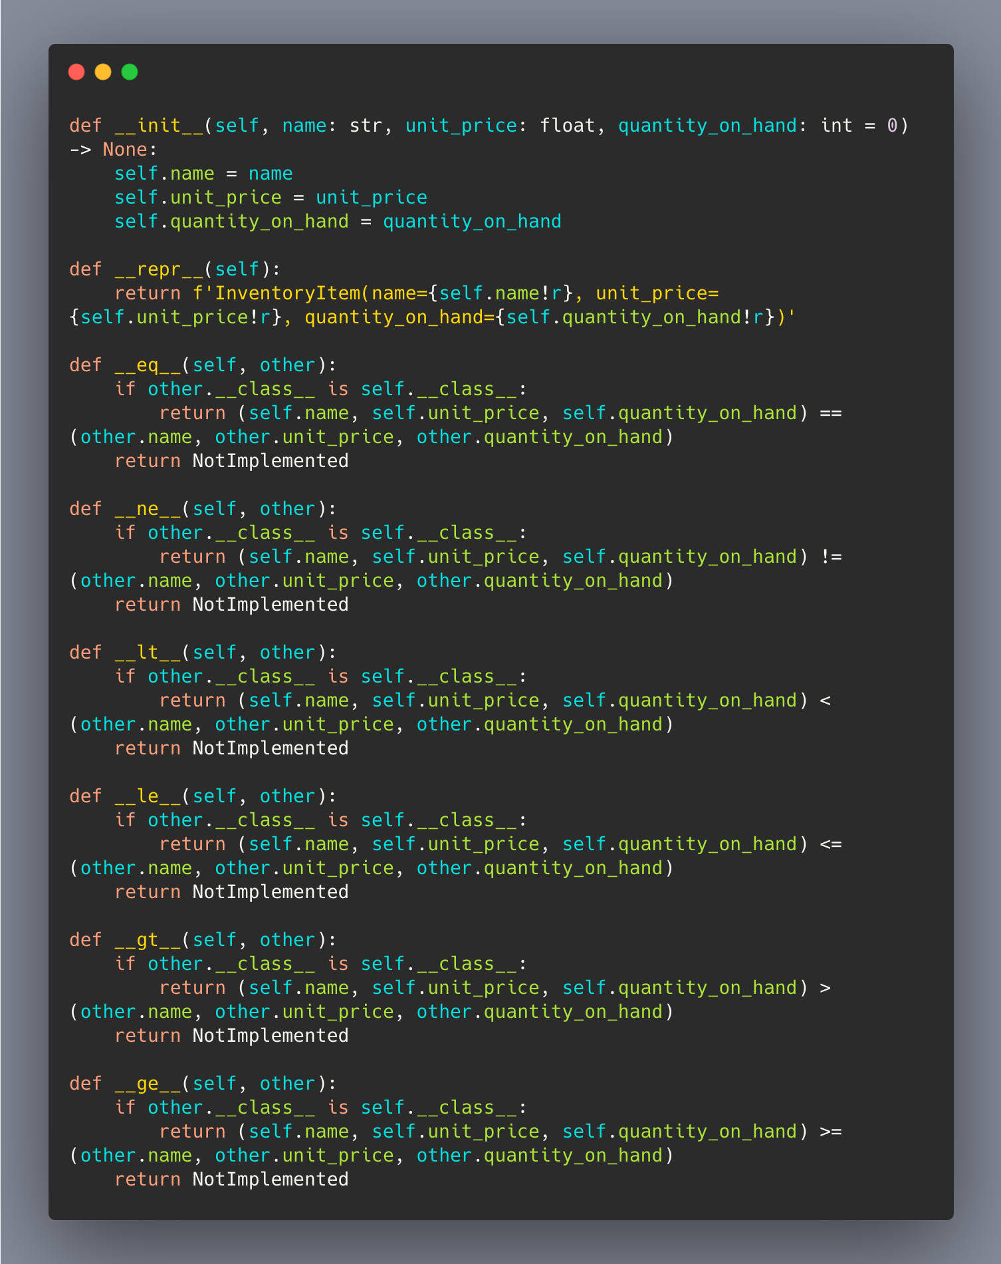
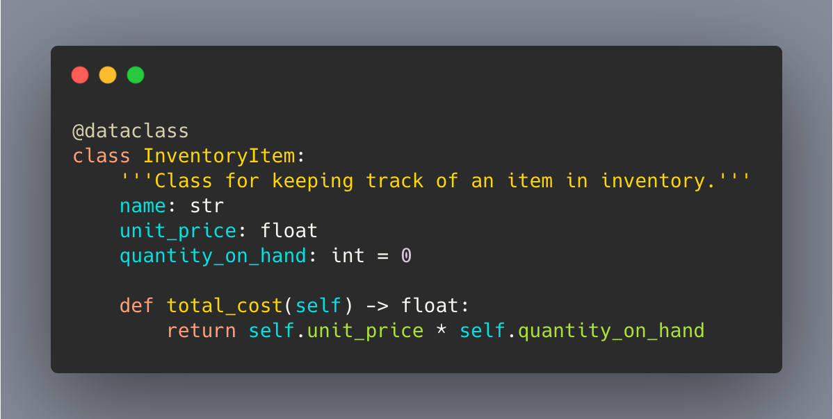
Dataclasses
__init__, __repr__, ==, !=, >, >=, <, <=

Slide 6
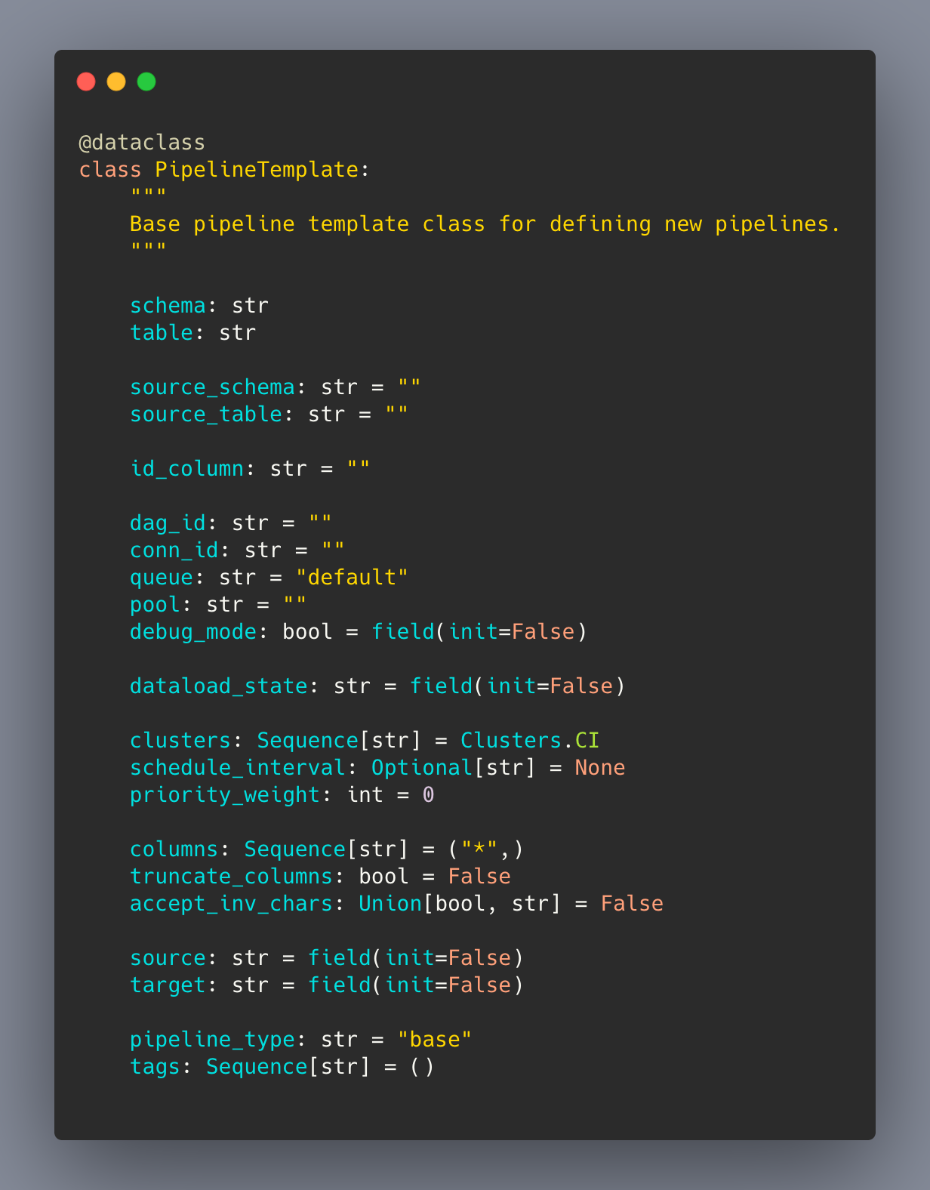
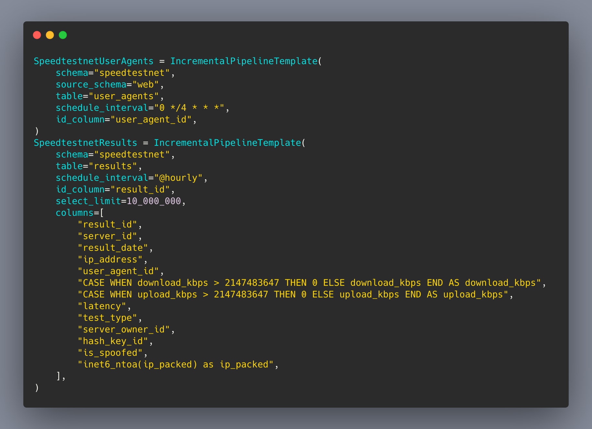
Applying dataclasses
JSON in UI -> pure Python in git
Subclass by pipeline type
Logic directly in class definition

Slide 7
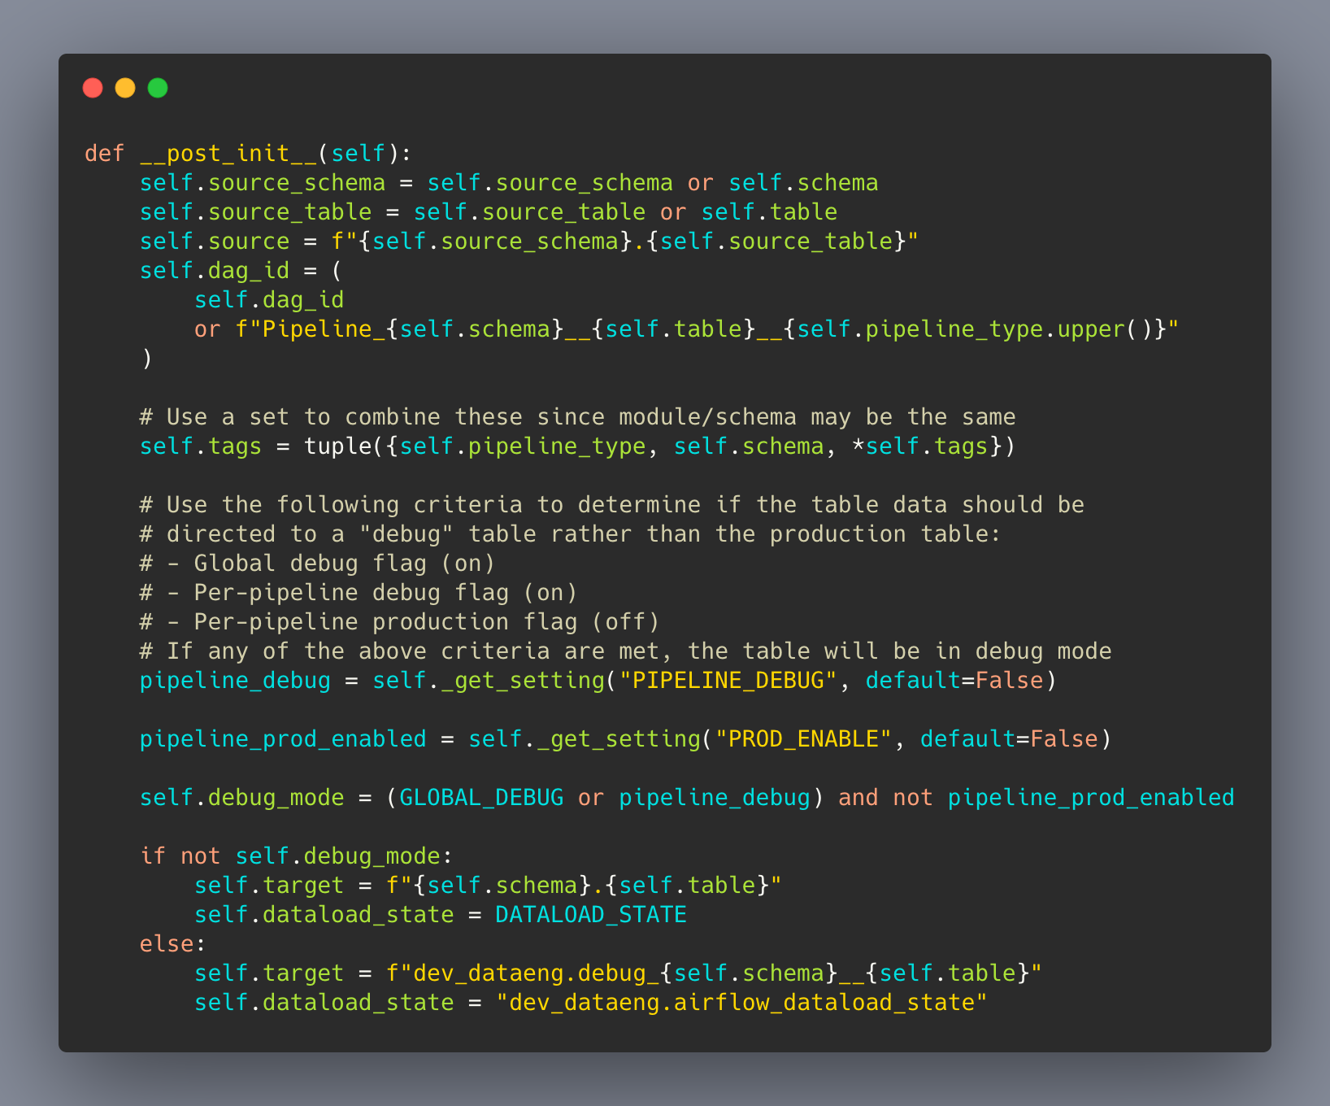
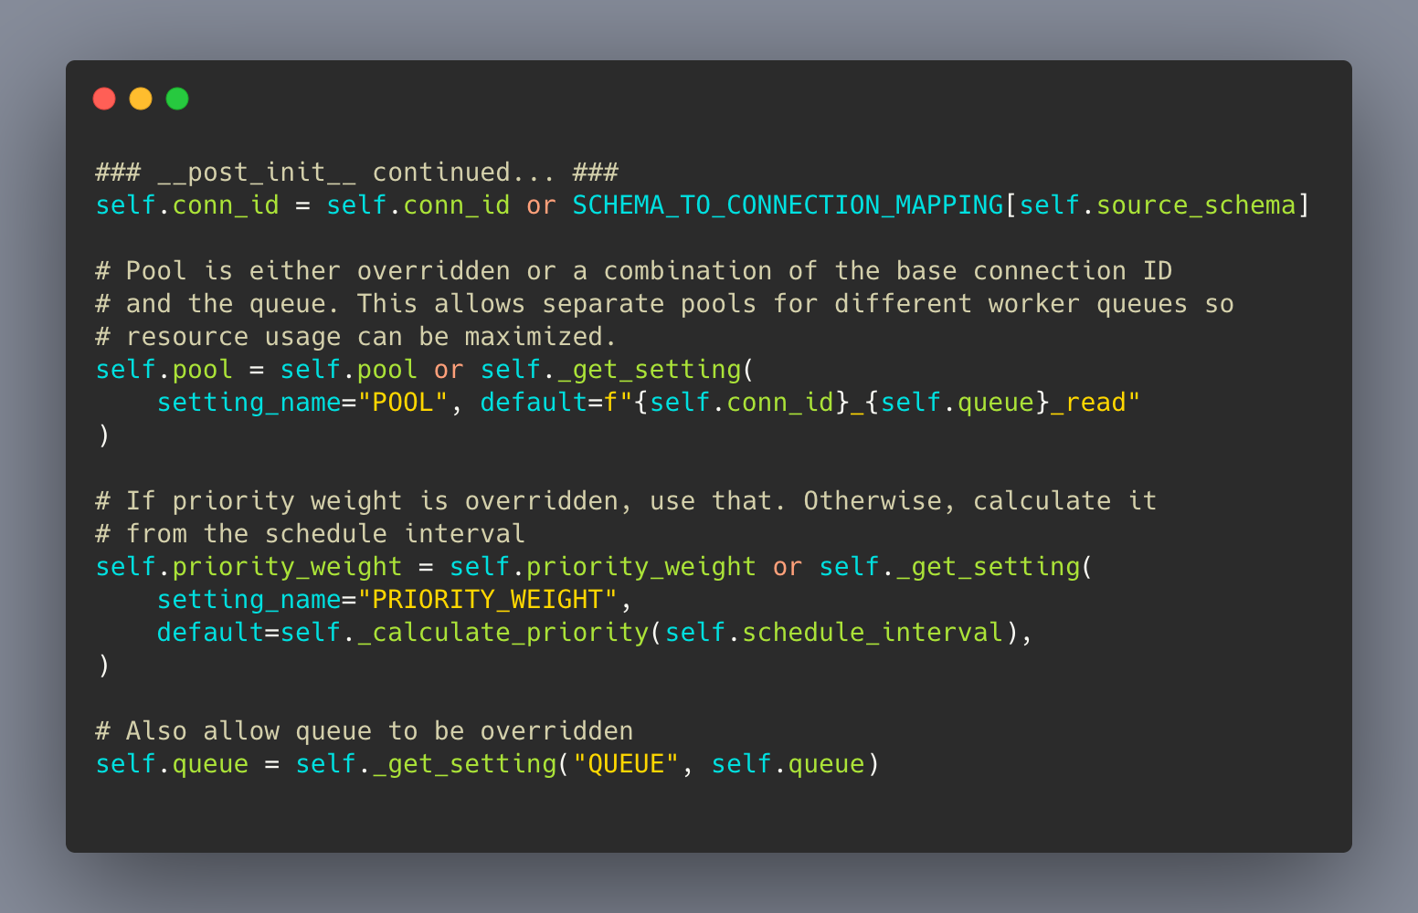
Applying dataclasses (cont’d)
Notes:
1 -> 3 -> 2
Only have to write the logic once, available in all our pipeline types

Slide 8
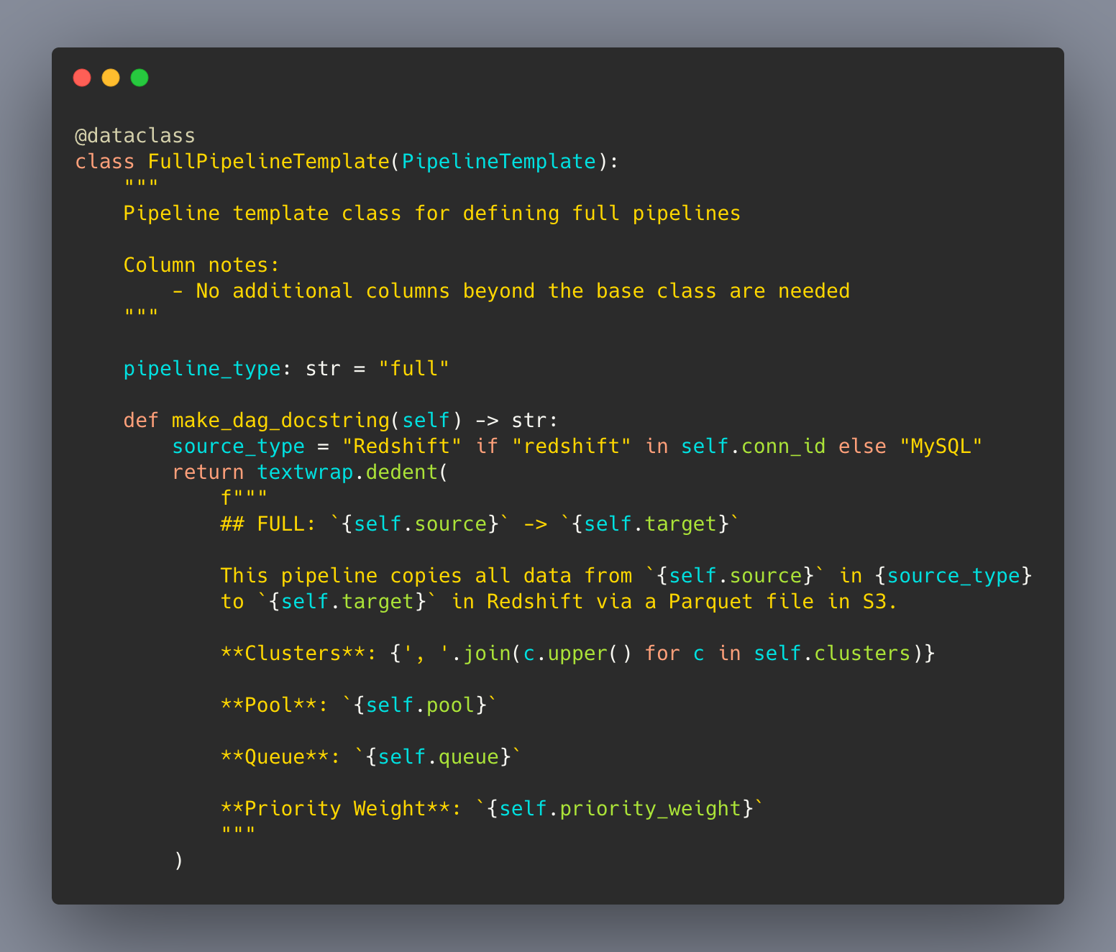
Applying dataclasses (cont’d)

Slide 9
Dataclasses + Dynamic DAGs
180 pipeline definitions ➡ 3 definitions!
Shared queries/steps
Shared alerting + all other Airflow goodies!

Slide 10
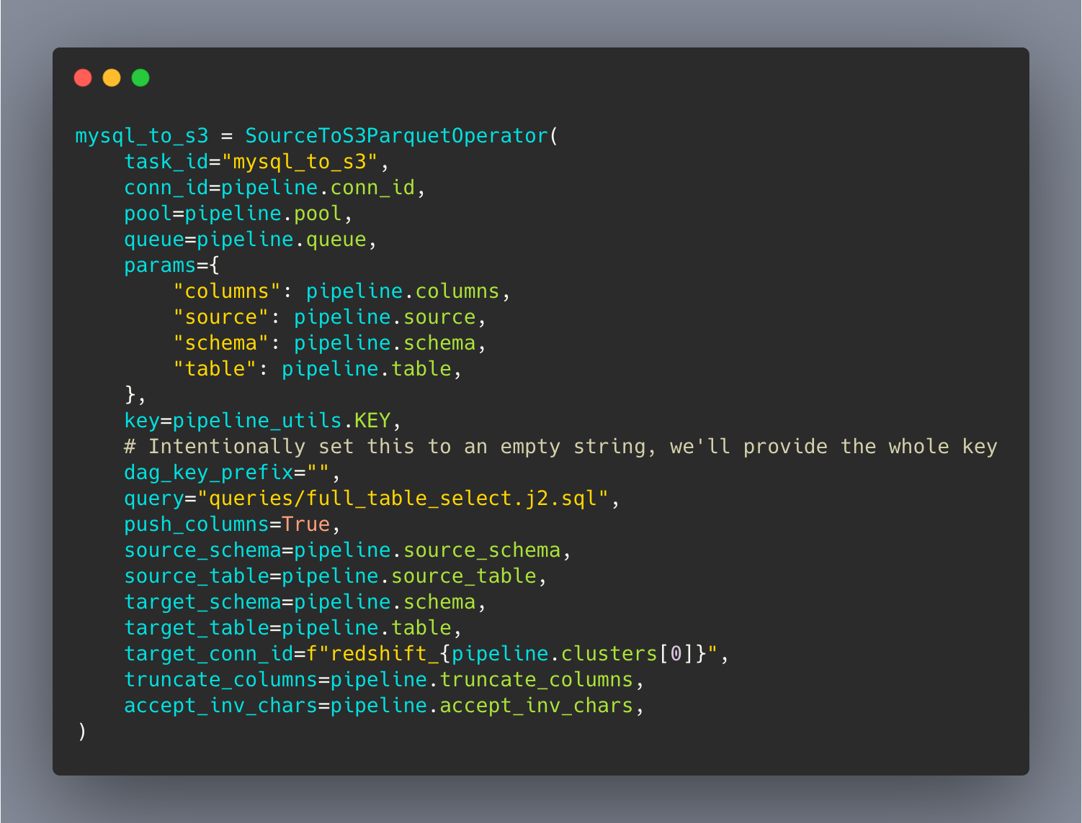
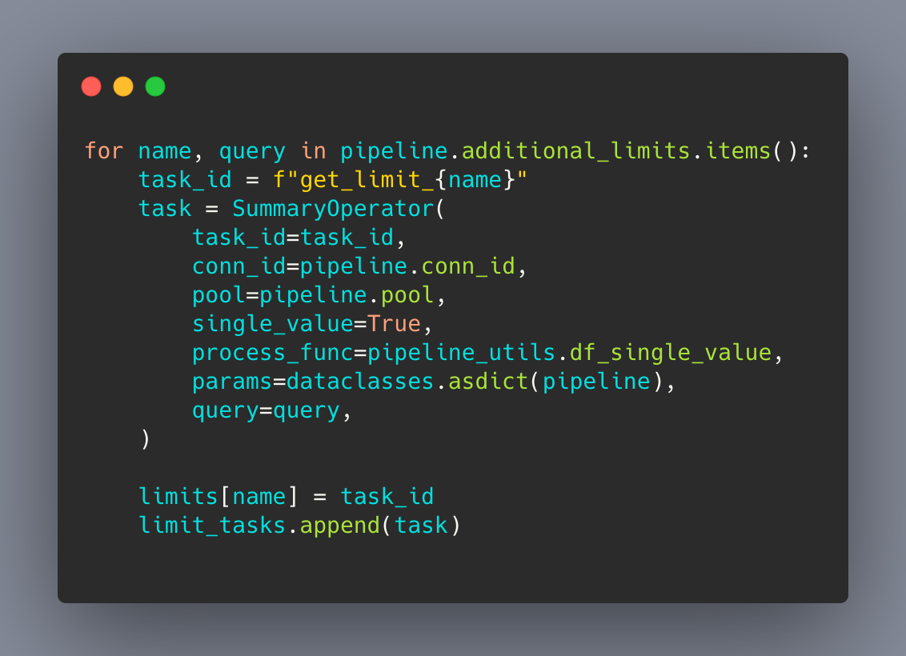
Dataclasses + Dynamic DAGs

Slide 11
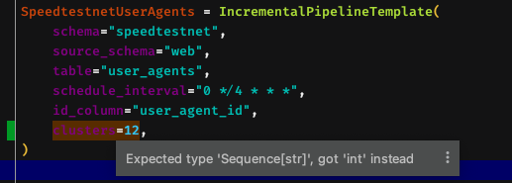
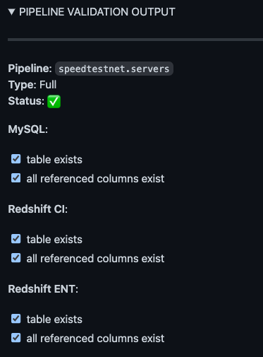
Validation
Type validation
Pre-PR validation
Notes:
Type errors actually raise exceptions

Slide 12
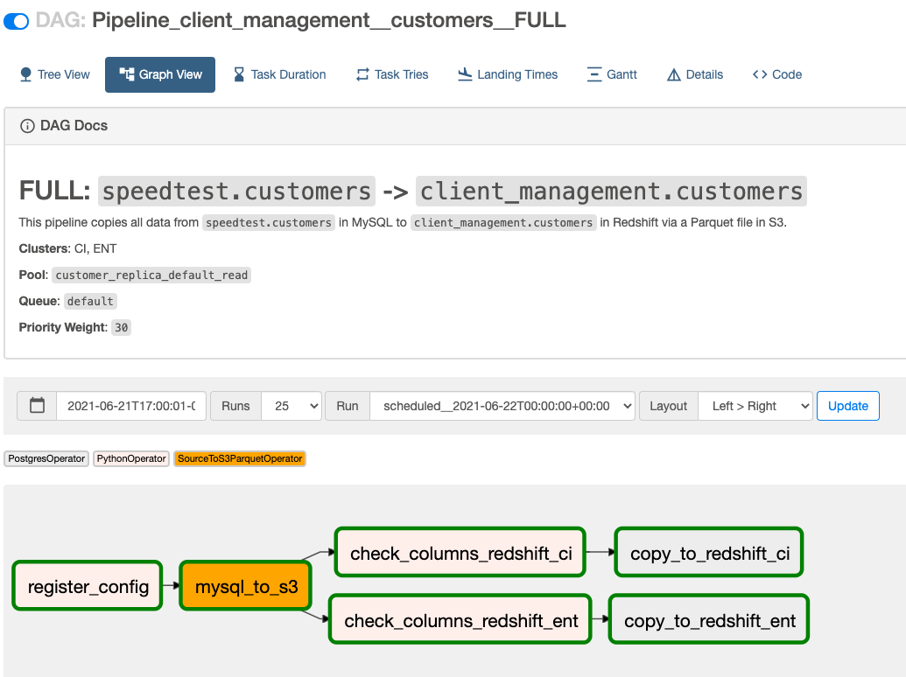
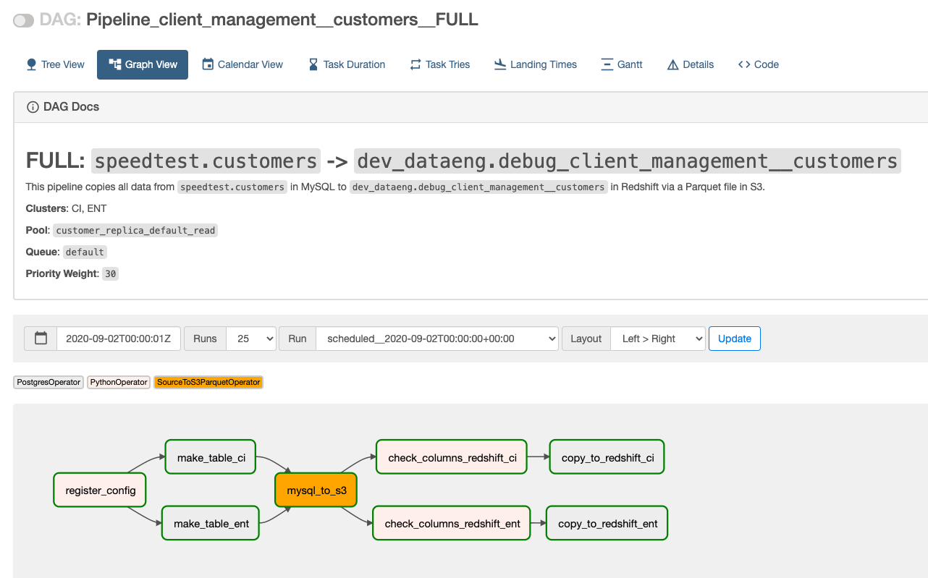
Testing
Production
Development

Slide 13
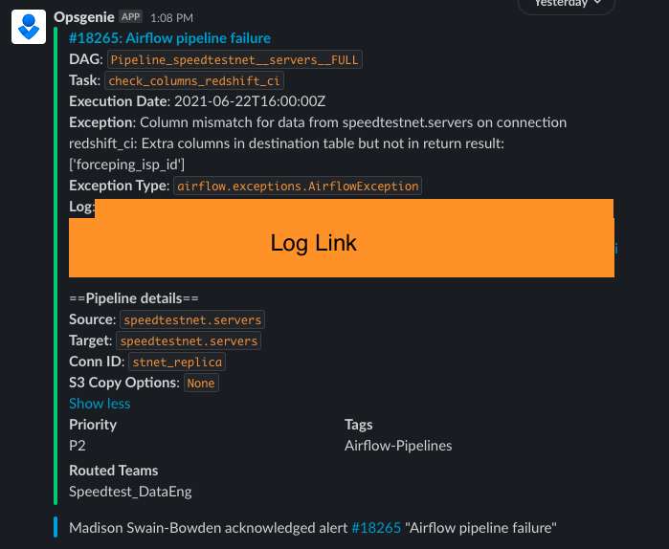
Alerts

Slide 14
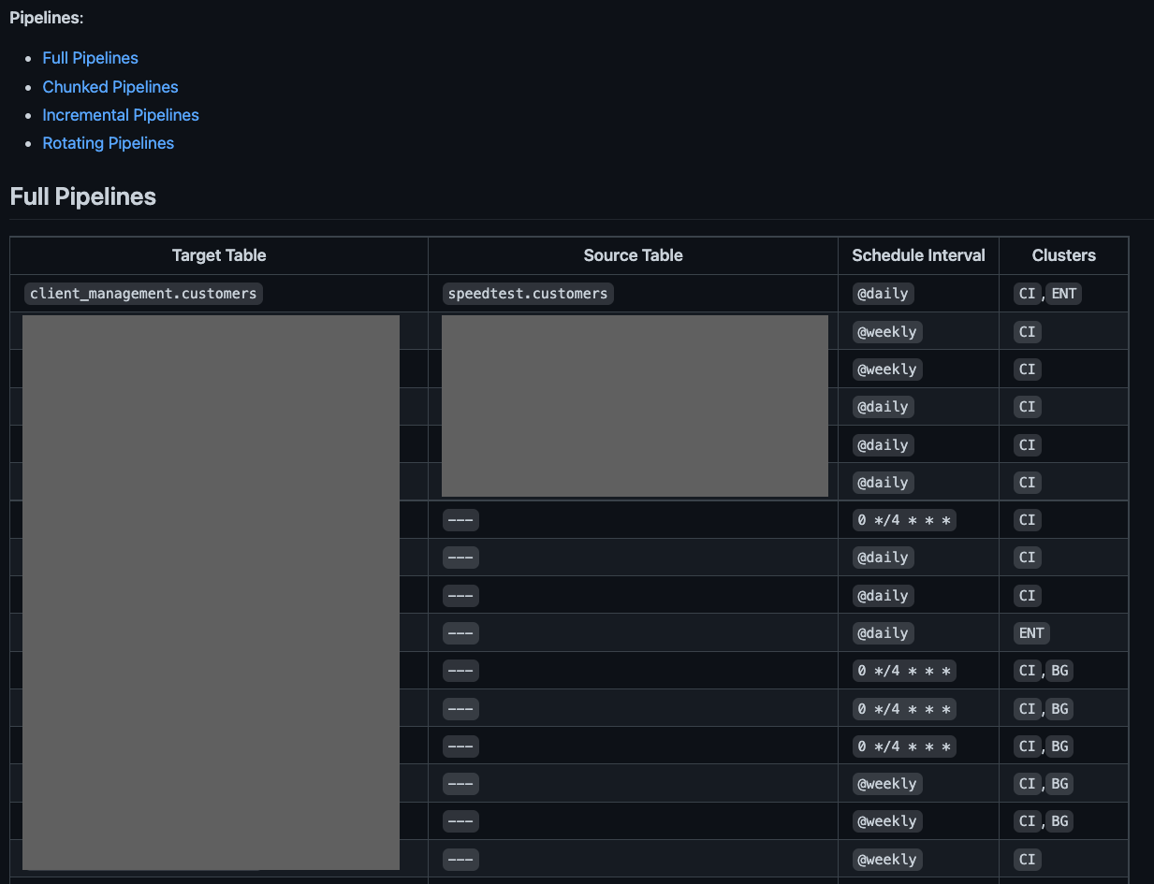
Documentation

Slide 15
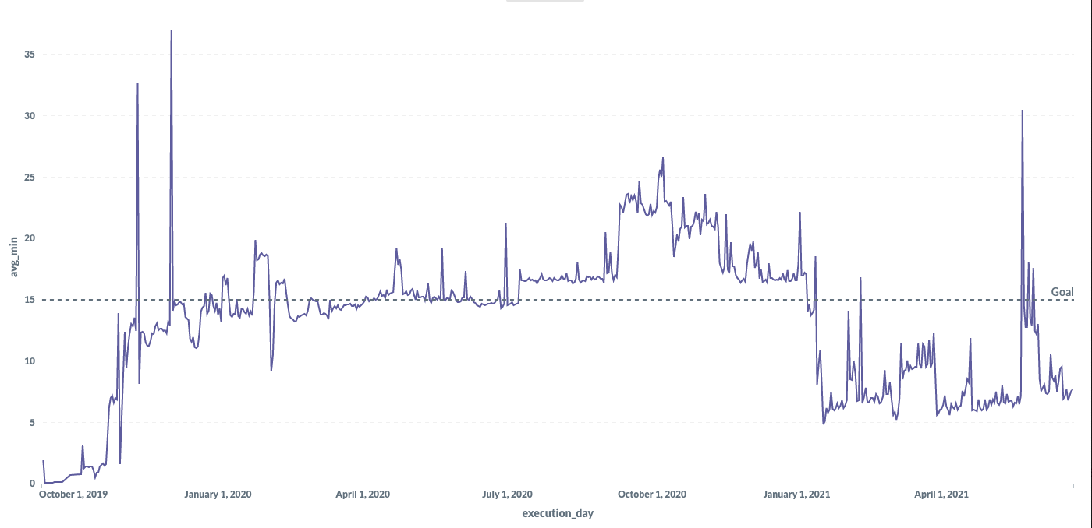
Airflow 2.0 Upgrade
50% Reduction in DAG execution time!
Update to 1.10.12
Enable DAG Serialization
(Redshift issues)
Update to Airflow 2.0

Slide 16
Takeaways
Dataclasses can be used for pipeline definitions (in lieu of YAML/JSON/etc)
Using native Python objects can make it easier to maintain pipelines (validation, testing, alerts, etc.)
Upgrade to Airflow 2.0!

Slide 17
Thank you!

