Slide 1



TRIBHUVAN UNIVERSITY
INSTITUE OF ENGINEERING
PULCHOWK ENGINEERING CAMPUS
Event-Blinker-
EMPHASIZES REAL-TIME UPDATES
Manish Adhikari (PUL078BEI019)
Nandani Sah (PUL078BEI023)
Prabin Raj Dhungana (PUL078BEI026)

Slide 2
Introduction
Background
Many people miss local events due to lack of timely, location-based information.
Event organizers find it hard to promote events to nearby audiences effectively.
Current platforms don’t offer real-time, interactive maps to discover events nearby.
Our project solves this by providing a live map with blinking event markers and easy event management.
1

Slide 3
Introduction
Problem
01
People miss local events due to poor real-time awareness.
02
Event organizers struggle to reach nearby audiences effectively.
03
No real-time event updates
04
Existing platforms lack interactive, location-based event discovery.
2

Slide 4
Introduction
Objectives
01
Centralized event discovery platform
02
Real-time updates and notifications
03
Provide dynamic, blinking markers to highlight active nearby events.
04
Integrated ride-sharing system
3

Slide 5
LITERATURE REVIEW
MEETUP: FOCUSED ON COMMUNITY GROUPS AND LACKS REAL-TIME UPDATES AND SUPPORT FOR SPONTANEOUS OR LARGE EVENTS.
EVENTBRITE: PRIMARILY TICKET-ORIENTED AND PROVIDES LIMITED LIVE STATUS OR REAL-TIME EVENT INTERACTION.
FACEBOOK EVENTS: EVENT INFORMATION IS UNSTRUCTURED, UNRELIABLE, AND LACKS REAL-TIME VERIFICATION AND PROPER MAP-BASED DISCOVERY.
4

Slide 6
TECHNOLOGY STACK
FRONTEND: REACT NATIVE, REACT
BACKEND: NODE.JS, EXPRESS
DATABASE: POSTGRESQL, POSTGIS
REAL-TIME: SOCKET.IO
5

Slide 7
SCOPE OF THE PROJECT
MOBILE APP FOR USERS
WEB PORTAL FOR ORGANIZERS AND ADMIN
EVENT CREATION AND APPROVAL
CHAT AND RIDE BOOKING
6

Slide 8
Related Theory
Geospatial Databases & Queries
Location-Based Services (LBS)
01
03
Real-Time Data Streaming
Push Notification Systems
02
04
7

Slide 9
EVENT DISCOVERY FEATURE
LOCATION-BASED SEARCH
MAP VIEW OF EVENTS
FILTER BY CATEGORY AND DATE
REAL-TIME EVENT APPEARANCE
8

Slide 10
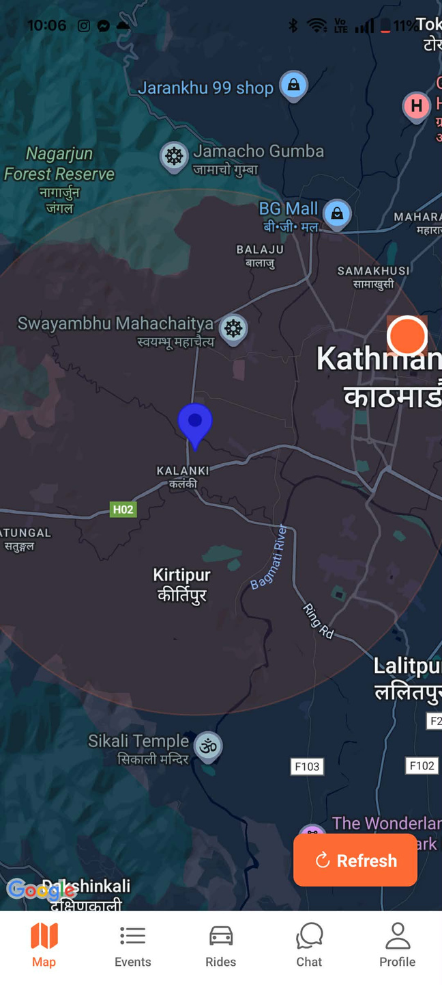
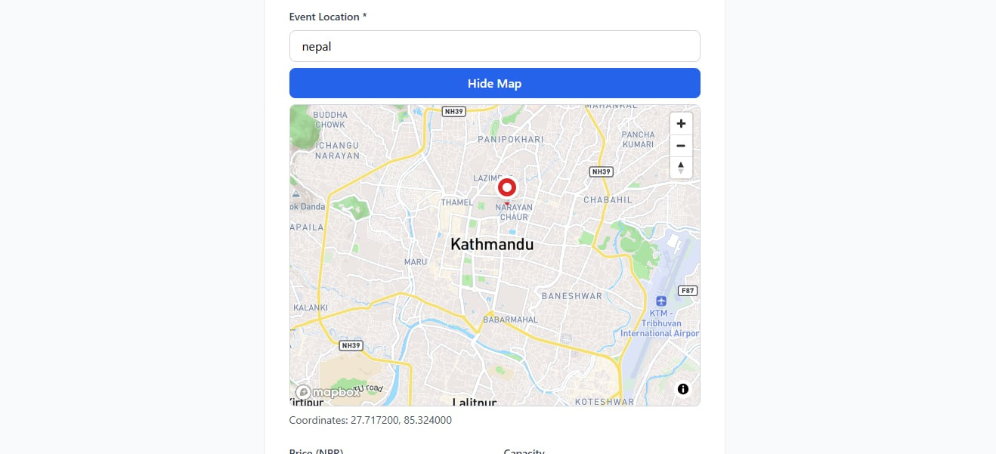

Slide 11
REAL-TIME CHAT SYSTEM
EVENT-SPECIFIC CHAT ROOMS
USERS AND ORGANIZERS CAN CHAT
AI ANSWERS COMMON QUESTIONS(WORKING)
MESSAGES DELIVERED INSTANTLY
10

Slide 12
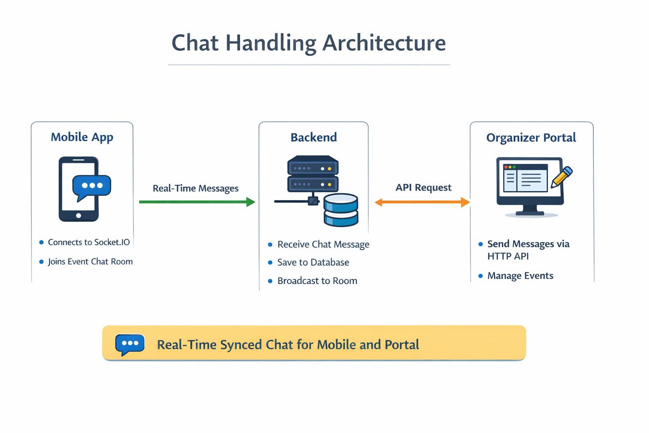
11

Slide 13
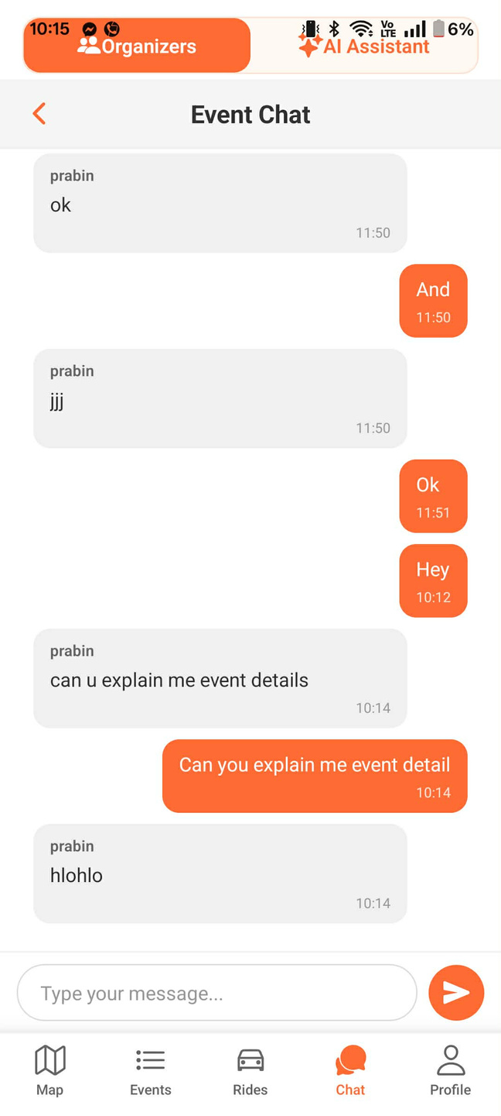
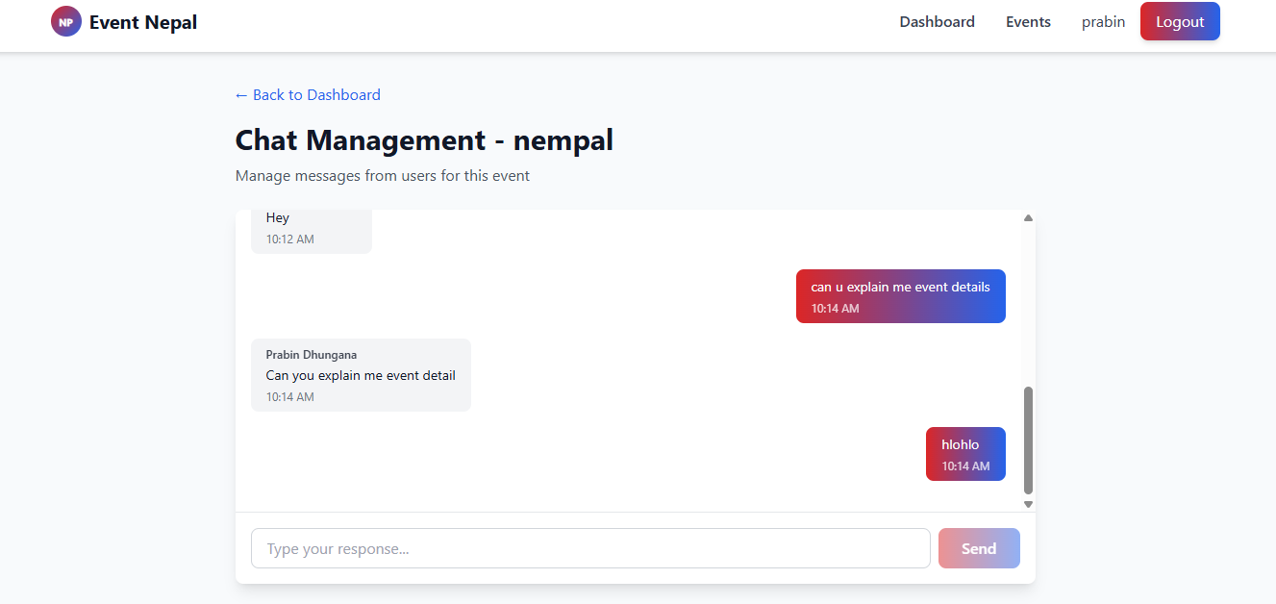
12

Slide 14
RIDE SHARING FEATURE
USERS REQUEST RIDES TO EVENTS
RIDERS REGISTER AND GET VERIFIED
DISTANCE-BASED PRICE CALCULATION
REAL-TIME RIDE NOTIFICATIONS
13

Slide 15
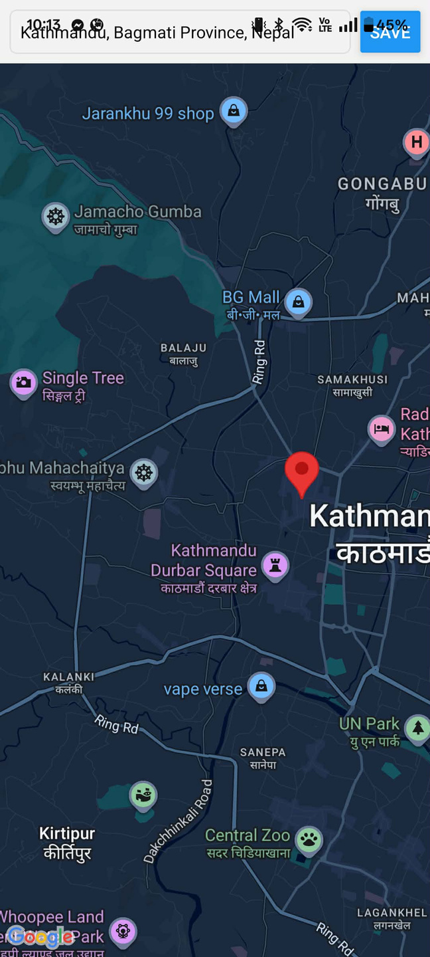
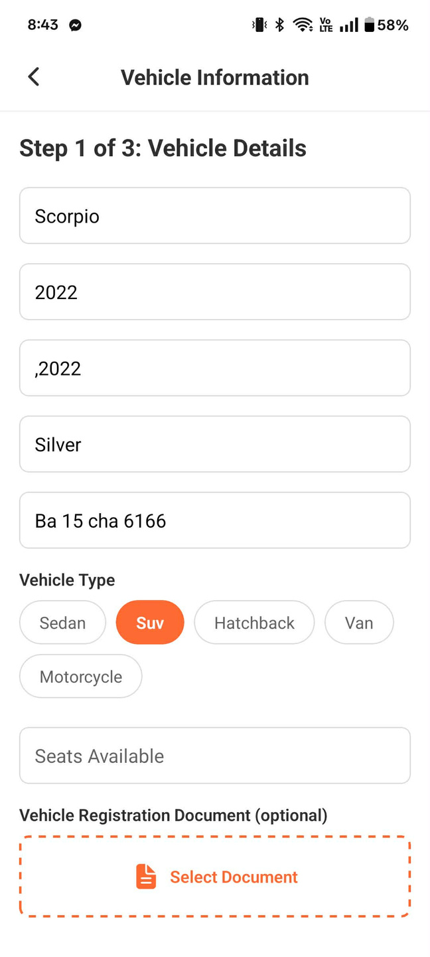
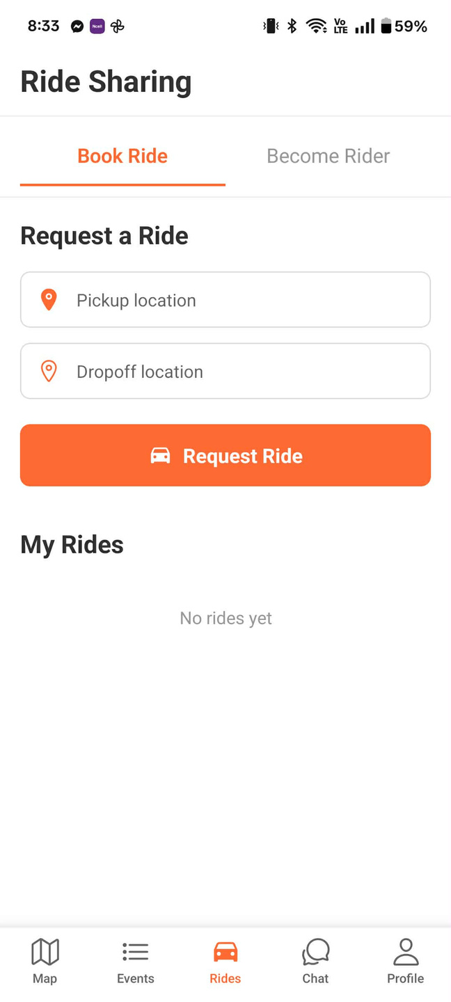


Slide 16
DISTANCE IS NEEDED TO CALCULATE RIDE FARE AND MATCH NEARBY RIDERS
We use GPS coordinates (latitude & longitude)
Each location is represented as a point on the Earth
Earth is round, so straight-line distance is not accurate
Therefore, we use geographical distance calculation
INPUT USED:
Pickup location (latitude, longitude)
Drop-off location (latitude, longitude)
15

Slide 17
HOW DISTANCE IS CALCULATED IN OUR SYSTEM
Locations are stored in database using PostGIS
PostGIS automatically calculates distance between two points
Distance is returned in meters and converted to kilometers
This distance is used for fare calculation
TOTAL FARE = BASE FARE + (DISTANCE × RATE PER KM)
16

Slide 18
SECURITY & VERIFICATION
JWT-BASED AUTHENTICATION
PASSWORD HASHING
ADMIN APPROVAL FOR EVENTS
RIDER AND ORGANIZER VERIFICATION
17

Slide 19
Methodology
Requirements Gathering
System Design & Architecture
BACKEND & DATABASE SETUP
MOBILE & WEB FRONTEND DEVELOPMENT
REAL-TIME INTEGRATION
TESTING & DEPLOYMENT
18

Slide 20

PROJECT PROGRESS (CURRENT STATUS)
CORE FEATURES IMPLEMENTED
EVENT DISCOVERY WORKING
CHAT AND AI INTEGRATED
RIDE-SHARING (SOLVING)
TESTING IN PROGRESS
19

Slide 21

CHALLANGES FACED
Real-time synchronization
GeOSPATIAL QUERY OPTIMIZATION
AI RESPONSE HANDLING
IMAGE UPLOAD MANAGEMENT
20

Slide 22
CONCLUSION
THE PROJECT SOLVES REAL-WORLD PROBLEMS USING MODERN TECHNOLOGIES, OFFERING A SECURE AND SCALABLE SYSTEM. ADAPTED TO NEPAL’S CONTEXT, IT CONSIDERS LOCAL NEEDS AND INFRASTRUCTURE, MAKING IT PRACTICAL, RELIABLE, AND WELL-SUITED FOR EFFECTIVE REAL-WORLD IMPLEMENTATION.
21

Slide 23

Thank You

