Slide 1



TRIBHUVAN UNIVERSITY
INSTITUE OF ENGINEERING
PULCHOWK ENGINEERING CAMPUS
Event-Blinker-
A REAL-TIME GEOSPATIAL EVENT AND RIDE-SHARING PLATFORM
Manish Adhikari (PUL078BEI019)
Nandani Sah (PUL078BEI023)
Prabin Raj Dhungana (PUL078BEI026)

Slide 2
Introduction
Background
Information overload and fragmentation on social platforms. Difficulty in localized real-time event discovery (FOMO). Lack of integrated platforms addressing "last-mile" transportation. Event Blinker solves this by integrating maps, AI, and ride-sharing.
1

Slide 3
Introduction
Problem
01
Information Staleness: Existing platforms lack real-time status updates.
02
Geospatial Inefficiency: Hard to discover nearby events without intelligent map support.
03
Transportation Barriers: Lack of localized integrated transport.
04
Static Assistance: No context-aware, localized query resolution.
2

Slide 4
Real-time event discovery with Mapbox GL & PostGIS.
AI Virtual Concierge (Blinker AI) via LLAMA 3.3.
P2P ride-sharing with Haversine distance & NPR dynamic pricing.
Verification portals for Events, Organizers, and Riders.
Introduction
Objectives
01
Centralized event discovery platform
02
Real-time updates and notifications
03
Provide dynamic, blinking markers to highlight active nearby events.
04
Integrated ride-sharing system
3

Slide 5
LITERATURE REVIEW
MEETUP: FOCUSED ON GROUPS; LACKS REAL-TIME UPDATES & RIDE INTEGRATION. EVENTBRITE: TICKET-ORIENTED; LIMITED LIVE STATUS OR REAL-TIME INTERACTION. FACEBOOK EVENTS: UNSTRUCTURED DATA; LACKS SPATIAL VERIFICATION AND DISCOVERY.
4

Slide 6
TECHNOLOGY STACK
FRONTEND: REACT NATIVE (EXPO), REACT / VITE
BACKEND: NODE.JS, EXPRESS (11 ROUTE MODULES)
DATABASE: POSTGRESQL + POSTGIS EXTENSION
REAL-TIME & AI: SOCKET.IO, LLAMA 3.3 (OPENROUTER)
5

Slide 7
SCOPE OF THE PROJECT
MOBILE APP FOR END USERS
WEB PORTALS FOR ORGANIZERS & ADMIN
AI VIRTUAL CONCIERGE (BLINKER AI)
GEOSPATIAL EVENT ENGINE
P2P RIDE-SHARING SYSTEM
6

Slide 8
Core Technologies
Socket.io Bi-Directional Streaming
PostGIS Geospatial Engine
01
03
Three-Tier Client-Server Architecture
Multi-Model AI Fallback Logic
02
04
7

Slide 9
GEOSPATIAL DISCOVERY MODULE
GEOSPATIAL EVENT SEARCH
INTERACTIVE MAPBOX GL DASHBOARD
RADIUS-BASED FILTERING (ST_DWITHIN)
REAL-TIME MARKER UPDATES
8

Slide 10
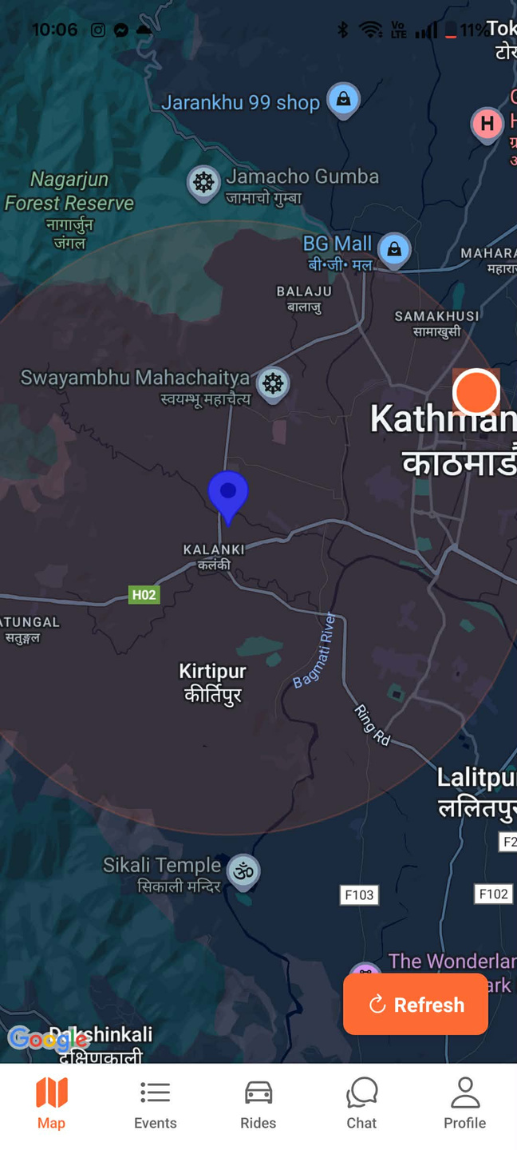
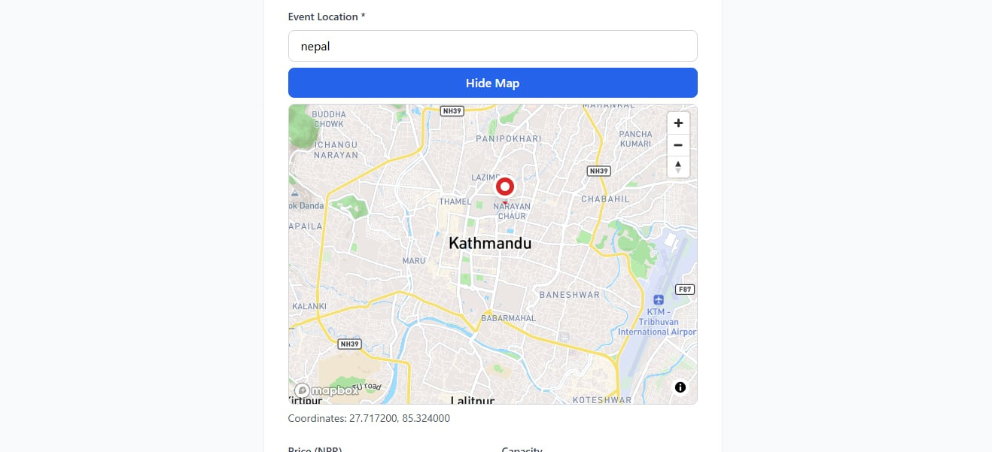

Slide 11
LIVE CHAT & AI INTEGRATION
EVENT-SPECIFIC DISCUSSIONS
ATTENDEE AND ORGANIZER INTERACTION
AI CONCIERGE (LLAMA 3.3) FOR QUERIES
INSTANT BROADCASTING VIA SOCKET.IO
10

Slide 12
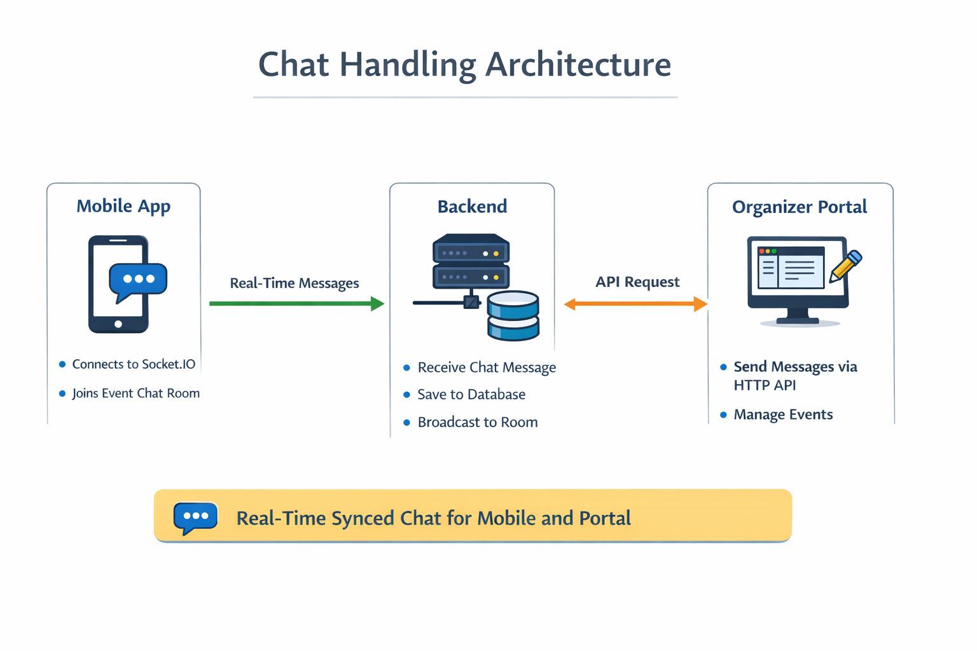
11

Slide 13
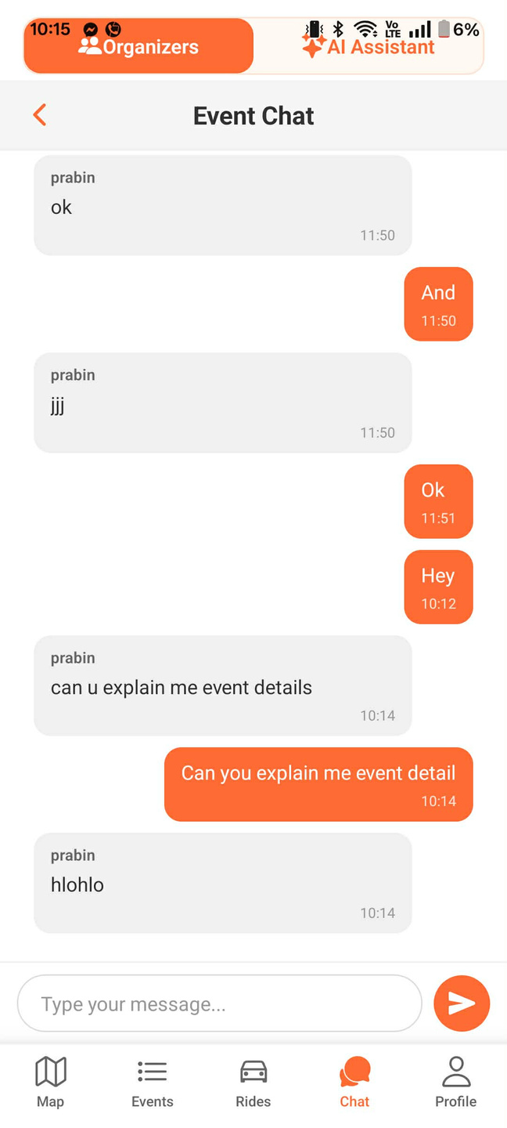
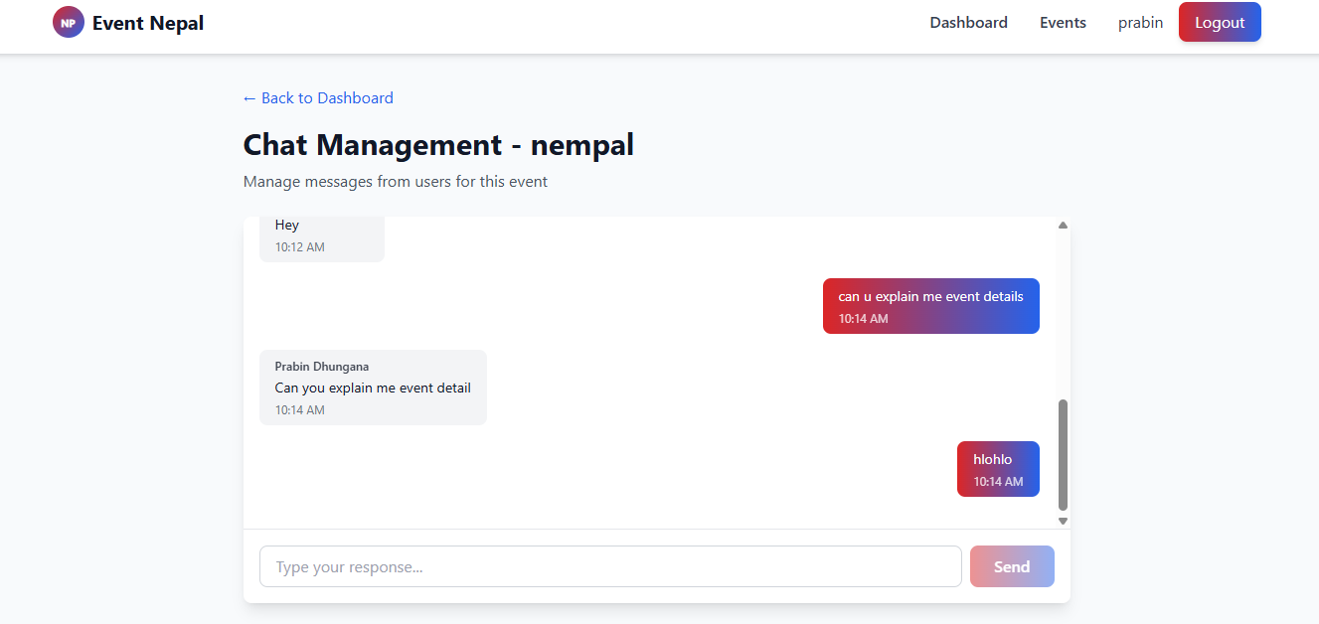
12

Slide 14
UNIFIED RIDE SHARING MODULE
P2P CUSTOM PRICE NEGOTIATIONS
3-STEP DRIVER VERIFICATION PROCESS
DYNAMIC PRICING & HAVERSINE METRICS
LIVE RIDE STATUS NOTIFICATIONS
13

Slide 15
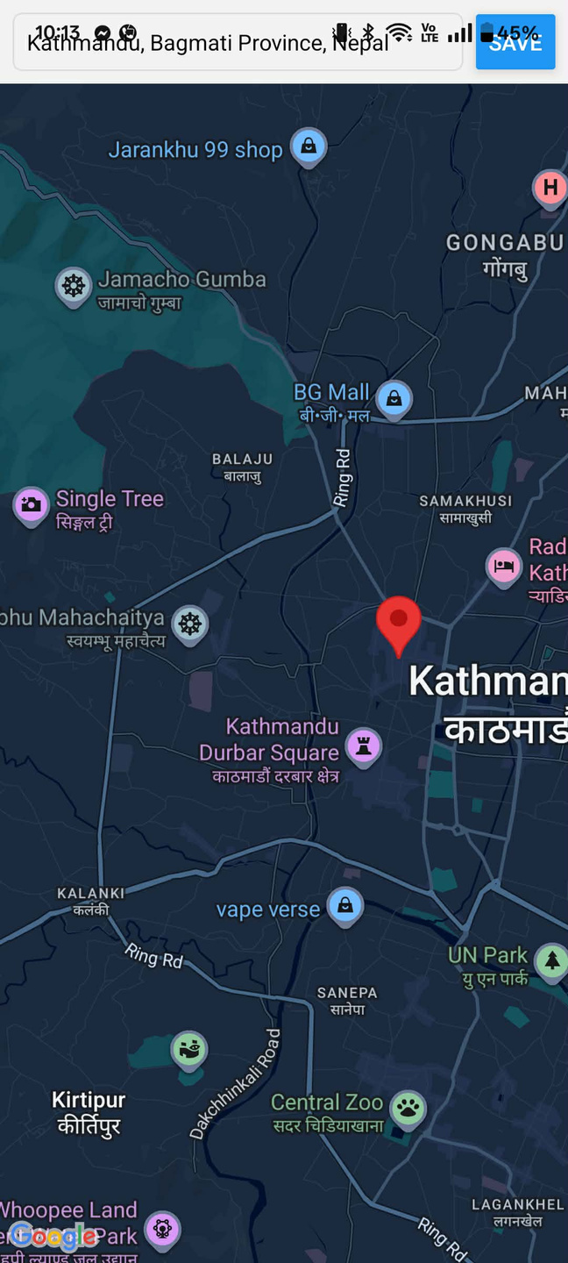
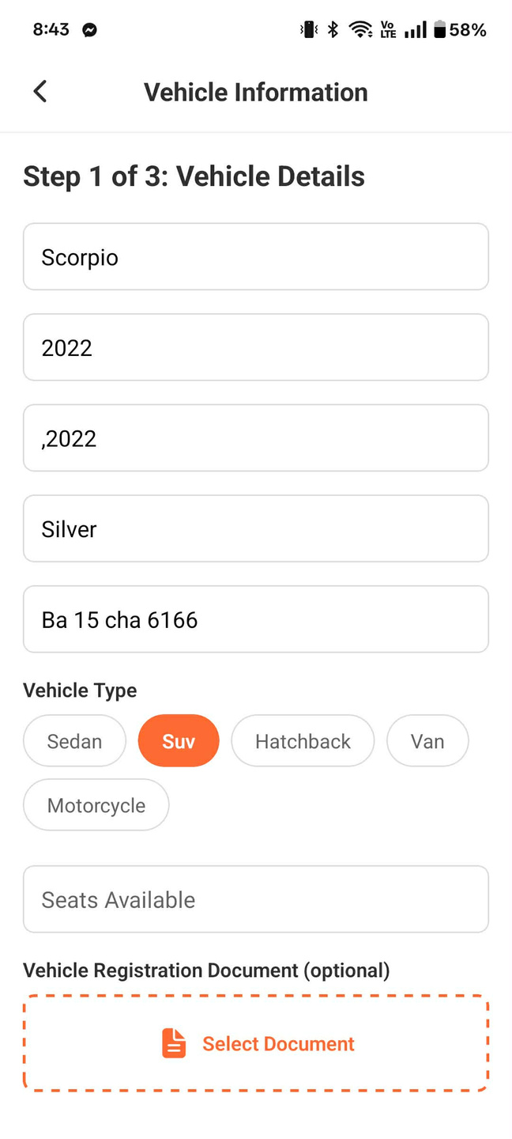
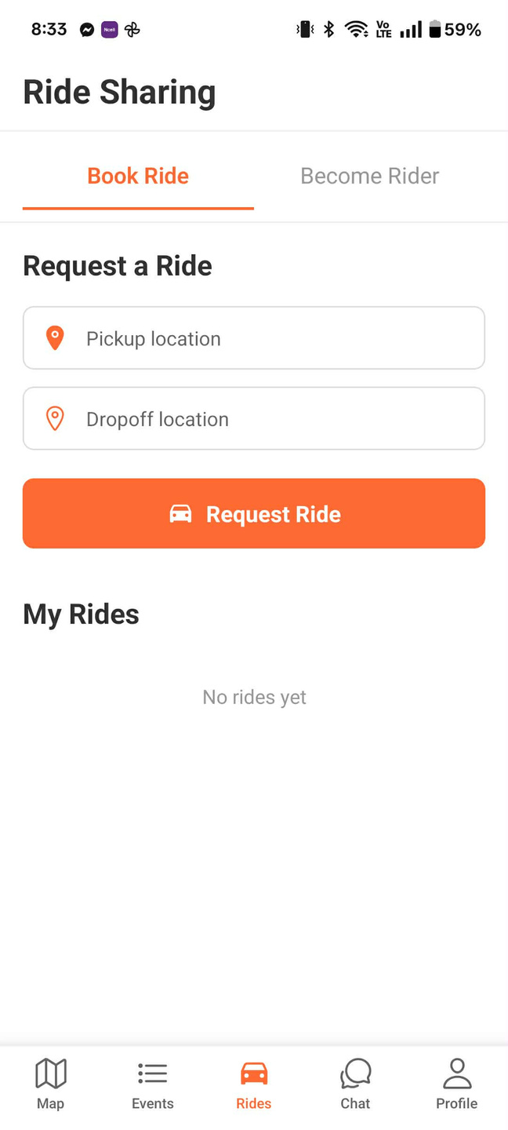
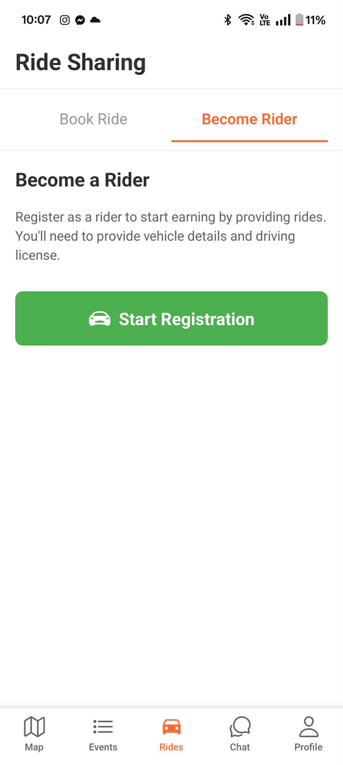

Slide 16
DISTANCE IS REQUIRED FOR SPATIAL FILTERING & ACCURATE FARE LOGIC We utilize GPS coordinates (Latitude & Longitude). Haversine formula determines the shortest path over Earth's sphere. Output yields precise geographical distances in kilometers.
INPUT DATA USED: Pickup coordinates (Lat, Lng) Drop-off coordinates (Lat, Lng)
15

Slide 17
HOW DISTANCE AND FARE ARE CALCULATED Coordinates stored securely via PostGIS geometry types. PostGIS (ST_Distance) evaluates points for rapid querying. Haversine algorithm serves as backend standard for precise ride metrics.
TOTAL FARE = BASE FARE (50) + (DISTANCE / KM x VEHICLE RATE)
16

Slide 18
PLATFORM SECURITY & INTEGRITY
STATELESS JWT AUTHENTICATION
BCRYPT HASHING & RATE LIMITING
ADMIN VERIFICATION FOR ACTORS
DRIVER LICENSE & DOCUMENT REVIEW
17

Slide 19
Work Completed
DATABASE & GEOSPATIAL ENGINE
RIDE SHARING LIFESTYLE
AI MULTI-MODEL INTEGRATION
MOBLE, WEB & ADMIN PORTALS
VARIOUS ROUTE MODULES COMPLETED
PRODUCTION DEPLOYMENT (RENDER)
18

Slide 20

PROJECT PROGRESS (ACHIEVEMENTS) CORE BACKEND ARCHITECTURE (11 MODULES) POSTGIS GEOSPATIAL EVENT DISCOVERY BLINKER AI CONCIERGE ACTIVE P2P RIDE-SHARING FULLY IMPLEMENTED CROSS-PLATFORM SYSTEM DEPLOYED
19

Slide 21

CHALLENGES RESOLVED
POSTGIS GIST INDEX OPTIMIZATION
SOCKET.IO CORS COMPATIBILITY
AI HALLUCINATION & CONTEXT GROUNDING
MULTI-MODEL FALLBACK RELIABILITY
SCHEMA EVOLUTION MANAGEMENT
20

Slide 22
CONCLUSION
EVENT BLINKER SEAMLESSLY MERGES EVENT DISCOVERY, LOCALIZED AI ASSISTANCE, AND LOGISTICS INTO ONE UNIFIED ECOSYSTEM. UTILIZING POSTGIS AND SOCKET.IO ENSURES HIGH-PERFORMANCE, REAL-TIME EXPERIENCES WHILE CATERING TO LOCAL TRANSPORT NEEDS.
21

Slide 23

Thank You

