Slide 1

Analysis on Electric Vehicles
By : Prabin Basyal

Slide 2
Introduction and Data Description
Objective:
While there is a growing consciousness in the world about the environmental impact of transportation, electric cars have cropped up as an alternative to reduce carbon emissions and improve sustainability. Nevertheless, electric cars are still not that widely adopted due to a number of factors that come in the way of their acceptance: high prices, limited ranges, and absence or paucity of charging infrastructure. Insight into the current status of electric car markets will go a long way in informing likely areas for improvement to be pursued in the future with the intention of encouraging as many people as possible to adopt an electric car.
Data Summary:
Rows : 112634
Columns : 17

Slide 3
Data preprocessing
Handling Missing Value by Dropping Rows
From the dataset, we noticed that there were several columns with missing values only in a few rows. Since our dataset is so big, we are not losing much by removing those few rows in terms of accuracy and representation for our data analysis. Dropping these rows with missing values is easy and simple, providing a clean dataset to work with without having to make assumptions or impute values that might introduce bias or errors into our analysis.
Missing values are present in the following columns:
Model (20)
Legislative District (286)
Vehicle Location (24)
Electric Utility (443 missing values)
Since these missing values are small in number for their respective columns, we can safely drop the rows without any loss to the overall dataset. That way, we would continue with a clean dataset.

Slide 4
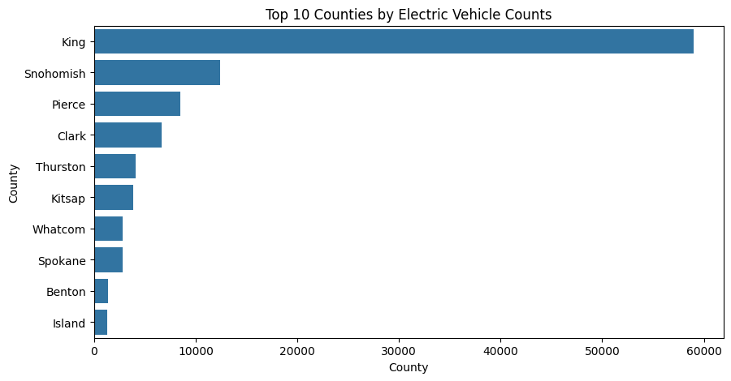
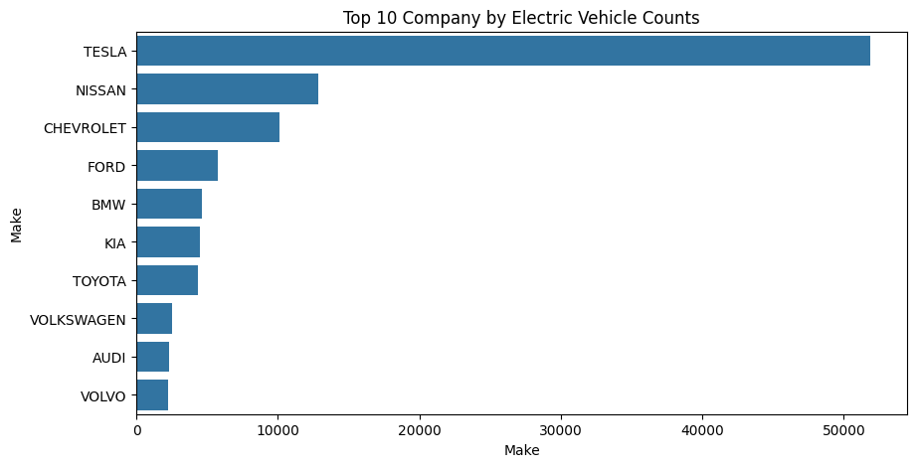
Exploratory Data Analysis
Univariate Analysis
King County is taking the lead in the adoption of electric vehicles, with other counties, such as Snohomish and Pierce counties, following suit.
The visualization highlights Tesla as the top makes leading the electric vehicle market,followed by Nissan, and Chevrolet indicating Tesla is the most popular than any other brand.

Slide 5
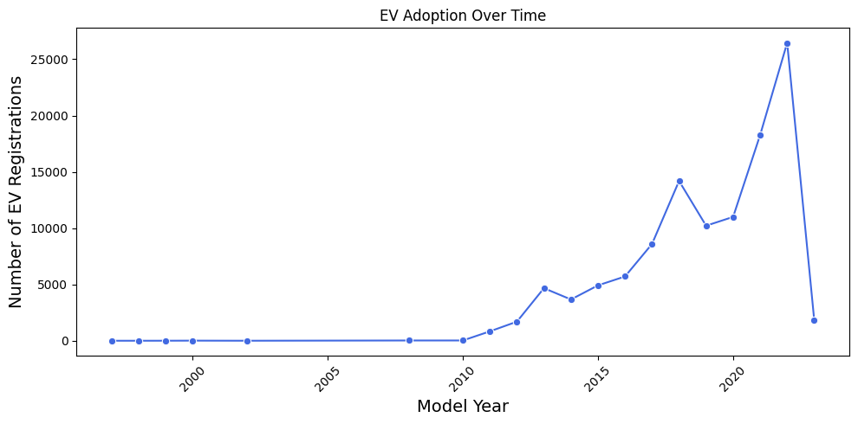
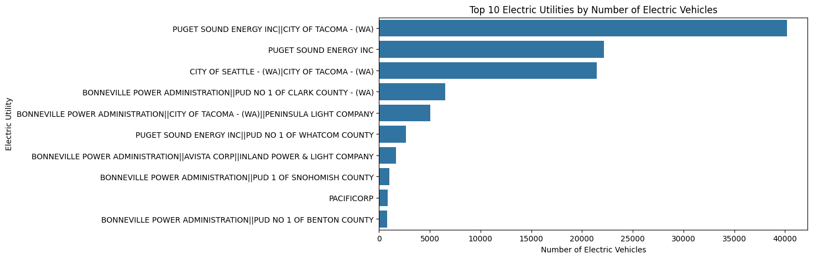
Exploratory Data Analysis
Univariate Analysis
This is a big jump in electric vehicle registrations according to the "EV Adoption Over Time" visualization; it started increasing in the early 2010s, which has further accelerated more in the 2020s. It follows that in recent years, exponential growth in EV adoption has occurred, and thus it is becoming more popular.
The bar chart shows the electric utilities by number of vechicels. Puget sound energy inc. has the highest number of electric vechicles.

Slide 6
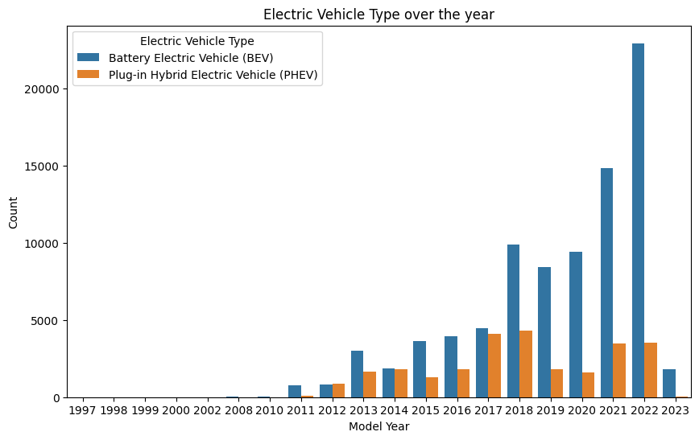
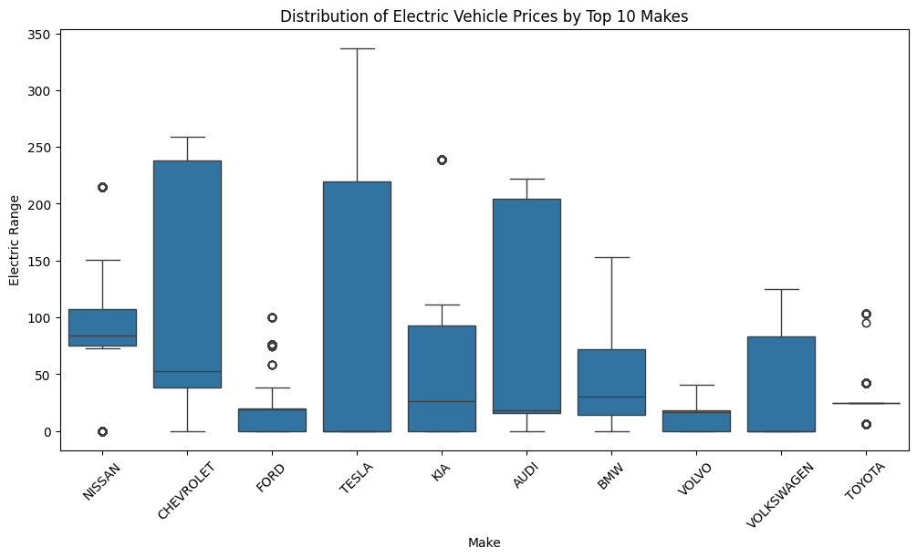
Exploratory Data Analysis
Bivariate Analysis
Comparing BEVs with PHEVs over the years reflects the clear trend toward the fact that BEVs are gaining more momentum, especially in the year 2023.
The boxplot reveals a significant variation in the Electric Range among the top 10 EV makes, Nissan as it is very popular has range between 75 to 105.

Slide 7
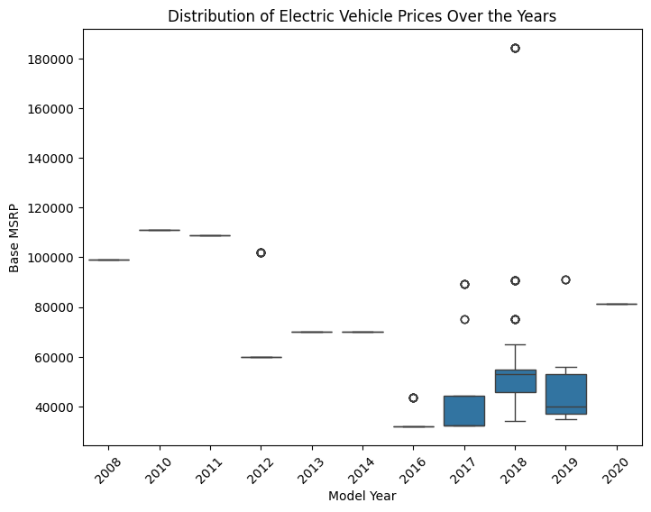
Exploratory Data Analysis
Bivariate Analysis
The visualization reveals a increase in the median price of electric vehicles over the years. In 2008 to 2011 the prices where very high compared to prices now.

Slide 8
Exploratory Data Analysis
TASK: Create a Choropleth using plotly.express to display the number of EV vehicles based on location.

Slide 9
Exploratory Data Analysis
TASK: Create a Racing Bar Plot to display the animation of EV Make and its count each year.

Slide 10

THANK YOU

