Slide 1
Capstone Project
Credit Card Default Prediction
By
Prabin Deb Nath

Slide 2
Content
Introduction
Problem Statement
Data Summary
Approach Overview
Exploratory Data Analysis
Modelling Overview
Feature Importances
Challenges
Conclusion

Slide 3
Introduction
In today’s world credit cards have become a lifeline to a lot of people so banks provide us with credit cards. Now we know the most common issue there is in providing these kind of deals are people not being able to pay the bills. These people are what we call “defaulters”.

Slide 4
Problem Statement
Predicting whether a customer will default on his/her credit card

Slide 5
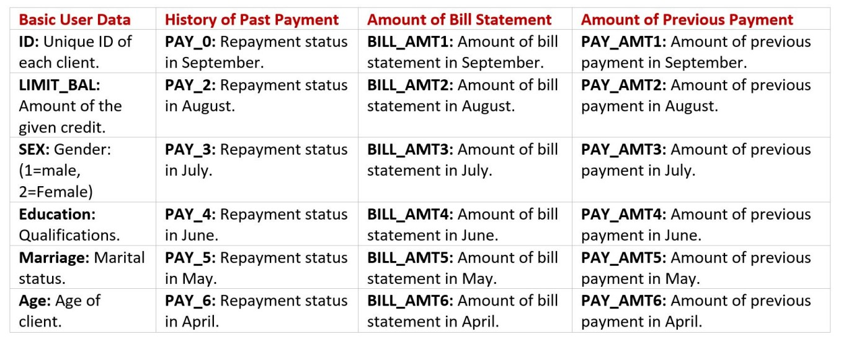
Data Preview
Dependent Variable: DEFAULT (Yes = 1, No = 0)
Independent Variables:

Slide 6
Pipeline
Data Cleaning
Data Exploration
Modeling
Understanding and Cleaning
Null value analysis
Outlier Treatment
Graphical
Univariate analysis with visualization
Bivariate Analysis
with visualization
Machine Learning
Logistic regression
Decision tree
Random Forest
XGBoost
CatBoost

Slide 7
Basic Exploration
There are 30000 rows and 25 columns in the given data.
There are no duplicate or null values present.
We will have to rename a few variables to understand them easily.
Education has a few extra values [0,5,6]; we will add them into category [4] since we are only been provided with details for [1,2,3,4].
Marriage also has an extra value [0]; we will add it into the category [3].

Slide 8
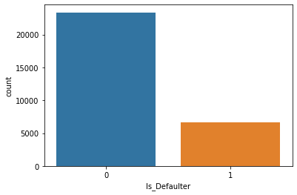
Defaulter Distribution
As we can see there is class imbalance in our response variable.
What is class imbalance?
Class imbalance is a problem in machine learning where the total number of one class of data significantly outnumbers the total number of another class of data.
In our situation class 0 outnumbers class 1, i.e. there are very few defaulters in the given data.

Slide 9
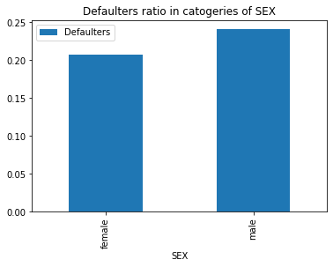
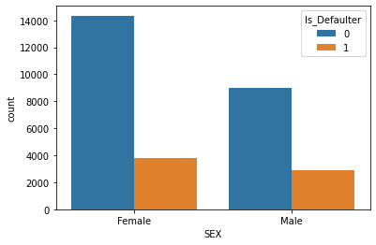
Gender Distribution
we can see that number of females are more than the males
but the default ratio of male is quite higher than female

Slide 10
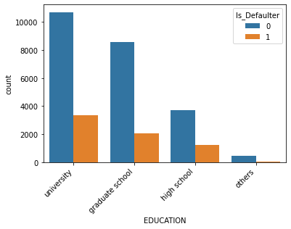
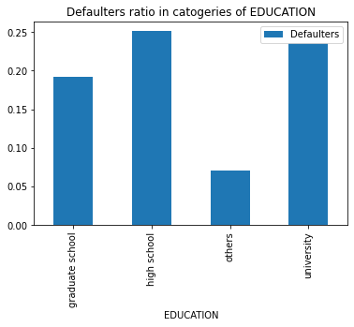
Education Distribution
Number of people from university is height followed by graduate school
university and High School persons are more likely to be defaulter in comparison with the graduate school persons.

Slide 11
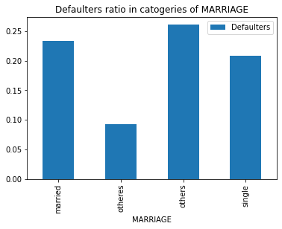
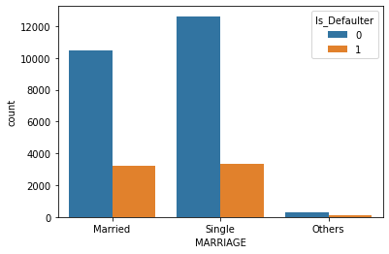
Marital Distributions
people who are not married nor single are more likely to make default of bills in comparison with single and married person

Slide 12
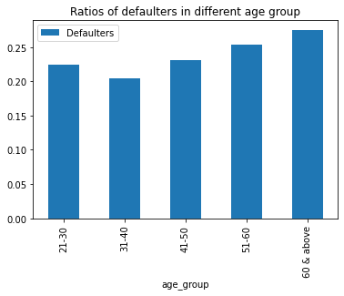
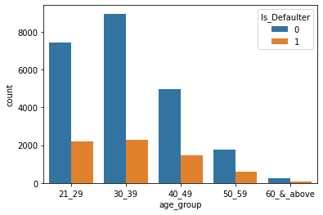
Age Distribution
In aur dataset we can clearly see that most of the credit card holder are of age between 21 to 40 , so we can say that company's target customer are mostly youngster.
We can clearly see that as the age increases, chances of the default also increases.

Slide 13
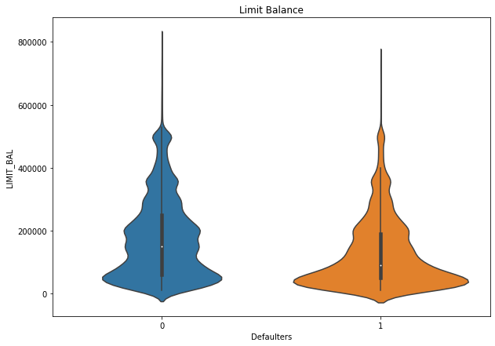
Limit Balance
LIMIT_BAL ranges from 10000 to 1000000 with most of the values less than or equal to 200000.
Most of DEFAULTS are from users within the LIMIT of 10000 to 50000, DEFAULTS keep on decreasing as the LIMIT gets higher.
This indirectly means than as the LIMIT increases the number of DEFAULTS decreases.

Slide 14
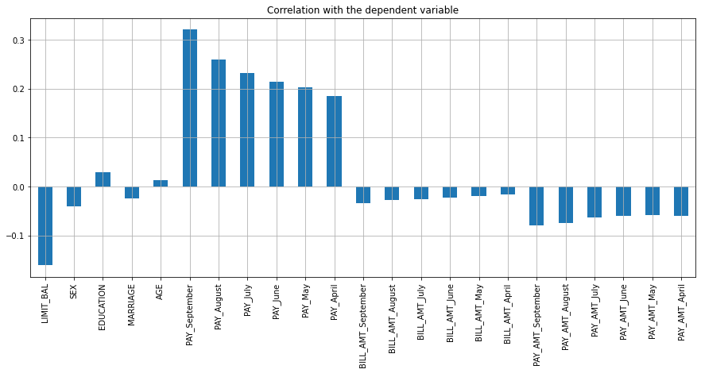
Correlation with the dependent variable
Details of past payments show more correlation with the dependent variable.
Education and Age also show a positive correlation, whereas most of the other variables either show no or negative correlation.

Slide 15
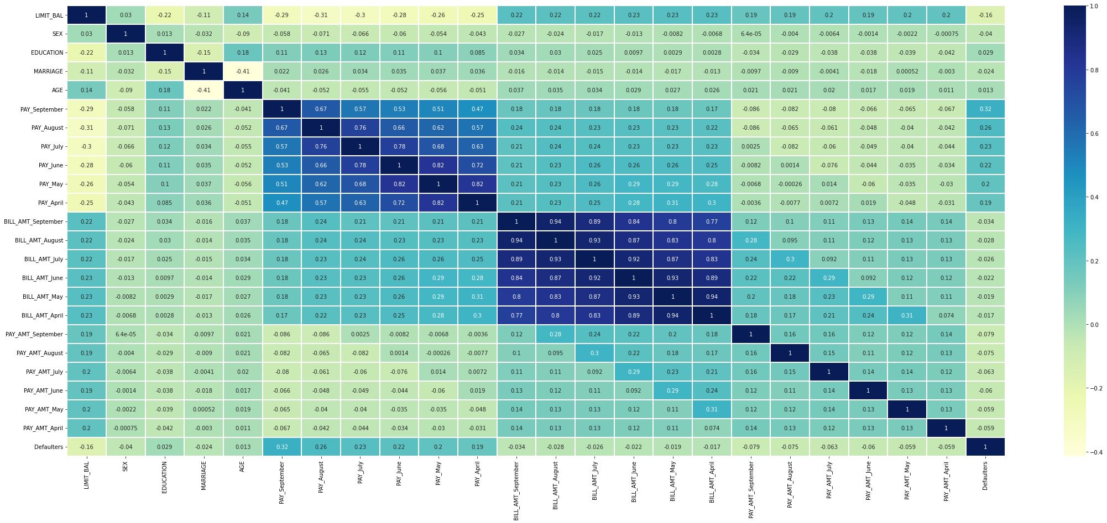
Correlation Heatmap
Multicollinearity exists between variables of History of past payment.
Multicollinearity exists between variables of Amount of Bill Statement.

Slide 16
Modeling Overview
Supervised learning
Binary Classification
Imbalance data with 22% defaulters
Models Used:
Logistic Regression
Decision Trees
Random Forest
SVM
XGBoost
CatBoost
LightGBM

Slide 17
Modeling Steps
Model Evaluation
Data Preprocessing
Data Fitting and Tuning
Feature selection
Feature engineering
Train test data split(75%-25%)
SMOTE oversampling
Start with default model parameters
Hyperparameter tuning
Measure scores on training & test data
Model testing
Compare models

Slide 18
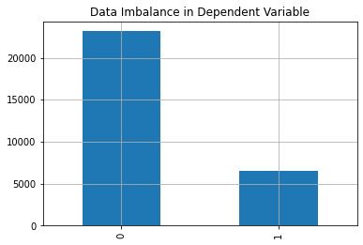
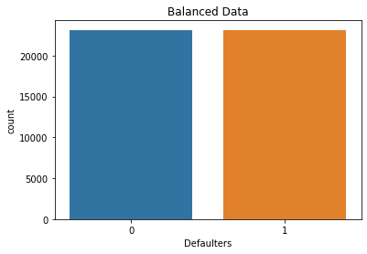
Data Pre-processing
We need to prepare the data before we put them through algorithms.
We start by dropping Id and performing one-hot encoding for the categorical features.
Since our data is unbalanced we oversample our training data using SMOTE Tomek to remove the class imbalance. As shown in the bar plots the class imbalance has been treated after using SMOTE.
Separate the dependent and the independent variables, where y is the dependent variable DEFAULT and X contains the rest of the features in our dataset.
Now do the train test split to separate the training and the testing data that we will use to build and validate our models. (70% training and 30% test data.)
We will also oversample our training data using SMOTE Tomek to remove the class imbalance. As shown in the bar plots the class imbalance has been treated after using SMOTE.

Slide 19

Model building
Now that we have prepared our data, it's time to use them on algorithms. The models we will be using are:
Logistic Regression
DecisionTreeClassifier
RandomForestClassifier
XGBClassifier
CatBoostClassifier
We will compare them and select the best-performing model for the classification.

Slide 20
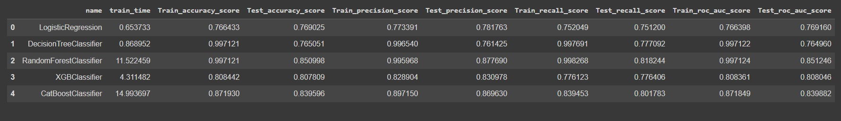
Performance metrics Before tunning
From the metrices of different algorithms we can see that the performance of XGBoost and CatBoostClassifier relatively good.
Random Forest Classifier has also given good results but it is overfitted.

Slide 21
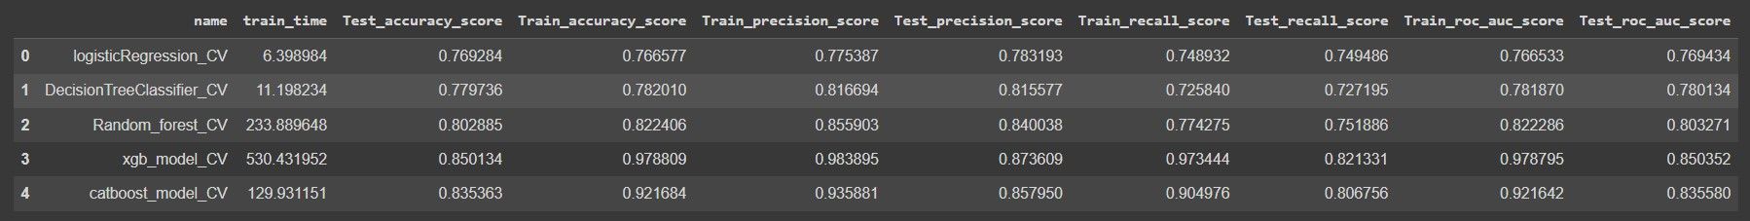
Hyperparameter tuning and cross validations.
To perform the hyperparameter tuning and cross-validations, we will use Grid Search CV and Randomized Search CV. Three Cross validations for each set will be conducted to find the best parameters.
From the above metrices we can say that XGB model performance is relatively better then the others

Slide 22
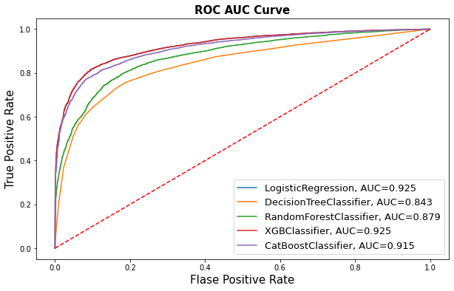
AUC-ROC curve comparison

Slide 23
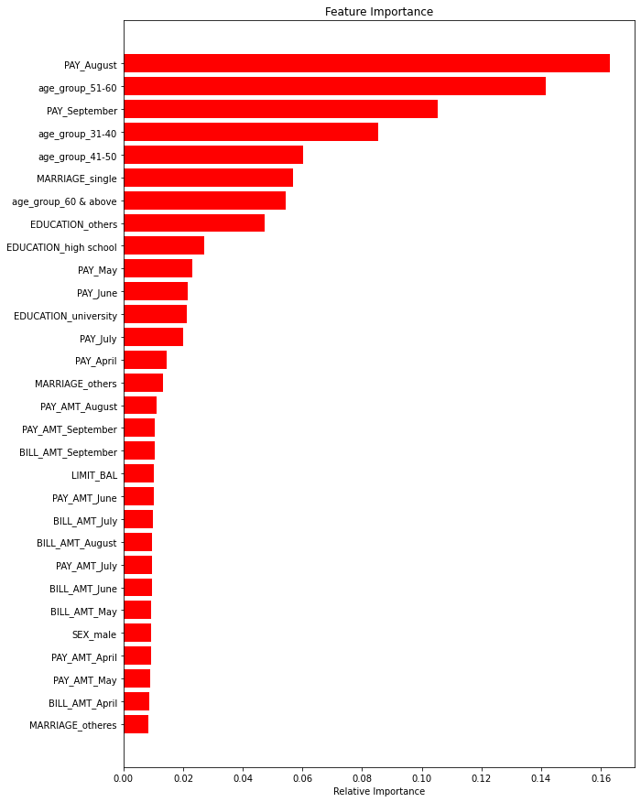
Feature importance
The top 10 features crucial in classifying the DEFAULTS are
['PAY_August', 'age_group_51-60', 'PAY_September', 'age_group_31-40', 'age_group_41-50', 'MARRIAGE_single', 'age_group_60 & above', 'EDUCATION_others', 'EDUCATION_high school', 'PAY_May']

Slide 24
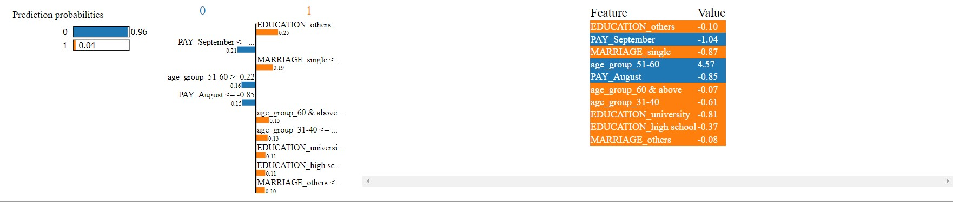
Model explain ability using LIME

Slide 25

Challenges
Understanding the columns.
Feature engineering.
Getting a higher recall on the models.

Slide 26

Conclusion
The default rate is higher for males, increases as the education increases, also increases as the age of a person increases. i.e clients whose age over 60 was higher than mid-age and young people.
In all of these models, our recall revolves in the range of 76 to 84%.with the best fit model as random forest

