Slide 1
Multi-Modal Gaming Biometric Stress Dataset
A Tactical FPS Case Study & Technical Documentation 51 Participants | 2,969 Events | Open-Source Package

Slide 2
1. Data Collection Methodology
• Participant Cohort: 51 active gaming participants (SUB001 - SUB051).
• Approvals & Ethics: Participant informed consent & IRB protocol compliance.
• Hardware Setup (HW): ProtoCentral ECG/PPG Heart Rate hardware sensors (BPM & RR interval) + 1080p HD Webcam at 30 FPS.
• Software Tools: Game Telemetry Listener + OpenCV/DeepFace computer vision for real-time facial micro-expression analysis.
• Data Synchronization: Real-time Unix epoch millisecond timestamp pairing between game telemetry events and biometric feeds.

Slide 3
2. Directly Measured vs. Derived Components
• DIRECTLY MEASURED COMPONENTS (Raw Sensor / Telemetry Signals):
- timestamp_ms: Hardware Unix epoch clock (milliseconds).
- event, player_name, victim, weapon: Directly logged game engine telemetry.
- bpm, rr_ms: Directly measured PPG/ECG cardiac metrics.
- dominant_emotion: Directly observed facial affect classification.
• DERIVED COMPONENTS (Algorithmic / Fused Metrics):
- bio_status: DERIVED — Cardiac arousal state relative to baseline.
- stress_score: DERIVED — Psychological stress index (0-100) computed using Russell's Circumplex Affect Model.
- composite_stress: DERIVED — Fused multimodal index combining bio_status, facial stress, and event weights.

Slide 4
3. Game Environment & Framework Portability
• Test Environment Context:
- A popular tactical FPS game (Valorant) was utilized as the initial test platform after acquiring developer platform telemetry access.
• Cross-Game Portability (What changes if a different game is used?):
- UNCHANGED: Cardiac biosignals (bpm, rr_ms, bio_status), facial affect tracking (dominant_emotion, stress_score), and temporal synchronization remain 100% game-agnostic.
- CHANGED: Specific event hooks (event) and item/weapon IDs (weapon) map to target game schema (e.g., BOMB_PLANTED in CS2 vs SPIKE_PLANTED, AK-47 vs Vandal).
- The core multimodal stress engine is modular and instantly transferable to any competitive gaming title.

Slide 5
4. ProtoCentral Hardware Analysis & Sensor Dropouts
• Identified HW Failure: Complete cardiac signal loss (0 BPM) in SUB037 and SUB038, and intermittent loss (53%) in SUB007.
• Cause Analysis: Motion artifacts & PPG electrode contact detachment during intense high-speed gameplay rounds.
• Action Taken: These 3 subjects are excluded from cardiac averages to preserve mathematical integrity.
• Reporting to ProtoCentral? YES. We recommend sharing a field-validation report with ProtoCentral highlighting high-dynamic motion artifacts during competitive gaming to assist their sensor electrode placement guidelines.

Slide 6
5. Facial Expressions: Detection of 'Surprise'
• Is 'Surprise' Detected? YES. Surprise is fully supported in our 7-emotion classification taxonomy (123 total occurrences in dataset).
• Breakdown in High-Stress Tier: Anger (59%), Fear (32%), Surprise (9% / 21 events).
• Classification Impact: Surprise represents high-arousal but neutral/mixed valence (startle response to sudden ambushes).
• Isolating Surprise from Fear/Anger ensures our Stress Score accurately isolates negative valence (frustration) without misclassifying sudden excitement.

Slide 7
6. Decoupling of Heart Rate and Facial Stress
• Core Finding: Heart Rate (BPM) and Facial Stress are statistically independent (Pearson r = -0.027).
• Physiological Decoupling: High heart rate (physical arousal) does not imply facial distress, and vice versa.
• Temporal Habituation: Stress remains remarkably flat across the session (no fatigue or warm-up decay).
• Stress is Episodic: Driven strictly by discrete micro-events (KILLS/DEATHS), not cumulative time.

Slide 8
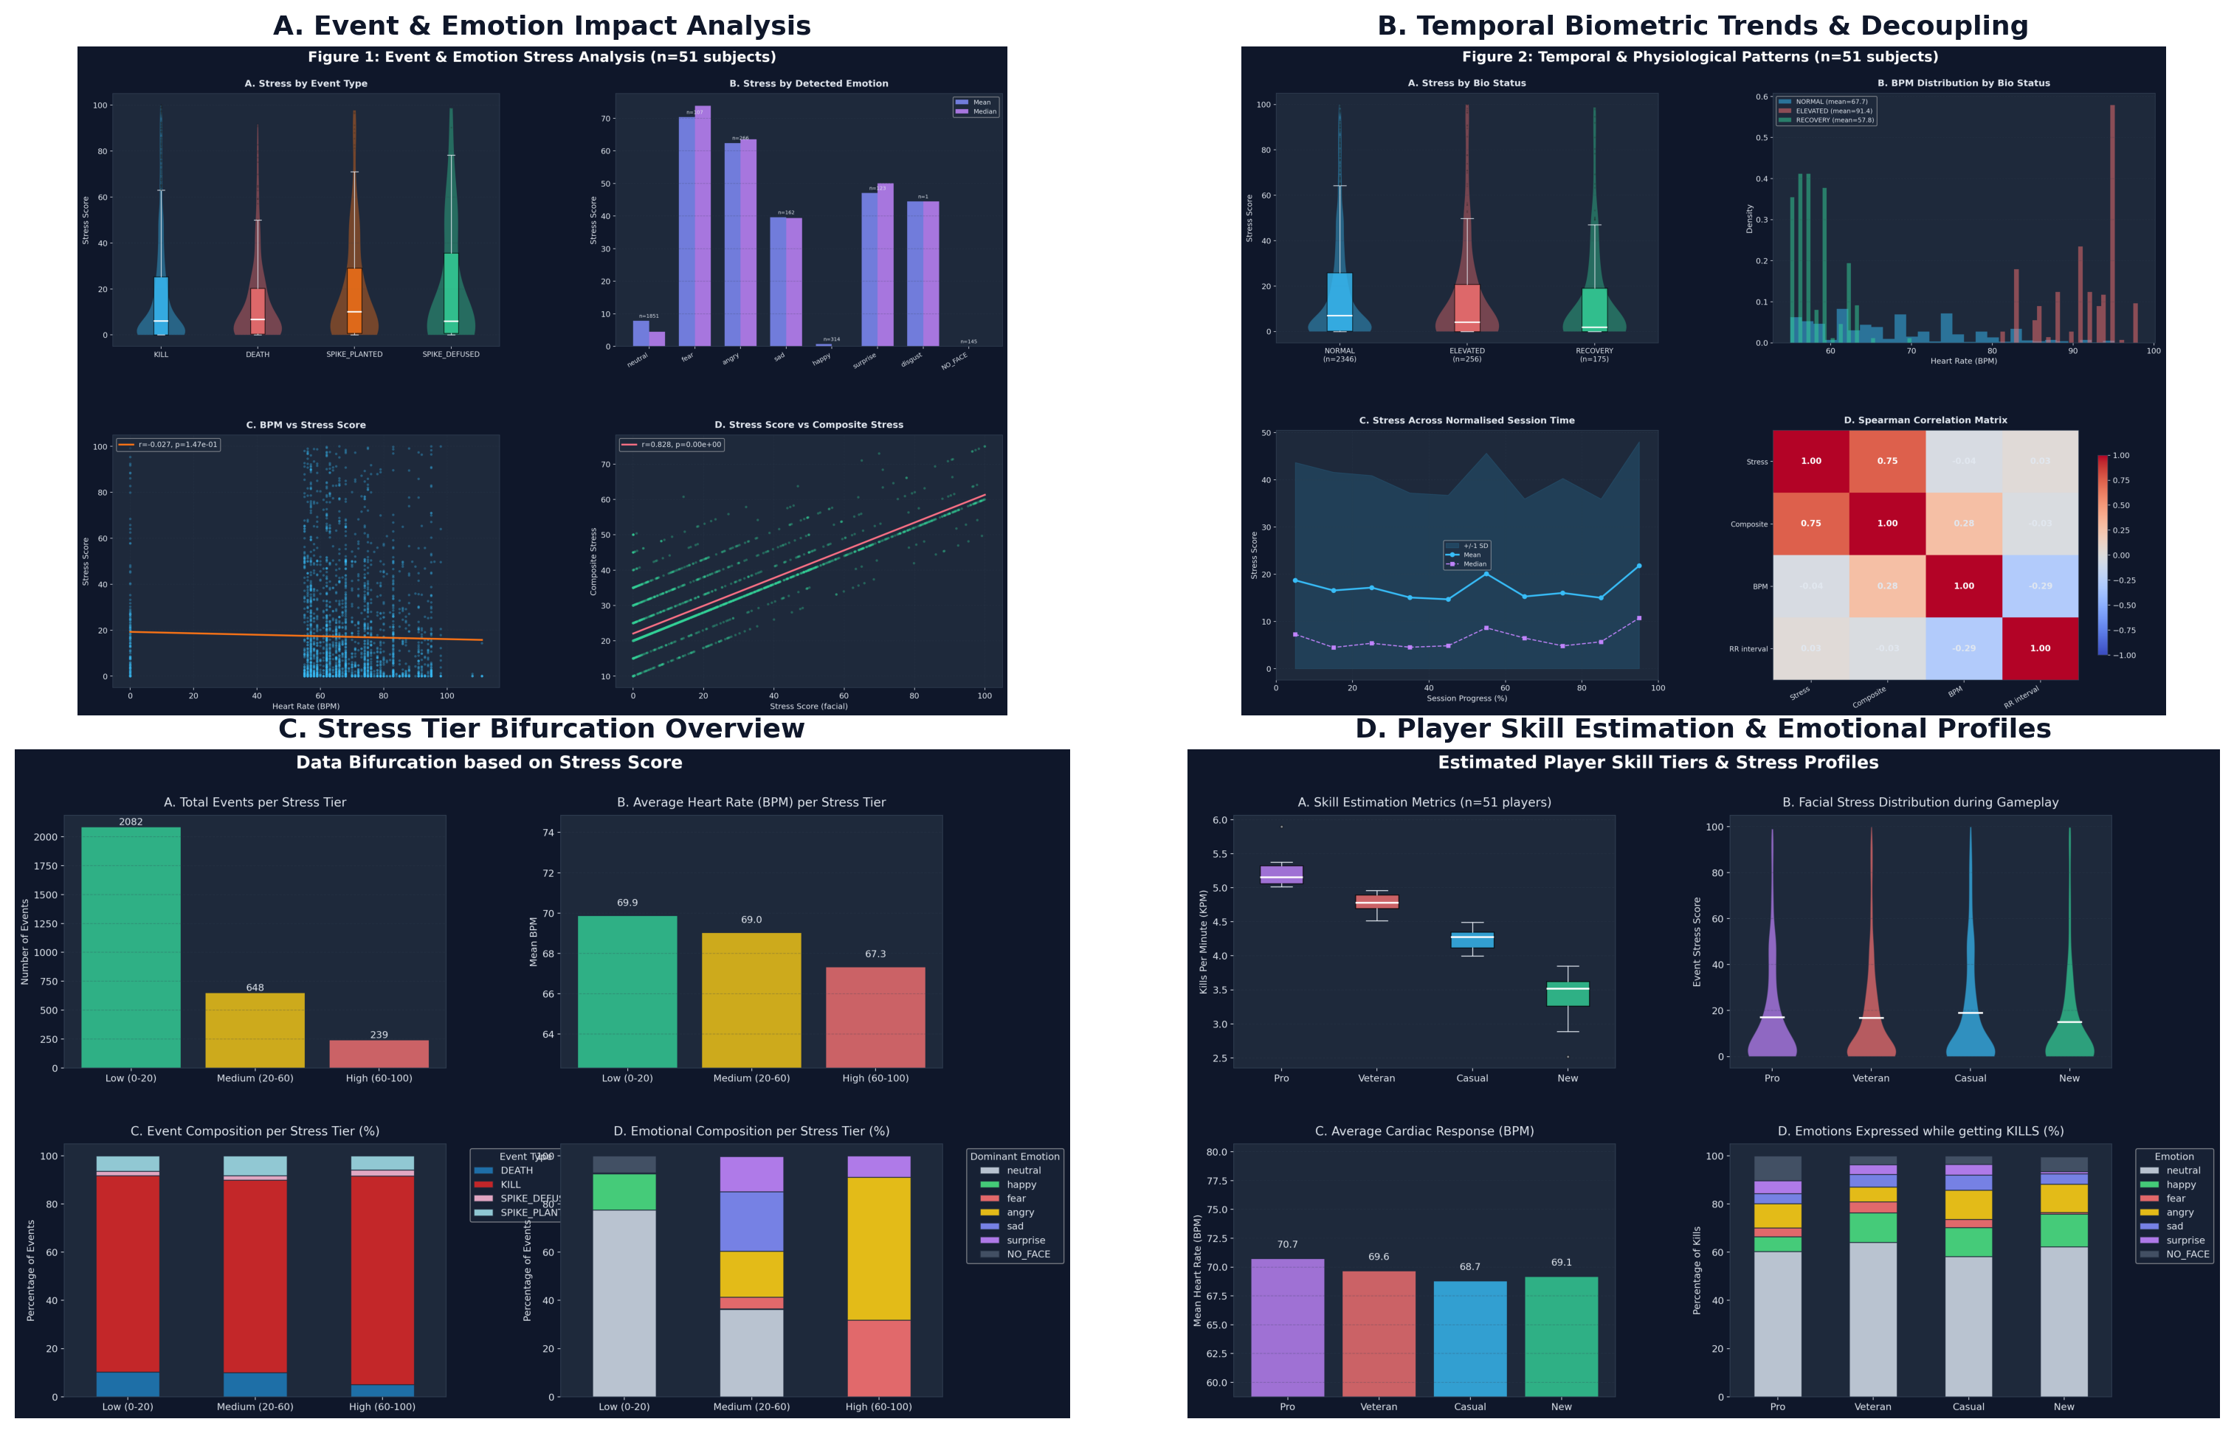
7. Dataset Visual Findings Overview

Slide 9
8. Data Bifurcation by Stress Score
• Low Stress (0-20): 70.1% of gameplay (baseline map navigation).
• Medium Stress (20-60): 21.8% of gameplay (angle holding / engagement).
• High Stress (60-100): 8.0% of gameplay (intense firefights).
• The 'Ice in the Veins' Effect: Heart rate drops slightly during peak facial stress (69.9 -> 67.3 BPM) as players hold their breath and lock focus during firefights.

Slide 10
9. Skill Tiers & Psychological Bell Curve
• Skill Proxy: Categorized into Pro, Veteran, Casual, and New based on Kills Per Minute (KPM).
• Physical Arousal: BPM scales linearly with skill (Pros avg 70.7 BPM due to aggressive play-style).
• Psychological Bell Curve: Casual players exhibit the highest facial stress (18.1 avg) due to frustration without total mastery.
• KILLS Emotions: Pros express Anger/Surprise (aggressive focus), while Casuals express Fear during kills.

Slide 11
10. Dataset Packaging, Contents & Schema
• Packaging & Directory: 51 CSV files consolidated in All_CSVs directory.
• Size & Scale: ~265 KB total storage size across 2,969 processed biometric rows.
• Sanitization: Scrubbed raw image file paths (image_file) to protect participant privacy.
• Schema & Descriptions: Generated dataset_schema.json, 51 schema_SUBxxx.json files, and README.md Data Dictionary describing all 11 columns (timestamp, event, player, victim, weapon, bpm, rr_ms, bio_status, dominant_emotion, stress_score, composite_stress).

Slide 12
11. Sample PyTorch Dataset Loader
# Sample PyTorch Dataset Class (pytorch_dataset_loader.py) import os, glob, torch, pandas as pd, numpy as np from torch.utils.data import Dataset, DataLoader class GamingBiometricDataset(Dataset): def __init__(self, csv_dir, exclude_failures=True): files = sorted(glob.glob(os.path.join(csv_dir, "*.csv"))) if exclude_failures: files = [f for f in files if not any(s in f for s in ["SUB037", "SUB038"])] frames = [pd.read_csv(f) for f in files] self.df = pd.concat(frames, ignore_index=True) # Categorical Encodings self.event_m = {"KILL":0, "DEATH":1, "SPIKE_PLANTED":2, "SPIKE_DEFUSED":3} self.emo_m = {"neutral":0, "happy":1, "sad":2, "surprise":3, "fear":4, "angry":5, "NO_FACE":6} self.df["event_id"] = self.df["event"].map(self.event_m).fillna(0).astype(int) self.df["emotion_id"] = self.df["dominant_emotion"].map(self.emo_m).fillna(0).astype(int) # Measured Features X vs Derived Targets Y self.features = self.df[["bpm", "rr_ms", "emotion_id", "event_id"]].values.astype(np.float32) self.targets = self.df[["stress_score", "composite_stress"]].values.astype(np.float32) def __len__(self): return len(self.features) def __getitem__(self, idx): return torch.tensor(self.features[idx]), torch.tensor(self.targets[idx])

