Slide 1
Anomaly Detection in Valorant Biometrics
Identifying Errors and Extreme Responses
Dataset: 51 Subjects

Slide 2
1. Methodology
Multi-method anomaly detection pipeline:
Data Integrity Checks: Missing values, duplicate timestamps
Statistical Outliers: Z-score and IQR bounds
Temporal Anomalies: Burst events and session lengths
Multivariate Detection: Isolation Forest & Mahalanobis distance

Slide 3
2. Critical Hardware Failures
Not all data is usable. Identified complete or partial sensor failures:
SUB037: 100% BPM=0 (Complete failure)
SUB038: 100% BPM=0 (Complete failure)
Action taken: These subjects must be excluded from cardiac (BPM) analysis.

Slide 4
3. Logical Consistency (Good News)
The dataset is highly consistent logically:
0 contradictions between Emotion and Stress (Happy always = 0 stress).
0 impossible physiological values (Stress strictly bounded 0-100).
Bio-status markers perfectly align with BPM thresholds.

Slide 5
4. Cohort Outliers (Extreme Responders)
Some subjects exhibit unusually extreme stress responses compared to the group:
SUB032: Mean stress 47.8 (Z-score: +3.08). Highly reactive.
SUB025: Identified as highly anomalous by Isolation Forest (21% of events) due to rare combinations of extreme stress and high BPM.

Slide 6
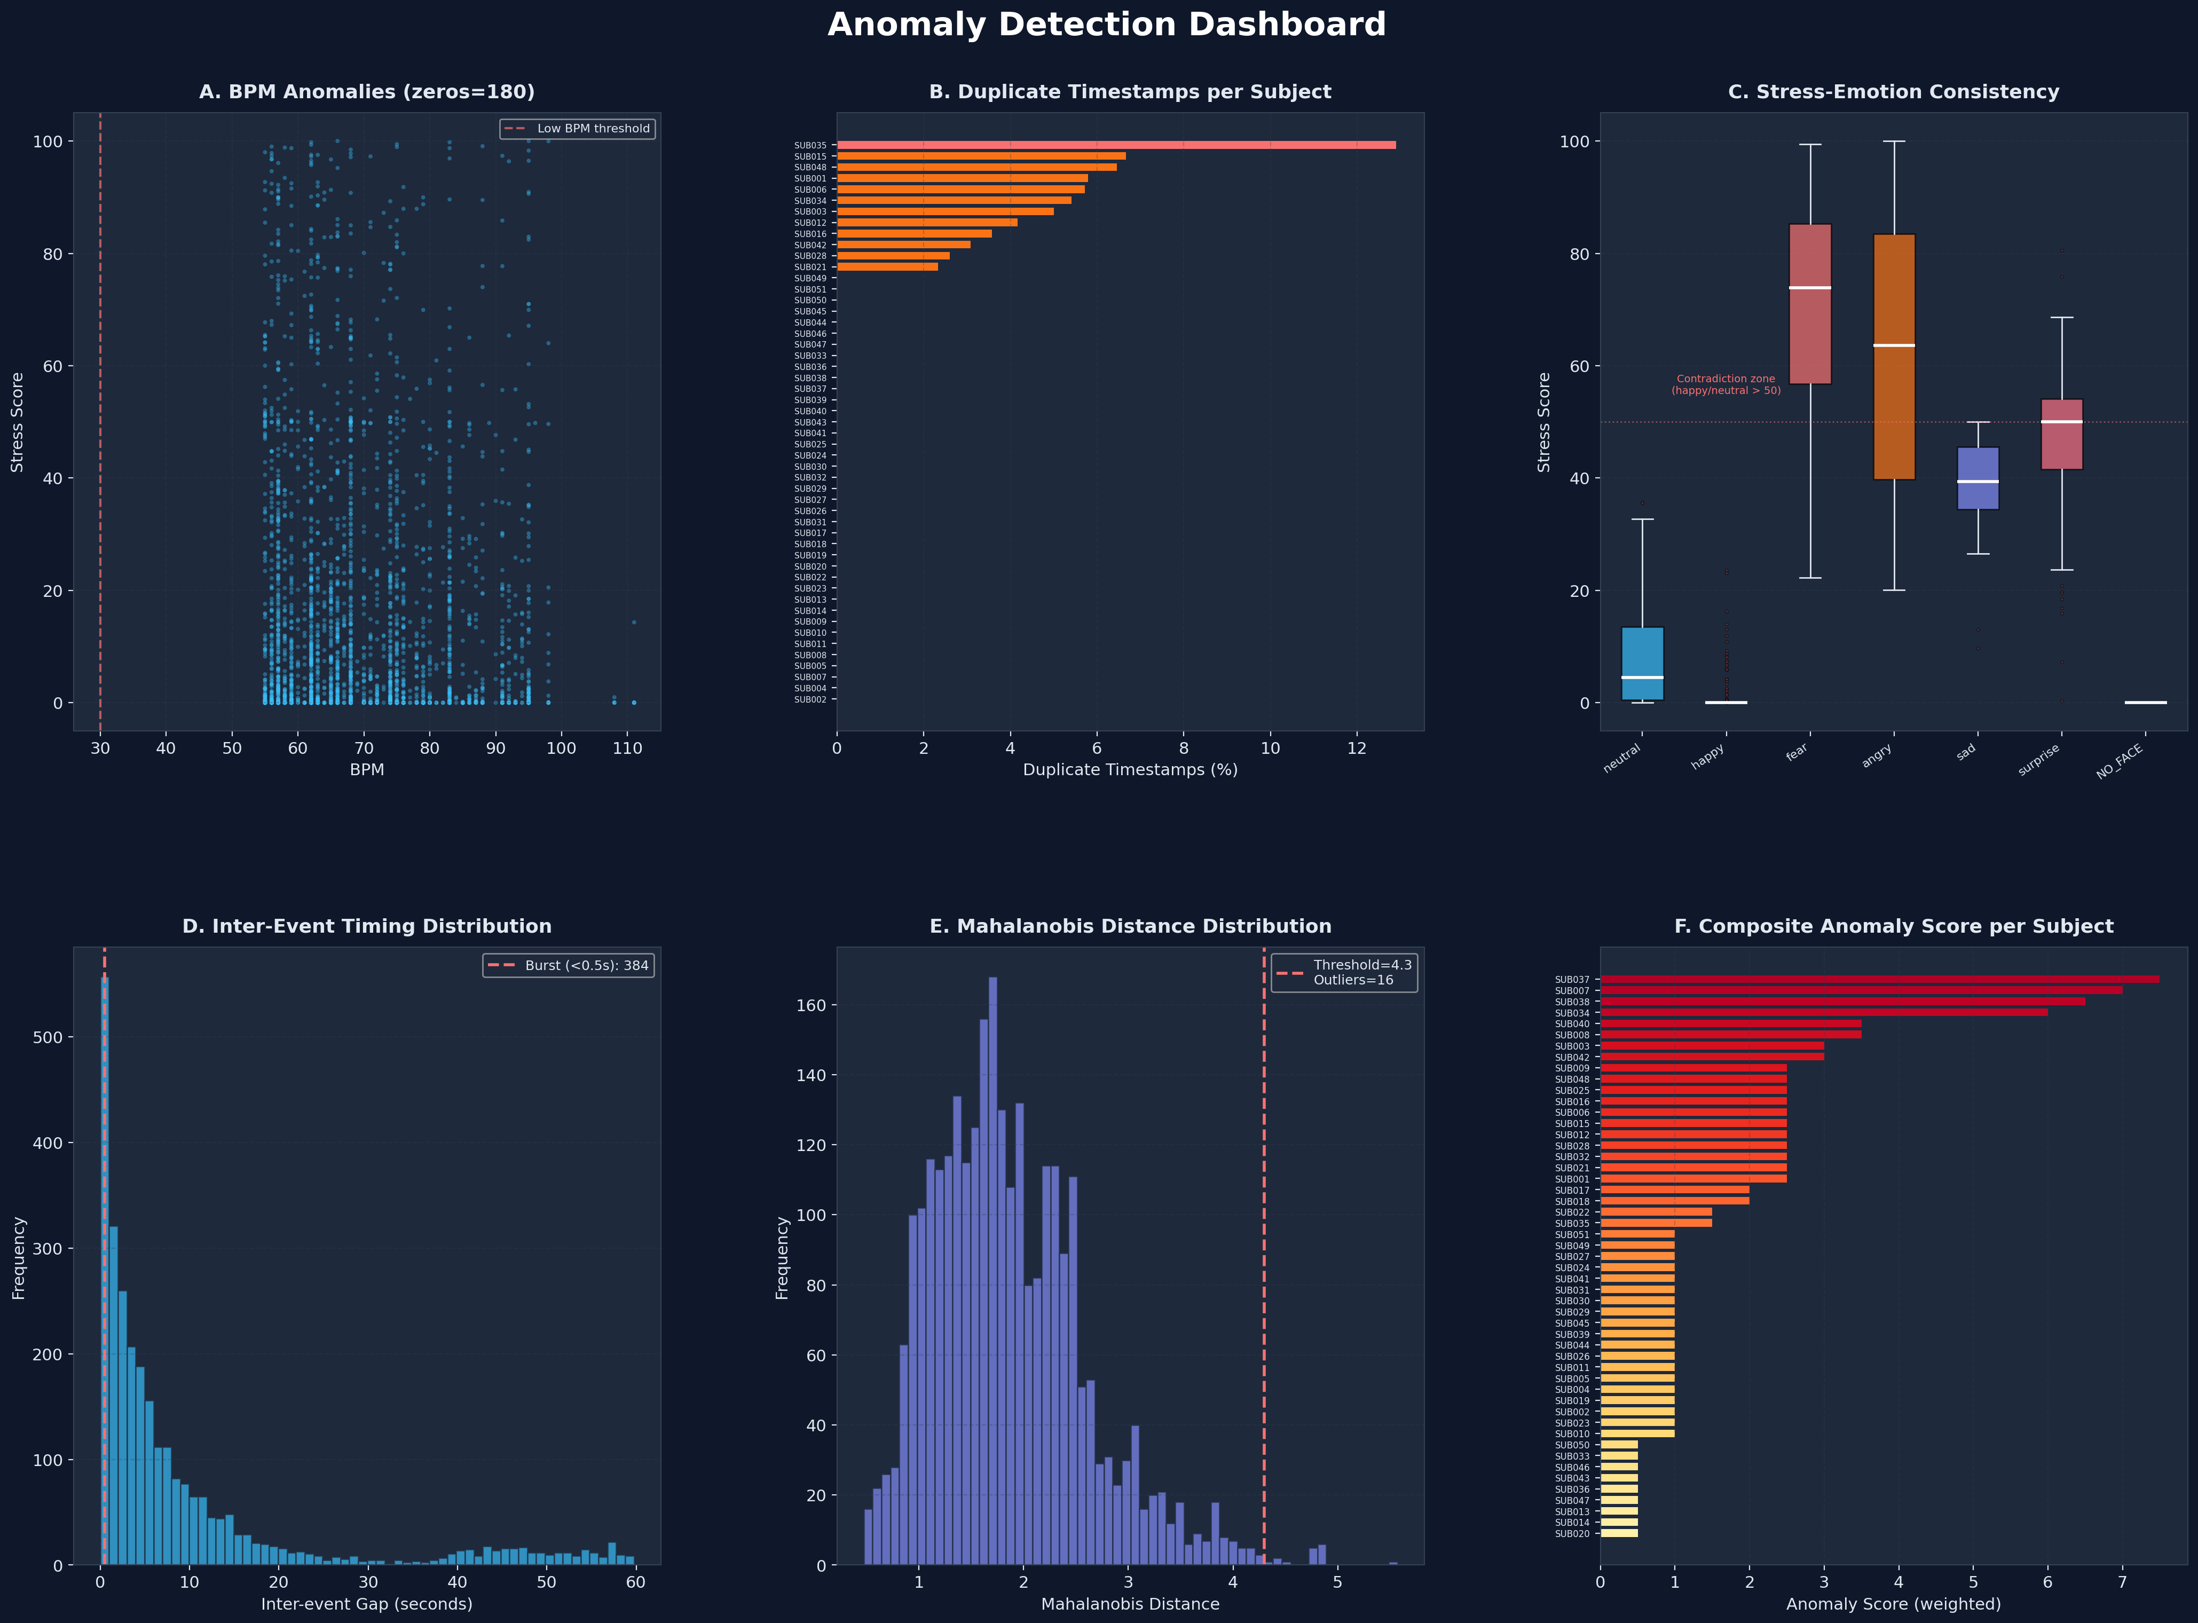
5. Visual Dashboard

Slide 7
6. Conclusion
The dataset is generally clean and robust.
Excluding the 2 hardware-failure subjects yields a highly reliable dataset.

