Slide 1
Trend & Temporal Analysis
Understanding Stress Over Time and Across Events

Slide 2
1. Temporal Trends (Habituation)
Does playing Valorant make you more stressed over time?
Finding: Stress remains strikingly flat across the session.
There is no 'warm-up' period and no 'fatigue' drop-off.
Valorant successfully sustains a constant baseline level of tension.

Slide 3
2. Decoupling Heart Rate and Facial Stress
Cardiac Response and Facial Expression measure two different types of stress.
Pearson Correlation: r = -0.027
They are statistically independent.
A high heart rate does not guarantee an angry/fearful facial expression.

Slide 4
3. What Drives Facial Stress? (Emotions)
Facial Emotion is the #1 predictor of the Stress Score (p<0.001).
Fear (Mean Stress: 70.4)
Anger (Mean Stress: 62.4)
Neutral (Mean Stress: 7.9)

Slide 5
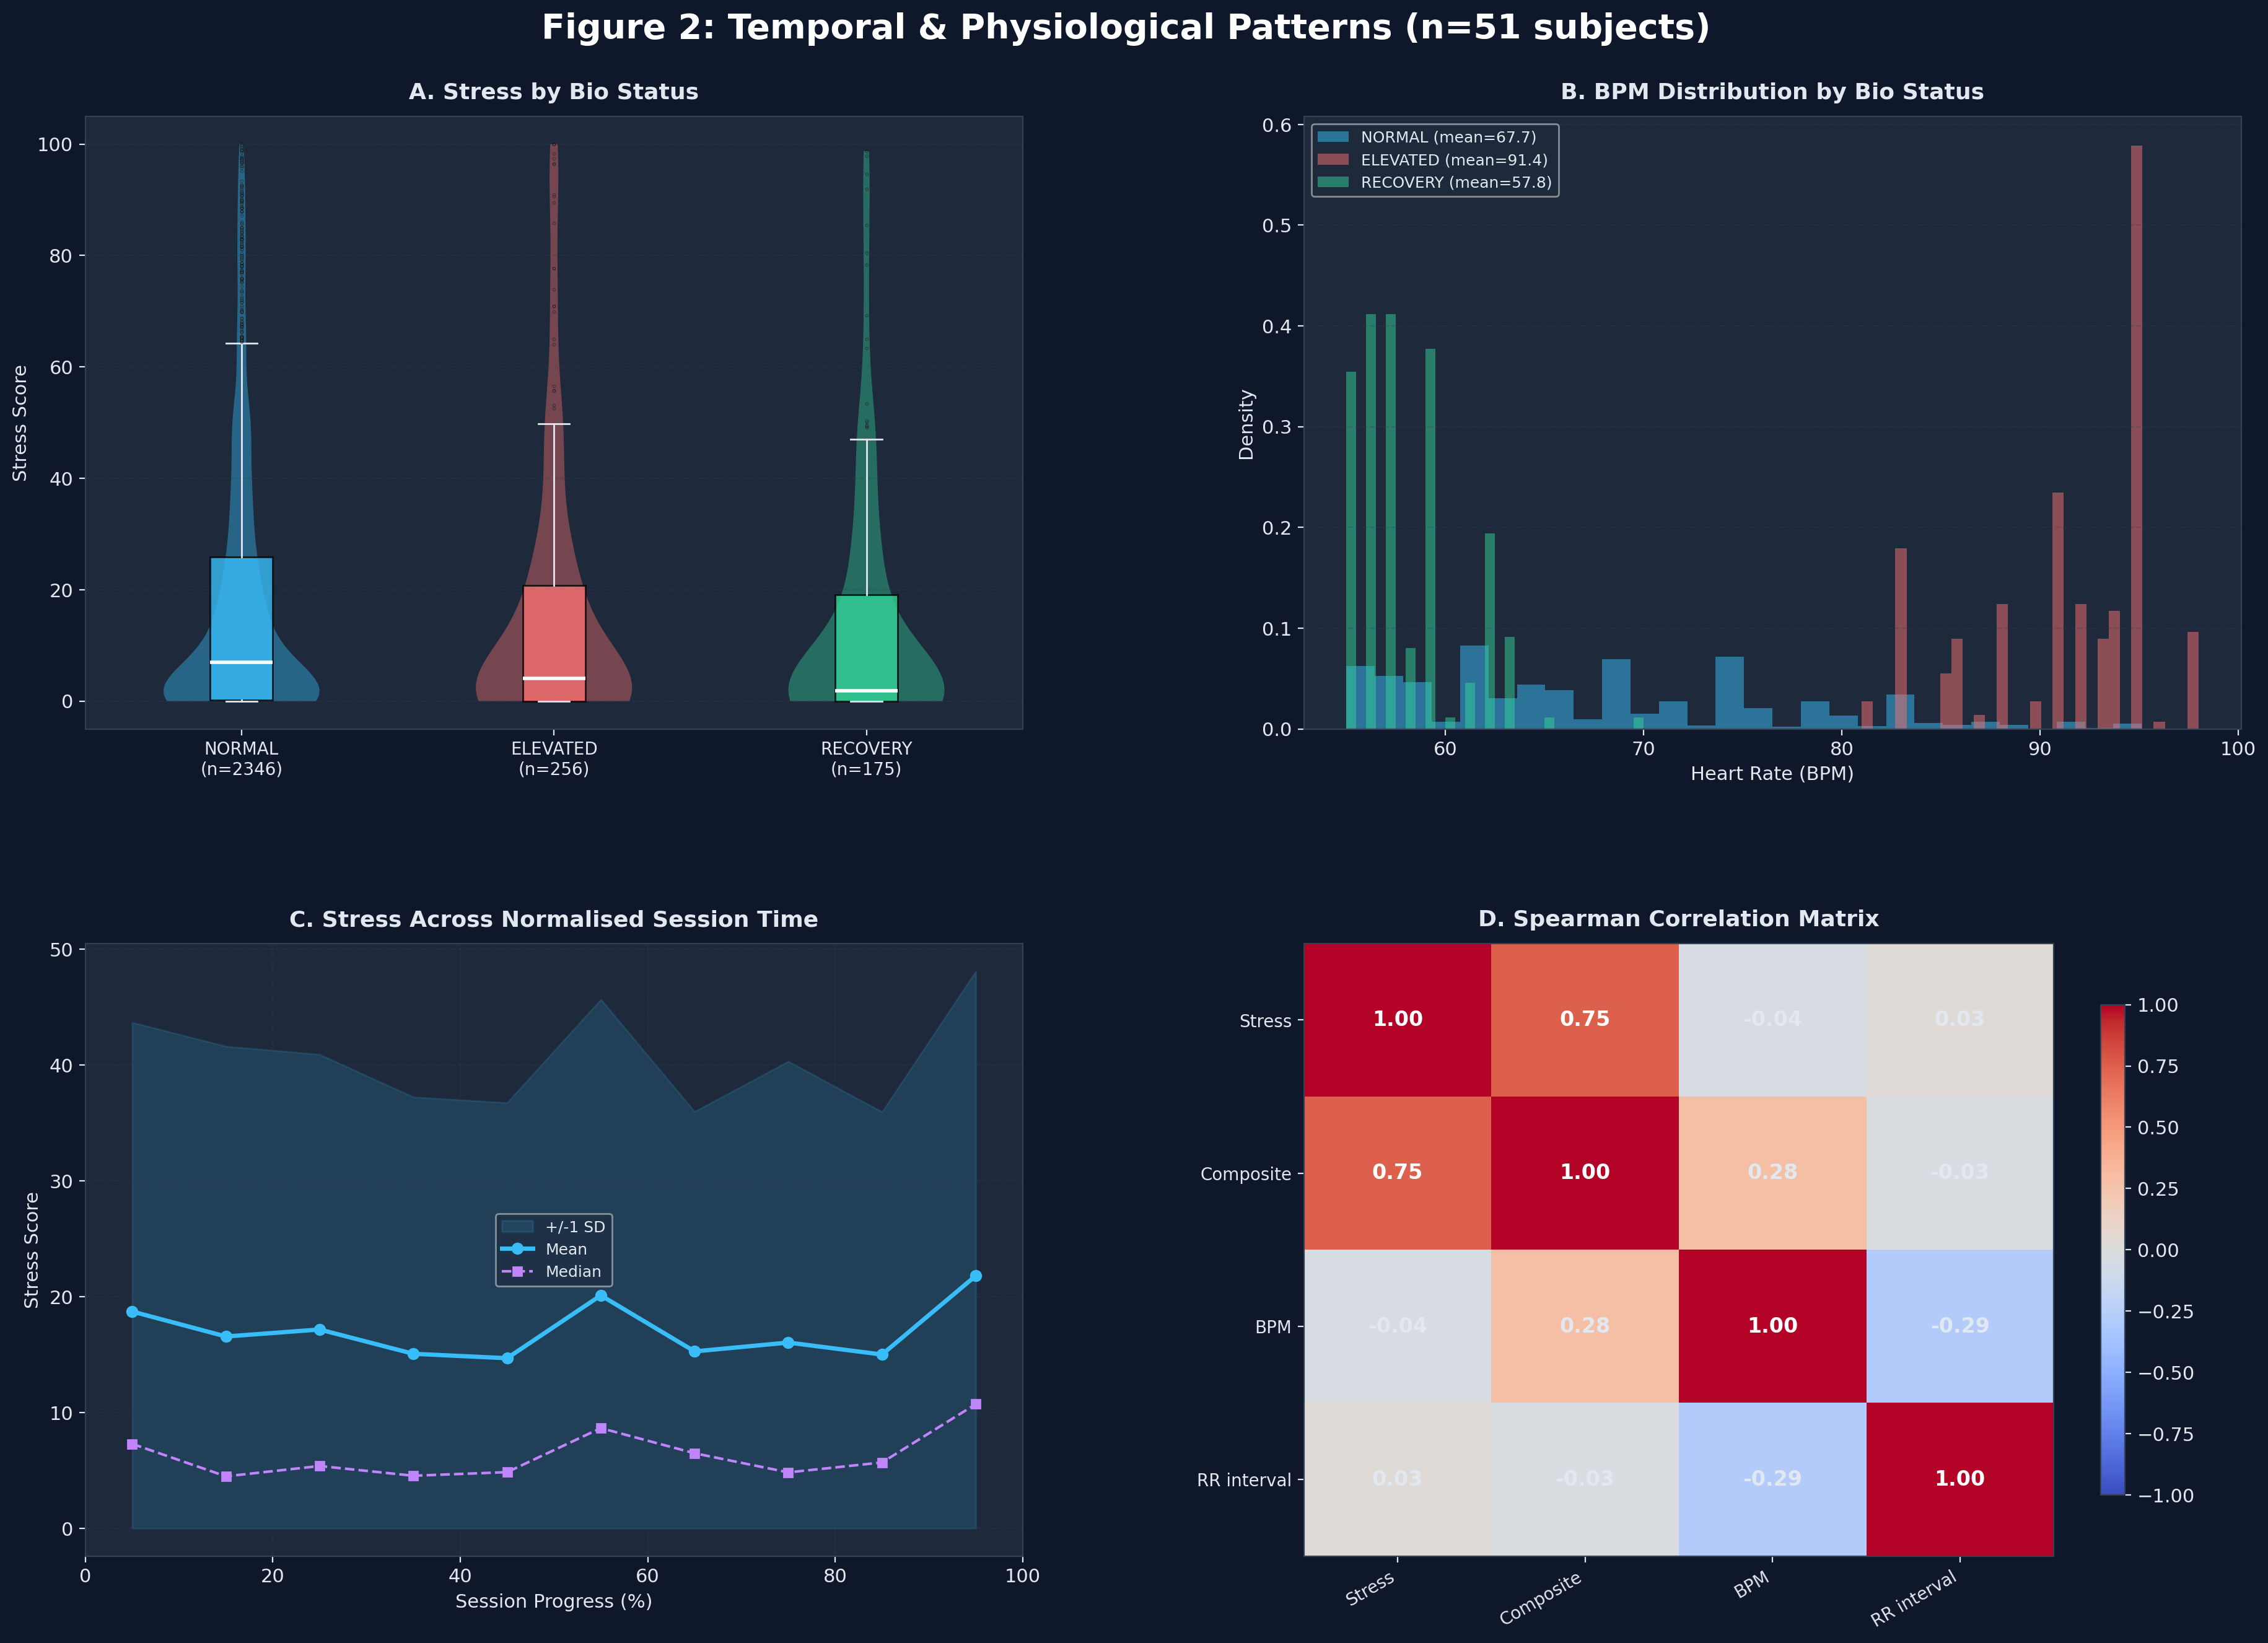
4. Visual Evidence: Temporal Trends

Slide 6
5. Key Takeaway
Valorant stress is episodic, not cumulative.
It is driven entirely by discrete micro-events (kills/fights) that trigger immediate emotional responses, rather than a slow build-up of physical tension over time.

