Slide 1
Player Skill Tiers
Estimating Expertise through Biometric Performance

Slide 2
1. Defining the Tiers
We categorized subjects by their aggression and impact (Kills Per Minute):
Pro (Top 15%): >5.2 KPM
Veteran (Next 35%): 4.7 - 5.2 KPM
Casual (Next 35%): 3.8 - 4.7 KPM
New Player (Bottom 15%): <3.8 KPM

Slide 3
2. Heart Rate Scales with Skill
Physical arousal directly correlates with skill level:
Pro: 70.7 BPM
Veteran: 69.6 BPM
Casual: 68.7 BPM
New Player: 69.1 BPM
Pros play a much faster, more aggressive game requiring higher cardiac output.

Slide 4
3. The Stress 'Bell Curve'
Psychological stress (facial expression) does not scale linearly:
Casuals show the highest facial stress (Avg 18.1). They understand the game but lack total mastery.
New Players show the lowest facial stress (Avg 14.4). They play passively.
Pros drop to a moderate stress level (Avg 17.0). Mastery allows them to remain facially composed.

Slide 5
4. Fear vs. Anger: The Emotion of a Kill
New Players & Casuals show significantly more Fear when getting a kill (chaotic survival).
Pros & Veterans show significantly more Anger and Surprise (aggressive focus).

Slide 6
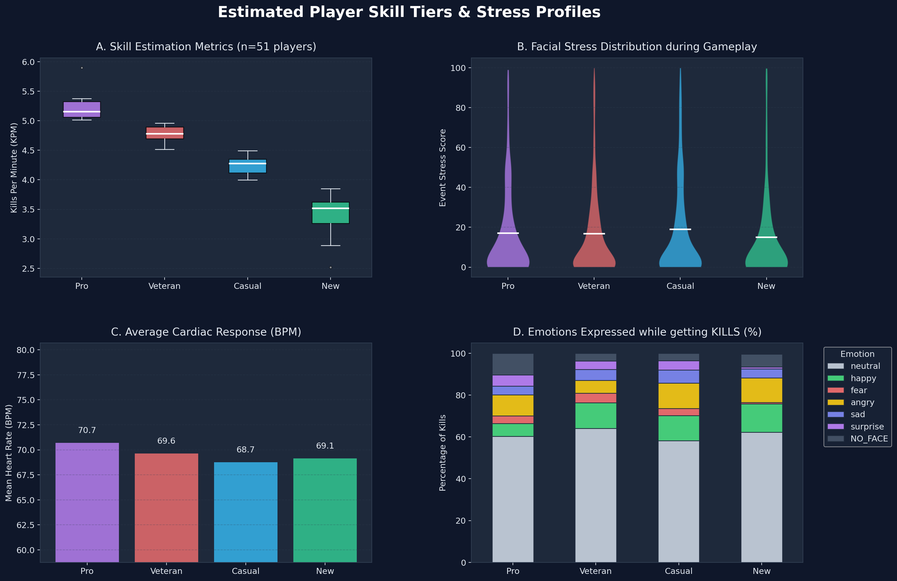
5. Visual Dashboard: Skill Estimation

