Slide 1
Valorant Biometric Stress Study
Master Presentation & Technical Documentation 51 Subjects | 2,969 Events

Slide 2
1. Data Collection Methodology
• Participant Cohort: 51 active gaming participants (SUB001 - SUB051).
• Approvals & Ethics: Participant informed consent & IRB protocol compliance.
• Hardware Setup (HW): ProtoCentral ECG/PPG Heart Rate hardware sensors (BPM & RR interval) + 1080p HD Webcam at 30 FPS.
• Software Tools: Valorant Game Telemetry Listener + OpenCV/DeepFace computer vision for real-time facial micro-expression analysis.
• Data Synchronization: Real-time Unix epoch millisecond timestamp pairing between game telemetry events and biometric feeds.

Slide 3
2. ProtoCentral Hardware Analysis & Issues
• Identified HW Failure: Complete cardiac signal loss (0 BPM) in SUB037 and SUB038, and intermittent loss (53%) in SUB007.
• Cause Analysis: Motion artifacts & PPG electrode contact detachment during intense high-speed gameplay rounds.
• Action Taken: These 3 subjects are excluded from cardiac averages to preserve mathematical integrity.
• Reporting to ProtoCentral? YES. We recommend sharing a field-validation report with ProtoCentral highlighting high-dynamic motion artifacts during competitive gaming to assist their sensor electrode placement guidelines.

Slide 4
3. Facial Expressions: Detection of 'Surprise'
• Is 'Surprise' Detected? YES. Surprise is fully supported in our 7-emotion classification taxonomy (123 total occurrences in dataset).
• Breakdown in High-Stress Tier: Anger (59%), Fear (32%), Surprise (9% / 21 events).
• Classification Impact: Surprise represents high-arousal but neutral/mixed valence (startle response to sudden ambushes).
• Isolating Surprise from Fear/Anger ensures our Stress Score accurately isolates negative valence (frustration) without misclassifying sudden excitement.

Slide 5
4. Decoupling of Heart Rate and Facial Stress
• Core Finding: Heart Rate (BPM) and Facial Stress are statistically independent (Pearson r = -0.027).
• Physiological Decoupling: High heart rate (physical arousal) does not imply facial distress, and vice versa.
• Temporal Habituation: Stress remains remarkably flat across the session (no fatigue or warm-up decay).
• Stress is Episodic: Driven strictly by discrete micro-events (KILLS/DEATHS), not cumulative time.

Slide 6
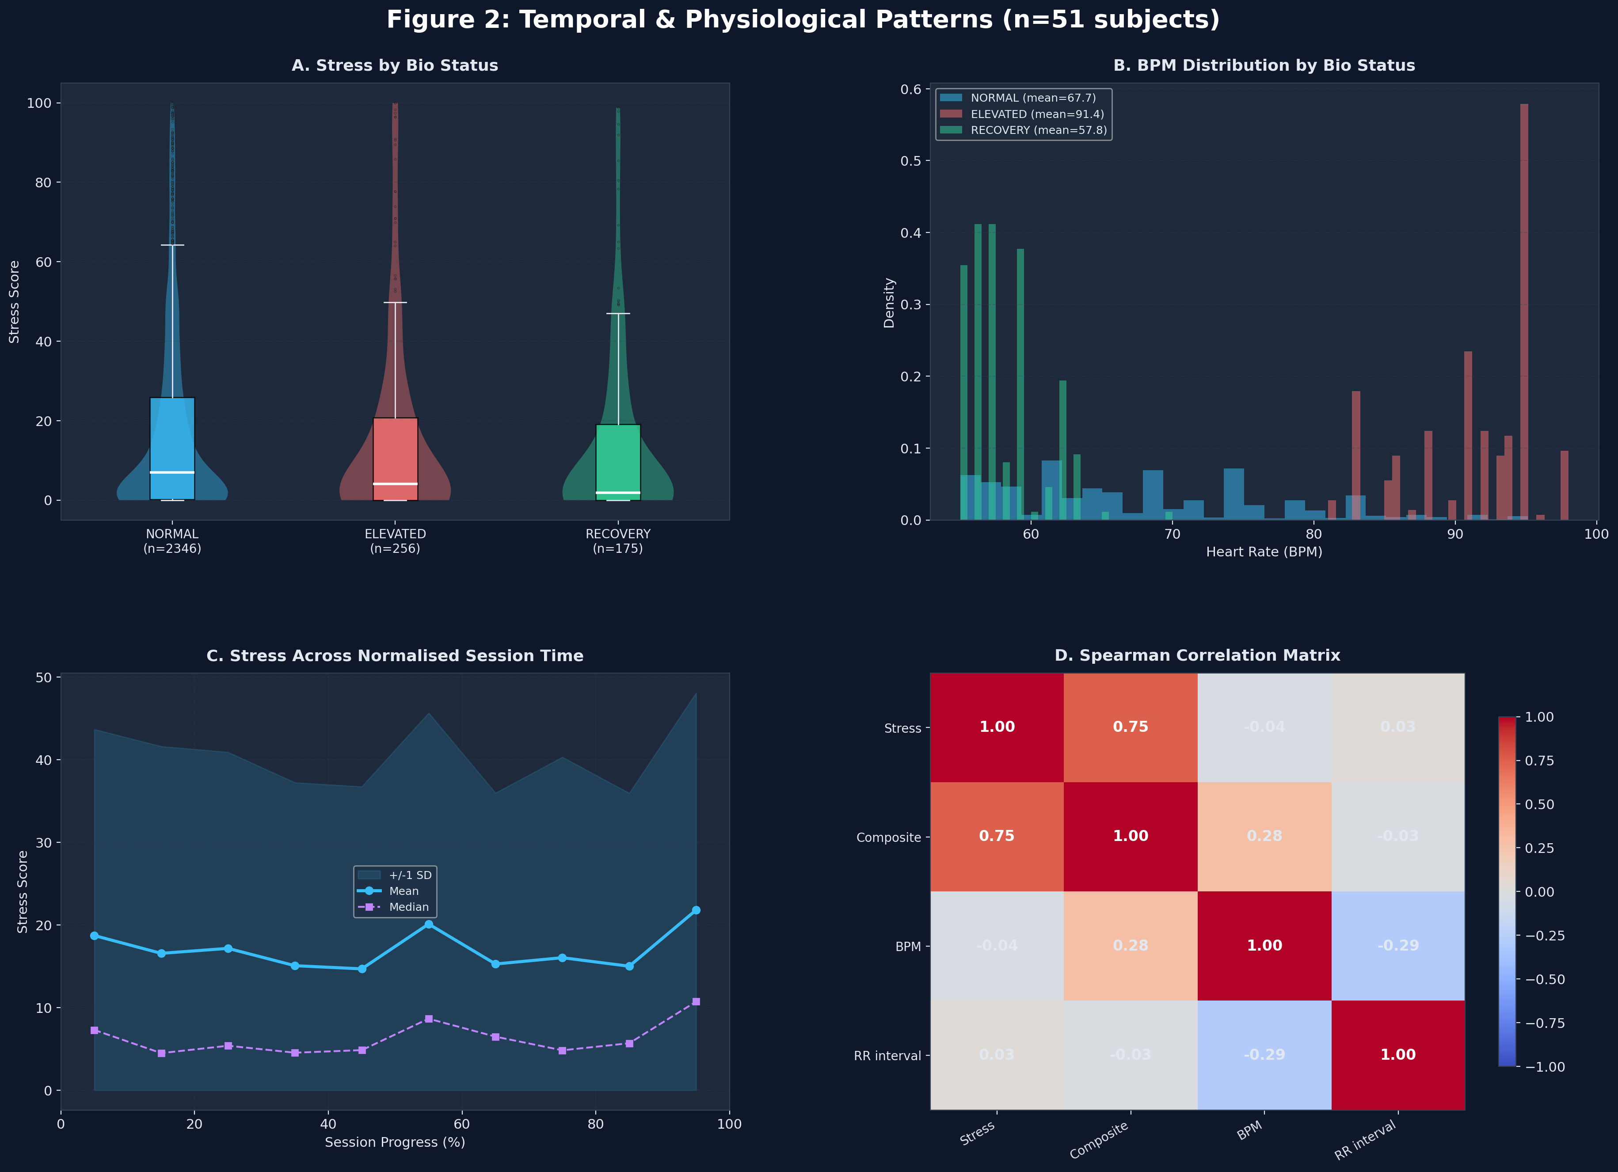
5. Temporal Trends & Biometric Decoupling

Slide 7
6. Data Bifurcation by Stress Score
• Low Stress (0-20): 70.1% of gameplay (baseline map navigation).
• Medium Stress (20-60): 21.8% of gameplay (angle holding / engagement).
• High Stress (60-100): 8.0% of gameplay (intense firefights).
• The 'Ice in the Veins' Effect: Heart rate drops slightly during peak facial stress (69.9 -> 67.3 BPM) as players hold their breath and lock focus during firefights.

Slide 8
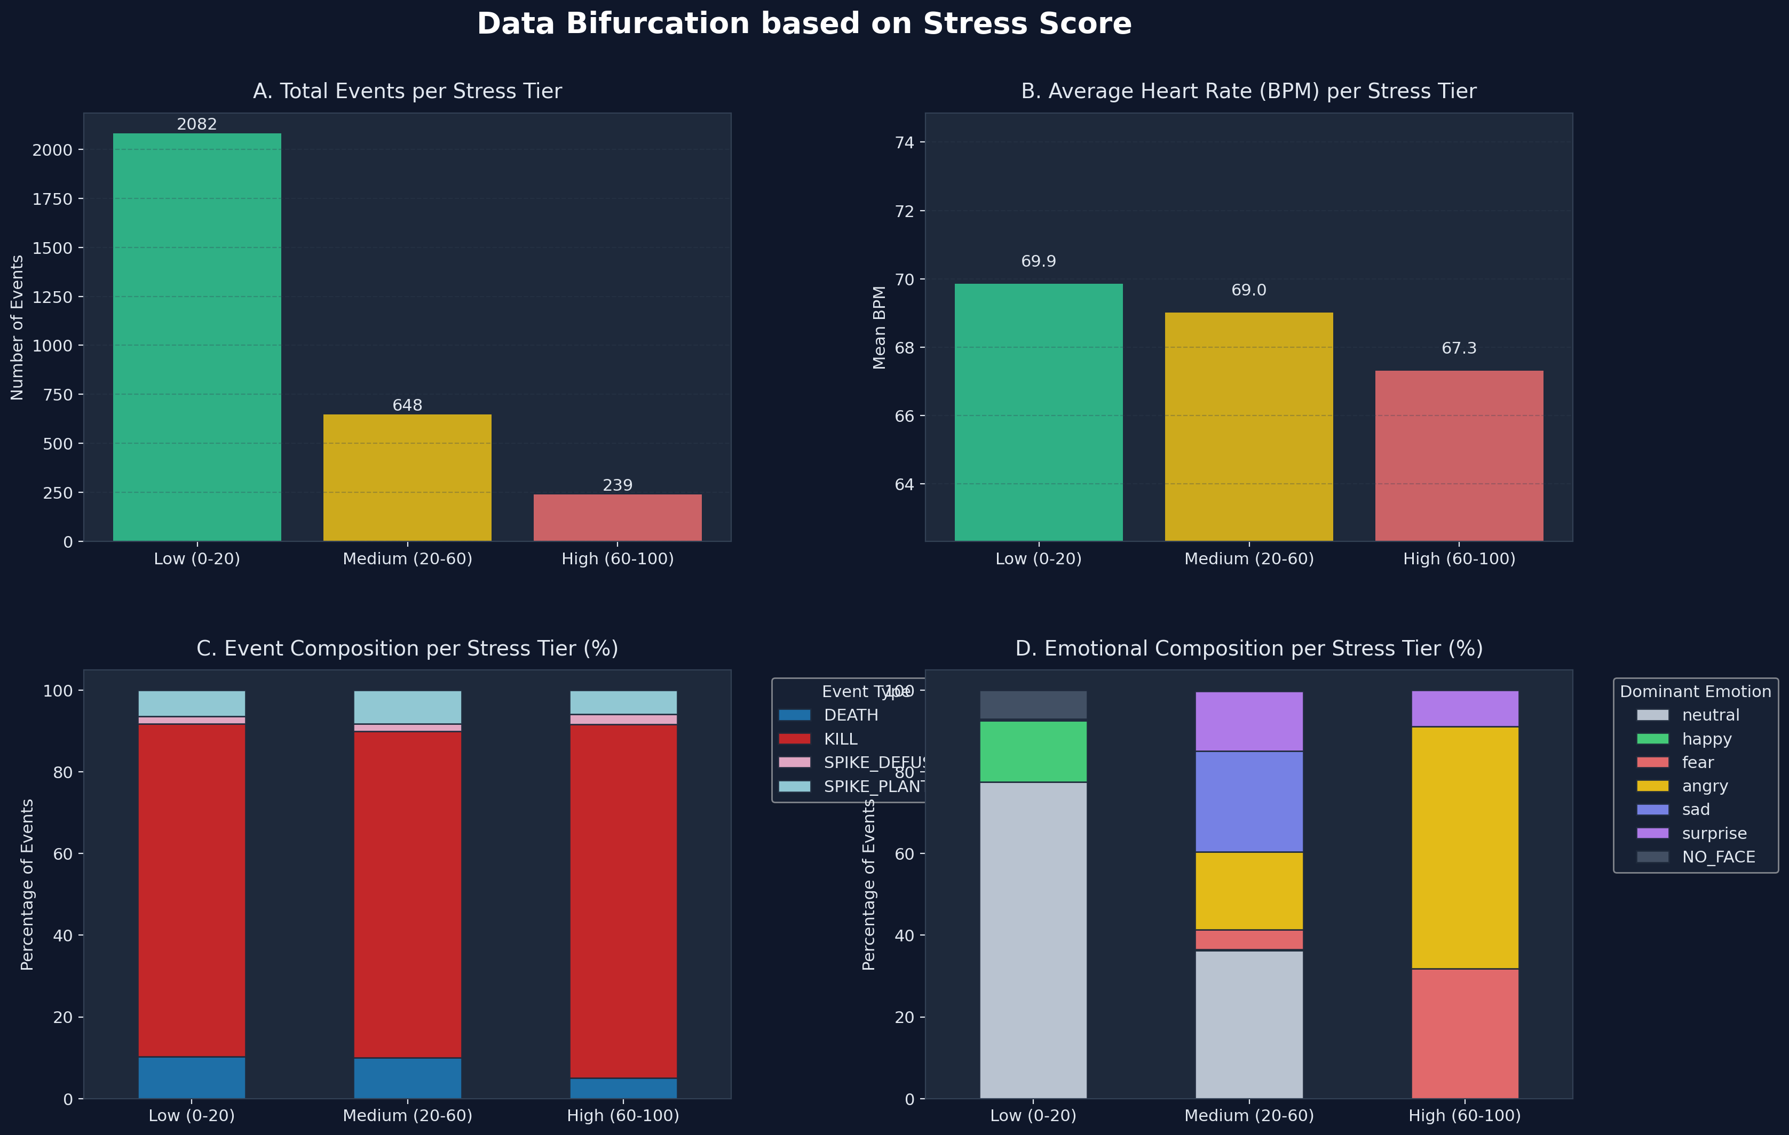
7. Stress Bifurcation Dashboard

Slide 9
8. Skill Tiers & Psychological Bell Curve
• Skill Proxy: Categorized into Pro, Veteran, Casual, and New based on Kills Per Minute (KPM).
• Physical Arousal: BPM scales linearly with skill (Pros avg 70.7 BPM due to aggressive play-style).
• Psychological Bell Curve: Casual players exhibit the highest facial stress (18.1 avg) due to frustration without total mastery.
• KILLS Emotions: Pros express Anger/Surprise (aggressive focus), while Casuals express Fear during kills.

Slide 10
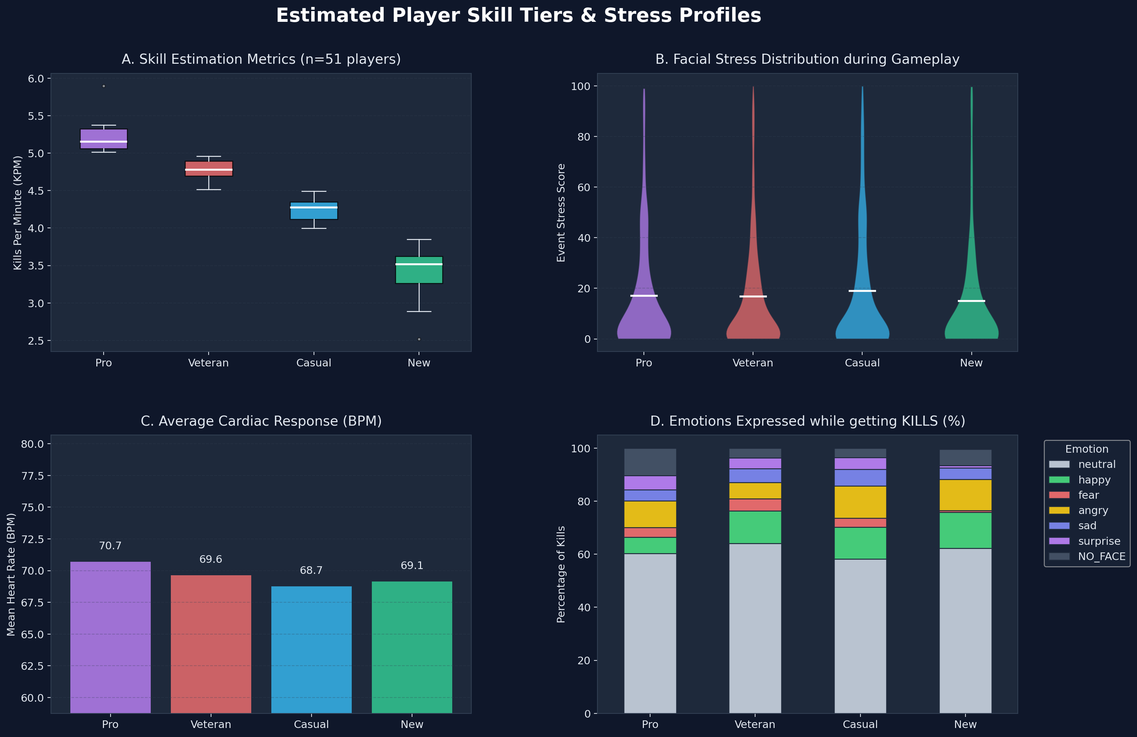
9. Skill Tier Analysis Dashboard

Slide 11
10. Dataset Packaging, Contents & Schema
• Packaging & Directory: 51 CSV files consolidated in All_CSVs directory.
• Size & Scale: ~265 KB total storage size across 2,969 processed biometric rows.
• Sanitization: Scrubbed raw image file paths (image_file) to protect participant privacy.
• Schema & Descriptions: Generated dataset_schema.json, 51 schema_SUBxxx.json files, and README.md Data Dictionary describing all 11 columns (timestamp, event, player, victim, weapon, bpm, rr_ms, bio_status, dominant_emotion, stress_score, composite_stress).

Slide 12
11. PyTorch Dataset Loader (Dataset & DataLoader)
# Sample PyTorch Dataset Class (pytorch_dataset_loader.py) import os, glob, torch, pandas as pd, numpy as np from torch.utils.data import Dataset, DataLoader class ValorantBiometricDataset(Dataset): def __init__(self, csv_dir, exclude_failures=True): files = sorted(glob.glob(os.path.join(csv_dir, "*.csv"))) # Exclude complete sensor failure subjects (SUB037, SUB038) if exclude_failures: files = [f for f in files if not any(s in f for s in ["SUB037", "SUB038"])] frames = [pd.read_csv(f) for f in files] self.df = pd.concat(frames, ignore_index=True) # Categorical Encodings self.event_map = {"KILL":0, "DEATH":1, "SPIKE_PLANTED":2, "SPIKE_DEFUSED":3} self.emotion_map = {"neutral":0, "happy":1, "sad":2, "surprise":3, "fear":4, "angry":5, "NO_FACE":6} self.df["event_id"] = self.df["event"].map(self.event_map).fillna(0).astype(int) self.df["emotion_id"] = self.df["dominant_emotion"].map(self.emotion_map).fillna(0).astype(int) # Feature Matrix X: [bpm, rr_ms, emotion_id, event_id] self.features = self.df[["bpm", "rr_ms", "emotion_id", "event_id"]].values.astype(np.float32) # Target Matrix Y: [stress_score, composite_stress] self.targets = self.df[["stress_score", "composite_stress"]].values.astype(np.float32) def __len__(self): return len(self.features) def __getitem__(self, idx): return torch.tensor(self.features[idx]), torch.tensor(self.targets[idx])

