Slide 1
Memory Protection Features in ARM and Linux
Prabindh Sundareson

Slide 2
Contents
Security features in ARM HW
  Memory Protection
Memory Protection Status in Software
  Linux
  Android
External security frameworks

Slide 3
Memory Protection Features in ARM
Derived from Page Table entries, applicable to different types of pages
  pages, sections …
Consists of Read-Only (RO), and Execute Never (XN)
This is available in ARMv6 and above systems, only with MMU enabled
Memory protection is a combination of HW, Kernel usage of HW features, and information embedded in userland applications by toolchain for region protection

Slide 4
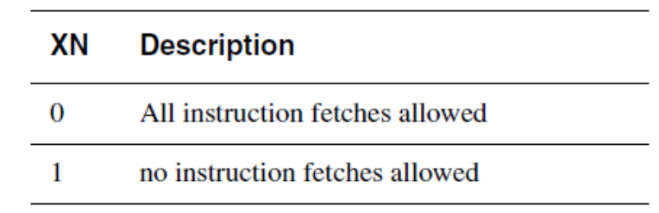
Execute Never (XN)
Part of First and Second Level Page Table Entries
A15 adds an extra entity - PXN (Privileged XN)

Slide 5
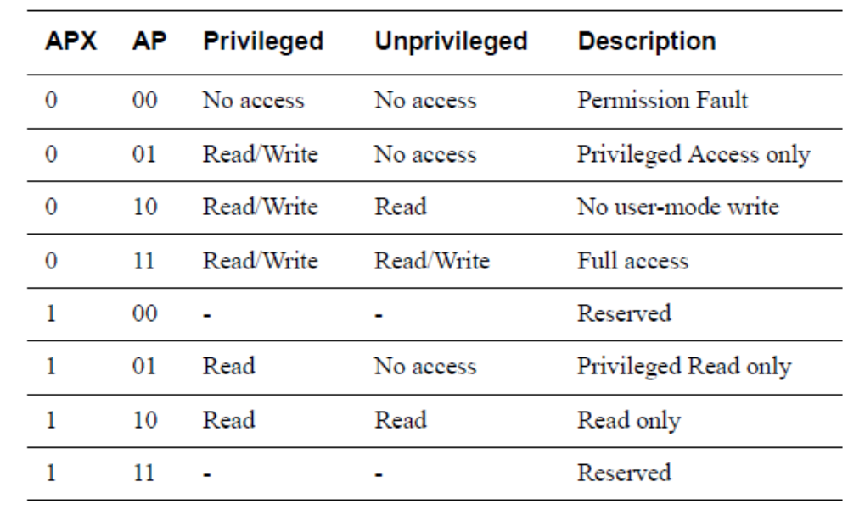
Read Only (RO)
Part of AP and APX Data Access Permissions in Page Table entry

Slide 6
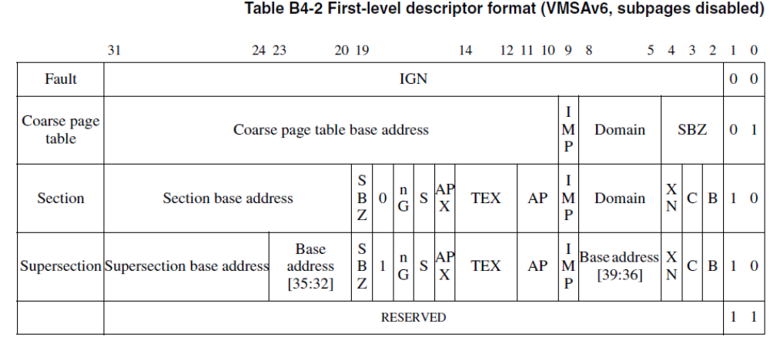
ARM First Level Descriptor

Slide 7
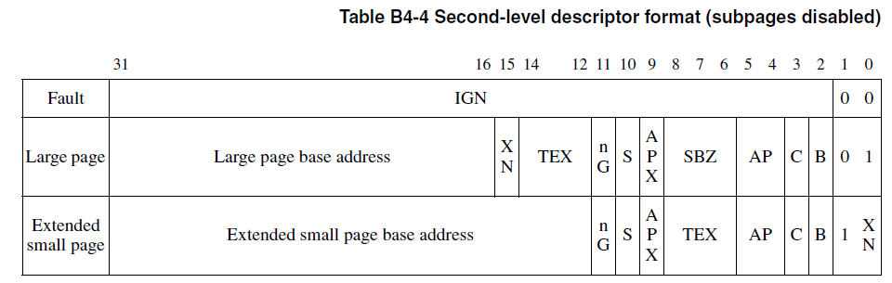
ARM Second Level Descriptor

Slide 8
Linux handling of Page Tables
Linux standardises Page Table across architectures, independent of specific HW – x86, ARM or other
  Linux bit encodings are different from that of ARM Page Table entries, but mapping is straightforward to an extent

Slide 9
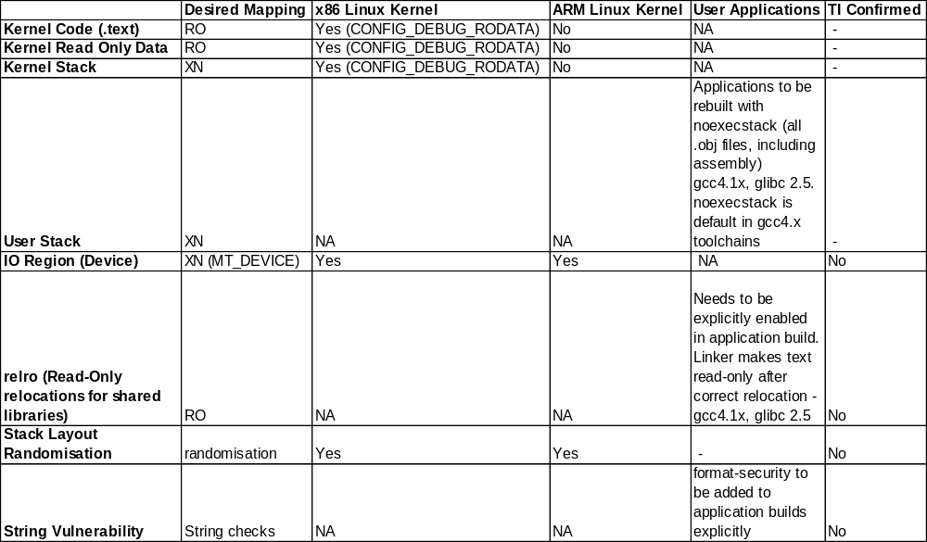
Native Linux – Memory Protection Status
Note –
1. All object files in an application have to be built with noexecstack, including assembly.
Even if one file is not built with this, the entire application is built without XN for the stack
2. Xorg, some media players in Linux are reported to have issues with XN in stack
3. This status is as of Sep 2012

Slide 10
Other Security Techniques
Commonly used are - grsecurity, PaX
These are not in mainline Linux kernel including for ARM, and need to be applied separately
grsecurity provides kernel hardening features (ex devmem, ports)
PaX provides memory protection features (including XN emulation)
These also include patches for toolchains to ensure protection mapping

Slide 11
Android Status
Starting from Android 2.3 onwards, Android adds
  Address space layout (ASLR) randomisations
  Support for XN
  Other features described in (http://source.android.com/tech/security/)

Slide 12
References
MT_DEVICE ioremap
  http://lkml.indiana.edu/hypermail/linux/kernel/1108.2/02745.html
GCC patch for GNU-STACK
  https://android.googlesource.com/toolchain/gcc/+/f68bf0c483879d30c4d97b9eaf8f9eb558ea1c45%5E1..f68bf0c483879d30c4d97b9eaf8f9eb558ea1c45/
Russell King on .text RO
  http://www.spinics.net/lists/arm-kernel/msg120951.html
Bypassing XN/ ASLR
  http://www.phrack.org/issues.html?issue=58&id=4#article
Grsecurity Patchset for 3.x
  http://mirrors.muarf.org/grsecurity/stable/grsecurity-2.9-3.2.18-201206011935.patch.gz
Gentoo Hardened
  http://www.gentoo.org/proj/en/hardened/pax-quickstart.xml
Ubuntu Security
  https://wiki.ubuntu.com/Security
ROM filesystems and booting
  http://elinux.org/images/b/b1/Filesystems-for-embedded-linux.pdf
  http://lugatgt.org/content/booting.inittools/downloads/presentation.pdf
  http://processors.wiki.ti.com/index.php/Creating_a_Root_File_System_for_Linux_on_OMAP35x#Configure_the_Linux_Kernel_for_RAMDISK_support
Loadable Kernel Modules - introduction
  http://www.ibm.com/developerworks/linux/library/l-lkm

Slide 13
Linux Kernel References
ELF loading
  arch/arm/kernel/elf.c b/arch/arm/kernel/elf.c, fs/binfmt_elf.c
    Contains elf loading and protection settings based on elf information
Page Table operations
    arch\arm\include\asm\pgtable-2level-types.h
    arch\arm\include\asm\pgtable-2level-hwdef.h
    arch\arm\include\asm\pgtable.h
    arch\arm\mm\mmu.c

