Slide 1
Software for Education Tablet - TI
Prabindh Sundareson

Slide 2
Agenda
Education Market
Key System Requirements
Key Software Requirements
TI Software for Education Tablet Market
Flash10 Software on Cortex-A8 SOCs
Roadmap

Slide 3
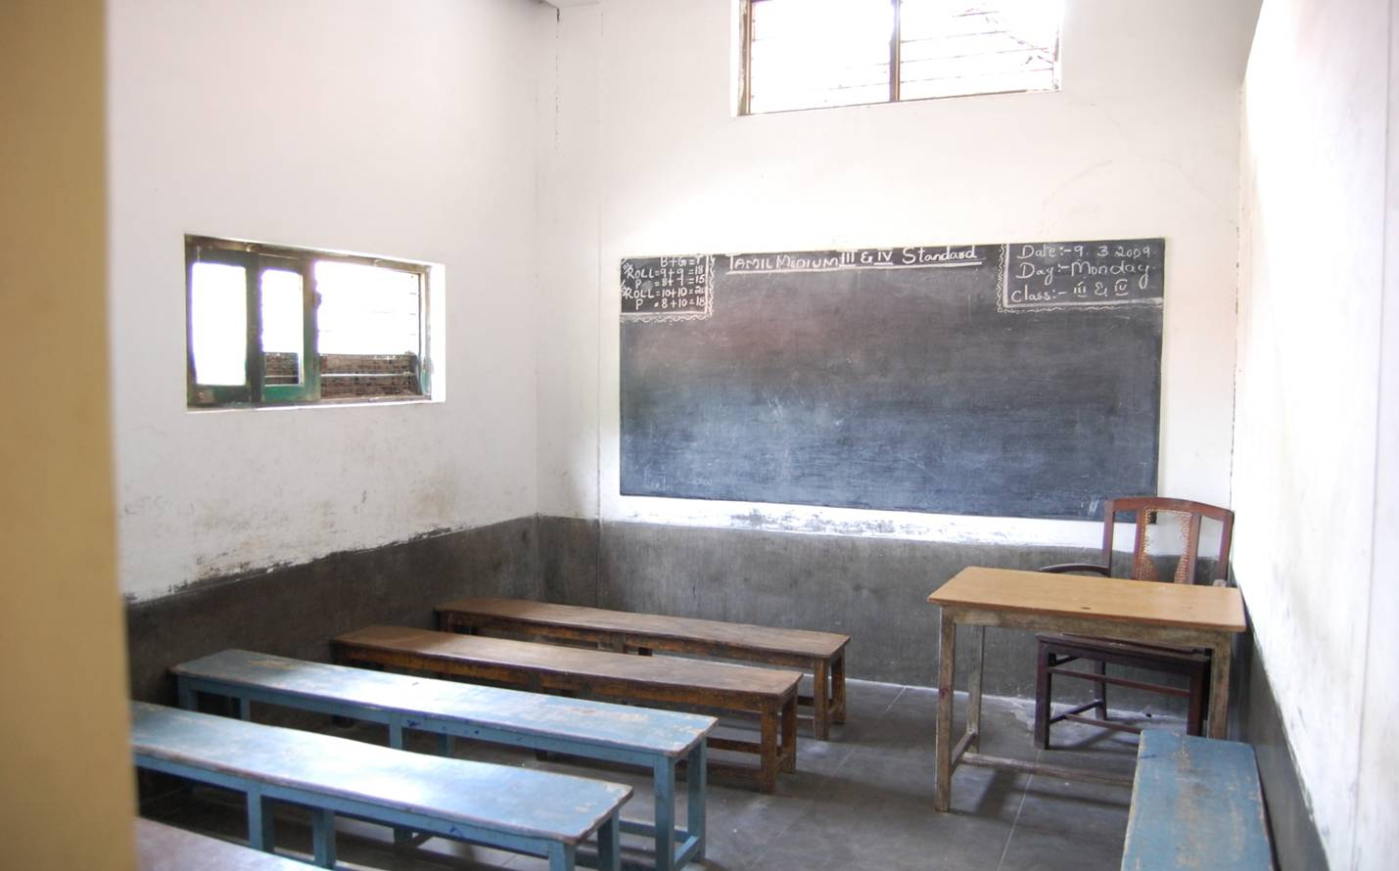
Education Market
Student population of more than 200 million in India
Dropout rate high
Only 12 million join the higher education stream
Education tablets can improve the engagement of students, improve overall scores, improve the tracking and encourage participation from parents
Multiple range of tablet devices are required – to take care of differing requirements in Public schools, Private schools, and local conditions
How can ICT help ?

Slide 4
ICT in Education
K11-K12
Higher Secondary
Secondary Schools (K9-K12)
150-180K schools in Secondary Grade
All schools will have “one” ICT enabled classroom by 2012
Individual State Govts. are the decision makers
Public Private Participation – (bet Govt & Pvt Edu Service Providers)
L1 based Tender mechanism
10-20 Computers + 1 Projector…/School
5 year maintenance of Hardware/Software
2000 Lumen, SVGA/XGA, projectors typically spec’ed
K9-K10
Secondary
Secondary
K6-K8
Upper Primary
Primary Schools (K1-K8)
950K schools in Primary & Upper Primary
Huge Demand for ICT (to supplement teachers & improve interest in Students)
But ICT yet to make inroads
Need customization – more rugged, less maintenance, easy to use…
Govt has announced Universalisation of Primary Education
High Drop out rates
147+ M students enroll in K1-K5
Only 28 M get into K9-K12
12 M get into Higher Education after schooling
K1-K5
Primary

Slide 5
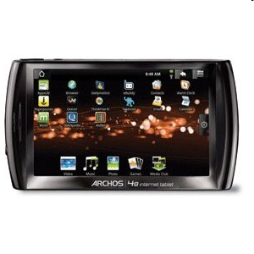
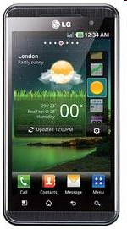
TI in Handheld Tablets
TI SOCs are used in devices ranging from entry level tablets, to devices performing complex multi - screen use-cases
TI Cortex-A8 products incorporate advanced power management technologies, integrated peripheral set, thus contribute to lower system cost

Slide 6
Key System Requirements for Education Tablets
Processing power
Entry level tablets can be designed with ARM9 devices, and higher end devices with multimedia capabilities need Cortex-A8 and NEON
Ability to drive different display types and sizes
Helps in designing for different requirements from schools and institutions
Support for local persistent storage
SD card, Flash
Touch-screen support
HW Graphics/ Animation capabilities
This determines the acceptance of the product in the market, and content usability. Android needs OpenGL ES acceleration
Video capture and streaming
For advanced tablets, video conferencing with faculty is a requirement
Low power consumption
Tablets have to be designed for operating non-stop during classes
Device form factor
Should be hand-held, restrictions on heat dissipation

Slide 7
Key Software Requirements for Education Tablets
Operating System support
Android is widely used due to packaged software bundle (OS + UI, multimedia framework, connectivity, storage)
Content consumption software
Adobe Player/ client
Majority of education content is created using Adobe Flex tools, and hence Flash client player is necessary for this content
Video content
Graphics/ Animation is aided by having real-life video content
Multi-language support
Both Qt and Android support localization options
Browser for targeted learning from websites
Webkit, Firefox
Capability to securely store and share data between students and faculty teachers

Slide 8


Architecture for Education Tablet Market
SW Architecture
Base OS for ARM9 / Cortex-A8
Graphics SDK (HW OpenGL ES) package
HW Accelerated UI (Android, Qt, Browser)
Application (Flash10, Java, HTML5)
TI Cortex-A8 Processors
Touchscreen
ARM
RAM
Display
Capabilities
NEON
LCD - QVGA to XGA, 720P, 1080P
Cortex-A8 – upto 1.5 GHz
NEON coprocessor
SGX530 3D - HW Engine
SGX (3D)
Storage
Shared
Memory
Advantages
Peripheral Integration, SW compatibility
Optimised – Flash10, Qt, Android

Slide 9
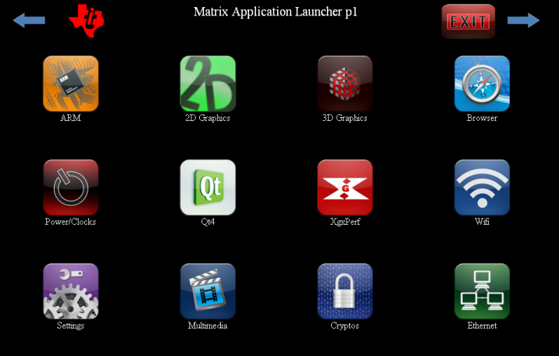
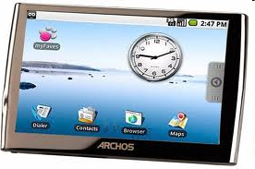
TI Graphics for Education Tablet Market
TI provides a high performance Graphics SDK on Linux/Android
2D acceleration, 3D acceleration
On Qt, Android
Low cost HW platforms for development (Linux/ Android)
Beagleboard – Cortex-A8 based
ARM9 based low cost boards
Cortex-A8 Graphics Software Value Proposition
Optimised NEON accelerated Android, Qt
GLES2.0 accelerated Qt, and Android frameworks
Integrated software stack and kernel, scales across requirements

Slide 10
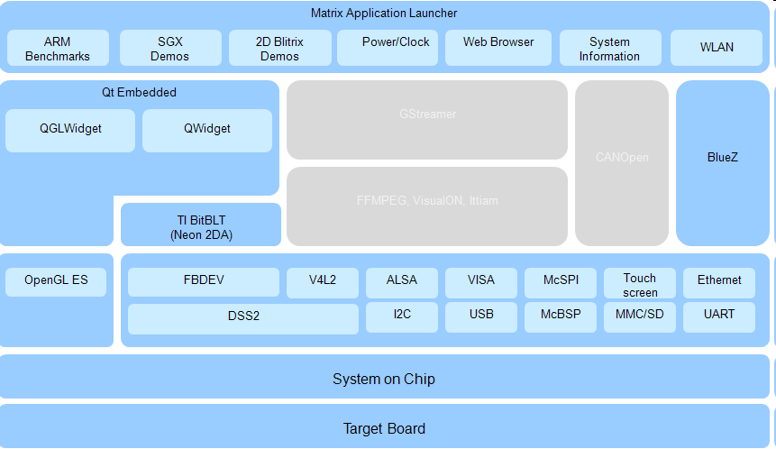
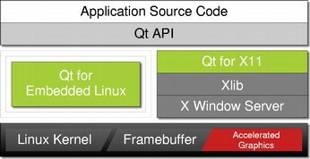
Linux Graphics Software Stack - Qt

Slide 11
Android Graphics Stack – GLES1.1/2
All composition / windowing operations are accelerated through HW SGX530
All 3D operations are accelerated through HW SGX530
Cortex-A8 with NEON is used extensively for 2D operations
HW Display system provides options to rotate and position the content

Slide 12
Flash10
Flash10 client player (browser based) allows playback of Graphics, Animation, and video, as a browser plugin
Flash10 is supported on TI A8 platforms only
As Linux plugin, Depends on Firefox, GTK
As Android plugin, Depends on Webkit
AIR on Android
Allows standalone applications to be created
Cortex-A8 Value Proposition
Optimised Flash10 client player (Browser plugin)
Support on both Android and Linux

Slide 13
Summary
TI provides core software for creating handheld education tablets
Flash10 support on Linux and Android
Qt accelerated framework support
Android accelerated UI framework support
Customers can start using reference BSP and driver support available right now on TI Cortex-A8 devices

Slide 14
References
Flash10.3 – Accelerated package available now in the TI download pages in TI website
http://www.ti.com/tool/adobeflash-a8
Accelerated SGX530 Graphics Packages for Linux and Android
http://software-dl.ti.com/dsps/dsps_public_sw/sdo_sb/targetcontent/gfxsdk/latest/index_FDS.html

Slide 15
Q & A

