Slide 1
Enabling two level translation tables in ARMv7 MMU
Prabindh Sundareson, 2013

Slide 2
Why two level ?
For an introduction to how one-level page table is built to meet ARM Memory Management specifications, and the steps required for basic initialisation, refer to “Turning on an ARM MMU and Living to tell the tale”
http://www.embedded-bits.co.uk/2011/mmucode/
Two level tables are required to support 4kB small page allocations in ARMv7, and gives more control to allocators
Linux uses 4kB pages for most of the allocations on ARM so is important to understand the steps

Slide 3
Two level mapping
First level table
This table (Translation table in ARM parlance) consists of 4096, 32 bit entries
Each entry covers 1 MB of ARM address space
Each entry points to physical address of a level2 table
Second level table
This table (Page table in ARM parlance) consists of 256 entries in each
Each entry covers 4kB of ARM address space
Each entry points to a 4kB block of physical memory
Number of Level-one tables | Number of Level-two tables
1 | 4096

Slide 4
Mapping virtual to physical address
Since there can be many “virtual” views of the system physical memory, the ARM HW needs to know which “view” to choose
This is accomplished by writing to a register named TTBR, when switching contexts
In Linux, refer to proc-v7-2level.S
http://lxr.free-electrons.com/source/arch/arm/mm/proc-v7-2level.S?a=arm
The TTBR (Translation Table Base) register points to the level one table for that process

Slide 5
Mapping virtual to physical address
The simplest mapping in two level translation is to have a 1:1 virtual:physical mapping
In an operating system like Linux, each process has its own set of tables, and is switched to the right table whenever there is a process (context) switch using TTBR

Slide 6
Creating the table entries
For 1:1 mapping, below algorithm can be used
Algorithm for first level page table
Given the address (A) of a small page (4kB) in physical memory,
Offset (O) of entry in Level one table = (A >> 20), ie 1 MBth index in which “A” falls in the full 4GB memory space
level1_table[O] = address of Oth Level two table | flags
Algorithm for second level page table
Given the address (A) of a small page (4kB) in physical memory,
Offset (O2) of entry in Level two table = Offset of the 4kB page within the 1 MB section
level2_table[O2] = (Top 20 bits of A) | flags

Slide 7
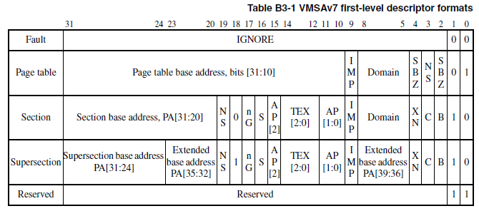
Flags and bit fields in level one table

Slide 8
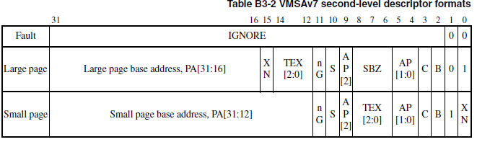
Flags and bit fields in level two table

Slide 9
Key (non-default) bit fields
TEX, C, and B bits
Control the caching attributes of the page
AP[] bits
Control the access permissions
Entry type flag bits
0x1 for small page in Level one, and 0x2 for small page in Level two tables

Slide 10
Allocating the tables
To ensure that the HW traverses the tables properly, it is required to align the address of the allocated tables per below restrictions
Alignment requirement for level 1 page table
4096*4 bytes
Alignment requirement for level 2 page table
256*4 bytes

Slide 11
Decoding the page tables
After creating the tables, the HW should be capable of decoding the entries to determine the right physical address, given a virtual address
This process is specified by ARM as per below

Slide 12
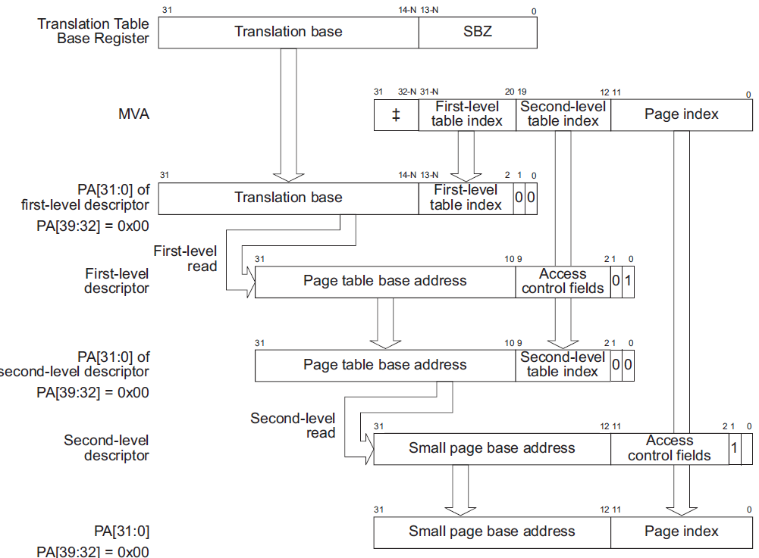
Decoding the page tables

Slide 13
Typical issues in page tables
Alignment
Bit field mismatch
Offset mismatch

Slide 14
Code
http://github.com/prabindh

