Slide 1
Introduction to graphics

Slide 2

GPU HW Architectures
CPUs are programmed with sequential code
Typical C program – linear code
Well defined Pre-fetch architectures, cache mechanisms
Problem ?
Limited by how fast “a” processor can execute, read, write
GPUs are parallel
Small & same code, multiple data
Don’t care - control dependencies
If used improperly can reduce throughput
“Output” is a result of a matrix operation (n x n)
Graphics output – color pixels
Computational output – matrix values

Slide 3
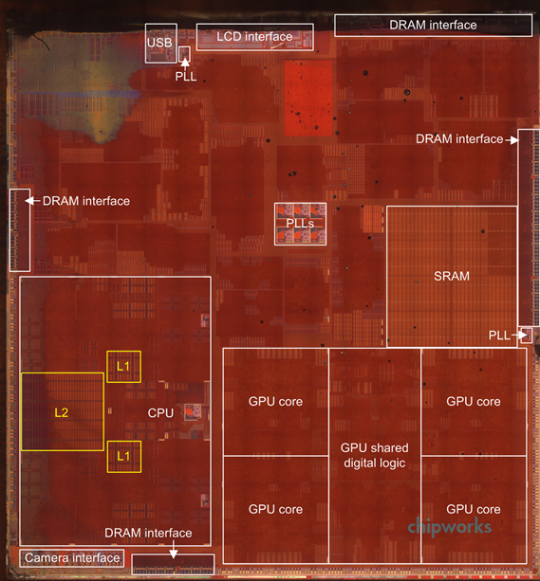
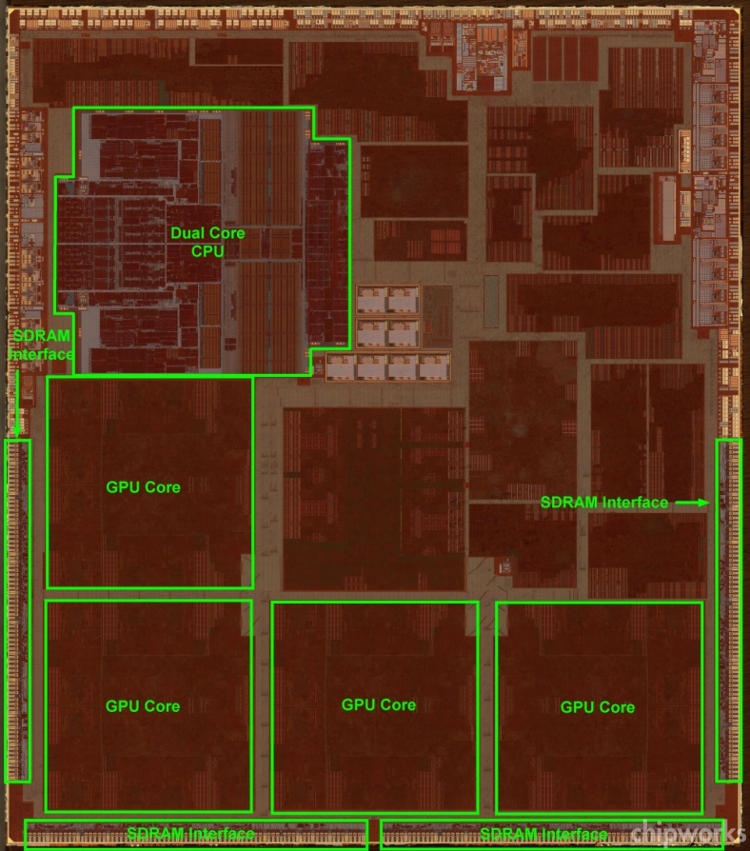
GPU integrated SOCs
The A5, A6, A7 chipsets
On A5, CPU size ~= GPU size
On A6X and A7, CPU size < GPU size! GPU core sizes ~ 35 mm2 @ 28nm

Slide 4
Embedded GPU Architectures
GPUs vary in
Unified vs separate shader HW architecture
internal cache size
Bus size
rendering blocks
Separated 2D and 3D blocks
From - http://www.socip.org/socip/speech/pdf/2-Vivante-SoCIP%202011%20Presentation.pdf
Spec evolution

Slide 5
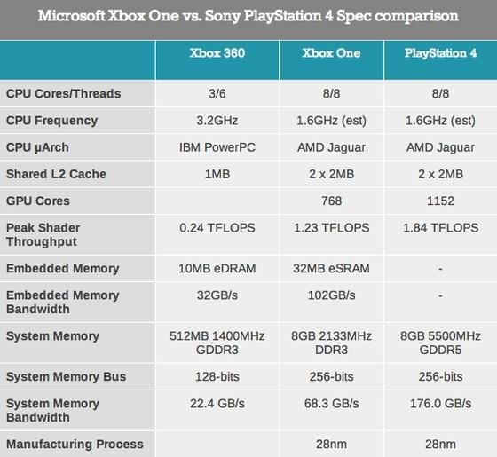
Xbox One vs Sony PS4 (40+ Watt devices)
Embedded markets
require <10W !
From – AnandTech

Slide 6
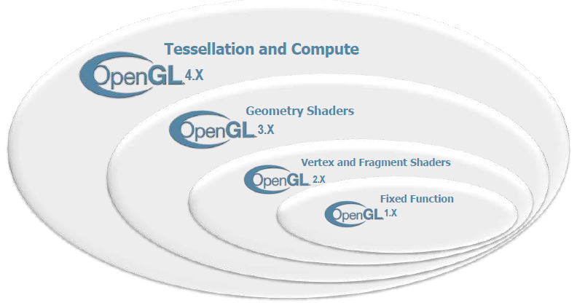
OpenGL specification evolution
GLES API defined

Slide 7
The OpenGL ES API
From the Khronos OpenGL ES Reference Card
“OpenGL® ES is a software interface to graphics hardware.
The interface consists of a set of procedures and functions that allow a programmer to specify the objects and operations involved in producing high-quality graphical images, specifically color images of three-dimensional objects”
API reference card
http://www.khronos.org/opengles/sdk/docs/reference_cards/OpenGL-ES-2_0-Reference-card.pdf
Dependencies

Slide 8
OpenGL Dependencies
OpenGL depends on a number of external systems to run
A Windowing system (abstracted by EGL/ WGL/ XGL …)
External inputs – texture files, 3D modelling tools, shaders, sounds, …
OpenGL is directly used by
OS/ Driver developers (ofcourse!)
HW IP designers
Game studios (optimisation)
Researchers (Modelling, Realism, ) …
Tools developers
Application developers do not generally program on OpenGL, but rather do it on an Android API binding, or Java binding
Extensions

Slide 9
What are Extensions ?
Extension types
OES – Conformance tested by Khronos
EXT – Extension supported by >1 IP vendor
Proprietary (vendor_ prefix) – Extension from 1 IP vendor
How to check for extensions ?
getSupportedExtensions (WebGL), getExtension()
glGetString (openGL ES)
Number of extensions
OpenGL ➔ 400 +
OpenGL ES ➔ 100+
GLES 3

Slide 10
OpenGL ES 3.0
Announced 4Q 2012
New features
ETC (ETC2) texture compression support (+Alpha)
Additional objects for managing Uniforms, Pixel Buffers
3D textures
Geometry instancing
Multiple Render Target support
MSAA to texture
Client Server

Slide 11
The GL Client – Server Model
Client (application on host), server (OpenGL on GPU)
Server can have multiple rendering contexts, but has a global state
Client will connect to one of the contexts at any point of time
Client can set the states of the server by sending commands
Further API calls will thus be affected by the previous states set by the client
Server expects not-to-be interrupted by the client during operation
Inherent nature of the parallel processor
GL,SL, EGL spec versions

Slide 12
OpenGL Specifications
Core GL Spec
Shader Spec
Platform Integration
OPENGL Full version
GLSL companion
EGL
Currently in 4.0+
Currently in 1.20
Currently in 1.4
ES version
GLSL-ES companion
EGL
Currently in 3.0
Currently in 1.0.16
Currently in 1.4
Common
Common-Lite
What we miss in ES compared to desktop version:
Polygons, Display lists, Accumulation buffers,…
Programming Flow

Slide 13
Programming flow in OpenGL ES
Step1:
Initialise EGL for rendering – Display, Context, Surface
Step2:
Describe the scene (VBOs, Texture coordinates) – objects with Triangles, lighting
Step3:
Load the textures needed for the objects in the scene
Step4:
Compile the Vertex and Fragment Shaders
Step 5:
Select the output target (FBO, Fb, Pixmap …)
Step5:
Draw the scene
Step 6
Render (Swap) to Display,
Run this in a loop
Frames/vertex/basics

Slide 14
Preliminaries
Pixel Throughput
Memory bandwidth for a 1080P display @ 60 fps
Overdraw
Vertex Throughput
Vertex throughput for a 100k triangle scene
Tearing, VSync
Frame switch
(Uniform)
Real frame switch
happens here
Driver frame draw
(non-uniform)
Triangles

Slide 15
Why Triangles ?
Connectivity, Simplicity, Cost of Tests
+
???
+
Vertex info

Slide 16
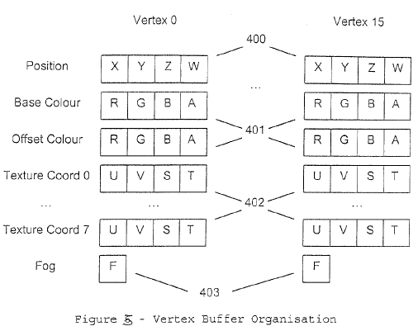
Vertex Information Basics
From EP20030250715
Generic render

Slide 17
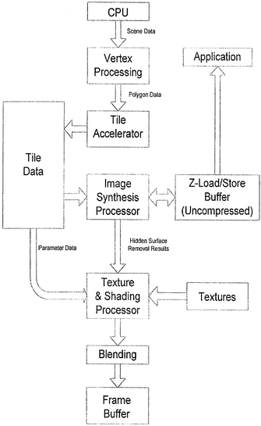
Generic 3D Rendering Path
From US 20120212489 A1
Tiled renderer

Slide 18
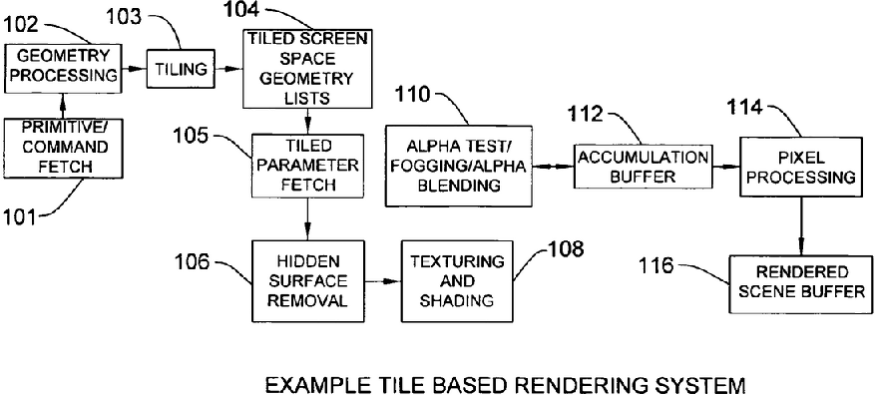
Tile Based Rendering System
Why Tiles ?
From US 8310487 B2
Breakup of APIs

Slide 19
3D rendering loop
Sort the vertices
Generate the primitives
Clip the vertices to the display region
Transform/ Lighting / Vertex shading
Hidden Surface Removal
Texturing / Fragment shading
Final Pixel formating

Slide 20
The GLES API – Overall view
Vertex
Operations
Texture
Operations
Shader
Operations
VBOs
Attaching attributes
Attaching textures
Loading texture data
Mipmaps
Loading, compiling,
Linking to program
Binary shaders
State
Management
Rendering
Operations
GL
CFF
Front/Back facing
Enable/Disable (culling, ..)
Get/ Set uniforms
Rendering to Framebuffer
Rendering to FBO
RTT
EGL
Global Platform
Management
Context
Management
egl, wgl, glx ..
Antialiasing,
Configuration
Surface - window
Threading models
Context sharing

