Slide 1
Programming the GPU

Slide 2
The C,F,F (Clear, Flush, Finish) APIs
Clear
Clears the current target view area (entire screen – FBO or Fb)
Is that it ?
Sequence 1
Draw something <frame1>
Draw something <frame2>
Sequence 2
Draw something <frame1>
Clear
Draw something <frame2>
The role of the GPU internal cache / fast memory
Engine by default reads back from fb
By specifying “Clear” – the engine can eliminate reads
Further extensions allow discard as well
Viewport determines the draw area

Slide 3
Flush, and Finish
Several types of rendering methods adopted by GPUs
Immediate rendering
Deferred rendering
Immediate rendering – everyone is happy
Except the memory bus!
Deferred – the GPU applies its “intelligence” to do/not do certain draw calls/ portions of draw calls
Used most commonly in embedded GPUs
No concept of “bit exactness” in Graphics rendering
Hence, some API calls may not finish intended operations
Flush() – The call ensures pending operations are kicked off, returns
Finish() – The call ensures pending operations are kicked off, “waits for completion”, returns

Slide 4
A note on WebGL – vs native code
In native code, need to handle creation of a Display, Surface, Context
For example, refer to this native code (sgxperf)
eglGetDisplay
eglInitialize – for this display
eglBindAPI – bind to GLES/ VG context
eglChooseConfig – configure surface type, GLES1/2/VG, Depth/Stencil buffer size
eglCreateWindowSurface / eglCreatePixmapSurface
eglCreateContext
eglMakeCurrent
eglSwapBuffers
But Platform initialisation in WebGL is handled by browser
Only configurations are – stencil, depth, AA, Alpha, preserve
No EGL calls in JS application code
No multi-threading issues (not yet, but “workers” are coming)
The hands on labs will focus on GL (rendering), not EGL (platform)
Lab framework

Slide 5
Functions/API calls to be modified in the framework
Provided in the workshop notes
Lab

Slide 6
Programming
ClearColor
Clear – clears with color specified earlier
Flush/ Finish
➔ First Lab Exercise

Slide 7
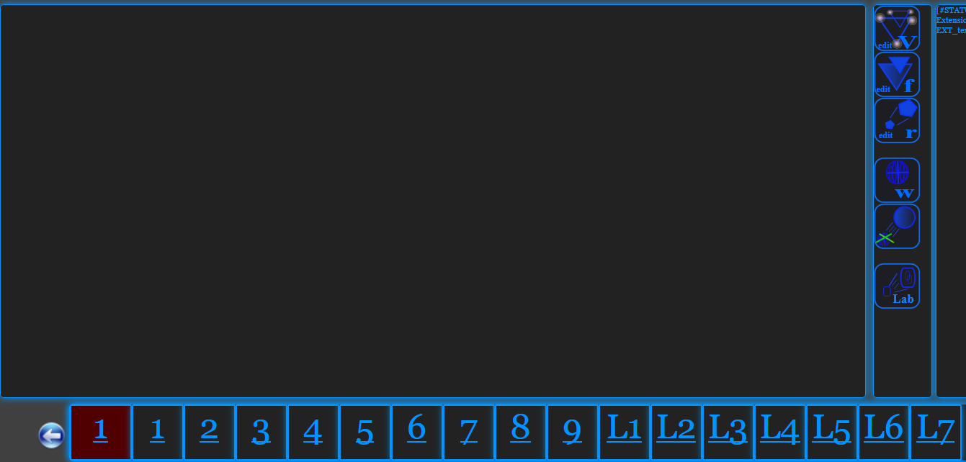
Lab L1 – CLEAR colour, Viewport
4
(Edit Render code)
2
3
(Clone Lab)
(Launch Personal Lab)
(Relaunch after Edit)
(Launch Lab)
1

