Slide 1
Vertex Rendering

Slide 2
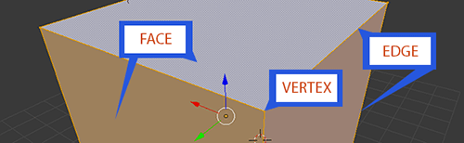
What are vertices ?
Vertices –
Points defined in a specific coordinate axes, to represent 3D geometry
Atleast 3 vertices are used to define a Triangle – one of the primitives supported by GLES
Where from ?

Slide 3
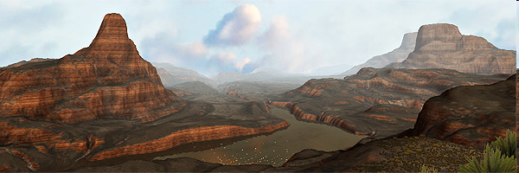
Vertex basics
Where do vertices come from ?
Output of Modelling tools
Mesh rendering / transforms – optimisations
For 2D operations (ex Window systems), just 2 triangles
Depth Complexity

Slide 4
Depth-Complexity
Overlapping region
# of times same area rendered
Ideal ~ 1
> 1, higher complexity
Goal is to reduce Depth-Complexity
Summary of vertex ops

Slide 5
Vertex Operations
Vertex operations are floating point intensive matrix operations - reciprocals, square-roots
Conversion to Triangles (not needed in OpenGL ES)
Sorting
Clipping
Transformation/ Scale
Perspective
Vertex Shaders
Scan conversion
Edge walk
Interpolation
Followed by Pixel Operations
Attributes

Slide 6
Vertex Attributes
A vertex is characterised by its position {x,y,z}
{x,y,z} are floating point values
Additionally, normals are required for directional lighting calculations in shader
Vertex normal, Face normal - Description
3D Tools output the normal map also along with vertex information
Additionally, texture coordinates are required
Again, 3D tools output the texture coordinates
Each HW implementation must support a minimum number of vertex attributes
Maximum number can be queried using MAX_VERTEX_ATTRIBS
CPU to GPU xfer

Slide 7
Vertices – CPU to GPU
Optimising Vertex operations
A 3D object will have a lot of “common” vertices
Ex – Cube has 6*2 triangles, (6*2)*3 vertices, but only 8 “points”
So rather than passing vertices, pass 8 vertices, and 36 indices to the vertices to reduce Bandwidth
Indices can be 16bit, so reduce BW by ~50%
GL_ARRAY_BUFFER (vertices), GL_ELEMENT_ARRAY_BUFFER (index)
STATIC_DRAW, DYNAMIC_DRAW
Tip: Re-use by binding
What are Vertex Buffer Objects ?
genBuffers (createBuffer in WebGL), binding, bufferData/offset and usage
Usage of Index Buffers (ELEMENT_ARRAY_BUFFER)
Objects

Slide 8
A note on Binding, Buffer Objects
What is “Binding” ?
Binding a server to a client – ex, VBO to a texture
All objects are associated with a context state
Binding an object is ~ copying the object state ➔ context
Removes client⬅➔server movement everytime
“Xfer-once-to-server, keep the token, Use-multipletimes-later”
Good practice to “unbind” after operations– set binding to 0/null to avoid rogue programs changing state of bound object
Buffer-Objects
Allows data to be stored on the “server” ie, the GPU memory, rather than client memory (via pointer)
GPU can decide where to place it for the fastest performance
Lab

Slide 9
With and Without VBO
Without VBO
ARRAY_BUFFER and ELEMENT_ARRAY_BUFFER used, in glBindBuffer()
Vertices and Attributes uploaded individually as buffers via
glEnableVertexAttribArray()
glVertexAttribPointer()
Drawn via
glDrawElements
pointer to index buffer passed
CPU-GPU data transfer happens every draw
With VBO
ARRAY_BUFFER and ELEMENT_ARRAY_BUFFER used, in glBindBuffer()
Vertices and Attributes uploaded individually via
glBufferData()
Attributes specified only by offsets in buffer
glVertexAttribPointer takes in only offset
Drawn via
glDrawElements()
No pointer passed here
Hint to GL via “GL_STATIC_DRAW” or similar

Slide 10
Stride specification
Stride can be specified as ‘0’, in which case the GL Engine automatically calculates required stride corresponding to the type specified for the attribute

Slide 11
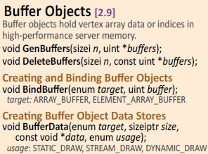
Programming !
Recall the Bandwidth needs for the vertex transfers / frame
Passing Vertices
Create Buffer Object
bindBuffer
bufferData
Indices are passed as type ELEMENT_ARRAY
Passing Attributes
bindAttribLocation
enableVertexAttribArray
vertexAttribPointer
Render
DrawElements
➔Lab – Point Cloud

Slide 12
Lab L3 – Point Cloud in viewport

