Slide 1
Texturing

Slide 2
Definition
Texture – A bitmap buffer in memory, usually containing color data
Textures are used for showing better realism in scenes

Slide 3
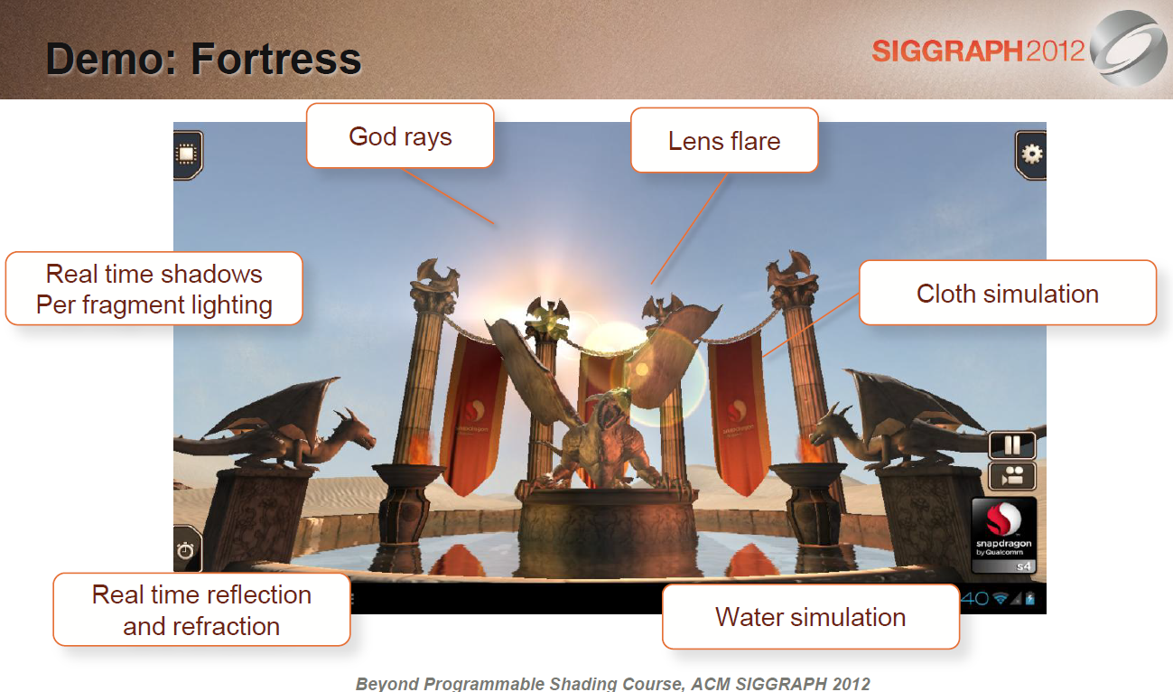
Textures for realism

Slide 4
Texturing 3D objects
Mapping from a bitmap to a 3D object involves matching the texture coordinates to the object surface
Texture coordinates are calculated along with the vertex coordinates
3D tools output Texture coordinates along with vertex information, for the scene
Approach of data transfers

Slide 5
Correct approach of data transfers
Generate Object (ex, glGenBuffers, glGenTextures)
Bind Object to an ID “xyz” (glBindBuffer(xyz), ..)
Transfer data to Object (glBufferData, glTexImage2D)
Unbind (glBindBuffer(0))
➔ After this point, the data remains bound to “xyz” and is managed by GPU.
Can be accessed later by referencing “xyz”
➔ Applies to VBOs, Textures, …
Note the implicit “no atomicity” – needs locking
➔Pixel Buffer Objects and performance
subTexImage2D

Slide 6
How to update regions ?
It is possible to update selected regions of already uploaded textures
Using glTexSubImage2D
In embedded systems, not used widely
Performance implications of read-back path
Remember the client-server paradigm
Texture formats

Slide 7
Texturing basics
Texture Formats available
RGB* formats, Luminance only formats
Relevance of YUV
Texture Filtering
Maps texture coordinates to object coordinates – think of wrapping cloth over object
Mipmaps
Local optimisation – use pre-determined “reduced” size images, if object is far away from viewer – as compared to filtering full image
Objective is to reduce bandwidth, not necessarily higher quality
Application can generate and pass through TexImage2D() for multiple levels
GPU can generate using GenerateMipMap()
Occupies more memory
Uv mapping

Slide 8
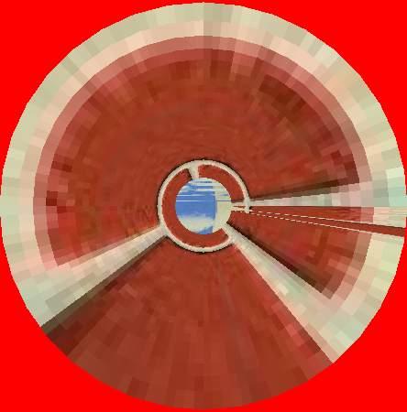

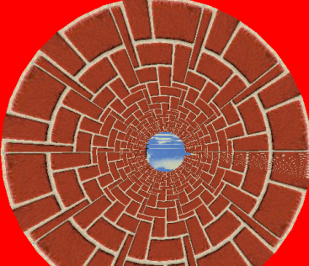
Texturing 2D objects
object
Mapping from a bitmap to a rectangle is straightforward
0:1 range maps to 0:1 of object size
TexParameter determines filtering mode
TexParameter determines REPEAT
TexCoordinates determine if texture extends to full size of object or not
texture
S,T = {0:1}
Upscaled
Texcoords {0:10}
+ REPEAT
Non-image textures

Slide 9
Non-Image Textures
Textures need not be image data
Textures can be used to pass per-pixel “attributes” to the fragment shaders
Bump-maps and similar techniques for passing normal information
light-maps for lighting information
….
compression

Slide 10
Texture Compression types
GLES spec supports RGBA textures, Luminance …
To reduce memory bandwidth, compression used
Texture Compression major types
PVRTC, ETC1, Others
Android primarily supports ETC1
iOS supports PVRTC (and no other)
Extension support queryable using GL API queries
How to store this information in an uniform manner ?
Texture file formats
PVRTC (using Textool converter from IMG) commonly used
KTX file format
KTX

Slide 11
Khronos KTX file format
To render a texture, steps to be used today:
Application needs apriori knowledge of texture type, format, storage type, mipmap levels, and filename or the buffer data itself
Then load into server using TexImage2D()
Proprietary formats exist to separate this application+texture dependency –
ex, PVRT from IMG
ETC from Ericsson
KTX file format from Khronos is a standard way to store texture information, and the texture itself
See next slide for structure of the file
http://www.khronos.org/opengles/sdk/tools/KTX/

Slide 12
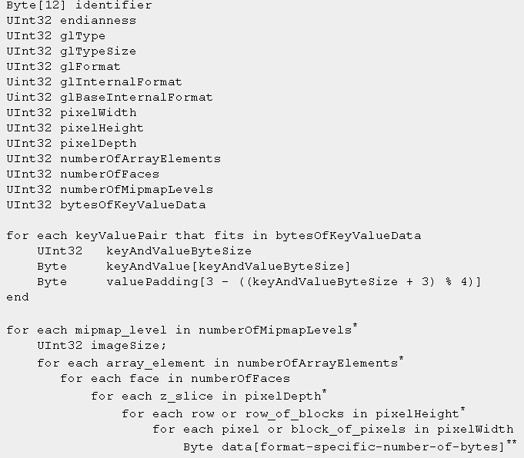
KTX format …
Passing coords

Slide 13
Texture coordinates to GPU
Texture coordinates are passed to GPU as “Attributes” along with the vertices
Gen-bind-bufferdata, then bindAttrib
Quiz:
When does the binding actually come into effect ?
WebGL/Textures

Slide 14
Note on WebGL and Textures
Because of the way file loads work on browsers (asynchronous), texture loading may not happen before the actual draw
Expect black screen for a very short-while till the Texture image loads from the website
On native applications, due to the synchronous nature of loading the texture this issue will not be present
Programming

Slide 15
Programming with Textures
bindTexture
pixelStorei (webGL only)
UNPACK_FLIP_Y_WEBGL
texImage2D
texParameteri
TEXTURE_MAG_FILTER
TEXTURE_MIN_FILTER
Note: WebGL “null” binding instead of “0”
Point Textures
Rectangular Texture

Slide 16
Lab L2 - Texturing

