Slide 1
Transformations

Slide 2
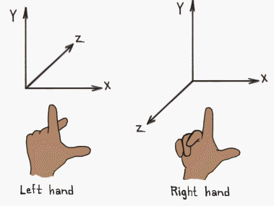
in OpenGL ES, negative z-values go into the screen. This is because OpenGL ES uses a right-handed coordinate system. GLKit, on the other hand (pun intended), uses the more conventional left-handed coordinate system.
http://www.learnopengles.com/understanding-opengls-matrices/

Slide 3
Vertices and Projection
Cartesian systems
OpenGL
+z → viewer
DirectX is left handed (APIs to translate)
Perspective, and Ortho
Perspective matches natural viewing expectation
Projection matrix (far/near, viewport size, Aspect ratio)
Order of matrix multiplication – reversed
projection*view*model
Perspective projection

Slide 4
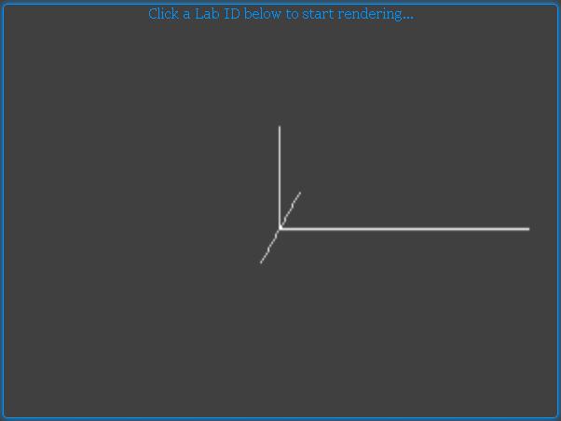
Lab L4 – Coordinate Axes
Click and move the mouse, to rotate the Z axis, around Y
y
x

Slide 5
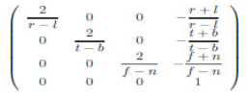
Orthographic projection - Matrix
Consists of a translation and scaling component
An object looks the same whether it’s close or far away from the camera

Slide 6
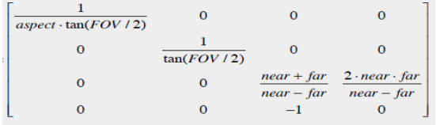
Perspective projection - Matrix
An object’s x and y are distorted, depending on the distance from the camera, giving the “perspective” effect

Slide 7

Perspective Projection
Viewing volume
Clipping
*If near plane is very close to object, expect nasty clipping to happen

Slide 8
Matrix ordering conventions
“Column-Major” notation ➔ Read matrix notations in transposed manner
M.V.P is to be treated P.V.M
OpenGL / ES uses the Column-Order convention for depiction of operations
Transformation

Slide 9
Transformations
All vertices are in model-space, when input to the GL engine
Where is the viewer ?
Moving the object to the viewer-eye at origin [MV transformation]
What is the bounding volume of the world ?
Object needs to be clipped to the bounding box [Projection]
Viewport normalisation
Done by perspective division, to result in values of -1:1
Diagram

Slide 10
Translation of a point - Example
[x y z 1] * [?] = [x-a y-b z-c 1]
[?] = [1 0 0 0]
= [0 1 0 0]
= [0 0 1 0]
= [-a -b -c 1]
Revise this
What happens if w is 0 ?
Point vs Vector !
From OpenGL FAQ - “…The translation components occupy the 13th, 14th, and 15th elements of the 16-element matrix …” (note the column order reference)
Observation -
Last row – non unity
W - purpose
Order of operation

Slide 11
Order of operations
Order - makes a difference for final position of object
Do Model matrix operations carefully
- From “The redbook”

Slide 12
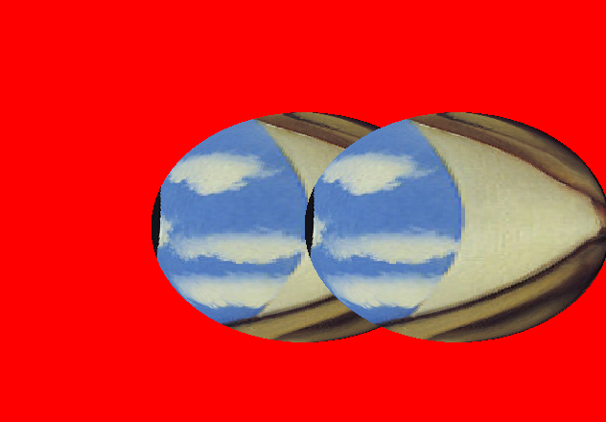
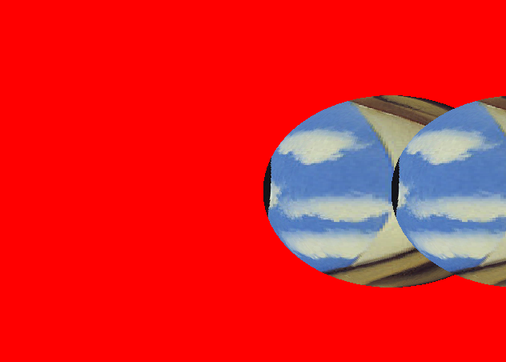
Translation
matrix1.translate(X,0.0,0);
X = 0
X = 0.4
➔ Translation applied to all objects (effect is not dependent on depth of object)

Slide 13
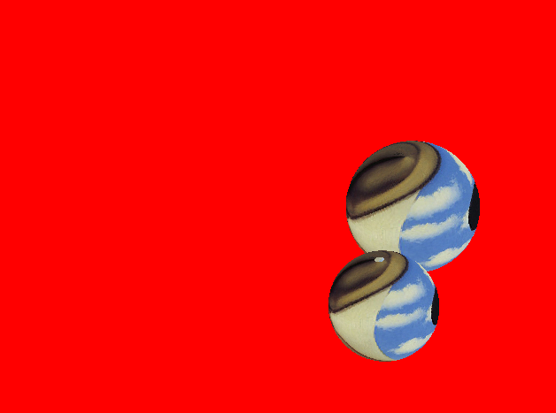

Rotation
y
-0
x
z
Rotation ➔ Observe effect of x offset!
Apply translation “after” rotation
Refresh M,V,P after every rotate
Lookat

Slide 14
Getting the eye to see the object
“Model” Matrix made the object “look” right
Now make the object visible to the “eye” – The “View”
Eye is always at the origin {0,0,0}
So using matrices, move the current object to the eye
“LookAt” is implemented in many standard toolkits
The LookAt transformation is defined by
Viewpoint - from where the view ray starts (eye)
A Reference point (where the view ray ends) – in middle of scene (center)
A look-”up” direction (up)
ex – gluLookAt Utility function
Significant contributor of grey-hair
Viewport

Slide 15
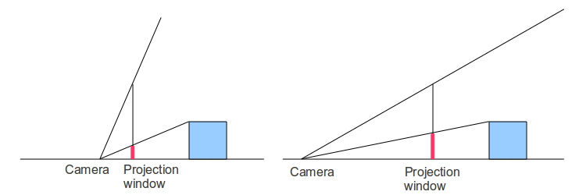
Perspective Projection
Needs the below four inputs
aspect ratio – (WIDTH / HEIGHT) of target screen
vertical field of view (called FOV): the vertical angle of the camera into which we look into
location of the near Z plane – Objects in front of this are not drarwn
location of the far Z plane – Beyond this, objects are not drawn
The vertical field of view enables moving “in” and “out” – making the same object appear small or big

Slide 16
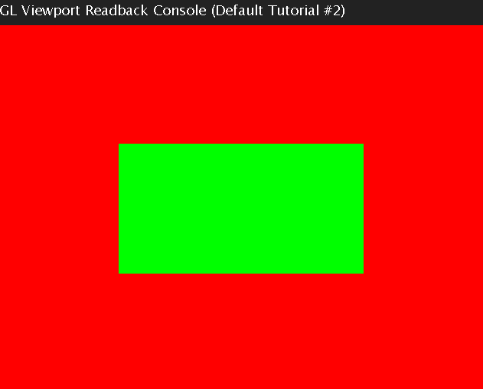
Viewport Transformation
Convert from the rendering to the final screen size
ie physical screen
Define the viewport using glViewport()
Viewport can be an area anywhere within the physical screen
Reminder – viewport(0,0,128,128)
This takes care of aspect ratio
After the transformation, successful triangles get to the rasterisation HW, and then to the Fragment shader
HW optimisations

Slide 17
GLES3.0 - Transform feedback
Refer quiz

Slide 18
Summary - The Transformation Sequence
Just a mathematical step - w
Translation example

Slide 19
HW Optimisations
Not all triangles are visible
HW can reject based on depth
coverage
Front-facing or back-facing (Culling)
Winding Rules used
Culling is disabled by default per specification
However, most HW do this optimisation by default to save on bandwidth/ later pixel processing
Programming

Slide 20
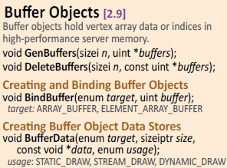
Programming !

Slide 21
Lab L6 – Rotating Model

Slide 22
Real life 3D models

Slide 23
Real-life modelling of objects
3D models are stored in a combination of
Vertices
Indices / Faces *
Normals
Texture coordinates
Ex, .OBJ, 3DS, STL, FBX …
f, v, v//norm, v/t, o
Export of vertices => scaling to 1.0-1.0
Vertex normals vs face normals
Materials (mtl), animations
Problem of multiple indices not allowed in openGL
Tools and Models
Blender, Maya, …
http://assimp.sourceforge.net/ - tool for importing multiple types
http://www.blendswap.com/ - Blender models
Tessellation of meshes can be aided by HW in GPUs

Slide 24
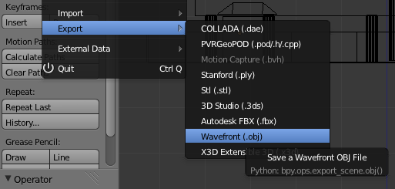
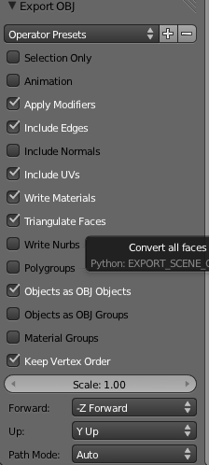
Exporting models from Blender
.obj export
Always triangulate for GLES2
Model always from Top-View
Ie, Y up (default setting)
Always UV unwrap each object
Normals if needed (lighting)
Rest is rendering as usual

Slide 25
Programming
Loading 3D models is an application functionality
No new APIs from OpenGLES are needed
A parser is required to parse the model files, and extract the vertex, attribute, normal, texture coordinate information

