Slide 1
Shaders

Slide 2
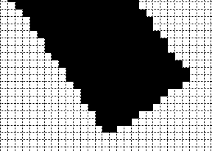
Vertices, Fragments - Revisited
Vertices –
Points defined in a specific coordinate axes, to represent 3D geometry
Atleast 3 vertices are used to define a Triangle – one of the primitives supported by OpenGL ES
Fragments
The primitives are “rasterised” to convert the “area” under the primitive to a set of color pixels that are then placed in the output buffer
Shader characteristics

Slide 3
Shader characteristics
Uniforms – uniform for all shader passes
Can be updated at run time from application
Attributes – changes per shader pass
Varying – Passed between vertex and fragment shaders
Ex, written by Vertex shader, and used by Fragment shader
gl_Position
Programs
Why do we need multiple programs in an application
for offscreen animation, different effects
MAX VARYING VECTORS – enum
Inputs to shader

Slide 4
Inputs to the Shaders
Vertex Shader
Vertices, attributes,
Uniforms
Fragment Shader
Rasterised fragments (ie, after rasteriser fixed function HW)
Varyings from vertex shader
Uniforms
Shader types

Slide 5
Shader types
Two types of shaders are recognised in OpenGL ES2.0 – Vertex, and Fragment shaders
Shaders are typically included in source code as strings (online compilation)
Shaders can be dynamically compiled, or can be pre-compiled and loaded as binaries
A “program” can be created with a group of related Vertex+Fragment shaders
There can be many shaders and programs in an application
Only one active at a time (made current by “useProgram”)
Shader usage model

Slide 6
Shader Usage Model
Application
Vertex shader source
User Application
Fragment shader source
GL library
Compiler
GL Context
UseProgram
Program
Linker
Vertex shader

Slide 7
Vertex Shaders
Vertex shaders operate on the vertices, and corresponding properties (“attributes”)
The same vertex shader code is run on all the vertices
A shader can operate only on the current vertex – ie “1” vertex. It does “not” have access to any other vertex even belonging to same primitive
The Vertex shader outputs one value per vertex
gl_Position
Additional per-vertex parameters can be sent to Fragment shaders using “varyings”
Upto a maximum of “MAX VARYING VECTORS”
Sample shader

Slide 8
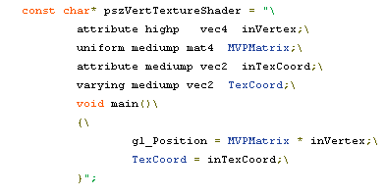
Vertex Shader Walkthrough
Frag shader

Slide 9
Fragment Shaders
A fragment is – a pixel belonging to an area of the target render screen (on-screen or off-screen)
Primitives are rasterised, after clipping
Fragment shader is responsible for the output colour, just before the post-processing operations
A Fragment shader can operate on “1” fragment at a time
Minimum number of “TEXTURE UNITS” is 8
Calculation of colors
Colors are interpolated across vertices automatically (Ref Lab 6 in the hands-on session) – ie, “varyings” are interpolated in Fragment shaders during rendering
Colors can be generated from a texture “sampler”
Each HW has a specific number of “Texture Units” that need to be activated, and textures assigned to it for operation in the shader
Additional information from vertex shader through “varyings”
Outputs
gl_FragColor
Sample Frag shader

Slide 10
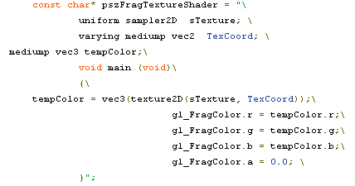
Fragment Shader walkthrough
Shader Program

Slide 11
Program
Each program consists of 1 fragment shader, and 1 vertex shader
Within a program, all uniforms share a single global space
Precision

Slide 12
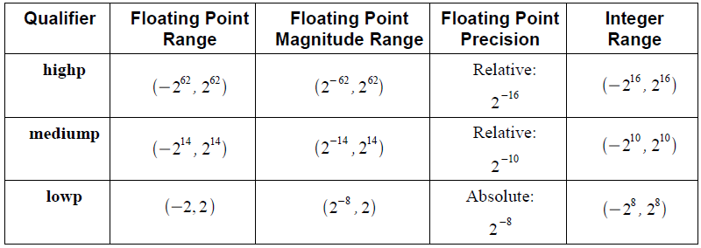
Precision of representations
Revision of “Precision” and “Range”
lowp, mediump, highp notations
Ex – “mediump vec3 tempColor;”

Slide 13
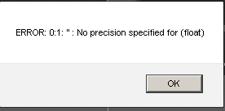
Note on precision
GLES2.0 mandates explicit specification of precision in shader
“varying mediump vec2 TexCoord”; //PASS
“varying vec2 TexCoord”; //WILL SHOW BELOW ERROR!
Why ?
Discussion on authors assumption
Functions

Slide 14
Functions available in GLSL (ES) Shader
General–
pow, exp2, log2, sqrt, inversesqrt, abs, sign, floor, ceil, fract, mod, min, max, clamp, mix, step
Trig functions–
radians, degrees, sin, cos, tan, asin, acos, atan
Geometric–
length, distance, cross, dot, normalize, faceForward, reflect, refract
Shader constructs

Slide 15
Constructs available in the shaders
Structures
struct light {
float intensity;
vec3 position;
} lightVar;
light lightVar2;
Arrays
float frequencies[3];
Vectors
vec3 myVector; //x,y,z accessed as myVector.x, myVector.y..
Matrices
mat3 myMatrix;
Note that there are limitations to declaring, initialising, and using variables in shaders
invariance

Slide 16
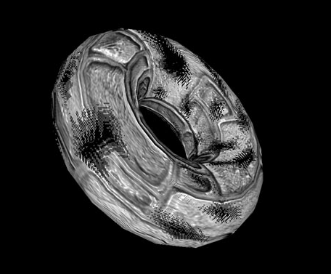
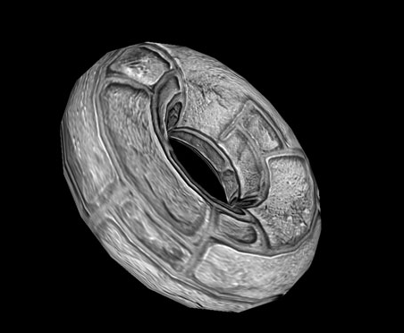
Invariance in shaders
Why values should change ?
Compiler quirks, temporary lack of GPR’s
GLES2 allows invariance to be maintained where specified, within / across multiple shaders
#pragma STDGL invariant(all)
Before declarations
Why invariance ?
Needed where precision is critical – specially depth-buffers
Multi-pass rendering example

Slide 17
Additional information on shaders
If errors are encountered on the shader, it will not be executed (try it in any of the online labs)
Specially important to WebGL
Reasons of security in browsers
Reduce cycles – by using measurement tools
Ex PVRShaman
RenderMonkey (now discontinued), ShaderMaker – useful tools to write shaders
techniques

Slide 18
Techniques for special effects
Fog effect
Shader adds a decay depending on distance of object from eye
Particle effects
Simulate fire, smoke
Cloth modelling
Lot of techniques including deformation, springs
Reflection/ refraction
Accomplished with blending , and resizing offscreen buffers
Shadows
Ambient Occlusion
Varying light around objects with neighbours

Slide 19
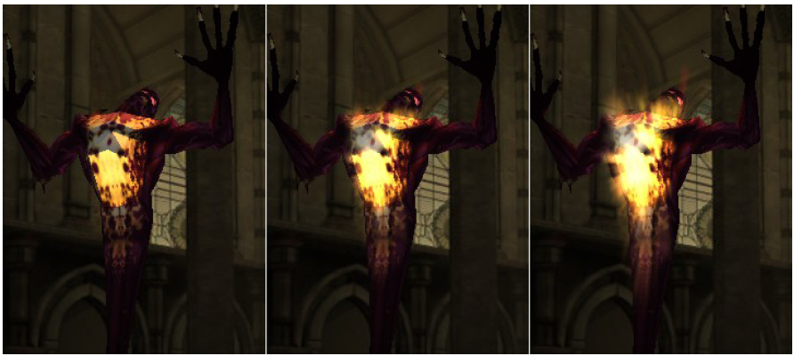
Techniques for special effects
Multiple render passes – with modified textures
Change texture coordinates dynamically, then blend results
Reference:
http://www.nada.kth.se/utbildning/grukth/exjobb/rapportlistor/2008/rapporter08/olsson_erik_08025.pdf

Slide 20
Advanced Shaders
Animation
Environment Mapping
Per-Pixel Lighting (As opposed to textured lighting)
Bump Mapping
Ray Tracers
Procedural Textures
CSS – shaders (HTML5 – coming up)

Slide 21

Programming with Shaders
Pass in shader strings
Compile, link, Use
Set uniforms
Do calculations
Next lab with shaders

Slide 22
Lab L7 – Making Clouds

