Slide 1
Rendering Targets

Slide 2
Rendering Targets
A rendering context is required before drawing a scene. And a correponding Framebuffer
Recall bindFramebuffer()
It can be
Window system Framebuffer (Fb)
Offscreen buffer (Implemented in a Frame Buffer Object)
FBO is not a memory area – it is information about the actual color buffer in memory, depth/ stencil buffers
By default, rendering happens to the Window system framebuffer (ID ‘0’)
Need

Slide 3
Need for offscreen rendering
Special effects
Refer the fire effect specified earlier (Multiple passes)
Interfacing to “non-display” use-cases
Ex, passing video through GPU, perform 3D effects, then re-encode back to compressed format
Edge detection/ computation – output is sent to a memory buffer for use by other (non-GL) engines
FBO

Slide 4
FrameBuffer Object
A Frame Buffer Object
Can be just a color buffer (ex, a buffer of size 1920x1080x 4)
Typically also has depth/ stencil buffer
By default – FBO – ID “0” is never assigned to new FBO
It is assigned to Window system provided Frame Buffer (onscreen)
Renderbuffers and Textures can be “attached” to FBO
For RB – application has to allocate storage
For FBO, the GL server will allocate the storage
rtt

Slide 5
Render-To-Texture
By binding a Texture to a FBO, the FBO can be used as
Stage 1 – target of a rendering operation
Stage 2 – used as a texture to another draw
This is “Render-To-Texture” (RTT)
This allows the flexibility of “discreetly” using the server to do 3D operations (not visible onscreen), then use this output as texture input to a visible object
If not for RTT, we have to render to regular Framebuffer then do CopyTexImage2D() or readPixels() which are inefficient
Offscreen rendering is needed for dynamic-reflections
APIs

Slide 6
Post-processing operations
Blending with Framebuffer - enables nice effects (Ref Lab #6)
Standard Alpha-Blending
glEnable ( GL_BLEND );
glBlendFunc ( GL_SRC_ALPHA, GL_ONE );
Is a “bad” way of creating effects
Reads back previous framebuffer contents, then blend
Makes application memory bound, specially at larger resolutions
Stalls parallel operations within the GPU
Recommended way is to perform Render-To-Texture, and blending where necessary in the shader
But needed for medical image viewing – ex Ultrasound images, > 128 slices blending
programming

Slide 7
Programming FBO and onscreen
glGenFramebuffers
glBindFramebuffer
Makes this FBO used
glFramebufferTexture2D(id)
Indicate ‘id’ is to be used for rendering to TEXTURE, so storage is different
glDeleteFramebuffers
Then, create separate object to texture with TEXTURE ‘id’
Then, use previous textureID id as input to texImage2D next
Switching to on-screen
Change binding to screen FB
Load different set of vertices as needed, different program as needed
Set texture binding to FBO texture drawn previously
DrawElements call
FBOs are used to do post-processing effects

Slide 8
Programming
Clear the current screen to a FBO off-screen, with a color
Using this FBO as RGB texture input, render another rectangle on-screen
“CheckFramebufferStatus()” -very important
Lab Exercise

Slide 9
Lab L5 – Render to Texture

Slide 10
OpenGL to GLES 2

Slide 11
Considering the GL to GLES movement
Ensure display lists are not used
Convert polygons to triangles/ lines
Check for missing extensions, shaders and rendering modes
Ex, shader language
Ex, 3D Texture (This is added in GL ES3.0) – Ultrasound image rendering
Performance:
Immediate, and Tile based-Deferred
Streaming textures
Use specific extensions – ex eglImage
Do not use glTexImage2D
Find out bottlenecks through profiling – CPU or GPU ?

Slide 12
Platform Integration

Slide 13
Setting up the platform - EGL
Context, Window, Surface
Refer to sgxperf - link
OpenGL ES –
EGL_SWAP_BEHAVIOR == “EGL_BUFFER_PRESERVED”
Reduces performance
Anti-aliasing configurations
EGL_SAMPLES (4 to 16 typically, 4 on embedded platforms)
WebGL - preserveDrawingBuffer – attribute
Optimisations done if it is known that app is clearing the buffer – no dirty region check and whole scene is drawn efficiently
Dirty region check made in some systems
Android

Slide 14
Android Integration Details
Android composition uses GLES2.0 mostly as a pixel processor, not a vertex processor
Uninteresting rectangular windows, treated as a texture
6 vertices
Blending of translucent screens/ buttons/ text
3D (GLES2.0) is natively integrated
3D Live wallpaper backgrounds
Video morphing during conferencing (?)
Use the NDK
Surfaceflinger

Slide 15
Android SurfaceFlinger architecture
Introduction to OpenGL interface on Android
http://code.google.com/p/gdc2011-android-opengl/wiki/TalkTranscript
HW acceleration on Android 3.0 / 4.x
http://android-developers.blogspot.com/2011/11/android-40-graphics-and-animations.html
composition

Slide 16
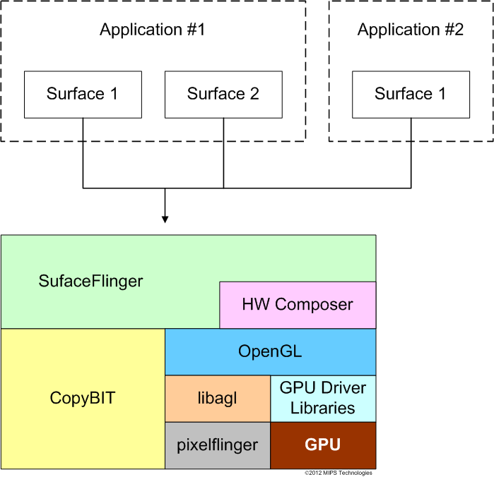
How Android accelerates composition
Indirectly, using window surfaces as textures
eglImage extensions allow direct usage
Rather than texImage2D
Understand overheads of texImage2D for live images
Below picture from IMGTECH website shows
the stack
3D

Slide 17
How Android accelerates 3D operations
Directly
Java wrappers (bindings) provided for GLES20 APIs, for the Java application writer
Not all APIs
Every API level includes more and more number of API coverage
3D rendering gets drawn to an Android “surface”
Then gets “composited” with other elements, before display on final screen
http://code.google.com/p/android-native-egl-example/source/browse/jni/renderer.cpp
iOS

Slide 18
iOS interface
Creating an application using Xcode
http://developer.apple.com/library/ios/#documentation/iphone/conceptual/iPhone101/Articles/00_Introduction.html#//apple_ref/doc/uid/TP40007514-CH1-SW1
GL Platform integration quite different from Android
http://developer.apple.com/library/ios/#documentation/3DDrawing/Conceptual/OpenGLES_ProgrammingGuide/Introduction/Introduction.html#//apple_ref/doc/uid/TP40008793-CH1-SW1
Lot of Apple specific extensions – ex MSAA
pixmaps

Slide 19
Pixmaps
EGL does not specify multi-process operation
Pixmap - A critical component in systems for composition with multiple processes / shared memory
EGL_KHR_image_pixmap
http://www.khronos.org/registry/egl/extensions/KHR/EGL_KHR_image_pixmap.txt
This is used for getting output from multiple processes as textures, and then used by composition manager to show the composited final desktop with blending enabled
Accelerated with openGL / ES
Used in Android, Xorg ….
Qt

Slide 20
Qt interface
How frameworks use 3D engine for blitting, composition work
Qt + powervr display plugin (Qt4 only)
Qt5 + eglfs or Qt + Wayland
GraphicsSystem
optimising

Slide 21
Optimising OpenGL / ES applications
Graphics performance is closely tied to a specific HW
Size of interface to memory, cache lines
HW shared with CPU – ex, dedicated memory banks
Power vs Raw performance
Intelligent Discarding of vertices/ objects (!)
Performance is typically limited by
Memory throughput
GPU pixel operations per GPU clock
CPU throughput for operations involving vertices
Load balancing of units – within the GPU
GPUs that are integrated into SOCs are closely tied to the CPU for operations, than discrete GPUs
Ex, GPU drivers offload some operations to CPU
debugging

Slide 22
Debugging OpenGL
Vanishing vertices, Holes
Improper lighting
Missing objects in complex scenes
Android Tools
systrace with GPU tracing enabled (http://developer.android.com/tools/debugging/systrace.html)
Windows Tools
PerfHUD ES
Perfkit/ GLExpert / gDEBugger
Intel GPA
Linux Tools
PVRTune (IMG)
GDebugger
Standard kernel tools
Intel GPA
Pixel vs Vertex throughput, CPU loading, FPS, Memory limited – tuning knobs

Slide 23
References
Specs - http://khronos.org/opengles
CanvasMatrix.js
https://github.com/toji/gl-matrix
Tools - http://www.iquilezles.org/apps/shadertoy/
http://www.inka3d.com/ (from Maya)
http://assimp.sourceforge.net/ - Asset importer
ARM – Mali – Architecture Recommendations
http://infocenter.arm.com/help/index.jsp?topic=/com.arm.doc.dui0363d/CJAFCCDE.html
Optimising games – simple tips
http://glenncorpes.blogspot.com/2011/09/topia-optimising-for-opengles20.html

Slide 24

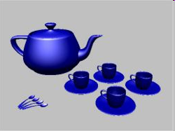
Appendix: Video and Graphics
Graphics is computed creation
Video is recorded as-is
Graphics is object – based
Video (today) is not
Graphics is computed every frame fully
Video is mostly delta sequences
Motion-detection, construction, compensation
But extensions like swap_region (Nokia) exist

