Slide 1

ICCE ASIA 2017 Program Outline
OCT 5,6,7
Bengaluru, India
Organised by IEEE Consumer Electronics Society Bengaluru & RAS Chapter

Slide 2
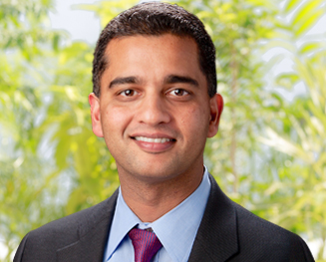


Keynote
Creating Smarter Machines through the Power of Analytics
Mr. Suman Narayan
Senior Vice President
Semiconductor Business Unit
Cyient
DIAMOND SPONSOR

Slide 3
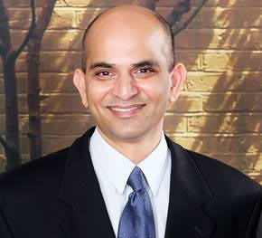

Keynote
Enabling Mobile eXtended Reality (XR)
Dr. Ajit Rao
Senior Director
Qualcomm
PLATINUM SPONSOR

Slide 4
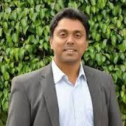

Keynote
Commercializing Hardware Innovations
Mr. Avinash Kaushik
Founder and CEO
Revvx Hardware/IoT Accelerator
Best Product Sponsor

Slide 5
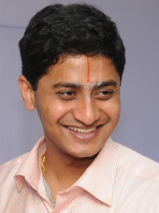
Keynote
Human motion detection and use in Entertainment/ Gaming - Challenges, Algorithms
Prof. Varadhan SKM
IIT Madras

Slide 6
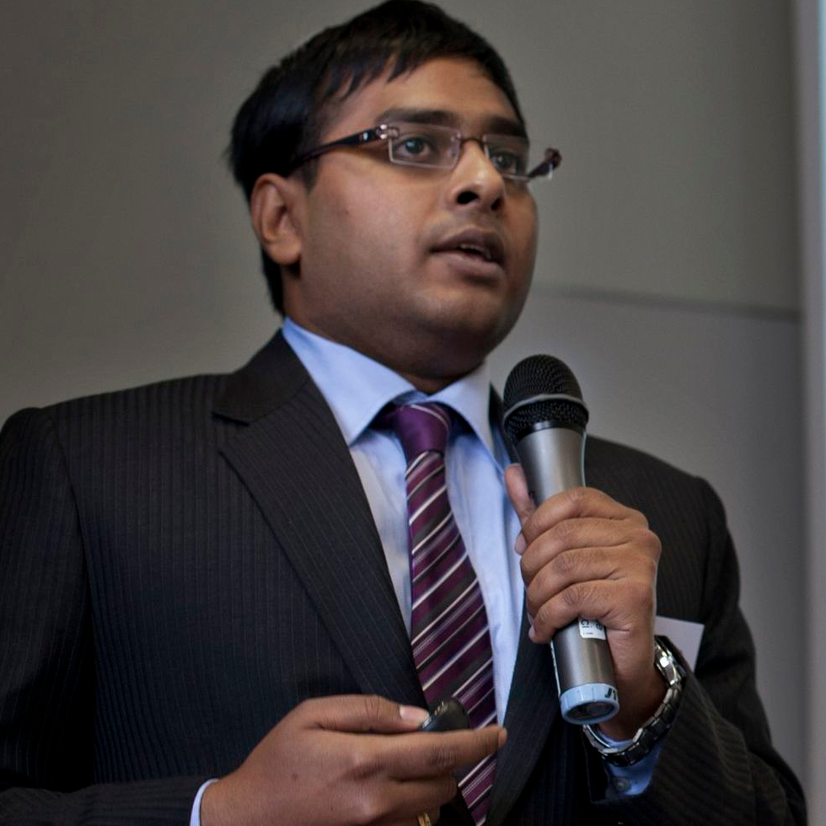
Tutorial (Oct 5)
BlockChain for the Internet of Things
Soumya Kanti Datta
Future Tech Lab

Slide 7

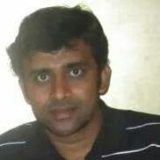
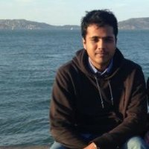
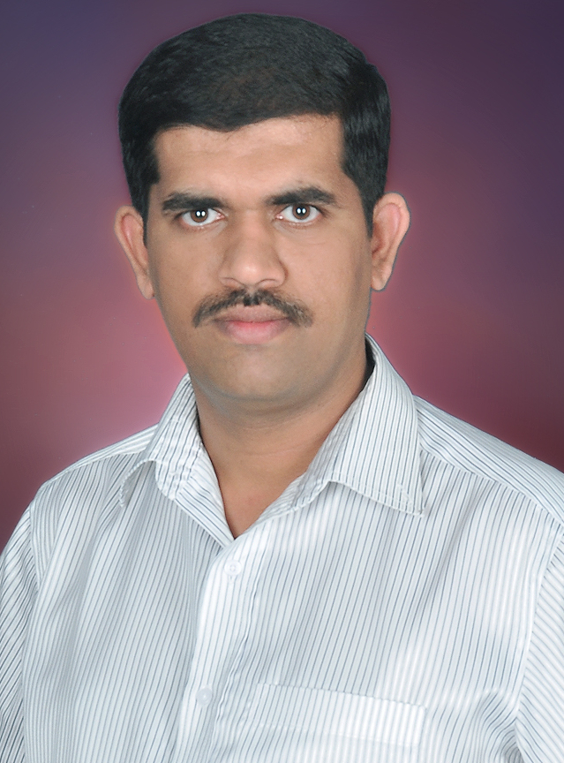

Tutorial
Moving to Vulkan – Next generation compute and graphics
Kumar Katragadda
Samsung Research India Bangalore
Khronos Chapter Leader
Mukund Keshava, Nvidia
Nilesh Shah, Qualcomm
Raghavendra Holla
Samsung Research India Bangalore
*All participants receive a Vulkan T-shirt and Specification documents, sponsored by Khronos

Slide 8

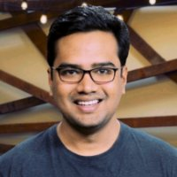
Tutorial
Deepdive into TensorFlow
Manoranjan Padhy
Google (Developer Ecosystem Team)

Slide 9
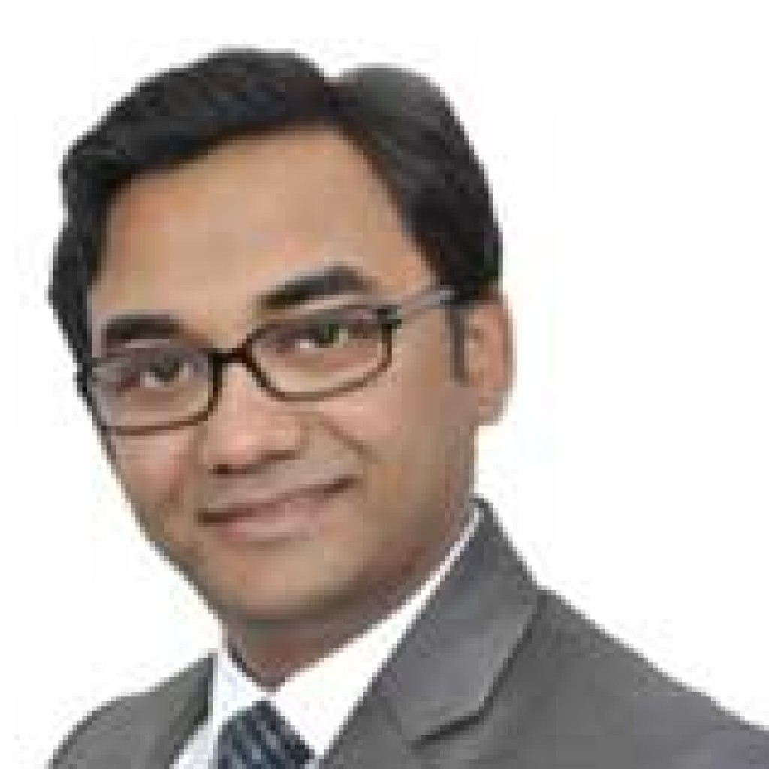
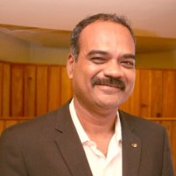
Panel Discussion
Mr Neeraj Gupta –
Director & CEO, FormulateIP,
Co-Founder, Excubator
Mr. Suman Narayan –
Senior VP, Cyient
Mr. Sudeendra Koushik –
Founder, Prasu Consulting

Slide 10
Startup Track
Robotics Technologies
Imaging Technologies
Consumer Medical Innovation
Local focus
* Names will be announced shortly

Slide 11
Women In Engineering
Papers and Invited Talks
* Names will be announced shortly

Slide 12
Award Ceremony
Best Paper
Best Product
1-Minute Madness Posters

Slide 13
Be a Part of ICCE
Registrations open
http://icce-asia2017.org/registration.html
Interested in volunteering ? Contact us
info@icce-asia2017.org

Slide 14
Organising Committee
Prabindh Sundareson, Nvidia
Kousik Sankar Ramasubramaniam, Cisco
Dr Vivek Rao, Continental Automotive
Soumya Kanti Dutta, Future Tech Lab
Dr Sudarshan TSB, Director, PES University
Satish Patel, Linaro
Arun Shankar Bhat, Continental Automotive
Dr Pratibha Moogi, Samsung Electronics
Nippun Kumar, Amrita University
Dr Sujatha DN, BMS CE
Dr Vivek Maik, SRM University
Technical Program Committee
Dr Sudarshan TSB, Professor & Associate Director, PES University South Campus, Bangalore
Mr. Soumya Kanti Datta, Future Tech Lab
Dr. Pratibha Moogi, Samsung Electronics
Dr. Ramasubramanian V, IIIT-Bangalore
Dr. Abhilasha, Amrita SOE
Dr. Vivek Maik, The Oxford COE
Mr. Kousik Sankar, CISCO TECH
Mr. Rajesh Narasimha - Thermo Fisher Scientific, Texas
International Advisory Panel
Dr. Mahesh Mehendale - Texas Instruments Fellow, and Director, Kilby Labs, India
Dr. Debabrata Das, Professor and Hewlett Packard Chair, IIIT-B
Dr. Thinagaran Perumal - Universiti Putra Malaysia
Mr. Stefan Mozar - Fellow IEEE, Past President, IEEE Consumer Electronics Society
Mr Sudeendra Koushik, Prasu (Innovator, Intrapreneur & Innovation Consulting)

