Slide 1
Rules of Inference

Slide 2
Introduction
Proofs in mathematics are valid arguments that establish the truth of mathematical statements
Argument: sequence of statements that end with conclusion.
Valid: conclusion or final statement of the argument must follow from the truth of preceding statements, or premises, of the statement.
Premises: All but the final proposition in the argument are called premises.
Conclusion: Final proposition.
An argument is valid if the truth of all its premises implies that the conclusion is true.
Rules of inference are our basic tools for establishing the truth of statements.

Slide 3
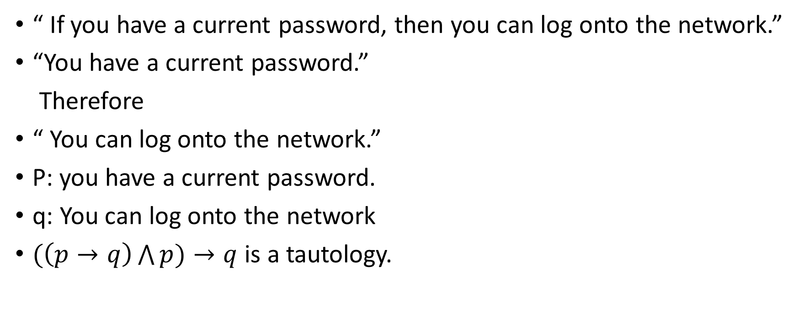
Valid arguments in propositional logic
“ If you have a current password, then you can log onto the network.”
“You have a current password.”
Therefore
“ You can log onto the network.”
P: you have a current password.
q: You can log onto the network
$(\left(p→q\right)\bigwedge{p)→q}$ is a tautology.

Slide 4
Rules of inference for propositional logic
We can always truth table to show that an argument form is valid.
Using truth table, we show when all the premises are true , then conclusion must be true.
What happens argument form involve 10 propositional variables?
We need 1024 different rows.
So, we can establish the validity of some relatively simple argument forms, called rules of inference.
These rules of inference can be used as building blocks to construct more complicated valid argument forms.

Slide 5
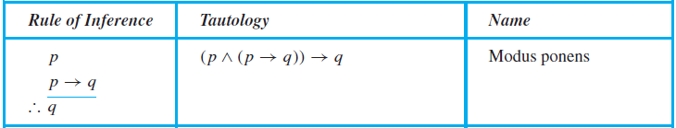
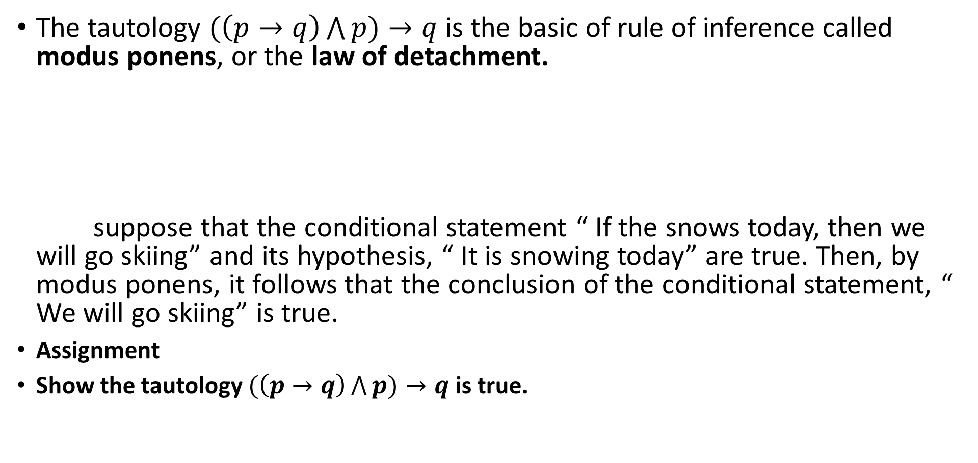
1. Modus ponens
The tautology $(\left(p→q\right)\bigwedge{p)→q}$is the basic of rule of inference called modus ponens, or the law of detachment. suppose that the conditional statement “ If the snows today, then we will go skiing” and its hypothesis, “ It is snowing today” are true. Then, by modus ponens, it follows that the conclusion of the conditional statement, “ We will go skiing” is true.
Assignment
Show the tautology $(\left(p→q\right)\bigwedge{p)→q}$ is true.

Slide 6
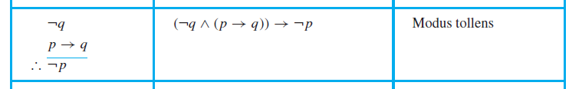
2. Modus Tollens
Assignment
(￢q ∧ (p → q))→￢p is tautology using truth table and also using law of logic.

Slide 7
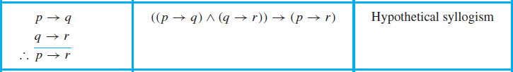
3. Hypothetical syllogism (Transitive rule)
Assignment:
((p → q) ∧ (q → r)) → (p → r) is tautology using truth table and also using law of logic.
State which rule of inference is used in the argument:
If it rains today, then we will not have a barbecue today. If we do not have a barbecue today, then we will have barbecue tomorrow. Therefore, if it rains today, then we will have a barbecue tomorrow.

Slide 8
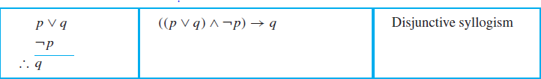
4. Disjunctive syllogism
Assignment:
((p ∨ q)∧￢p) → q is tautology using truth table and also using law of logic.

Slide 9
5. Addition
Assignment
p → (p ∨ q) is tautology using truth table and also using law of logic.
State which rule of inference is the basis of the following argument: “ It is below freezing now.” Therefore, it is either below freezing or raining now.”

Slide 10

6. Simplification
Assignment
(p ∧ q) → p is tautology using truth table and also using law of logic.
State which rule of inference is the basis of the following argument, “ It is below freezing and raining now. Therefore, it is below freezing now.”

Slide 11

7. Conjunction
Assignment
((p) ∧ (q)) → (p ∧ q) is tautology using truth table and also using law of logic.

Slide 12

8. Resolution
Assignment
1.((p ∨ q) ∧ (￢p ∨ r)) → (q ∨ r) is tautology using truth table and law of logic.
q ∨ r, is called the resolvent
the hypotheses and the conclusion must be expressed as clauses, where a clause is a disjunction of variables or negations of these variables.

Slide 13
For example, suppose we have a statement of the form p ∨ (q ∧ r).Because p ∨ (q ∧ r) ≡ (p ∨ q) ∧ (p ∨ r), we can replace the single statement p ∨ (q ∧ r) by two statements p ∨ q and p ∨ r, each of which is a clause. We can replace a statement of the form ￢(p ∨ q) by the two statements ￢p and ￢q because De Morgan’s law tells us that ￢(p ∨ q) ≡ ￢p ∧￢q. We can also replace a conditional statement p → q with the equivalent disjunction ￢p ∨ q.
EXAMPLE Show that the premises (p ∧ q) ∨ r and r → s imply the conclusion p ∨ s.
Solution: We can rewrite the premises (p ∧ q) ∨ r as two clauses, p ∨ r and q ∨ r. We can also replace r → s by the equivalent clause ￢r ∨ s. Using the two clauses p ∨ r and ￢r ∨ s, we can use resolution to conclude p ∨ s.

Slide 14
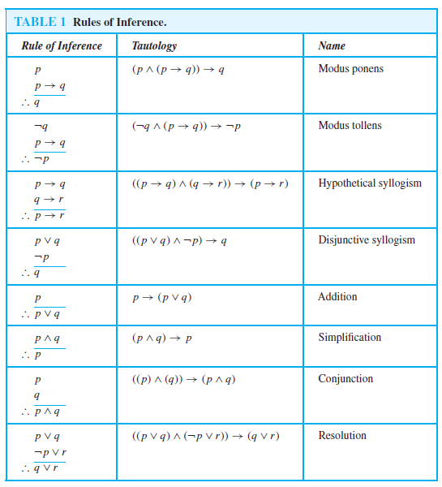

Slide 15
When there are several premises, several rules of inference are needed to show that argument is valid.
Show that the premises “It is not sunny this afternoon and it is colder than yesterday,” “We will go swimming only if it is sunny,” “If we do not go swimming, then we will take a canoe trip,” and “If we take a canoe trip, then we will be home by sunset” lead to the conclusion “We will be home by sunset.”
Solution: Let p be the proposition “It is sunny this afternoon,” q the proposition “It is colder than yesterday,” r the proposition “We will go swimming,” s the proposition “We will take a canoe trip,” and t the proposition “We will be home by sunset.” Then the premises become ￢p ∧ q, r → p,￢r → s, and s → t . The conclusion is simply t . We need to give a valid argument with premises ￢p ∧ q, r → p, ￢r → s, and s → t and conclusion t .
Step Reason
1. ￢p ∧ q Premise
2. ￢p Simplification using (1)
3. r → p Premise
4. ￢r Modus tollens using (2) and (3)
5. ￢r → s Premise
6. s Modus ponens using (4) and (5)
7. s → t Premise
8. t Modus ponens using (6) and (7)

Slide 16
EXAMPLE Show that the premises “If you send me an e-mail message, then I will finish writing the program,” “If you do not send me an e-mail message, then I will go to sleep early,” and “If I go to sleep early, then I will wake up feeling refreshed” lead to the conclusion “If I do not finish writing the program, then I will wake up feeling refreshed.”
Solution: Let p be the proposition “You send me an e-mail message,” q the proposition “I will finish writing the program,” r the proposition “I will go to sleep early,” and s the proposition “I will wake up feeling refreshed.” Then the premises are p → q,￢p → r, and r → s. The desired conclusion is ￢q → s. We need to give a valid argument with premises p → q, ￢p → r, and r → s and conclusion ￢q → s.
This argument form shows that the premises lead to the desired conclusion.
Step Reason
1. p → q Premise
2. ￢q →￢p Contrapositive of (1)
3. ￢p → r Premise
4. ￢q → r Hypothetical syllogism using (2) and (3)
5. r → s Premise
6. ￢q → s Hypothetical syllogism using (4) and (5)

Slide 17
Assignments
Show that the following argument is valid. If today is Tuesday, I have a test in Mathematics or economics. If my Economics professor is sick, I will not have test in Economics. Today is Tuesday and my Economics professor is sick. Therefore I have a test in Mathematics.
Show that the following argument is valid. If Mohan is a lawyer, then he is ambitious. If Mohan is an early riser, then he does not like idlies. If Mohan is ambitious, then he is an early riser. Then if Mohan is a lawyer, then he does not like the idlies.
If dogs are mammals, then cats are reptiles. If I am a mammal, then either I am a dog or I am a cat. Either dogs are mammals, or I am a mammal. Cats are not reptiles. I am not a dog. Therefore, I am a cat.

Slide 18
Fallacies
Common forms of incorrect reasoning, called fallacies, which lead to invalid arguments.
Three forms of faulty inference
Fallacy of affirming the conclusion.
Fallacy of denying the hypothesis
Circular reasoning

Slide 19
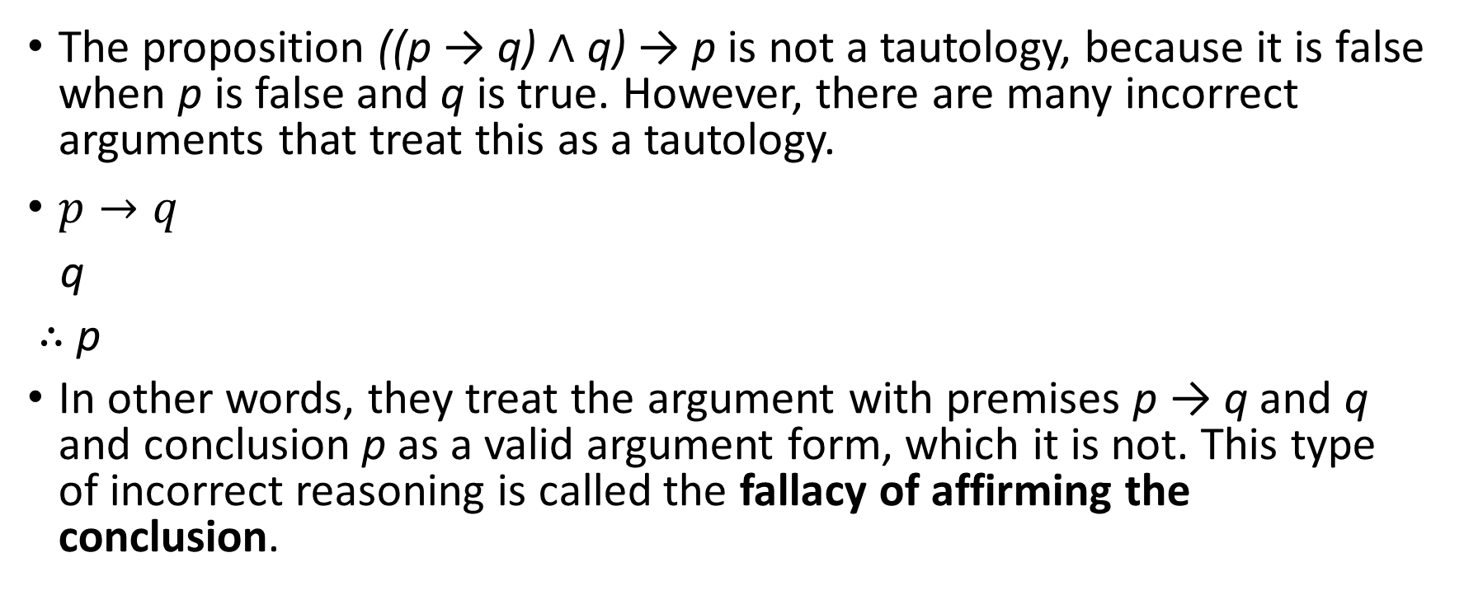
Fallacy of affirming the conclusion
The proposition ((p → q) ∧ q) → p is not a tautology, because it is false when p is false and q is true. However, there are many incorrect arguments that treat this as a tautology.
$p→q$
q
∴ p
In other words, they treat the argument with premises p → q and q and conclusion p as a valid argument form, which it is not. This type of incorrect reasoning is called the fallacy of affirming the conclusion.

Slide 20
EXAMPLE: Is the following argument valid?
If you do every problem in this book, then you will learn discrete mathematics. You learned discrete mathematics. Therefore, you did every problem in this book.
Solution: Let p be the proposition “You did every problem in this book.” Let q be the proposition “You learned discrete mathematics.” Then this argument is of the form: if p → q and q, then p. This is an example of an incorrect argument using the fallacy of affirming the conclusion.
Indeed, it is possible for you to learn discrete mathematics in someway other than by doing every problem in this book. (You may learn discrete mathematics by reading, listening to lectures, doing some, but not all, the problems in this book, and so on.)

Slide 21
Fallacy of denying the hypothesis
The proposition ((p → q)∧￢p)→￢q is not a tautology, because it is false when p is false and q is true. Many incorrect arguments use this incorrectly as a rule of inference. This type of incorrect reasoning is called the fallacy of denying the hypothesis.
(p → q)
￢p
∴ ￢q

Slide 22
If you do every problem in this book, then you will learn discrete mathematics. You learned discrete mathematics. Therefore, you did every problem in this book.
If the conditional statement p → q is true, and ￢p is true, is it correct to conclude that ￢q is true?
In other words, is it correct to assume that you did not learn discrete mathematics if you did not do every problem in the book, assuming that if you do every problem in this book, then you will learn discrete mathematics?
Solution: It is possible that you learned discrete mathematics even if you did not do every problem in this book. This incorrect argument is of the form p → q and ￢p imply ￢q, which is an example of the fallacy of denying the hypothesis.

Slide 23
Circular Reasoning ( Begging the question)
The fallacy of begging the question is known as circular reasoning.
If the statement that is used for proof is equivalent to the statement that is being proved then it is called circular reasoning.
The argument degenerate “It is true because it is true”.
We make statement A and offer statement B in support of the statement A, but actually A and B turn out to mean exactly the same things.
Eg: Man is mortal because man dies.
Ram is black because he is black.

Slide 24
Rules of inference for quantified statements
Universal instantiation
Universal generalization
Existential instantiation
Existential generalization

Slide 25
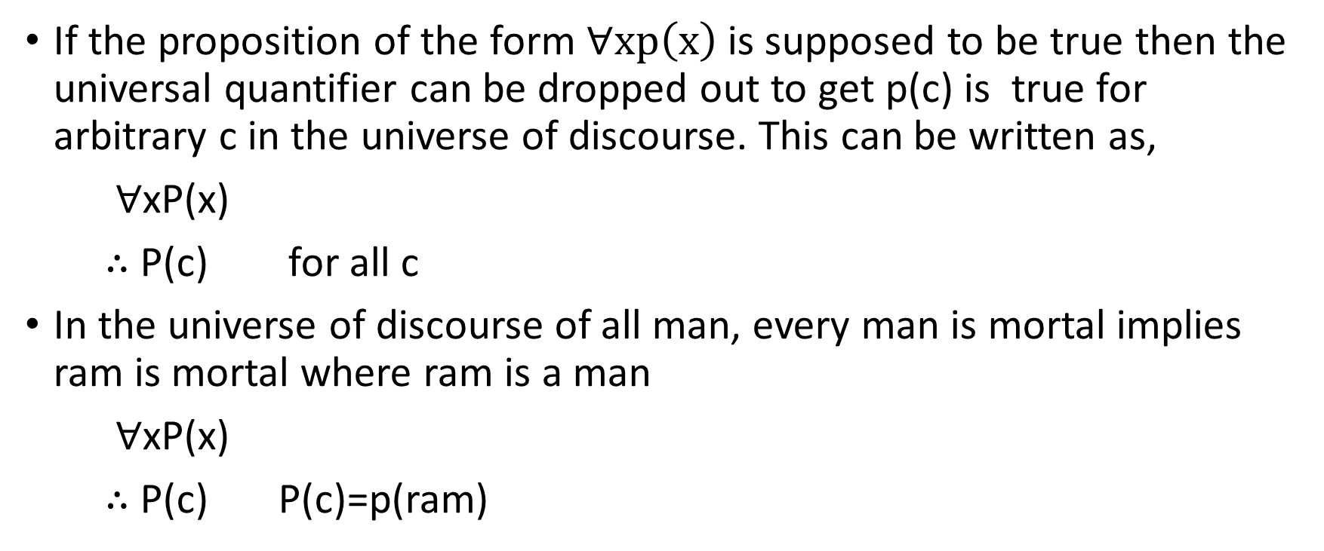
Universal instantiation
If the proposition of the form $∀xp\left(x\right)$ is supposed to be true then the universal quantifier can be dropped out to get p(c) is true for arbitrary c in the universe of discourse. This can be written as,
∀xP(x)
∴ P(c) for all c
In the universe of discourse of all man, every man is mortal implies ram is mortal where ram is a man
∀xP(x)
∴ P(c) P(c)=p(ram)

Slide 26
Universal Generalization
The rule of inference that states that ∀xP(x) is true, given the premise that P(c) is true for all elements c in the domain.
P(c) for an arbitrary c
∴ ∀xP(x)
Universal generalization is used when we show that ∀xP(x) is true by taking an arbitrary element c from the domain and showing that P(c) is true.
The element c that we select must be an arbitrary, and not a specific, element of the domain.

Slide 27
Existential instantiation
If the proposition of the form ∃xP(x) is supposed to be true then there is an element c in the universe of discourse such that p(c) is true.
∃xP(x)
∴ P(c) for some element c
Here the element c is not arbitrary , it must be specific such that p(x) is true.

Slide 28
Existential Generalization
the rule of inference that is used to conclude that ∃xP(x) is true when a particular element c with P(c) true is known.
That is, if we know one element c in the domain for which P(c) is true, then we know that ∃xP(x) is true.
P(c) for some element c
∴ ∃xP(x)
If there is some element c in the universe that has the property P, then we can say that there exists something in the universe that has the property P.

Slide 29
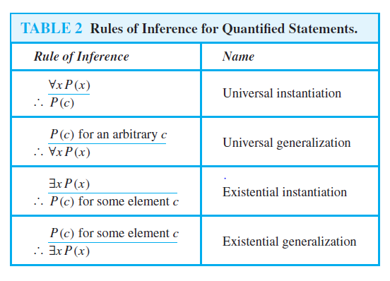

Slide 30
EXAMPLE: Show that the premises “Everyone in this discrete mathematics class has taken a course in computer science” and “Marla is a student in this class” imply the conclusion “Marla has taken a course in computer science.”
Solution: Let D(x) denote “x is in this discrete mathematics class,” and let C(x) denote “x has taken a course in computer science.” Then the premises are ∀x(D(x) → C(x)) and D(Marla). The conclusion is C(Marla).The following steps can be used to establish the conclusion from the premises.
Step Reason
1. ∀x(D(x) → C(x)) Premise
2. D(Marla)→C(Marla) Universal instantiation from (1)
3. D(Marla) Premise
4. C(Marla) Modus ponens from (2) and (3)

Slide 31
EXAMPLE: Show that the premises “A student in this class has not read the book,” and “Everyone in this class passed the first exam” imply the conclusion “Someone who passed the first exam has not read the book.”
Solution: Let C(x) be “x is in this class,” B(x) be “x has read the book,” and P(x) be “x passed the first exam.” The premises are ∃x(C(x)∧￢B(x)) and ∀x(C(x) → P(x)). The conclusion is ∃x(P(x)∧￢B(x)). These steps can be used to establish the conclusion from the premises.
Step Reason
1. ∃x(C(x)∧￢B(x)) Premise
2. C(a)∧￢B(a) Existential instantiation from (1)
3. C(a) Simplification from (2)
4. ∀x(C(x) → P(x)) Premise
5. C(a) → P(a) Universal instantiation from (4)
6. P(a) Modus ponens from (3) and (5)
7. ￢B(a) Simplification from (2)
8. P(a)∧￢B(a) Conjunction from (6) and (7)
9. ∃x(P(x)∧￢B(x)) Existential generalization from (8)

Slide 32
Assignments
3. Prove or disprove the validity of argument “Every living thing is a plant or animal” “Hari’s dog is alive and it is not a plant,” “All animal have heart”, Hence, Hari’s dog has a heart.”
4. Use rule of inference to show that the hypothesis “Dipen works hard,” “If Dipen works hard, then he is a dull boy,” and “If Dipen is a dull then he will not get the job,” imply the conclusion “Dipen will not get the job”.
5. For the set of premises “ If I play hockey, then I am sore the next day.
“I will take rest if I am sore.” “ I will not take rest.” What relevant conclusion can be drawn? Explain the rules of inference used to draw a conclusion.
6. Show that the hypothesis “It is sunny this afternoon and it is colder than yesterday.” “we will go swimming only if it is sunny,” “If we do not go swimming then we will take a trip,” and “ If we take a trip, then we will be home by sunset” lead to the conclusion “we will be home by sunset.”

