Slide 1
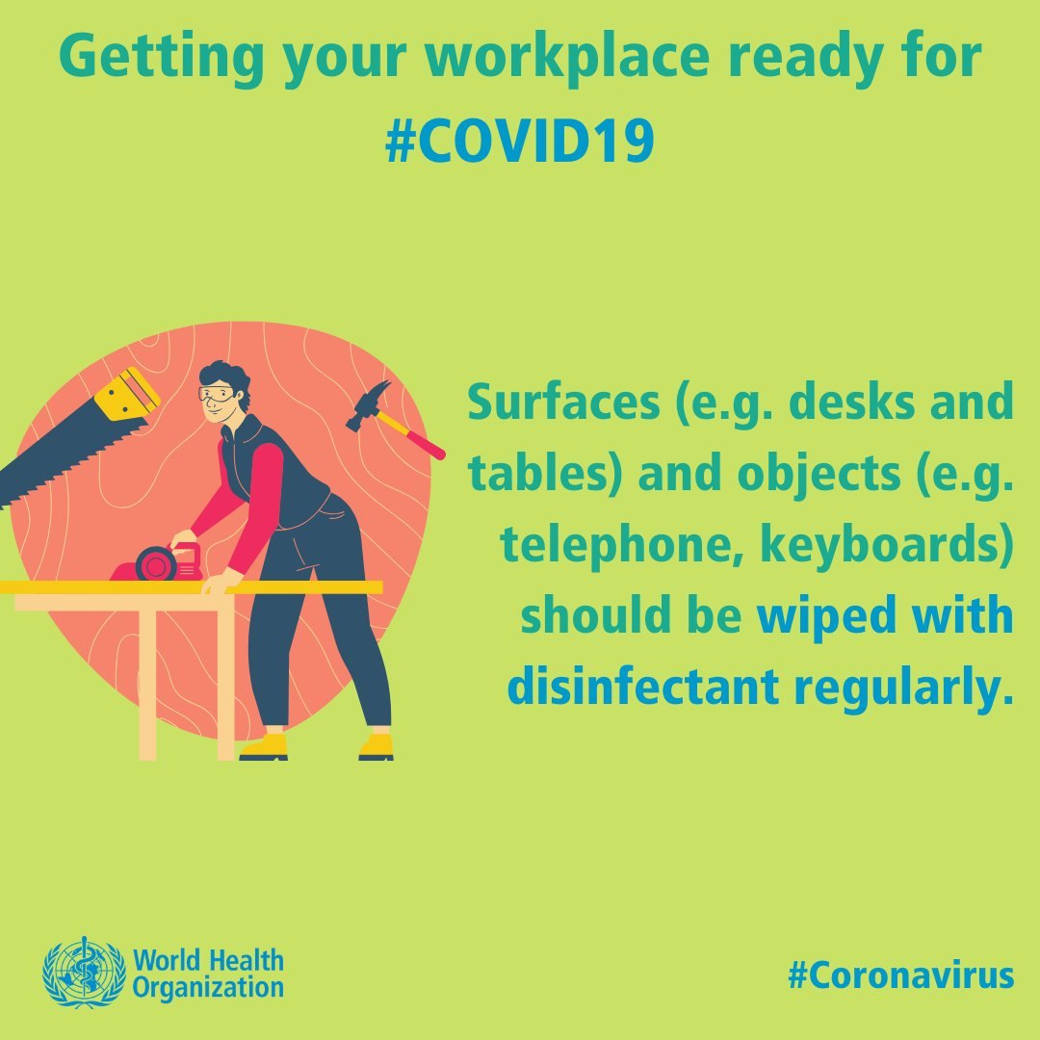
Getting your workplace ready for #COVID19
Surfaces (like desks, tables) and objects (like telephones, keyboards) should be wiped with disinfectant regularly
#Coronavirus

Slide 2
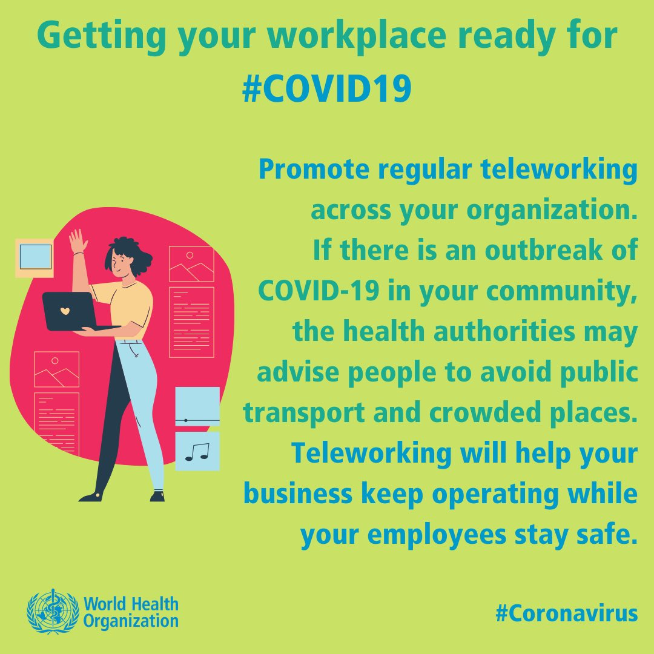
Getting your workplace ready for #COVID19
Promote regular teleworking across your organization. If there is an outbreak of COVID-19 in your community the health authorities may advise people to avoid public transport and crowded places. Teleworking will help your business keep operating while your employees stay safe.
#Coronavirus

Slide 3
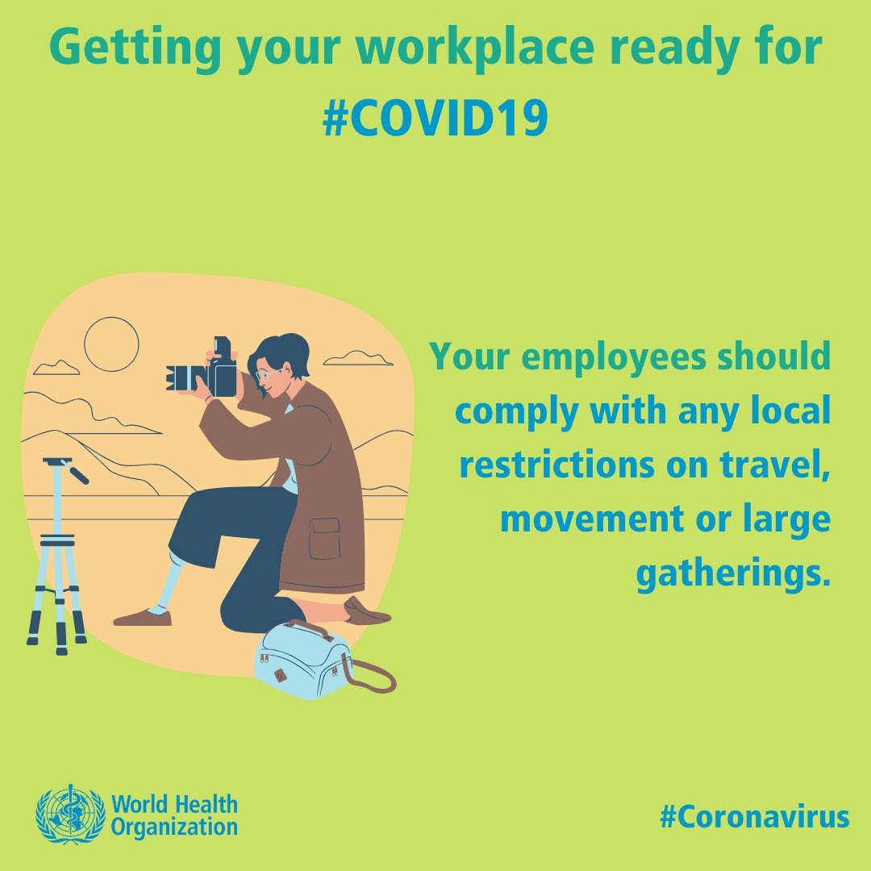
Getting your workplace ready for #COVID19
Your employees should comply with any local restrictions on travel, movement or large gatherings.
#Coronavirus

Slide 4
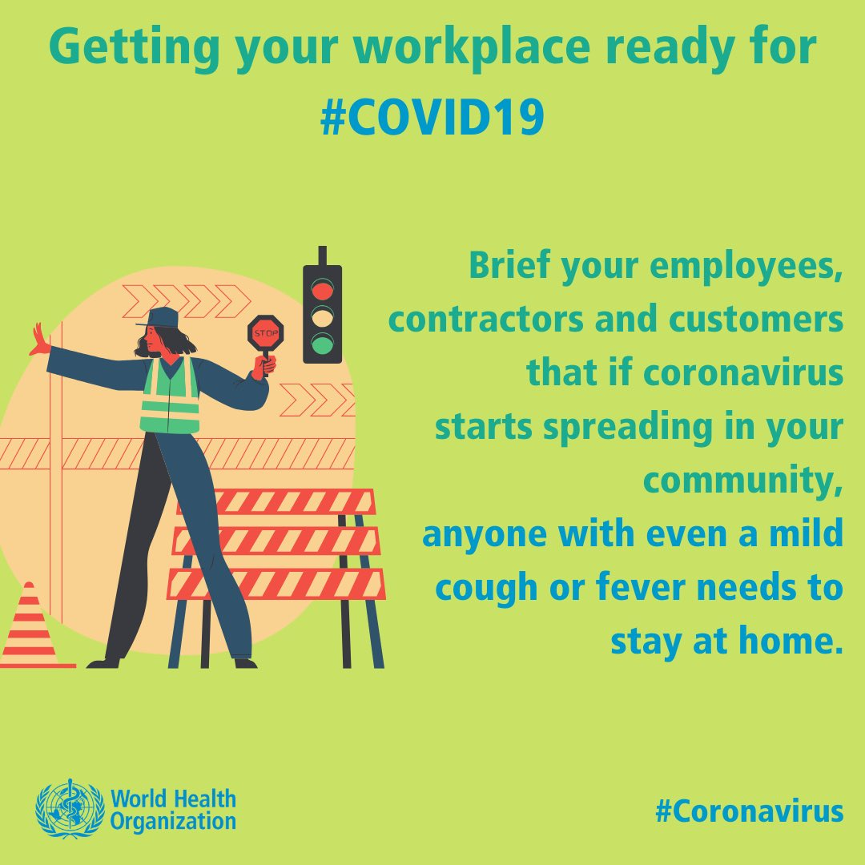
Getting your workplace ready for #COVID19
Brief your employees, contractors and customers that if coronavirus starts spreading in your community, anyone with even a mild cough or fever will need to stay at home.
#Coronavirus

Slide 5
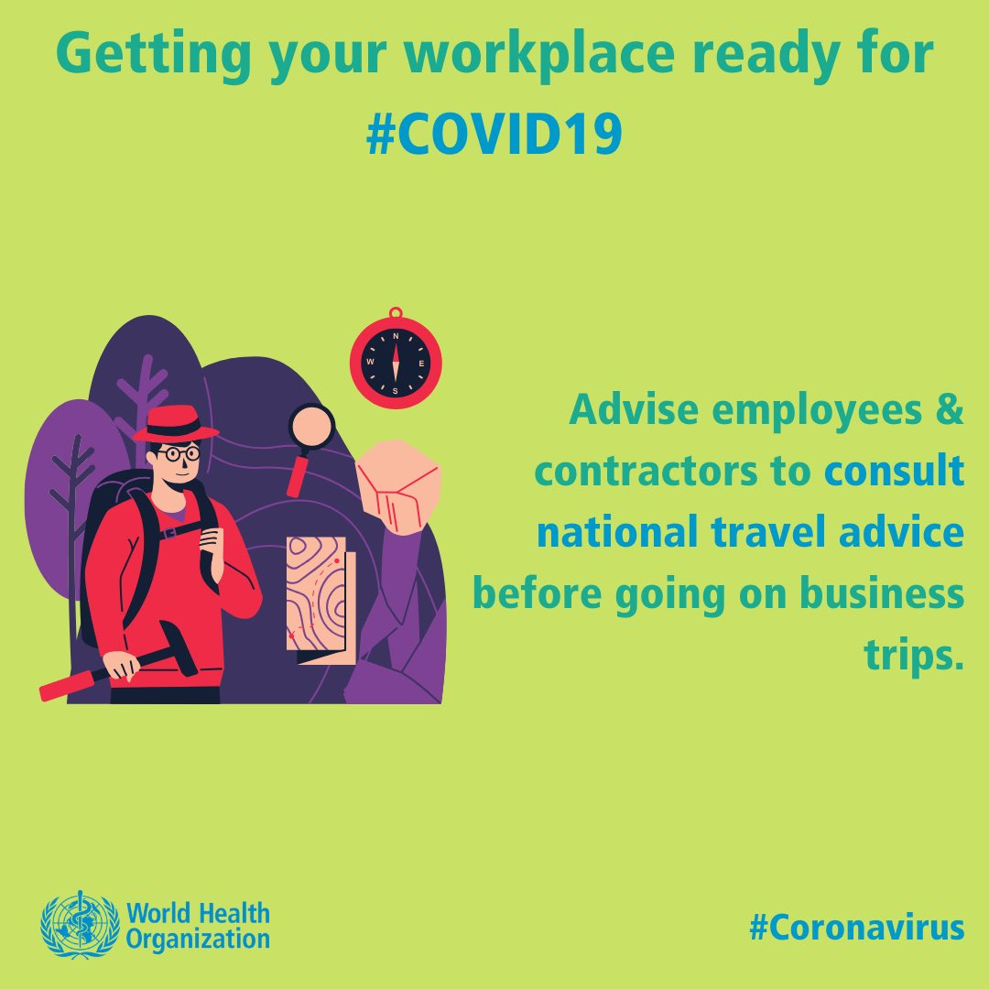
Getting your workplace ready for #COVID19
Advise employees and contractors to consult national travel advice before going on business trips.

Slide 6
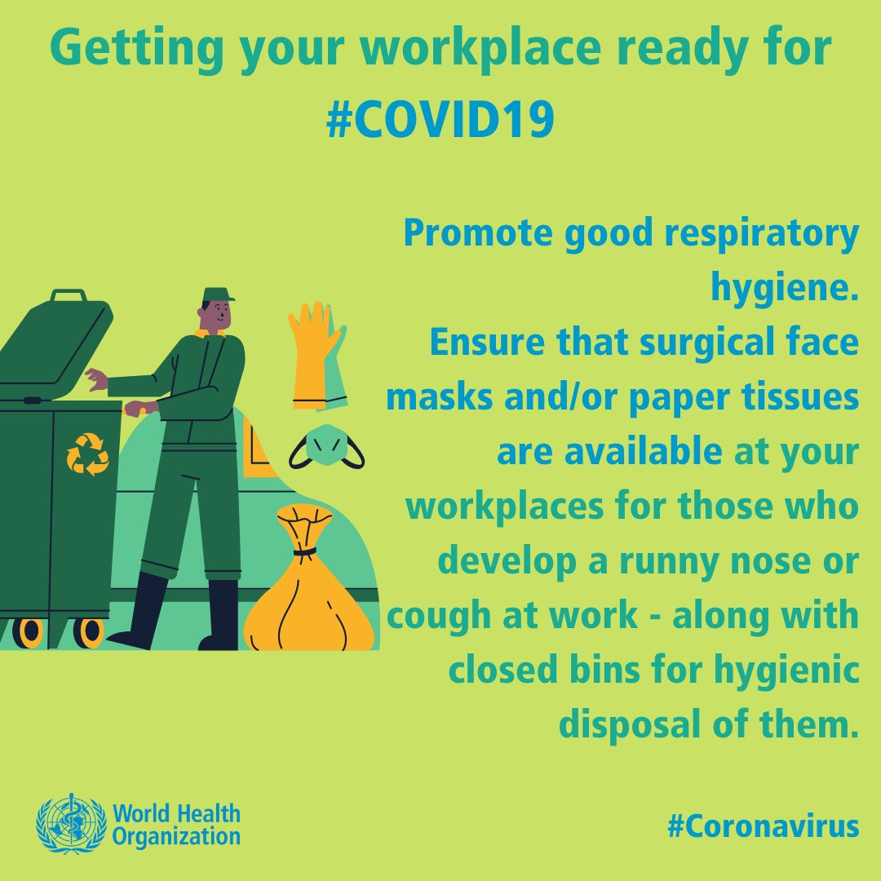
Getting your workplace ready for #COVID19
Promote good respiratory hygiene. Ensure that surgical face masks and/or paper tissues are available at your workplaces for those who develop a runny nose or cough at work – along with closed bins for hygienic disposal of them.
#Coronavirus

Slide 7
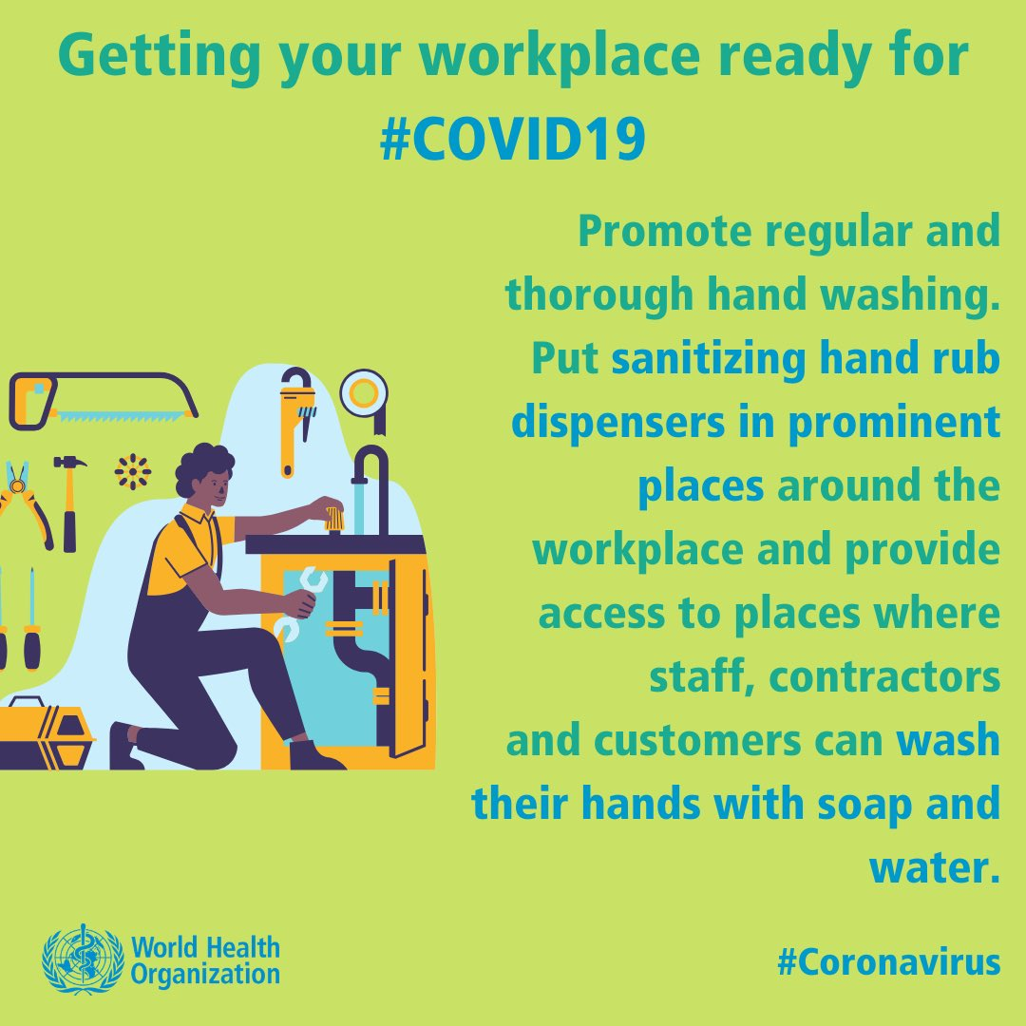
Getting your workplace ready for #COVID19
Promote regular and thorough hand washing. Put sanitizing hand rub dispensers in prominent places around the workplace and provide access to places where staff, contractors, and customers can wash their hands with soap and water.
#Coronavirus

Slide 8
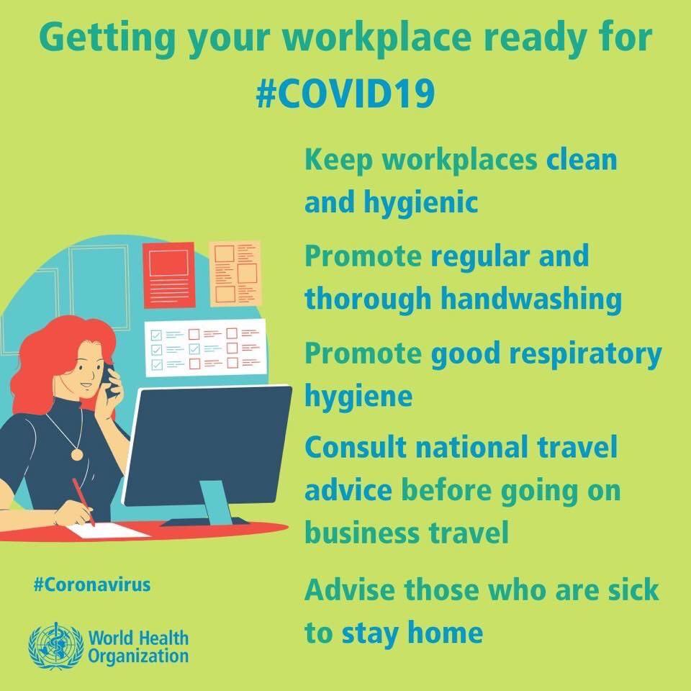
Getting your workplace ready for #COVID19
Keep workplaces clean and hygienic
Promote regular and thorough hand washing
Promote good respiratory hygiene
Consult national travel advice before going on business travel
Advise those who are sick to stay home
#Coronavirus

