Slide 1
Dr. Semmelweis and the discovery of handwashing: Replicate using R
Presentation Session : January 2018 – II
pRabin Raj shakya
prabinrs.guithub.io

Slide 2
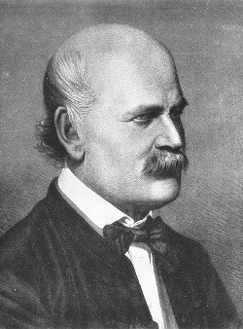
Meet Dr. Ignaz Semmelweis
This is Dr. Ignaz Semmelweis, a Hungarian physician born in 1818 and active at the Vienna General Hospital
childbed fever: A deadly disease affecting women that just have given birth. In the early 1840s at the Vienna General Hospital as many as 10% of the women giving birth die from it. He is thinking about it because he knows the cause of childbed fever: It's the contaminated hands of the doctors delivering the babies. And they won't listen to him and wash their hands!
Today, we're going to reanalyze the data that made Semmelweis discover the importance of handwashing. Let's start by looking at the data that made Semmelweis realize that something was wrong with the procedures at Vienna General Hospital.

Slide 3

General Introduction
R ?
R project for Statistical Computing
Free and open source
Package:tidyverse
Install.packages(“tidyverse”)
Library(tidyverse)
Collection of R packages designed for data science.
https://www.tidyverse.org

Slide 4
Read data / Load data
read_csv()
read_csv(file, col_names = TRUE, col_types = NULL,
locale = default_locale(), na = c("", "NA"), quoted_na = TRUE,
quote = "\"", comment = "", trim_ws = TRUE, skip = 0, n_max = Inf,
guess_max = min(1000, n_max), progress = show_progress())

Slide 5
The alarming number of deaths
The table above shows the number of women giving birth at the two clinics at the Vienna General Hospital for the years 1841 to 1846. You'll notice that giving birth was very dangerous; an alarming number of women died as the result of childbirth, most of them from childbed fever.
We see this more clearly if we look at the proportion of deaths out of the number of women giving birth.

Slide 6

my_data <- my_data %>%
mutate(new_column = old_column * 100)

Slide 7
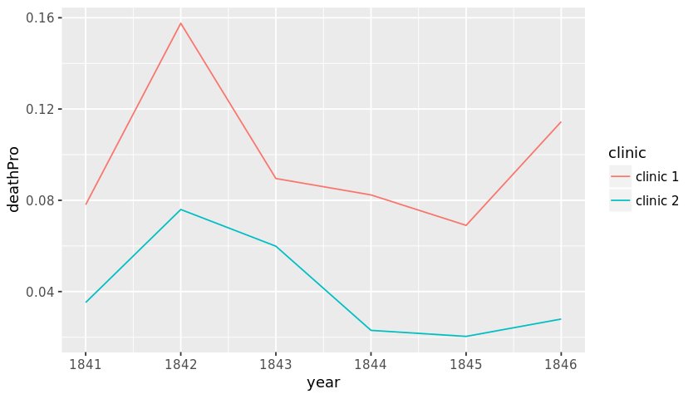
Death at the clinics
If we now plot the proportion of deaths at both clinic 1 and clinic 2 we'll see a curious pattern...
Use ggplot to make a line plot of proportion_deaths by year with one line per clinic.
The lines should have different colors.

Slide 8



Lets Do Task 3

Slide 9
The handwashing begins
Why is the proportion of deaths constantly so much higher in Clinic 1? Semmelweis saw the same pattern and was puzzled and distressed. The only difference between the clinics was that many medical students served at Clinic 1, while mostly midwife students served at Clinic 2. While the midwives only tended to the women giving birth, the medical students also spent time in the autopsy rooms examining corpses.
Semmelweis started to suspect that something on the corpses, spread from the hands of the medical students, caused childbed fever. So in a desperate attempt to stop the high mortality rates, he decreed: Wash your hands! This was an unorthodox and controversial request, nobody in Vienna knew about bacteria at this point in time.

Slide 10

The effect of handwashing
With the data loaded we can now look at the proportion of deaths over time. In the plot below we haven't marked where obligatory handwashing started, but it reduced the proportion of deaths to such a degree that you should be able to spot it!
Make a line plot of proportion_deaths by date for the monthly data frame using ggplot.
Use the labs function to give the x-axis and y-axis labels.

Slide 11
The effect of handwashing highlighted
Starting from the summer of 1847 the proportion of deaths is drastically reduced and, yes, this was when Semmelweis made handwashing obligatory.
The effect of handwashing is made even more clear if we highlight this in the graph.
Add a TRUE/FALSE column to monthly called handwashing_started which is TRUE for dates where obligatory handwashing was enforced.
Make a line plot of proportion_deaths by date for the monthly data frame using ggplot. Make the color of the line depend on handwashing_started.
Use the labs function to give the x-axis and y-axis any prettier labels.

Slide 12
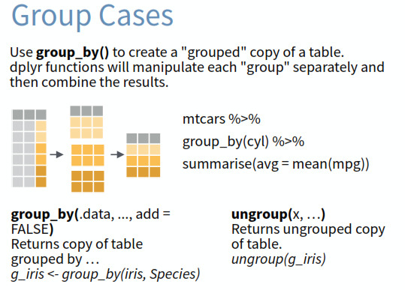
More handwashing, fewer deaths?
Again, the graph shows that handwashing had a huge effect. How much did it reduce the monthly proportion of deaths on average?
Use group_by and summarise to calculate the mean proportion of deaths before and after handwashing was enforced.
Put the resulting table into monthly_summary.

Slide 13
A statistical analysis of Semmelweis handwashing data
It reduced the proportion of deaths by around 8 percentage points! From 10% on average before handwashing to just 2% when handwashing was enforced (which is still a high number by modern standards). To get a feeling for the uncertainty around how much handwashing reduces mortalities we could look at a confidence interval (here calculated using a t-test).
Use the t.test function to calculate a 95% confidence interval around how much dirty hands increases proportion_deaths.

