Slide 1
Customer Churn Prediction
System
Linear Regression • Random Forest • XGBoost
Live demo: customer-churn-prediction-on.streamlit.app
PRESENTED BY
SUBASH ACHARYA D
Roll No. 24CSR306
THANNASI PRABU R
Roll No. 24CSR321
VIKRAM S
Roll No. 24CSR345
1

Slide 2
Problem Statement
Why churn prediction matters
Challenges
Proposed Solution
• Annual losses exceed ₹10,000 crore across telecom, banking and OTT due to churn.
• Rule-based retention systems miss complex behavioural patterns (usage shifts, payment irregularities, service interactions).
• Generic global datasets ignore localised drivers such as UPI usage trends and regional behaviour.
• Businesses react too late — churn signals are not detected early enough.
• No production-ready, interpretable models at 85–92% accuracy.
• Train Linear Regression, Random Forest and XGBoost on Telco customer churn data.
• Detect churn early using churn probability + risk levels for every customer.
• Explain every prediction (local drivers + global importance).
• Serve insights through a Flask web app and a deployed Streamlit dashboard.
• Deliver reproducible, interpretable ML with honest, test-set-validated metrics.
2

Slide 3
Objectives
Churn Prediction
Model Comparison
Interpretability
Data Preparation
Web Application
01
Online Deployment
02
03
04
05
06
Score every customer with a churn probability and a clear Churn / No-Churn verdict.
Build and evaluate Linear Regression, Random Forest and XGBoost side by side.
Explain why each model makes its call — local drivers and global importance.
Clean 7,032 records, encode features, standardise numeric fields and engineer new ones.
Ship a full UI — dashboard, prediction form, batch CSV and JSON API.
Host the app publicly on Streamlit Community Cloud from the GitHub repo.
3

Slide 4
Dataset Information
Telco Customer Churn — IBM sample dataset
7,032
20
26.6%
1,407
Records after cleaning
Features
Churn rate
Hold-out test customers
Core dataset fields
Preprocessing in src/preprocess.py
• Demographics: gender, SeniorCitizen, Partner, Dependents
• Usage: tenure, PhoneService, MultipleLines, InternetService
• Services: OnlineSecurity, OnlineBackup, DeviceProtection, TechSupport, Streaming
• Contract & billing: Contract, PaperlessBilling, PaymentMethod, Monthly / Total Charges
• Drop customerID; convert TotalCharges to numeric
• Map binary fields (gender, Partner, Dependents, services) to 0/1
• One-hot encode category fields; standardise numeric fields
• Engineer avg_charge_per_month and tenure_log
• Target: Churn → Yes/No (26.6% positive class)
4

Slide 5
Model Choosing
Linear Regression
Random Forest
XGBoost
Baseline
Retention champion
Gradient boosting
• Continuous score thresholded at 0.5
• Strong ROC-AUC 0.837
• Coefficient-weighted local explanations
• 79.8% accuracy on the test set
• 400 trees, max depth 12, balanced classes
• Best churn recall — finds 76.2% of churners
• Probability calibrated with threshold 0.70
• Recommended for retention teams
• 500 rounds, learning rate 0.05
• Mild imbalance weight 1.4
• Clean probability estimates
• 77.2% accuracy, AUC 0.817
5

Slide 6
System Architecture
CSV Dataset
Data Cleaning
ML Models
Artifacts
Apps
User
7,043 × 21
raw records
types • missing • encoding
feature engineering
Linear Regression
Random Forest • XGBoost
model/*.pkl
metrics • thresholds JSON
Flask web app
Streamlit dashboard
predict a customer
upload CSV • view charts
User selects a customer / uploads data → all three models score it → interpretations and visual analytics
6

Slide 7
Workflow
Load Data
Read Telco_Customer_Churn.csv
1
Clean Data
Convert types • drop NA • encode • engineer features
2
Train Models
Linear Regression • Random Forest • XGBoost
3
Save Artifacts
Full pipelines, metrics, thresholds via joblib/JSON
4
Inputs
Outputs
Deploy
Flask locally + public Streamlit Cloud app
5
Customer profile / CSV upload — predictions, probabilities, risk levels
Verdicts + churn probability, interpretation, CSV downloads, live charts
7

Slide 8
Application Modules
Flask Web App (app.py)
Streamlit App (streamlit_app.py)
• Model dashboard — metrics & confusion matrices
• Single prediction — 3-model verdicts + explanation
• Batch CSV upload with ensemble verdict
• JSON API — POST /api/predict
• Model dashboard — KPIs, bars, confusion matrices
• Predict a customer — form + live explanation
• Batch upload — downloadable results
• About — methodology and honest performance notes
Both apps share the same trained pipelines and preprocessing — one codebase, two front-ends.
8

Slide 9
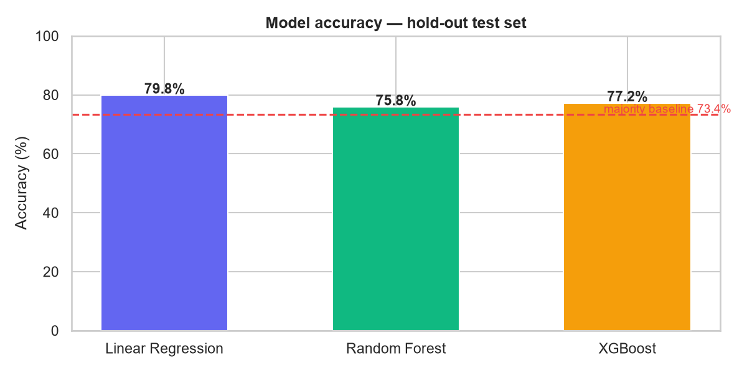
Model Performance & Validation
80/20 stratified train-test split • 1,407 test customers • all metrics test-set only
79.8%
76.2%
0.837
73.4%
Linear Regression accuracy
Random Forest churn recall
Best ROC-AUC (Linear Regression)
Majority-class baseline
Validation notes
• Stratified split keeps churn rate constant
• Accuracy-optimised decision thresholds per model
• Honest note: 85–92% is aspirational on this dataset — 75–80% is the realistic state of the art
• Random Forest finds 76% of future churners
9

Slide 10
Conclusion & Future Scope
Project Outcome
Future Improvements
• End-to-end churn system: clean → train → evaluate → deploy
• Three interpretable models with honest, test-set metrics
• Flask + Streamlit front-ends and a JSON API
• Publicly accessible Streamlit dashboard on the cloud
• Batch scoring with downloadable reports
• Localised data: UPI trends, migration patterns, regional behaviour
• SHAP / LIME explanations for every prediction
• Time-series and uplift models for retention campaigns
• Automated alerts for high-risk customers
• Model monitoring as new data arrives
10

Slide 11
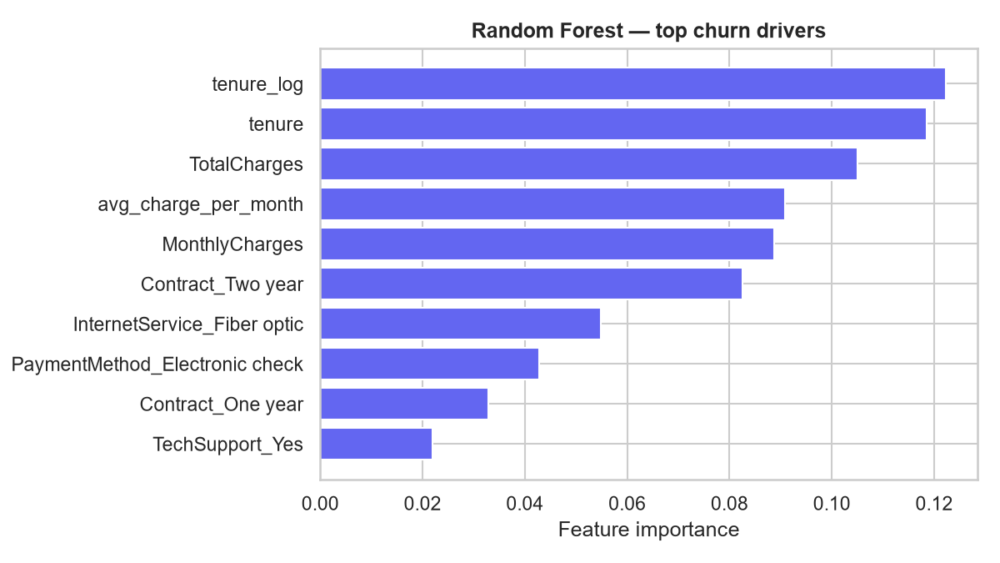
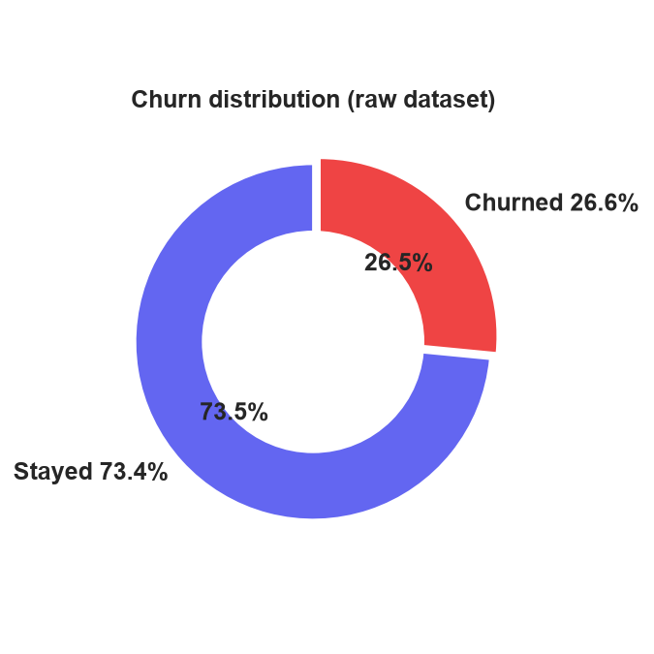
Output — Dashboard & Predictions
Live app: https://customer-churn-prediction-on.streamlit.app
Every customer gets a churn probability, risk level, consensus verdict and an explanation of the deciding features.
11

Slide 12
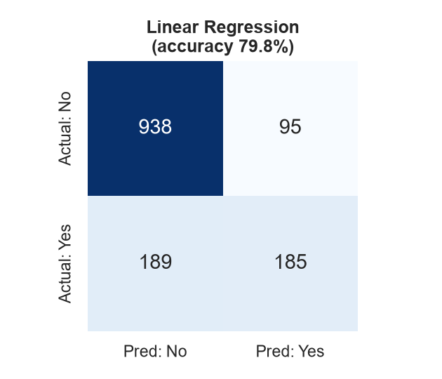
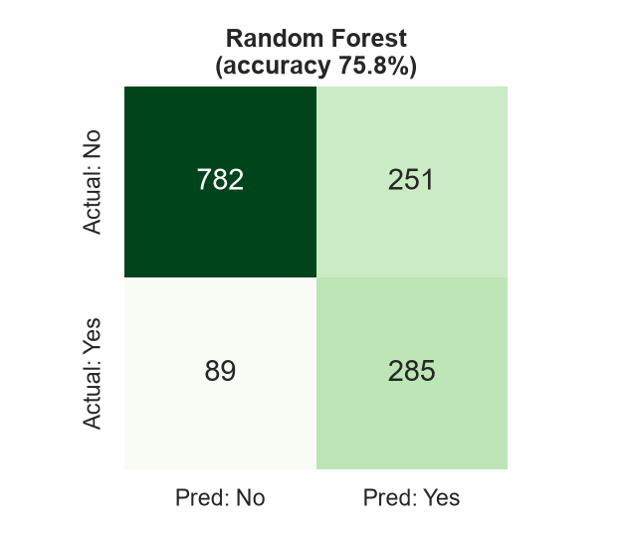
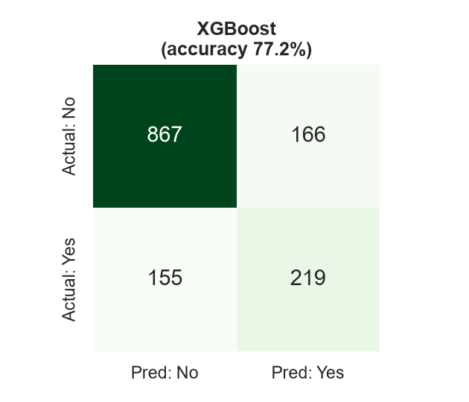
Output — Confusion Matrices (hold-out test set)
Linear Regression
Random Forest
XGBoost
Random Forest trades a little accuracy for far higher churn recall — the right trade for retention teams.
12

Slide 13
Output — Model Comparison Dashboard
Full interactive analytics on the deployed Streamlit app
Accuracy, precision, recall, F1, ROC-AUC and confusion matrices for all three models, side by side.
13

