Slide 1
Machine Learning

Slide 2


Slide 3
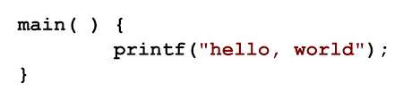
Hero Introduction

Slide 4
Hero Introduction
* Getting the feel of Machine learning
* Give a basic flow of attacking an ML problem

Slide 5
Agenda
* Introduction to Machine learning
* Career Options
* Solving a “Basic” Kaggle Problem (Hands on)

Slide 6
Machine Learning

Slide 7
Learning
In 40 over, Need 80 from 60. Which player to choose?
Dhoni or Koli?

Slide 8
Learning
Define Doctor:

Slide 9
Learning
Define Doctor:
Cure Disease (Defined Task)

Slide 10
Learning
Define Doctor:
Cure Disease (Defined Task)
Define Good Doctor

Slide 11
Learning
Define Doctor:
Cure Disease (Defined Task)
Define Good Doctor
Cure Disease Effectively and Efficiently
(Defined Performance)

Slide 12
Learning
Define Doctor:
Cure Disease (Defined Task)
Define Good Doctor
Cure Disease Effectively and Efficiently
(Defined Performance)
How to Become A Good Doctor?
Hard Work (Defined Experience)

Slide 13
Machine Learning
A Computer program is said to
  Learn from experience E
  For the specific task T
  For performance measure P
If its performance on T, as measured by P, improves with experience E.

Slide 14
Machine Learning
Marking the Email as Spam/Ham:
Task
Experience
Performance

Slide 15
Machine Learning
Types

Slide 16
Machine Learning Types
        Classification
Output: category
Example:
Supervised Learning Blockbluster/Flop movie
“Right Answers” are given already Lover/Friends/
Should produce more Right Answers
Regression
Output:Continuos data
Example:
Unsupervised Learning Amount of rain fall
Extract the Hidden Pattern/Structure Sales of a given product
There is no target output Clustering
        Group the data on similarity
        Example:
        Group news into different group

Slide 17
Career Options

Slide 18
Machine learning Career
Product Development
Machine learning Algorithm can be applied in product development
Example: related books in Amazon page, Differentiating spam and ham
  Analytics
Machine learning to get insights
Example: Amazon cash back - Salary day
Segmentation of Amazon Customers

Slide 19
Hands-on
Kaggle
Problem

Slide 20
Kaggle
A leading platform for predictive modeling and analytics competitions.
Companies and Researchers post their data.
Statisticians and Data Scientists from all over the world compete to produce the best models.
https://www.kaggle.com

Slide 21
Kaggle – Titanic Dataset
The sinking of RMS Titanic is one of the most infamous shipwrecks in history
Some people managed to survive this disaster.
Though there was some element of luck involved, some groups of people were more likely to survive than others, such as women, children and the upper class
The objective of this problem is to predict what sorts of people were likely to survive
https://www.kaggle.com/c/titanic/

Slide 22
Kaggle – Titanic Dataset
Dataset can be downloaded from the following link
www.kaggle.com/c/titanic/data
Files to be downloaded
  train.csv
  test.csv
Train.csv – This file contains the data which is to be used for training out models.
Test.csv – This file contains the data which is to be used for making predictions.

Slide 23
Titanic – Data Exploration
Refer to ipython notebook

Slide 24
Titanic – Data Exploration
Refer to ipython notebook

Slide 25
Linear Regression

Slide 26
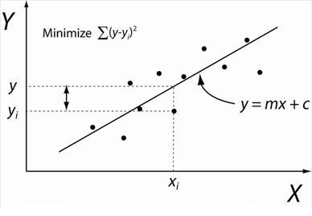
Linear Regression
Training
X -independent
Y – dependant
(to be predicted)
Find Linear equation which minimize SSE (sum of squared Error)
Model/pattern
y= mx + c

Slide 27
Linear Regression
Testing phrase
Model/pattern-
Y = mx + c
Find SSE for test data
Basic Model/pattern
Avg y value
SST (Basic SSE)
R2 = (1- SSE/SST)
If R2 is close to 1
Model is good

Slide 28
Logistic Regression

Slide 29
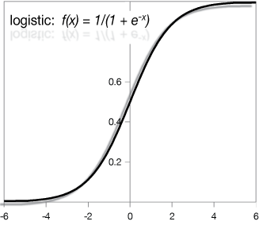
Logistic Regression
Training
Model/pattern
y = G(mx + c)
g – logistic function
Set an threshold t-0.7

Slide 30
Logistic Regression
Testing phrase
Model/pattern-
y = G(mx + c)
Predict for new values
t=0.7
If y=0.8
H(y)=1
If y=0.6
H(y)=0

Slide 31
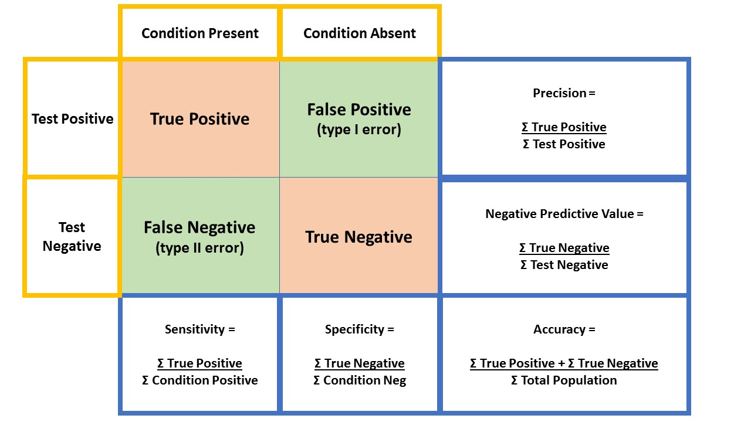
Logistic Regression
Classify patient as AIDS positive/negative
Condition
Actucal output
Test
Model output
True postive:
Predict HIV+ve
as HIV+ve
False positive
Predict HIV-ve as HIV+ve

Slide 32
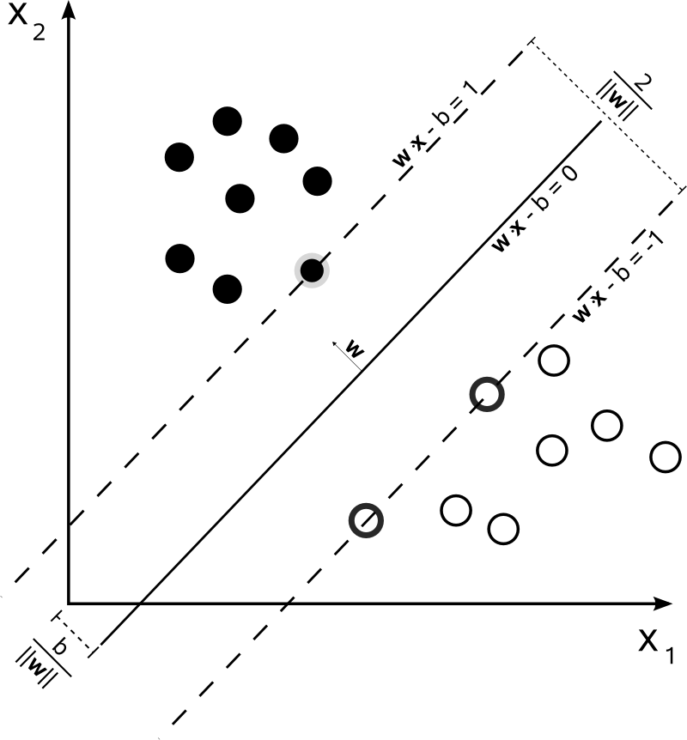
SVM
Training Phase
Model/pattern-
wx - b = 0

Slide 33
SVM
Testing Phase
Model/pattern-
wx - b = 0
If wx-b > 0
y =1
Else
y =0

