Slide 1

Synopsis Of Mini Project On
Casino Number Guessing Game

Slide 2
INTRODUCTION
This is an exciting project, where we will learn about the library used for random numbers: cstdlib. The program asks for a betting amount and then asks the user to guess a number on rolling. If the random number generated matches the user input, he wins, else money is deducted. The user can keep playing until he loses all the amount he put in initially.

Slide 3
ABOUT THE GAME
Casino is a Number Guessing Game. Player deposits an initial amount to start playing game. He guesses a number between 1 to 10 and enters betting amount. If he wins he will get 10 times of money he bets. If he bets on wrong number he will lost his betting amount. Game continues till user wants to play.
The luck factor in a casino game is quantified using standard deviations (SD). As the number of rounds increases, eventually, the expected loss will exceed the standard deviation, many times over.

Slide 4
ADVANTAGES AND DISADVANTAGES
1.The main advantage is that,these games can be potentially rewarding based on the player’s skill level.
2.They are fun to play and even provide entertainment.It is a form of leisure and a relaxation method.
3.Players get a unique chance to finish the game with big wins.They can immediately win twice or thrice of the amount they bet.
4.Game play is an important part of human behavior but it has taken on more importance than in the individual person’s development. The techniques to win would also improve our self-discipline.
5.They create new forms of revenue.Casinos in a community can surely increase employment of people.
6.They can contribute to government budgets.
Disadvantages:
1.It has problems with licensing and legality in different countries.
2.Children might get addicted to it and start gambling at a very young age.

Slide 5
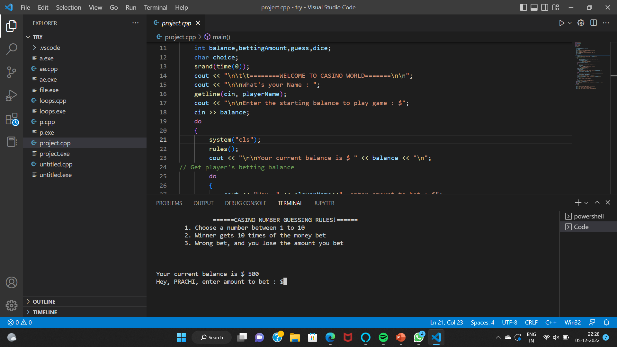
RESULT AND DISCUSSION

Slide 6
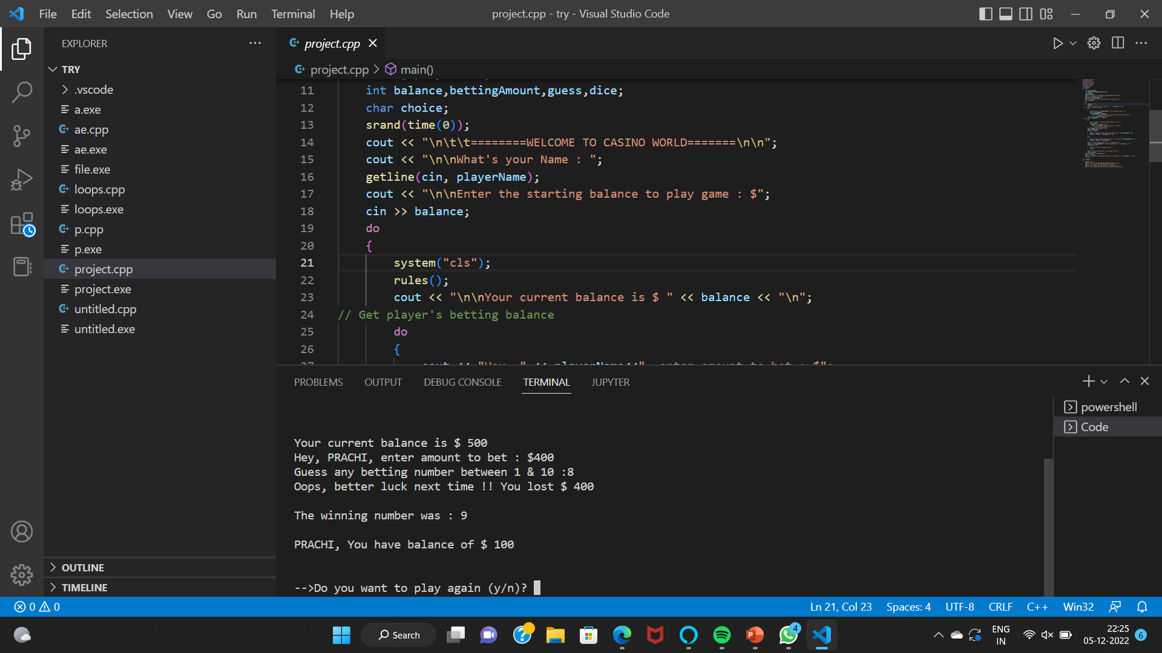

Slide 7
CONCLUSION
In this casino guessing game the player can see the amount he has played on, the right decision to be made, by showing the amount he will win or lose by playing a number. The player can add all the details including the number played and amount left. The player can finally play his chance by following the instructions given by the software. Since casino games are being played enormously worldwide, this source code is developed to avoid taking risky decisions. In this game you either become a billionaire or go bankrupt. No need to worry about the pre knowledge and experience, the computer will take care of your decision making.

Slide 8
REFERENCES
1. "Michael Shackleford is the wizard of odds". The Observer. Retrieved 13 October 2015.
2. Hagan, general editor, Julian Harris, Harris (2012). Gaming law : jurisdictional comparisons
3. www.codewithc.com
4. Code in code::blocks: List of Top Ten College Mini Projects in c/c++ with full source code (codeincodeblock.com)

