Slide 1
FACE RECOGNITION USING TRANSFER LEARNING
- Prachi G

Slide 2
Transfer Learning
Transfer learning (TL) is a research problem in machine learning (ML) that focuses on storing knowledge gained while solving one problem and applying it to a different but related problem.

Slide 3
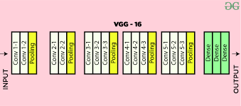
VGG-16
VGG16 is a convolutional neural network model.
The model achieves 92.7% top-5 test accuracy in ImageNet, which is a dataset of over 14 million images
belonging to 1000 classes.
It makes the improvement over AlexNet by replacing large kernel-sized filters (11 and 5 in the first
and second convolutional layer, respectively) with multiple 3×3 kernel-sized filters one after another.

Slide 4
Transfer learning with VGG16
The task was to do face recognition using transfer learning.
So I have used VGG16 for this purpose.
The CNN network is shown as per upcoming slides.

Slide 5
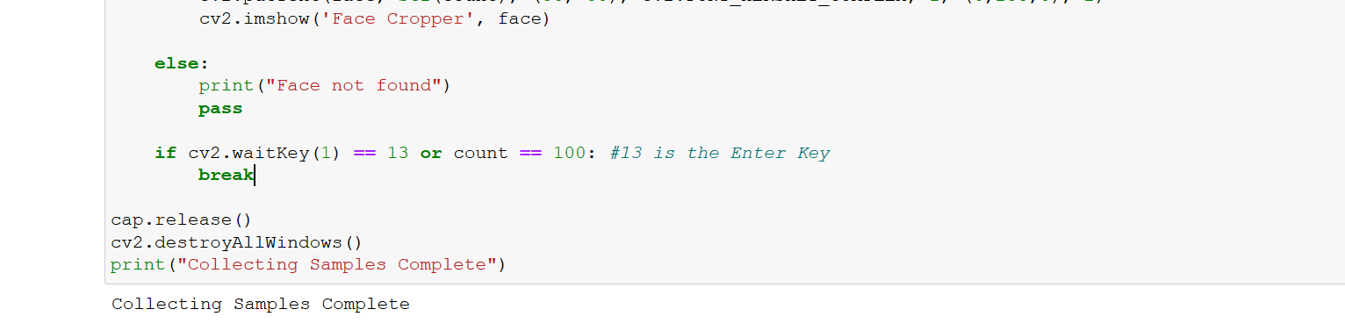
Step 1 : To collect the sample images

Slide 6
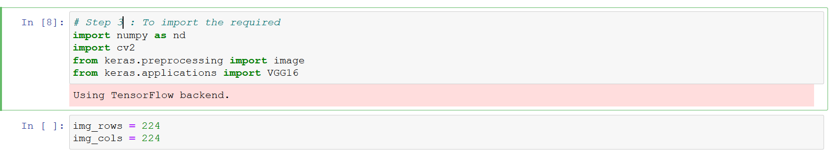
Step 2 : To import the required

Slide 7
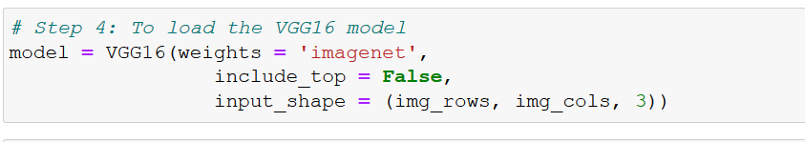
Step 3: To load the VGG model

Slide 8
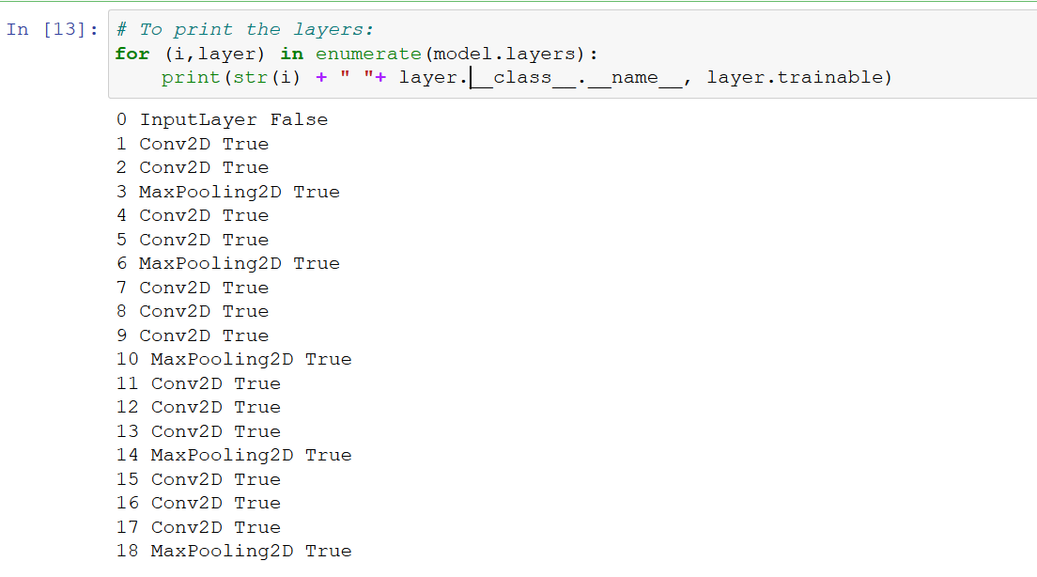
Step 4: To print the layers

Slide 9
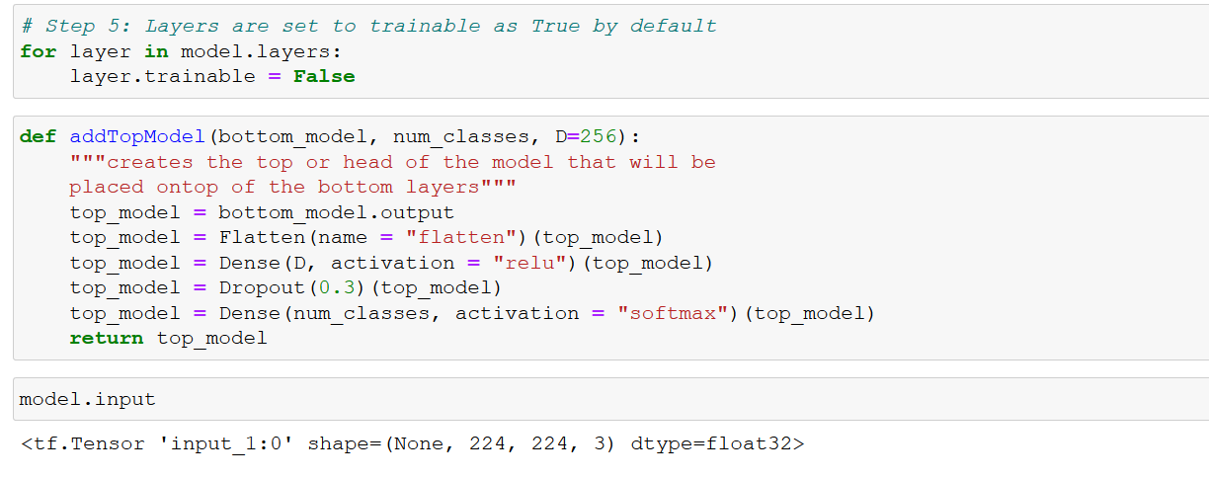
Step 5 : To set the layers to trainable and use a function that returns our FC Head

Slide 10
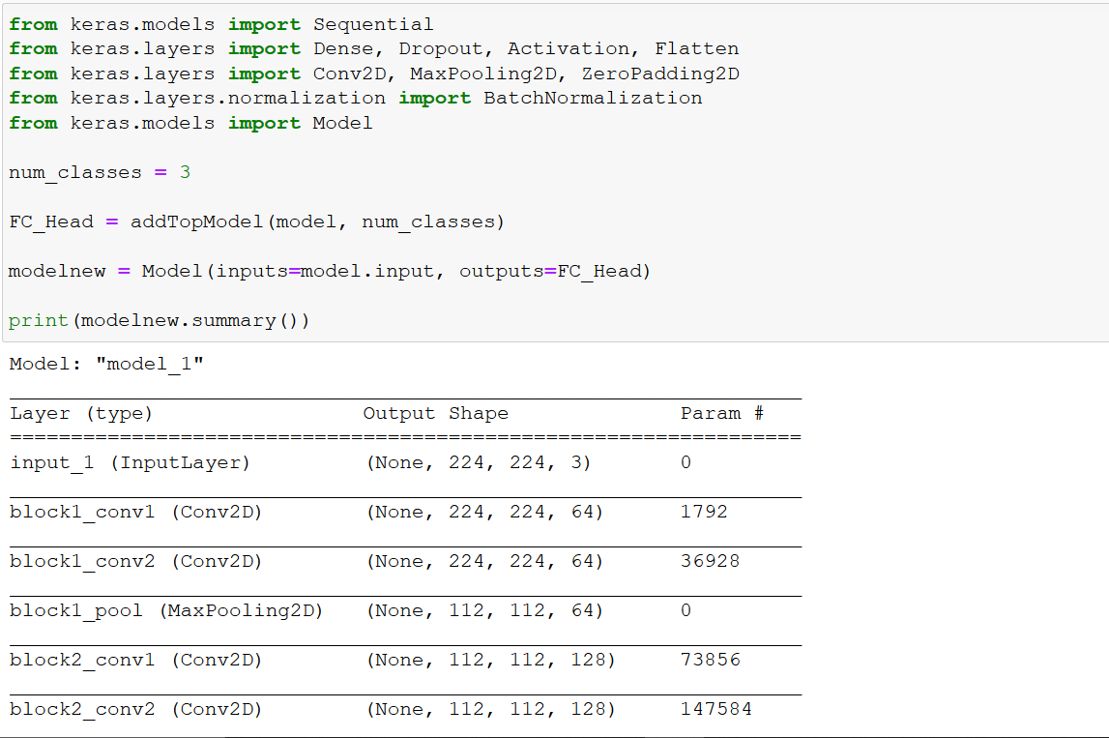
Step 6: Add Fc Head back onto VGG

Slide 11
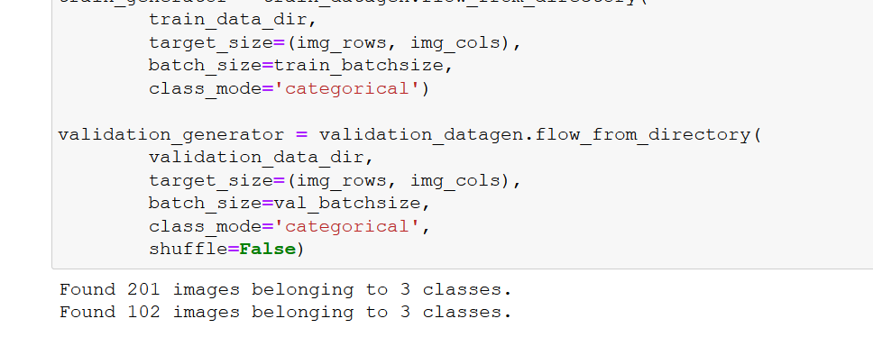
Step 7 : Data augmentation

Slide 12
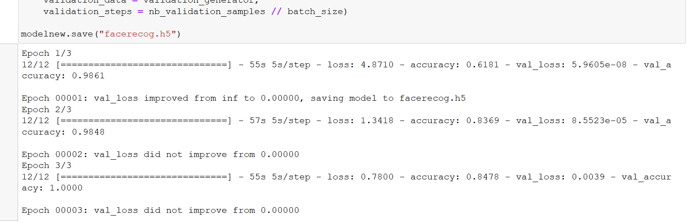
Step 8 : Training the model and saving it

Slide 13
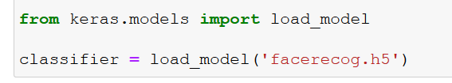
Step 9 : Loading the model

Slide 14
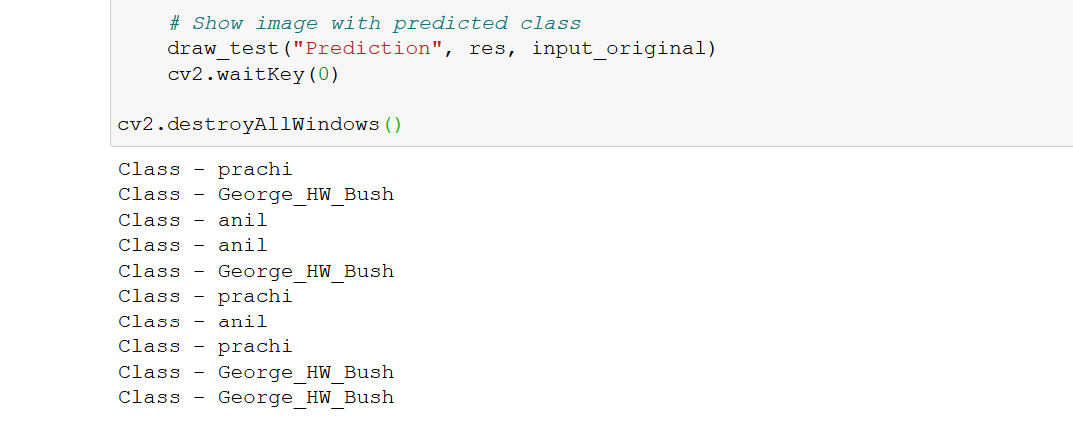
Step 10 : Testing the model

Slide 15
THANK YOU!

