Slide 1
Olist Store Analysis
Group 1

Slide 2
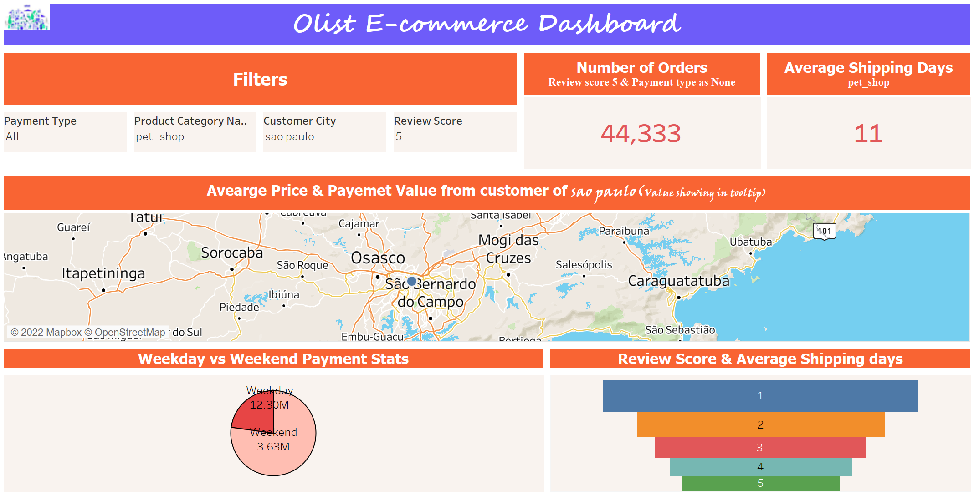
Tableau Dashboard

Slide 3
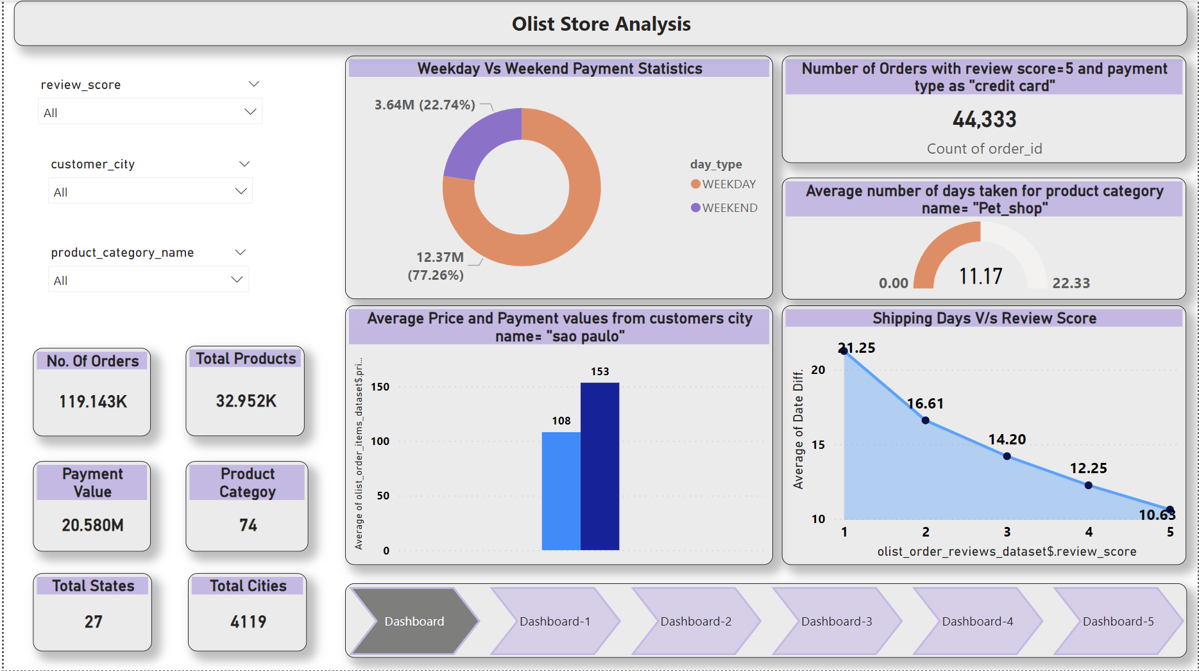
Power BI Dashboard

Slide 4
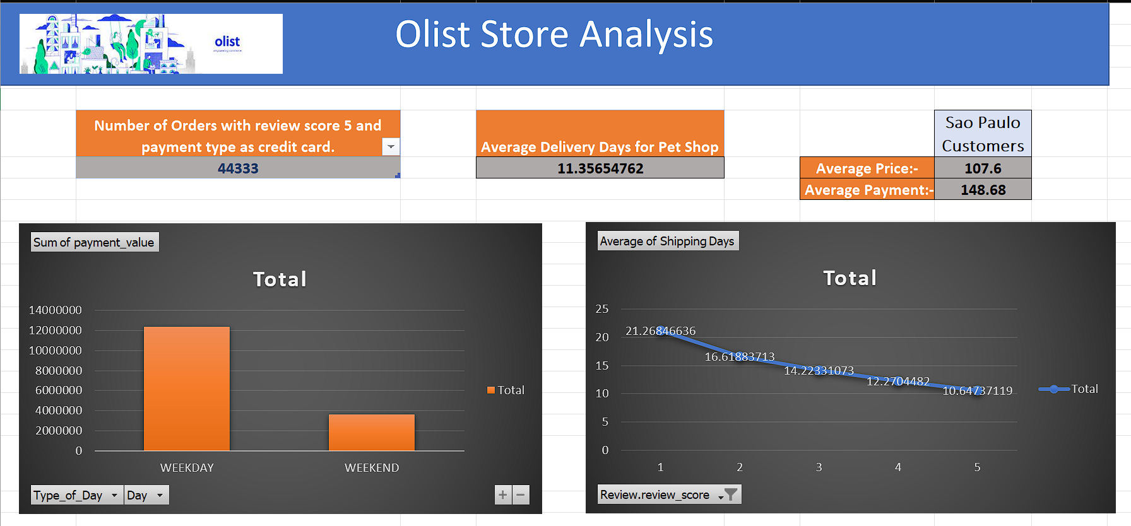
MS Excel

Slide 5
Data Description
olist_orders_dataset: This table is connected to 4 other tables. It is used to connect all the details related to an order.
olist_order_items_dataset: It contains the details of an item that had been purchased such as shipping date, price and so on.
olist_order_reviews_dataset: It contains details related to any reviews posted by the customer on a particular product that he had purchased.
olist_products_dataset: It contains related to a product such as the ID, category name and measurements.
olist_order_payments_dataset: The information contained in this table is related to the payment details associated with a particular order.
olist_customers_dataset: Details the customer base information of this firm.
olist_geolocation_dataset: It contains geographical information related to both the sellers and customers.
olist_sellers_dataset: This table contains the information related to all the sellers who have registered with this firm.

Slide 6
KPI Analysis
Weekday Vs Weekend Payment Statistics:
Number of Orders with review score 5 and payment type as credit card :
Average number of days taken for pet_shop:
Average price and payment values from customers of Sao Paulo city:
Relationship between shipping days Vs review scores:

