Slide 1
BOM → Drawing
Generating CAD drawings automatically from Bill of Materials data
Work done so far
Developed a Python-based BOM-to-CAD prototype
BOM data extracted from Excel using Pandas, and dimensions parsed from it
Part 10 plate geometry and 46-hole pattern generated programmatically
2D drawing generated in DXF format using ezdxf — including outline, holes, dimensions, labels and callouts
Generated DXF currently viewed and verified using an online CAD/DXF viewer
Added parameter validation and CAD layers
BOM ↔ Drawing Automation
1

Slide 2
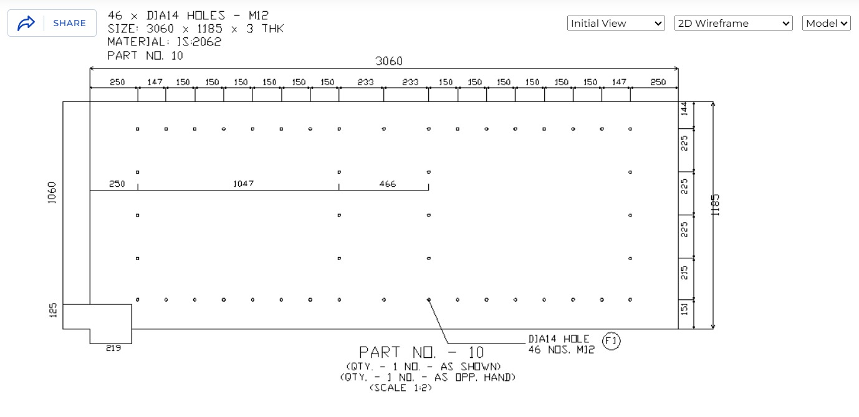
BOM → Drawing
Drawing made by the BOM :

Slide 3
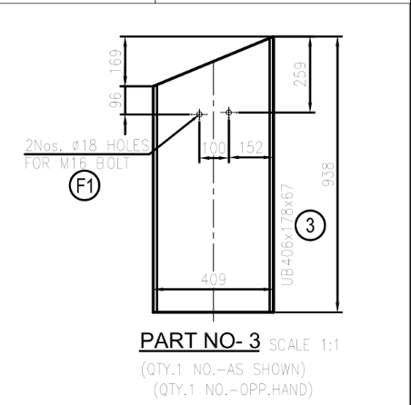
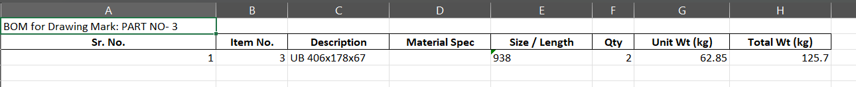
Drawing → BOM
Extracting Bill of Materials data automatically from engineering drawings
First approach: OpenCV + Tesseract
Current approach: Gemini API (gemini-3.6-flash)
Tested on a real drawing
Failed — only read the title text
Missed all dimensions and section labels
Used as a vision model to read the drawing
Extracts part data in JSON format
JSON processed by Python code
Calculates actual weights using standard steel engineering formulas
BOM ↔ Drawing Automation
2

Slide 4
Further Plans
Next steps for both work streams
BOM → Drawing
Drawing → BOM
Extend prototype beyond Part 10 to handle other plate / part types
Generalize hole-pattern and geometry logic instead of hardcoded values
Add dimensioning and GD&T standards matching shop drawing conventions
Validate generated DXF in actual CAD software, not just an online viewer
Support export to DWG / STEP in addition to DXF
Improve Gemini extraction accuracy on complex, multi-part drawings
Add a validation / review step before weights are finalized
Extend weight calculation to more materials and shapes
Test across different drawing formats and standards
Overall goal: Merge both pipelines into one integrated BOM ⇄ Drawing tool
BOM ↔ Drawing Automation
3

