Slide 1
WebTree DSGN 8230: Responsive Site Design
Group 4
Prachi Bansal
Ruchita Trivedi
Kaushik Mandala

Slide 2
Introduction
Group 4
Company Name: Web Tree
Group Members:
Prachi Bansal - Project Manager, Graphic Designer, Web Developer
Ruchita Trivedi - Content Writer, Team Lead, Web Developer
Kaushik Mandala - Designer, Web Developer, Quality Tester

Slide 3
Table of Contents
Sr.No. | Content
1 | About the Project
2 | Target Audience
3 | Design Process
4 | Development Process
5 | Summary

Slide 4
About the Project
The website “WebTree” is an IT company which provides the web services like Website Development, SEO, Mobile Application Development, Content Writing, etc.
This company can help in growing the existing business by promoting them online through SEO and digital marketing.
We mainly focused on unique design, ease of navigation, accessibility, graphics to appeal target audience.

Slide 5
Target Audience
WebTree is targeting large amount of audience like startups, small-midsize business, potential candidates and large corporate.
The chart below shows the target users.

Slide 6
Design Process
Colors are used for the website are : Black, Green, Gray and Pink.
We choose the color scheme because it compliments our logo which is green in color.
Graphic and media used are downloaded from Pixabay.com.
Software used for designing logo and slider images is Photoshop.

Slide 7
Development Process
Team Work:
As this website is a large project, building this project required utmost efforts from each of the member.
So, to complete this project on priority basis and within the given timeline, we distributed the task among ourselves by discussion on a group meeting.
We decided the name of our company and chosen the best relevant color scheme and the pages which will be included in our website.
Then the pages were divided to each member and roles were allocated accordingly.

Slide 8
Development Process
Software / Framework chosen :
Bootstrap 4
CSS 3
HTML 5
HTML and CSS are validated using W3C Validator.

Slide 9
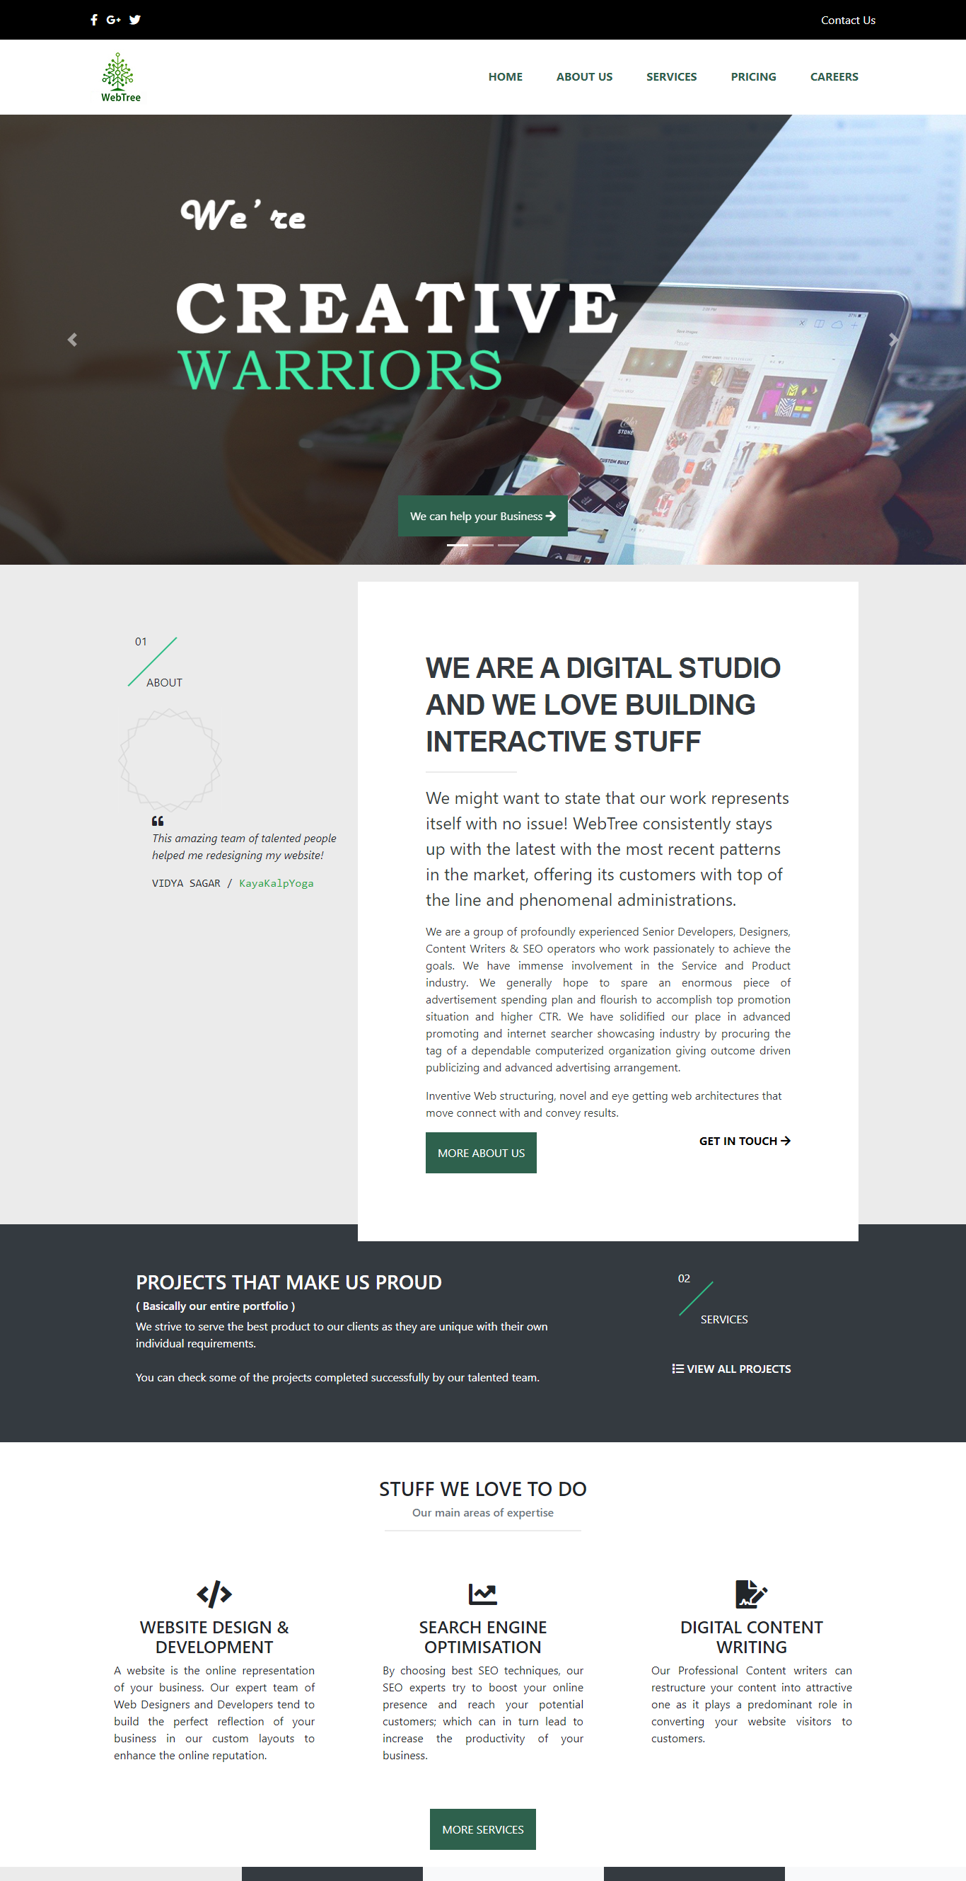
Demonstration
[Demonstration will be given in the browser window]

Slide 10
Summary
While making a website for IT Company we learnt Bootstrap4.
We choose color scheme and overall layout based on best of our knowledge and research.
For future we would like to add some more animation to make it more attractive.

Slide 11
Summary
The time spent on the various stages of this project can be estimated by the chart below:

Slide 12
Thank You

