Slide 1
Matrix Algebra Basics
H N Tiwari
Assistant Professor
Shri Ram College of Commerce

Slide 2
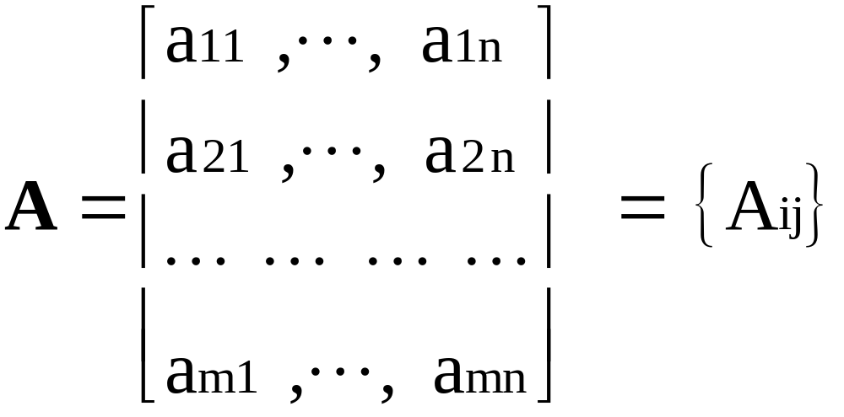
Matrix
A matrix is any doubly subscripted array of elements arranged in rows and columns.

Slide 3

Row Vector
[1 x n] matrix

Slide 4
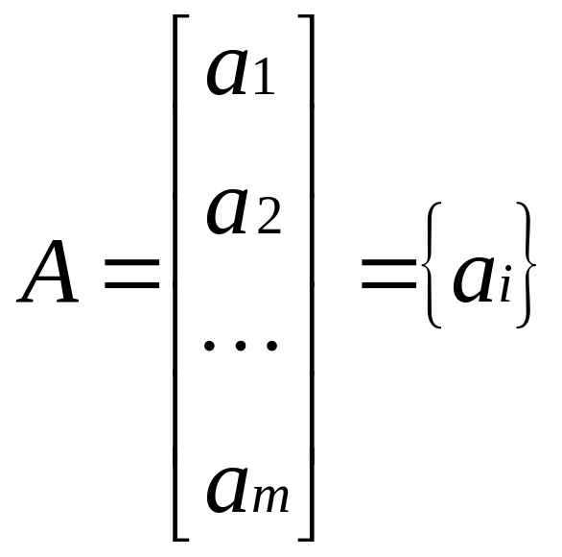
Column Vector
[m x 1] matrix

Slide 5
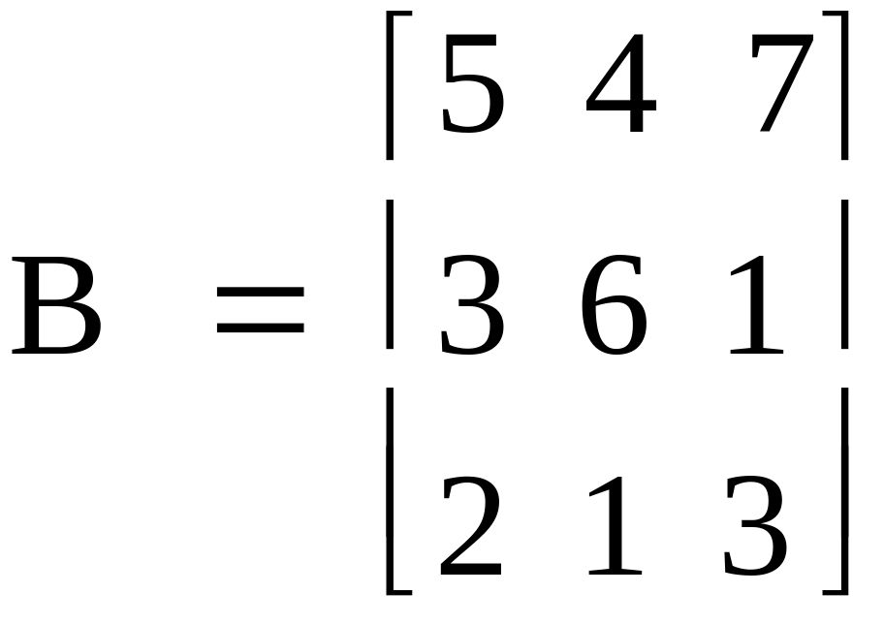
Square Matrix
Same number of rows and columns

Slide 6
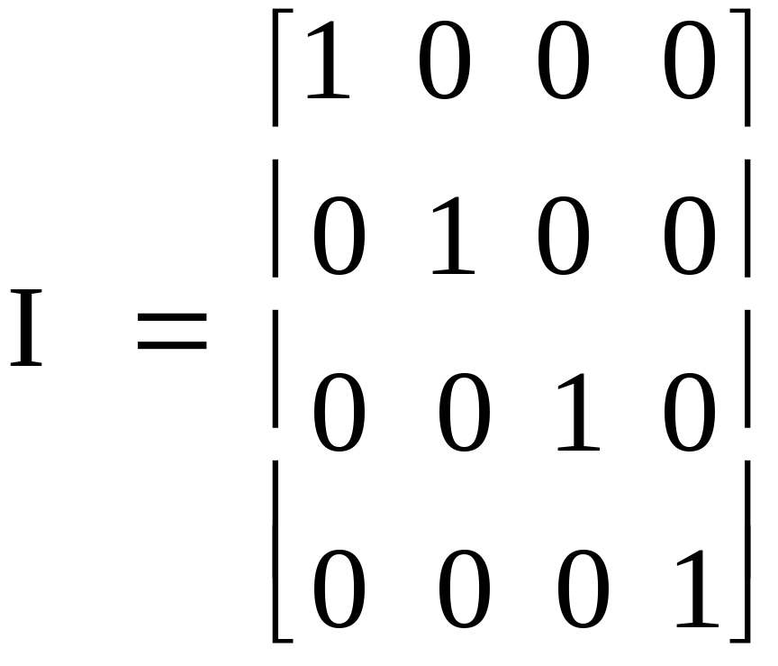
Identity Matrix
Square matrix with ones on the diagonal and zeros elsewhere.

Slide 7
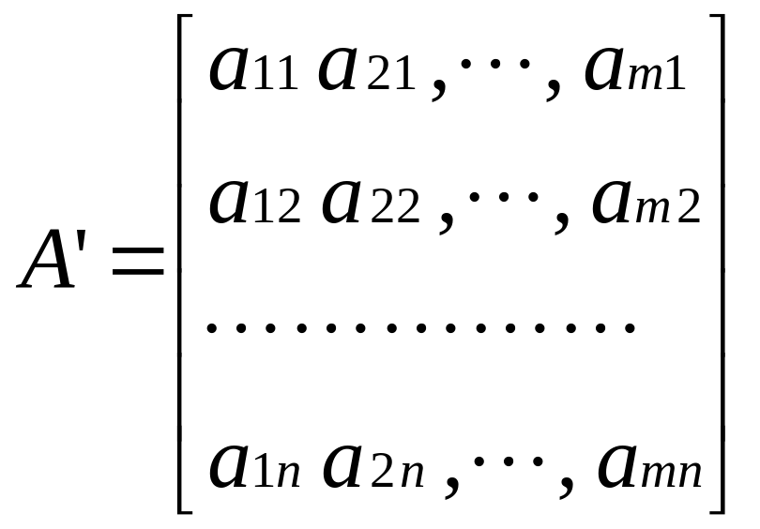
Transpose Matrix
Rows become columns and columns become rows

Slide 8

Matrix Addition and Subtraction
A new matrix C may be defined as the additive combination of matrices A and B where: C = A + B
is defined by:
Note: all three matrices are of the same dimension

Slide 9
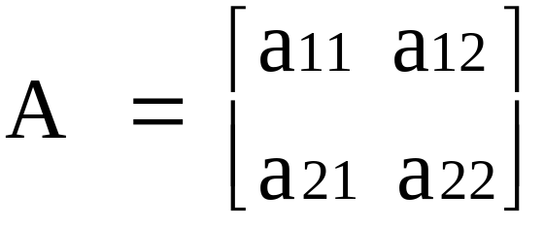
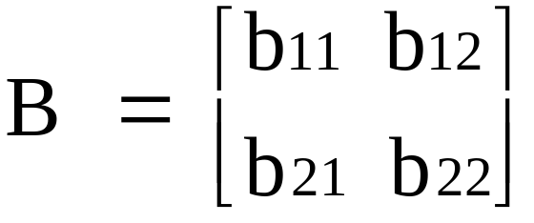
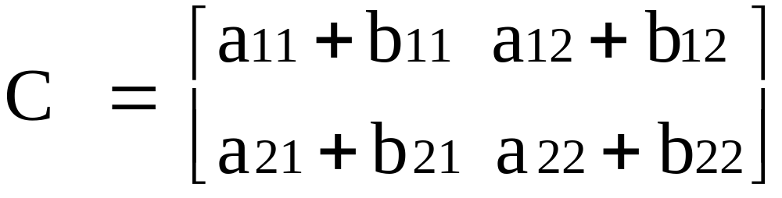
Addition
If
and
then

Slide 10
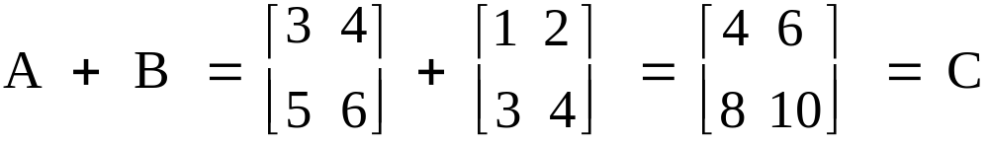
Matrix Addition Example

Slide 11

Matrix Subtraction
C = A - B
Is defined by

Slide 12
Matrix Multiplication
Matrices A and B have these dimensions:
[r x c] and [s x d]

Slide 13
Matrix Multiplication
Matrices A and B can be multiplied if:
[r x c] and [s x d]
c = s

Slide 14
Matrix Multiplication
The resulting matrix will have the dimensions:
[r x c] and [s x d]
r x d

Slide 15
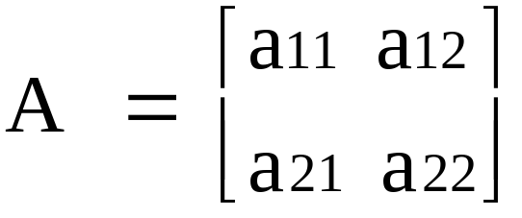
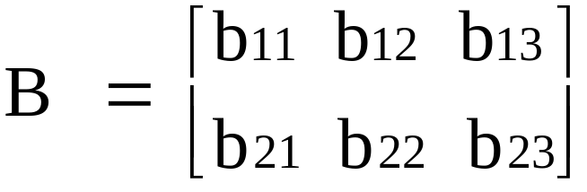
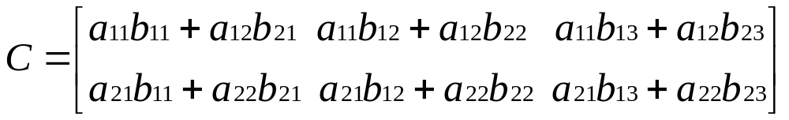
Computation: A x B = C
[2 x 2]
[2 x 3]
[2 x 3]

Slide 16
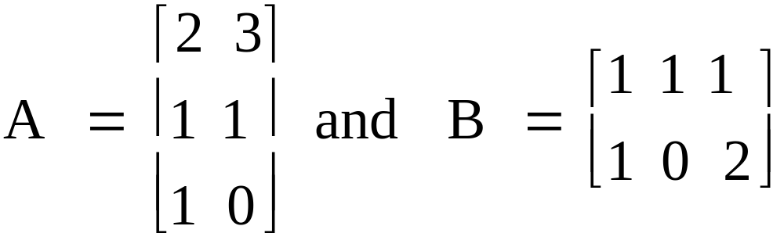
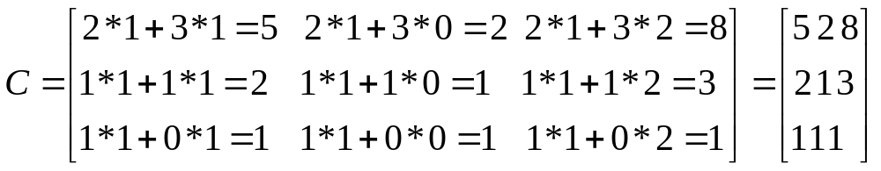
Computation: A x B = C
[3 x 2]
[2 x 3]
A and B can be multiplied
[3 x 3]

Slide 17
Computation: A x B = C
[3 x 2]
[2 x 3]
Result is 3 x 3
[3 x 3]

Slide 18
Inverse
Note that a / b = a x 1 / b
And that a x 1 / a = 1
1 / a is the inverse of a

Slide 19

Unany operations: Inverse
Matrix ‘equivalent’ of 1 is the identity matrix
Find A⁻¹ such that A⁻¹ * A = I

Slide 20
Unary Operations: Inverse
Inverse of (2 x 2) matrix
  Find determinant
  Swap a₁₁ and a₂₂
  Change signs of a₁₂ and a₂₁
  Divide each element by determinant
  Check by pre- or post-multiplying by inverse

Slide 21

Inverse of 2 x 2 matrix
Find the determinant
  = (a₁₁ x a₂₂) - (a₂₁ x a₁₂)
  For
  det(A) = (2x3) – (1x5) = 1
  A determinant is a scalar number which is calculated from a matrix. This number can determine whether a set of linear equations are solvable, in other words whether the matrix can be inverted.

Slide 22
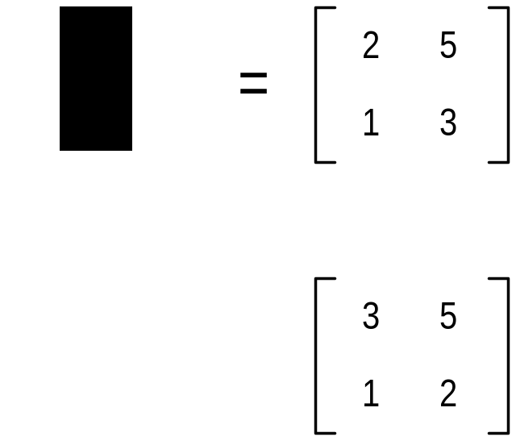
Inverse of 2 x 2 matrix
Swap elements a₁₁ and a₂₂
  Thus
  becomes

Slide 23

Inverse of 2 x 2 matrix
Change sign of a₁₂ and a₂₁
  Thus
  becomes

Slide 24

Inverse of 2 x 2 matrix
Divide every element by the determinant
  Thus
  becomes
  (luckily the determinant was 1)

Slide 25
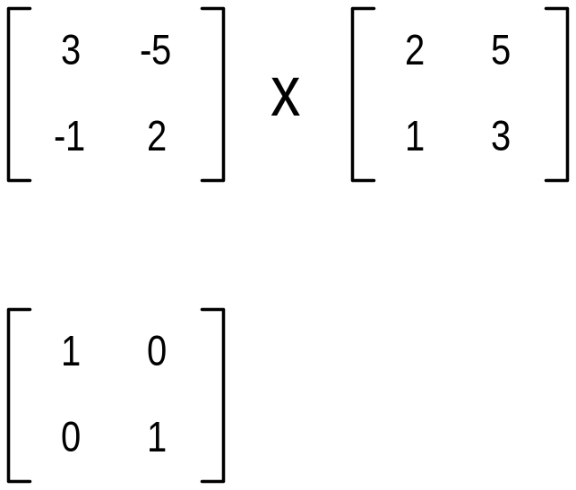
Inverse of 2 x 2 matrix
Check results with A⁻¹ A = I
  Thus
  equals

Slide 26
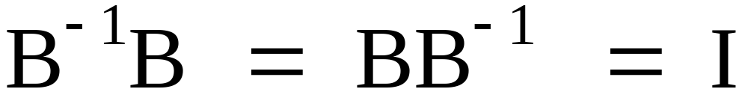
Matrix Inversion
Like a reciprocal in scalar math
Like the number one in scalar math

Slide 27
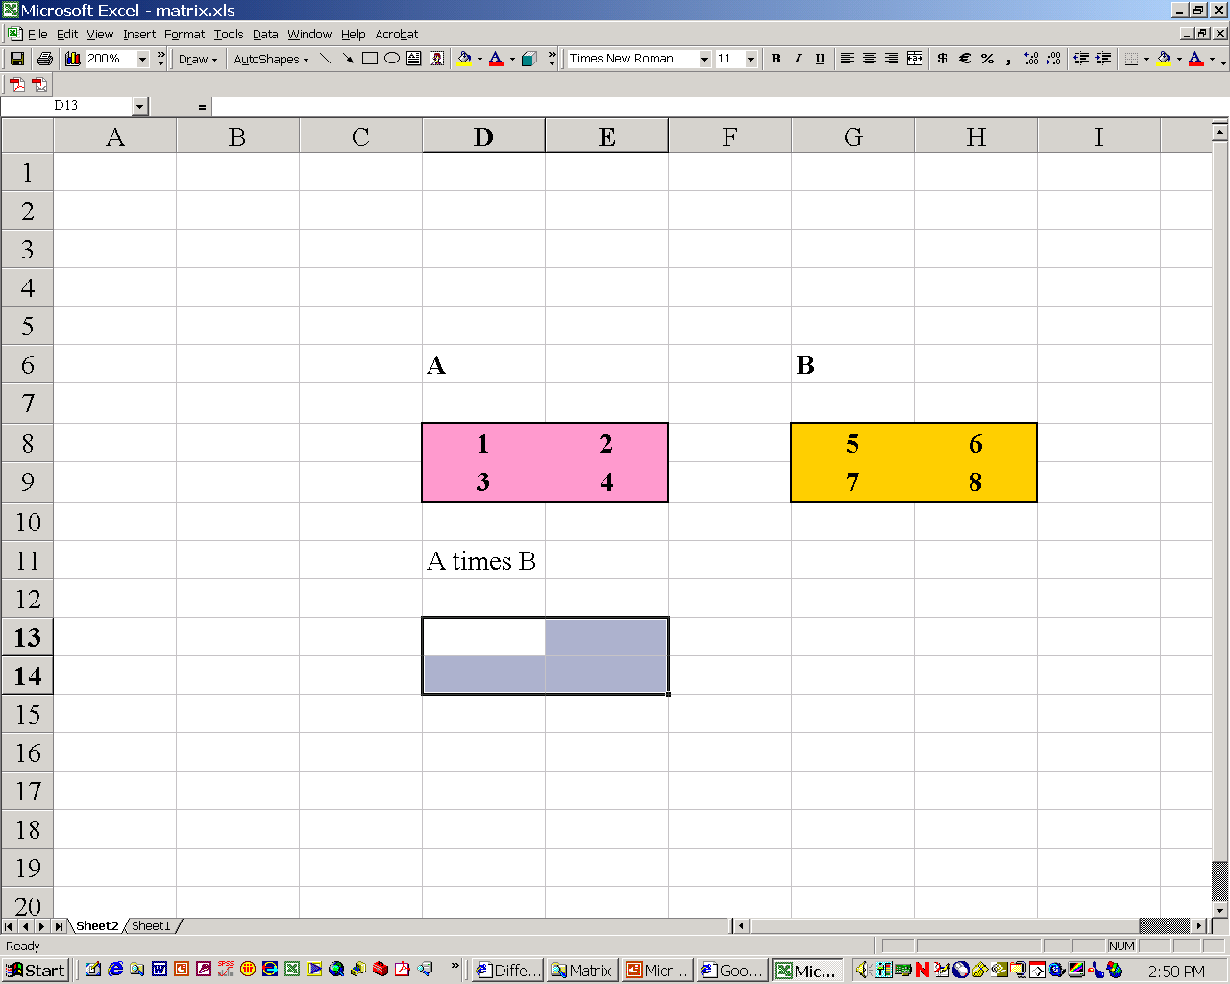
Matrix Operations in Excel
Select the cells in which the answer will appear

Slide 28

Matrix Multiplication in Excel
Enter “=mmult(“
Select the cells of the first matrix
Enter comma “,”
Select the cells of the second matrix
Enter “)”

Slide 29

Matrix Multiplication in Excel
Enter these three key strokes at the same time:
control
shift
enter

Slide 30
Basic Properties of Matrices
Assuming that all products and sums are defined for the indicated matrices A, B, C, I, and 0, we have
Addition Properties
  Associative: (A + B) + C = A + (B+ C)
  Commutative: A + B = B + A
  Additive Identity: A + 0 = 0 + A = A
  Additive Inverse: A + (-A) = (-A) + A = 0

Slide 31
Basic Properties of Matrices
(continued)
Multiplication Properties
  Associative Property: A(BC) = (AB)C
  Multiplicative identity: AI = IA = A
  Multiplicative inverse: If A is a square matrix and A⁻¹ exists, then AA⁻¹ = A⁻¹A = I
Combined Properties
  Left distributive: A(B + C) = AB + AC
  Right distributive: (B + C)A = BA + CA

Slide 32
Basic Properties of Matrices
(continued)
Equality
  Addition: If A = B, then A + C = B + C
  Left multiplication: If A = B, then CA = CB
  Right multiplication: If A = B, then AC = BC
The use of these properties is best illustrated by an example of solving a matrix equation.
Example: Given an n x n matrix A and an n x p matrix B and a third matrix denoted by X, we will solve the matrix equation AX = B for X.

Slide 33
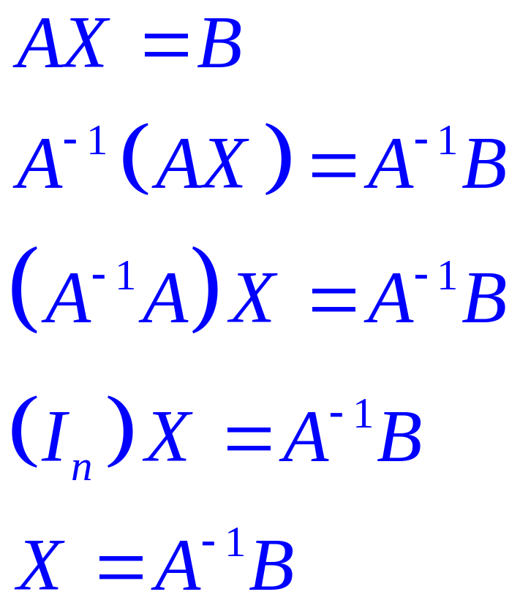
Solving a Matrix Equation
Reasons for each step:
Given; since A is n x n,
X must by n x p.
Multiply on the left by A⁻¹.
Associative property of matrices
Property of matrix inverses.
Property of the identity matrix
Solution. Note A⁻¹ is on the left of B. The order cannot be reversed because matrix multiplication is not commutative.

Slide 34
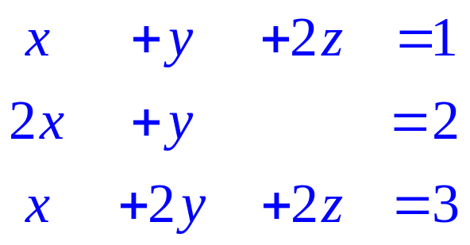
Example
Example: Use matrix inverses to solve the system

Slide 35
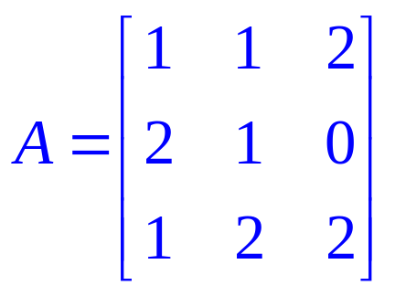
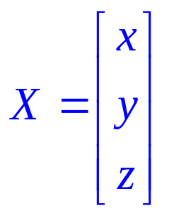
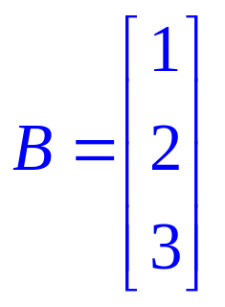
Example
Example: Use matrix inverses to solve the system
Solution:
  Write out the matrix of coefficients A, the matrix X containing the variables x, y, and z, and the column matrix B containing the numbers on the right hand side of the equal sign.

Slide 36
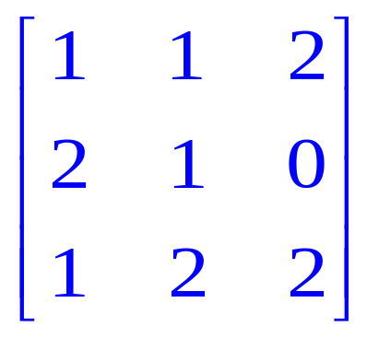
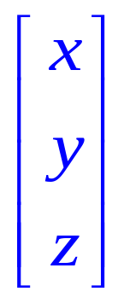
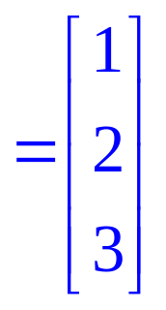
Example
(continued)
  Form the matrix equation AX = B. Multiply the 3 x 3 matrix A by the 3 x 1 matrix X to verify that this multiplication produces the 3 x 3 system at the bottom:

Slide 37
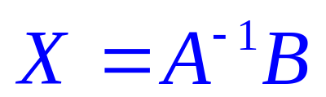
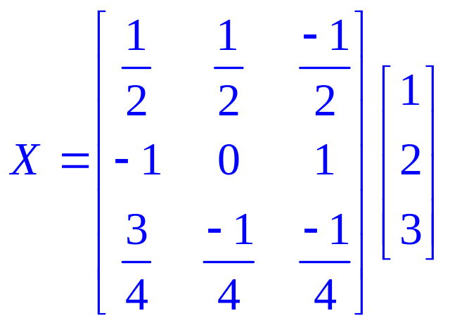
Example
(continued)
  If the matrix A⁻¹ exists, then the solution is determined by multiplying A⁻¹ by the matrix B. Since A⁻¹ is 3 x 3 and B is 3 x 1, the resulting product will have dimensions 3 x 1 and will store the values of x, y and z.

Slide 38
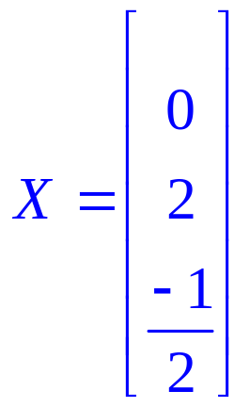
Example
Solution
The product of A⁻¹ and B is
The solution can be read off from the X matrix:
x = 0,
y = 2,
z = -1/2
Written as an ordered triple of numbers, the solution is
(0, 2, -1/2)

Slide 39
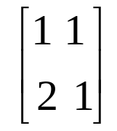
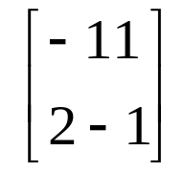
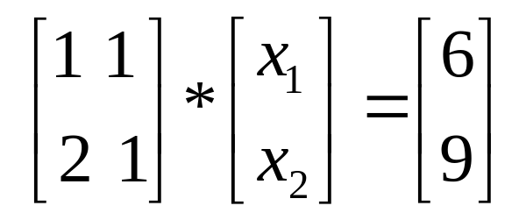
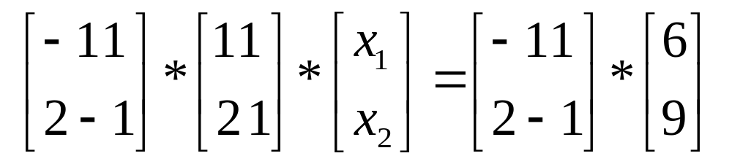
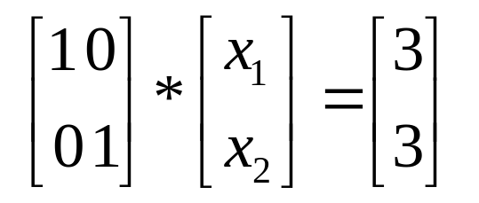
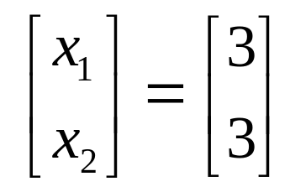
Solution
Note: Inverse of
is
Premultiply both sides by inverse matrix
A square matrix multiplied by its inverse results in the identity matrix.
A 2x2 identity matrix multiplied by the 2x1 matrix results in the original 2x1 matrix.

