Slide 1
INVESTMENT ANALYSIS USING
DATA STRUCTURES

Slide 2
PROBLEM STATEMENT
All of us make some or the other investment once we are introduced to the corporate life and even otherwise !
A person has made 6 such investments in the year of 2018.
He wishes to sell one of the investment because of his domestic issues to raise funds on 01 Jan 2019.
From the perspective of a programmer he has 3 data structures to choose from to carry out such an operation i.e.
Stacks
Queue
Trees
The investment he made are given in the form of a table.

Slide 3
SR No. | ASSET | AMOUNT INVESTED | PROFIT ON INVESTMENT | DATE OF INVESTMENT
1. | FD | 50,000 | +10 | 01 Jan 2018
2. | HOME | 10,00,000 | +5 | 10 Feb 2018
3. | SHARE A | 10,000 | +2 | 14 Apr 2018
4. | SHARE B | 15,000 | +3 | 30 Jun 2018
5. | MUTUAL FUNDS | 5,00,000 | +6 | 01 Aug 2018
6. | FARMING LANDS | 3,00,000 | 0 | 10 Oct 2018

Slide 4
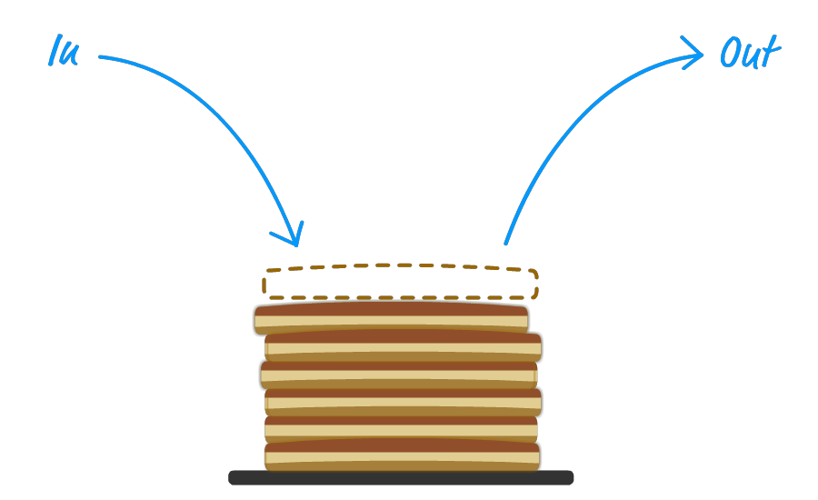

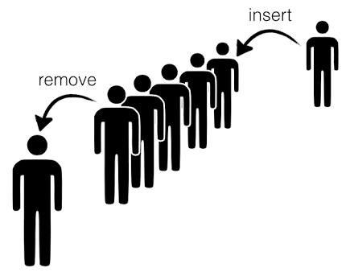
Now, Let’s take a tour of these data structures….

Slide 5
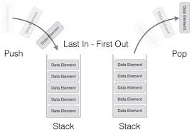
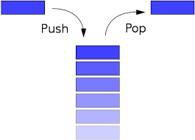
STACKS
A stack is a container of objects that are inserted and removed according to the last-in first-out (LIFO) principle. In the pushdown stacks only two operations are allowed: PUSH the item into the stack, and POP the item out of the stack. A stack is a limited access data structure - elements can be added and removed from the stack only at the top. PUSH adds an item to the top of the stack, POP removes the item from the top. A helpful analogy is to think of a stack of books; you can remove only the top book, also you can add a new book on the top. A stack is a RECURSIVE data structure. Here is a structural definition of a Stack:
A stack is either empty or It consists of a top and the rest which is a stack.

Slide 6

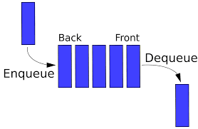
QUEUES
A queue is a container of objects (a linear collection) that are inserted and removed according to the first-in first-out (FIFO) principle. An excellent example of a queue is a line of students in the food court of the UC. New additions to a line made to the back of the queue, while removal (or serving) happens in the front. In the queue only two operations are allowed Enqueue and Dequeue. Enqueue means to insert an item into the back of the queue, dequeue means removing the front item. The picture demonstrates the FIFO access .The difference between stacks and queues is in removing. In a stack we remove the item the most recently added; in a queue, we remove the item the least recently added.

Slide 7
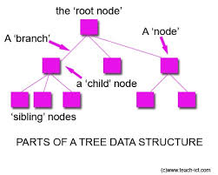
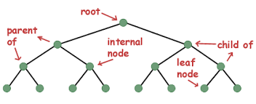
TREES
Tree is a hierarchical data structure which stores the information naturally in the form of hierarchy style.
Tree is one of the most powerful and advanced data structures.
It is a non-linear data structure compared to arrays, linked lists, stack and queue.
It represents the nodes connected by edges.
There are 3 methods for tree traversal – In order, Pre Order
And Post Order.

Slide 8
Node : A node is point of intersection/connection within network Trees in data structure made up of a node or vertices and edges Without having any cycle . The tree with no node is called null or empty tree. Traversal : Traversal is a process to visit all nodes of tree and may print their values too. Traversal of tree is divided into three types: 1]Pre-order 2]Post-order 3]In-order In-order Traversal : In this traversal method , the left subtree is visited first , then the root and later the right subtree. We should always remember that every node may represent a subtree itself. Lets take an Example :
1
In-order(Left ,Root ,Right):
5 2 6 1 9
In case of binary search tree In-order traversal gives nodes non-decreasing order
To get nodes of BST in non increasing order ,a variation of In-order traversal where In-order traversals reversed order can be used.
2
9
5
6

Slide 9
Last Investment made was Farming land .Hence ,it has to be popped first.
Push
Farming Land
Pop
Mutual Funds
Share B
Share A
Home
FD
OUTPUT USING STACKS
CP=3,00,000
Profit =Rs.0
SP=Rs.3,00,000

Slide 10
First Investment made was FD . Hence, it has to be de-queue first.
Enqueue
Farming Land
Mutual Funds
Share B
Share A
Home
FD
Dequeue
OUTPUT USING QUEUES
CP=Rs. 50,000
Profit= 10%=Rs. 5,000
SP= Rs. 55,000

Slide 11
Share A Home Mutual Funds FD Share B Farming Land
OUTPUT USING TREES
Using Trees For investing ,he has freedom to choose any asset that he wants to sell.
Hence, making the profit that he desires.

Slide 12
ALGORITHM
STEP 1 : Create Binary Search Tree With Desired Nodes
STEP 2 : Insert Required Nodes
STEP 3 : Perform In Order Traversal On The Tree And Display Nodes
STEP 4 : Delete Key Node
STEP 5 : Perform In Order Traversal On The Modified Tree And Display Nodes

Slide 13
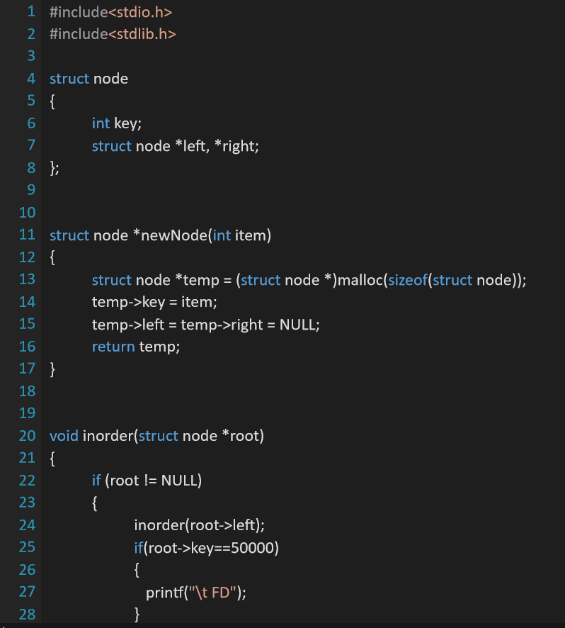
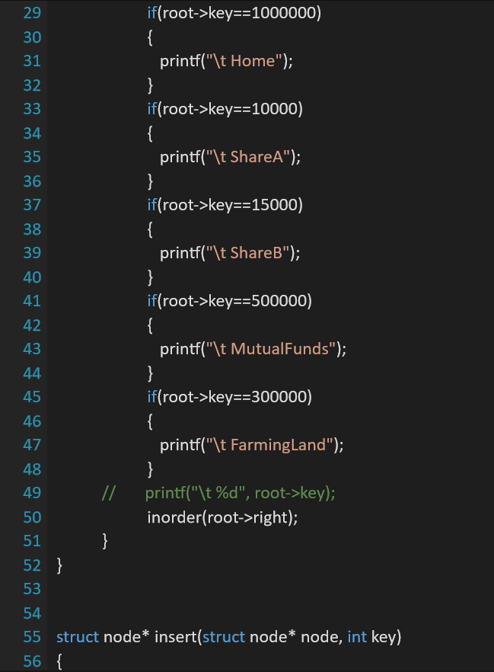
CODE

Slide 14
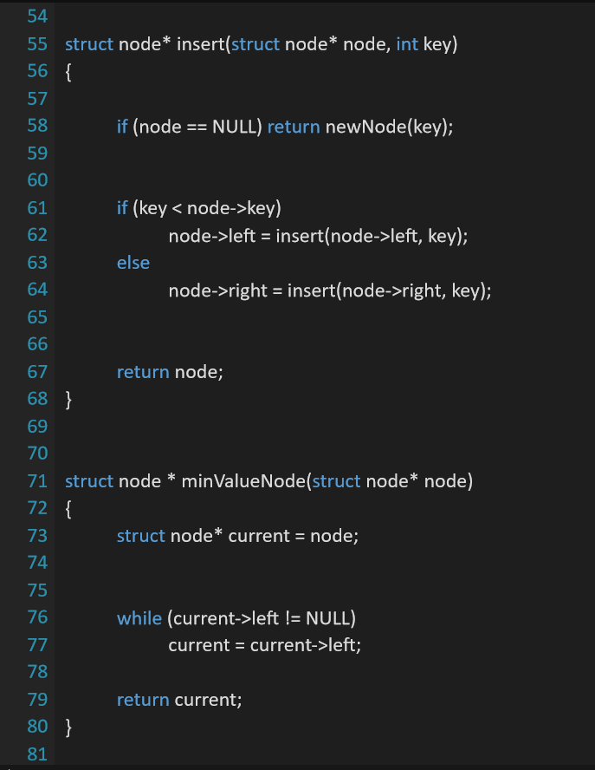
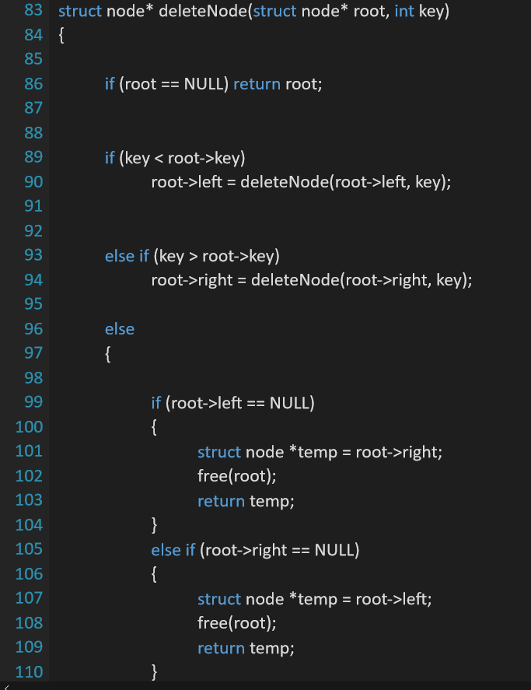

Slide 15
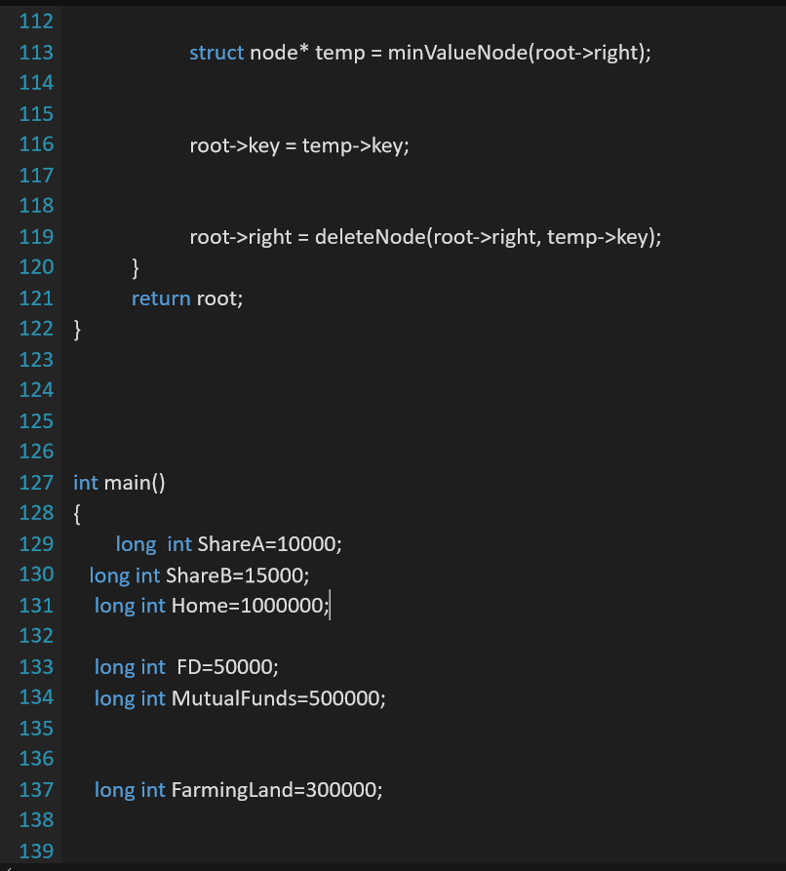
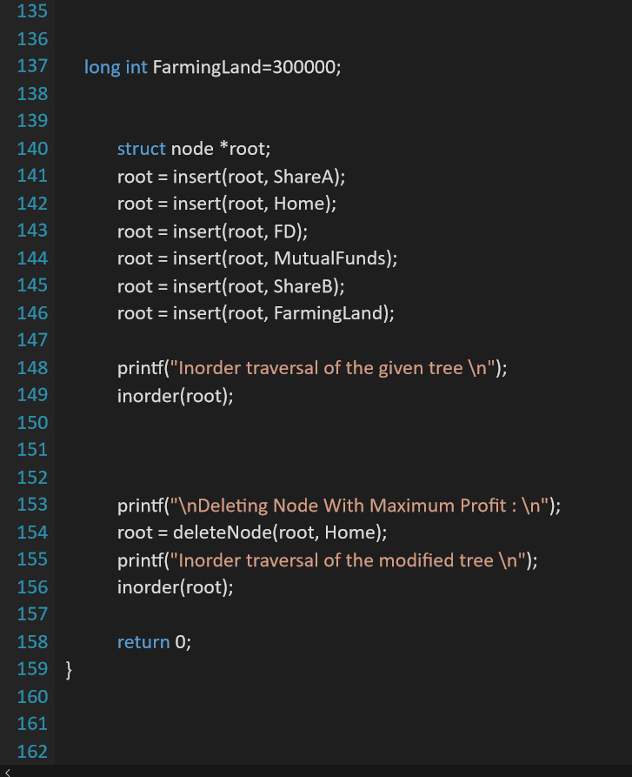

Slide 16
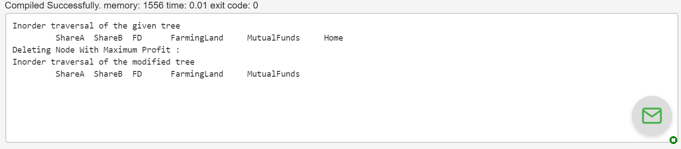
OUTPUT

Slide 17
COMPARISON BETWEEN STACKS, QUEUES, TREES
STACKS | QUEUES | TREES
1. It is a linear data structure | 1. It is a linear data structure | 1. It is a non-linear data structure
2. Structure: Same end is used to insert and delete elements. | 2. One end is used for insertion i.e. rear end and another end is used for deletion of elements i.e. front end. | 2. A tree is a structure consisting of one node called the root and zero or one or more subtrees. A tree can be empty with no nodes.
3. Working on the principle of LIFO (Last In First Out) | 3. Working on the principle of FIFO (First In First Out) | 3. A tree is a widely used abstract data type (ADT) or data structure implementing this ADT—that simulates a hierarchical tree structure, with a root value and subtrees of children with a parent node, represented as a set of linked nodes.
4. Operations: Push and Pop | 4. Operations: Enqueue and Dequeue | 4. Operations: Insertion,Deletion, inorder traversal and post traversal

Slide 18
APPLICATIONS OF TREES
One reason to use trees might be because you want to store information that naturally forms a hierarchy. For example, the file system on a computer.
Make information easy to search (tree traversal).
Manipulate sorted lists of data.
As a workflow for compositing digital images for visual effects.
Router algorithms.

Slide 19
ADVANTAGES OF TREES
If we organize keys in form of a tree (with some ordering e.g., BST), we can search for a given key in moderate time (quicker than Linked List and slower than arrays).
We can insert/delete keys in moderate time (quicker than Arrays and slower than Unordered Linked Lists).
Like Linked Lists and unlike Arrays, Pointer implementation of trees don’t have an upper limit on number of nodes as nodes are linked using pointers.

Slide 20
DISADVANTAGES OF TREES
It is applicable only for advanced users.
If any issue occurs it can be solved only by experts.
Slow access in case of some data types.
It takes O(logn) time to modify the list and to retrieve elements with a known location. These can be done in constant time in some other data structures.

Slide 21
BIBLIOGRAPHY:
WEBSITE :
http://www.cs.cmu.edu/~clo/www/CMU/DataStructures/Lessons/lesson4_1.htm
https://www.geeksforgeeks.org/binary-tree-data-structure
BOOKS :
DATA STRUCTURES THROUGH C : YASHWANT KANETKAR

Slide 22
Prachi Mate – 2625 Mahima Mule – 2626 Saniya Ponkshe – 2634 Gayatri Shirke - 2638
PRESENTED BY

