Slide 1
GAS LEVEL DETECTION AND AUTOMATIC BOOKING ALERT

Slide 2
A PRESENTATION ON GAS LEVEL DETECTION AND AUTOMATIC BOOKING ALERT
SR NO. | STUDENT NAME | ROLL NO
1 | Prajakta Vilas Pawar | 41
2 | Prachi Balasaheb Salunkhe | 15
3 | Jaywant Dattatray Thite | 20
Guide By
Prof.(Dr.)T. M. Dudhane

Slide 3
CONTENT
Introduction
Objective
Block diagram
Hardware require
Components require
Advantages
Reference

Slide 4
INTRODUCTION
The project IOT-based gas level detection and automatic booking notification was proposed to save the time.
LPG is a byproduct in the extraction of petroleum. LPG is used in different fields as a fuel. Like in cooking, welding, etc., LPG usage is increasing steeply day by day.
Now-a-days booking an LPG cylinder is an uncertain process. When we make a call to gas agency our call may not be connected or booking cannot be recorded. This creates more doubts in people’s mind. If we noticed well before the completion of gas, we don’t need to buy in black which save money.
If any gas leakage detects or fire we have given a buzzer sound with a notification to the mobile and exhaust fan will be turned on.

Slide 5
OBJECTIVE
Detection of LPG gas level within the cylinder and sending the notification SMS to user.
Real time gas observation system Automatically book the Gas cylinder.
LPG leak is detected through the sensor and information is sent to the user by SMS.
Users don't need to enter any info manually as all the specified information is stored.
To give daily statistics of gas consumption to use

Slide 6
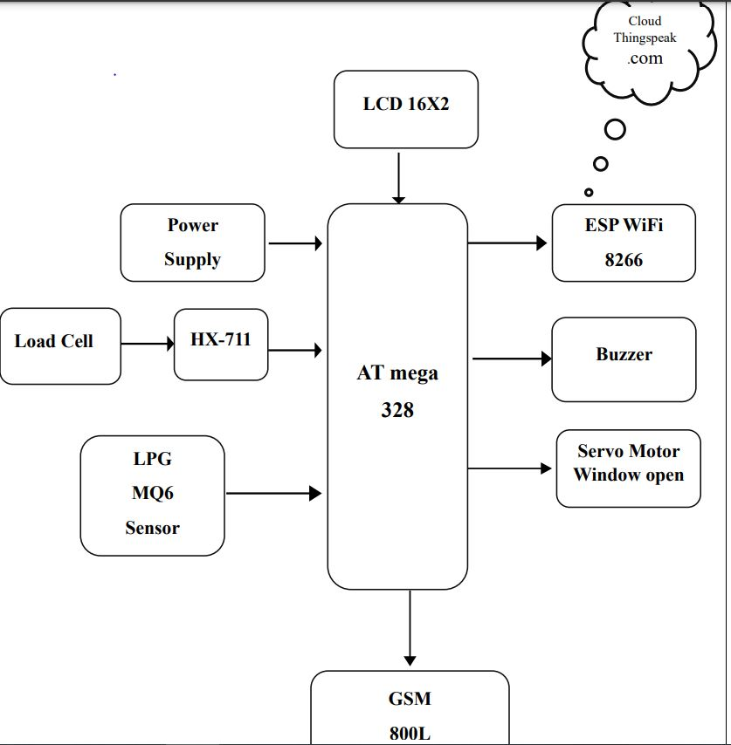
BLOCK DIAGRAM

Slide 7
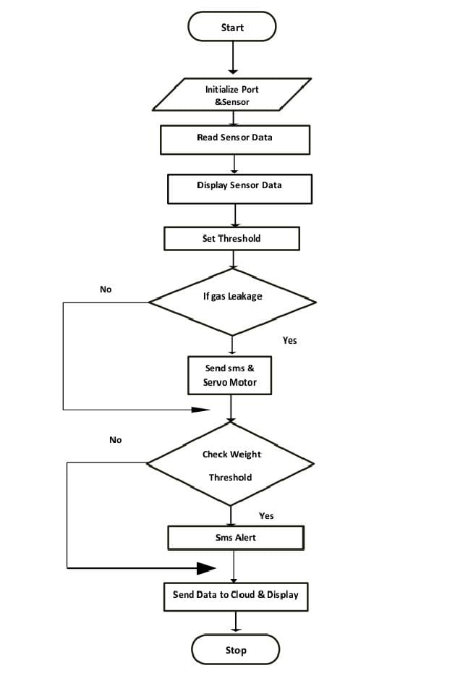
FLOWCHART

Slide 8
SOFTWARE USED
Arduino IDE (Programming)
Arduino is a prototype platform (open-source) based on an easy-to-use hardware and software. It consists of a circuit board, which can be programed (referred to as a microcontroller) and a ready-made software called Arduino IDE (Integrated Development Environment), which is used to write and upload the computer code to the physical board
2. Express PCB (Circuit And layout design)
Design of a PCB using layout software from ExpressPCB, which is freeware available at www.expresspcb.com. Before beginning you should make sure your computer has both ExpressPCB and ExpressSCH, if not than you should download the software. Before beginning the PCB process, you should come up with the initial design, build it and test it on a breadboard, fix any errors, and determine specific components. It is also useful to have datasheets and dimensions for all of the “special” components such as transistors, ICs, sensors, actuators, etc., on hand.

Slide 9
COMPONENTS REQUIRE
Microcontroller (AT mega 328)
Regulator (LM2596)
Lcd 16*2
Esp8266 (wifi module)
GSM Module
Servo Motor sg90
LPG MQ6
Load Cell
HX711

Slide 10
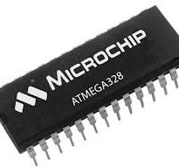
MICROCONTROLLER (AT MEGA 328)
Atmega328 is a low power CMOS 8-bit microcontroller based on the AVR enhanced RISC architecture.
By executing powerful instructions in a single clock cycle.
the controller achieves throughputs approaching 1 MIPS per MHz awing the system designer to optimize power consumption.

Slide 11
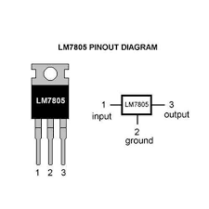
Regulator (LM7805)
The 7805 is a well-known linear voltage regulator that steps down higher voltage to a stable 5V output.
It is widely used in circuits that require a reliable 5V DC power supply.
Pin Layout:
Input: Connects to the higher voltage supply (7V–35V).
Ground: Common ground.
Output: Regulated 5V output.

Slide 12
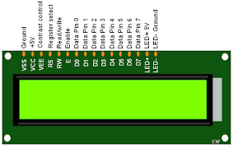
Lcd 16*2
The term LCD stands for liquid crystal display.
It is one kind of electronic display module used in an extensive range of applications like various circuits & devices like mobile phones, calculators, computers, TV sets, etc.
These displays are mainly preferred for multi-segment light-emitting diodes and seven segments.

Slide 13
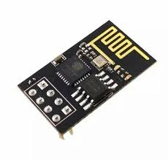
ESP8266 (WI FI MODULE)
Atmega328 is a low power CMOS 8-bit microcontroller based on the AVR enhanced RISC architecture.
By executing powerful instructions in a single clock cycle
the controller achieves throughputs approaching 1 MIPS per MHz awing the system designer to optimize power consumption.

Slide 14
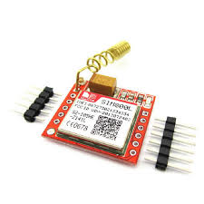
GSM MODULE
The SIM800L is a popular GSM/GPRS (Global System for Mobile Communications/General Packet Radio Service) module.
manufactured by SIM Com
that provides wireless communication capabilities.
It is widely used in IoT (Internet of Things) projects, remote monitoring, and embedded systems that require mobile connectivity for SMS, voice calls, and data.

Slide 15
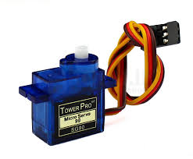
SERVO MOTOR
The SG90 is a small and lightweight servo motor with high output power.
IT is widely used in electronics projects.
IT is one of the most popular servo motors for hobbyists, especially in robotics and automation, due to its affordability, ease of use, and compatibility with microcontrollers like Arduino.

Slide 16
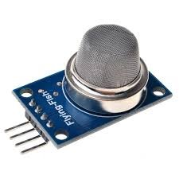
LPG MQ6
The MQ-6 is a gas sensor that detects the presence of Liquefied Petroleum Gas (LPG), propane, butane, and other flammable gases in the air.
It's widely used in safety systems, such as gas leak detection in homes and industries.
The sensor operates by detecting gas concentrations in the range of 200 ppm to 10,000 ppm.

Slide 17
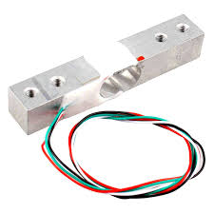
Load cell
A load cell is a sensor or transducer used to measure force or weight by converting the force applied to it into an electrical signal.
Load cells are widely used in various industrial, laboratory, and consumer applications like weighing scales, industrial machinery, and force sensors in robotics.

Slide 18
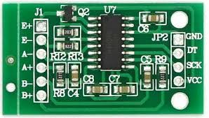
HX711
The HX711 is a highly integrated precision 24-bit analog-to-digital converter (ADC)
IT designed specifically for weigh scales and industrial control applications.
It is widely used in combination with load cells to provide accurate weight measurements by converting the small analog signals produced by the load cells into digital values.

Slide 19
ADVANTAGES
Real-time monitoring
The system can monitor the LPG level in real- time and publish the amount of gas as events.
Alerts
The system can send SMS notifications to the user when the LPG level is low or if there is agas leakage.
Connected devices
The user can respond to the alert from any location using a connected device like a smartphone
Safety
The system can detect gas leakage and fire, and turn on a buzzer and exhaust fan to alert the user.

Slide 20
REFERENCE
Shrestha, S., Anne, V. K., Chaitanya, R. (2019, April). IoT Based Smart Gas Management System. In 2019 3rd International Conference on Trends in Electronics and Informatics (ICOEI) (pp. 550-555). IEEE.
Suma, V., Shekar, R. R., Akshay, K. A. (2019, June). Gas Leakage Detection Based on IOT. In 2019 3rd International conference on Electronics, Communication and Aerospace Technology (ICECA) (pp. 1312-1315). IEEE.
Amin, M. M., Nugratama, M. A. A., Maseleno, A., Huda, M., Jasmi, K. A. (2018). Design of cigarette disposal blower and automatic freshner using mq-5 sensor based on atmega 8535 microcontroller. International Journal of Engineering & Technology, 7(3), 1108-1113.
Imade, S., Rajmanes, P., Gavali, A., Nayakwadi, P. V. N. (2018). Gas leakage detection and smart alerting system using IOT. International Journal of Innovative research & studies, 2(II).

Slide 21
THANK YOU

