Slide 1
C Language
SUBMITTED BY :-
Prachi Poddar
(10EGJCS739)
Notes:
This template can be used as a starter file for presenting training materials in a group setting.
Sections
Right-click on a slide to add sections. Sections can help to organize your slides or facilitate collaboration between multiple authors.
Notes
Use the Notes section for delivery notes or to provide additional details for the audience. View these notes in Presentation View during your presentation.
Keep in mind the font size (important for accessibility, visibility, videotaping, and online production)
Coordinated colors
Pay particular attention to the graphs, charts, and text boxes.
Consider that attendees will print in black and white or grayscale. Run a test print to make sure your colors work when printed in pure black and white and grayscale.
Graphics, tables, and graphs
Keep it simple: If possible, use consistent, non-distracting styles and colors.
Label all graphs and tables.

Slide 2
TOPIC COVERED IN TRAINING
Basic learning of C Language
Concepts of pointers and structures
File Handling in C
Graphics through C
Datastructures through C
Basic project development approach
Notes:
Give a brief overview of the presentation. Describe the major focus of the presentation and why it is important.
Introduce each of the major topics.
To provide a road map for the audience, you can repeat this Overview slide throughout the presentation, highlighting the particular topic you will discuss next.

Slide 3

C HISTORY
Developed between 1969 and 1973 along with UNIX
Designed by Dennis Ritchie at Bell Laboratories
Influenced by
- ALGOL (1960)
- CPL (Cambridge , 1963)
- BCPL (Martin Richard , 1967)
- B ( Ken Thompson , 1970)
Notes:
What will the audience be able to do after this training is complete? Briefly describe each objective how the audience will benefit from this presentation.

Slide 4
Compilation in C
C’s program building process involves four stages :-
Preprocessing (first pass) - includes file, conditional compilation instructions and macros
Compilation (second pass) – generates assemble source code
Assembly (third pass) – creates the object code i.e object file
Linking (final pass) – takes one or more object file or libraries as input and combines them to produce a single executable file.
Notes:
Discuss outcomes of the case study or class simulation.
Cover best practices.

Slide 5

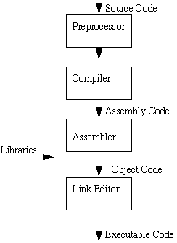

Slide 6
C Language Features
1
2
Low level language support
Procedural Oriented Language
3
High Level features
4
Efficient use of pointers
5
Base of all popular programming languages
Notes:
This is another option for an Overview slide.

Slide 7
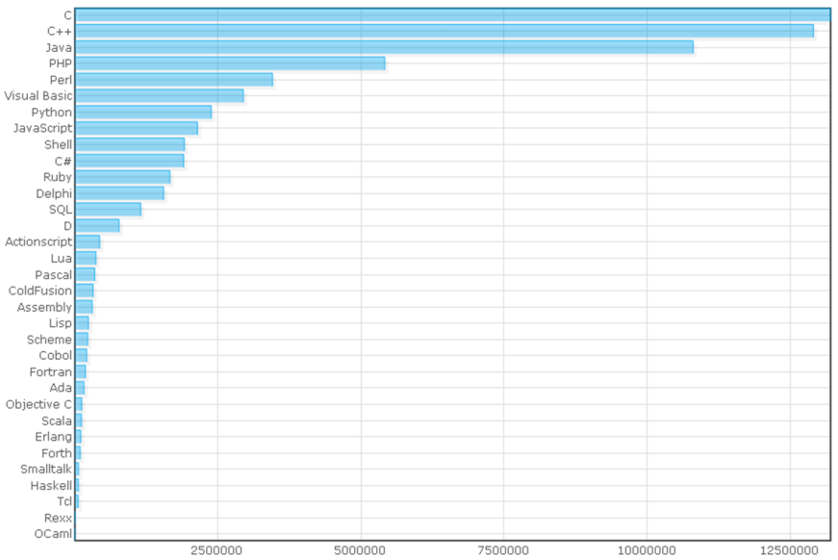
Above statistics conclude that C is still the most widely used language.

Slide 8
Advantages
Rich Libraries
Program portability
High speed of compilation
Easy to learn
Modular Programming
Bit Manipulation
Notes:
What will the audience be able to do after this training is complete? Briefly describe each objective how the audience will benefit from this presentation.

Slide 9
Disadvantages
Error prone
Difficult to modify
No provision to track down exceptions i.e run time errors
No support of object-oriented features
Weak Namespace
Dangling References
No automatic garbage collection
Notes:
What will the audience be able to do after this training is complete? Briefly describe each objective how the audience will benefit from this presentation.

Slide 10
Applications in C
C is widely used for the development of
Operating Systems
Language compilers , assemblers and interpreters
Drivers
Embedded Systems
Text Editors
Databases
Modern Programs
Notes:
Add a case study or class simulation to encourage discussion and apply lessons.

Slide 11
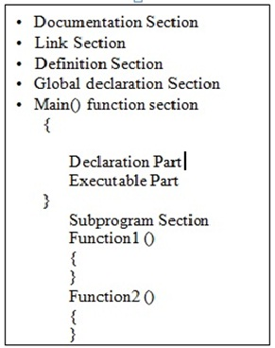

Basic structure of a C program

Slide 12

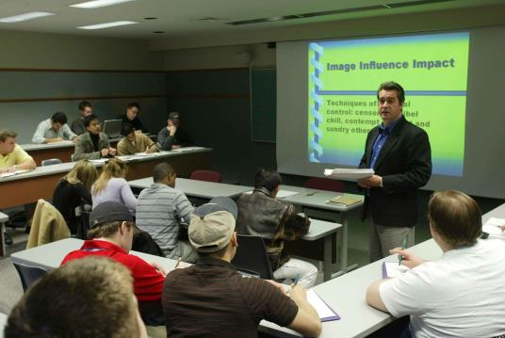
STUDENT DATABASE MANAGEMENT SYSTEM

Slide 13
PROJECT DETAILS
IMPLEMENTATION - C Language
2) REQUIREMENTS -
Processor : Intel Pentium 4 class processor or above
RAM : 100 MB
Hard Disk : 50 MB
Monitor : 15” CRT or LCD
Keyboard : Normal or Multimedia
Mouse : Compatible Mouse
3) FRONT END - .exe file
4) BACK END - Binary Files
5) PLATFORM - Windows 98/2000/XP/7/8/Vista,
Linux, Macintosh

Slide 14
Overview
The database is implemented using file handling.
All the work is done in primary memory and whenever the system is closed or on demand of the user ,the changes are permanently stored in the disk.
Similarly when existing database (file) is opened ,the primary key of all records are automatically arranged in the form of tree.
Notes:
What will the audience be able to do after this training is complete? Briefly describe each objective how the audience will benefit from this presentation.

Slide 15
OPERATIONS
Insert record
Append record
Display record
Update record
Delete record
Security Modification
Refresh
Exit
Notes:
What will the audience be able to do after this training is complete? Briefly describe each objective how the audience will benefit from this presentation.

Slide 16
FEATURES
Apart from the actual database , an index file is maintained .In primary memory , it is implemented in the form of AVL search tree and linked list to ensure efficient insertion, deletion and searching .
User Authentication is ensured maintaining user name and password.
Data consistency is ensured by introducing Primary Key which is unique for every record.
The possibility of invalid data entry is reduced to a large extend by adding some restrictions during the data entry.
Heavy use of comments are made to make the source code programmer friendly.
Notes:
What will the audience be able to do after this training is complete? Briefly describe each objective how the audience will benefit from this presentation.

Slide 17
CONCEPTS USED
Basic looping and if-else statements
File Handling
Pointers
Structures
Switch-case statements
Datastructures
Other Library functions
Notes:
What will the audience be able to do after this training is complete? Briefly describe each objective how the audience will benefit from this presentation.

Slide 18
Resources
Let US C (by Yashvant Kanatekar)
ANSI C (by Kernighan and Ritchie)
Mastering C (by K R Venugopal)
Datastructures (by Tenenbaum)
Data Structures (by Seymour Lipschutz)

Slide 19
Questions?

