Slide 1
Project Presentation of CO-OP Project at Industry (Module-2) (22CS421)
On
AI for early detection of heart disease using ECG and Imaging
Prachi (2210992052)
Sehdev Pratap (2210992278)
Raghav (2210992116)
Nishtha (2210991993)
Supervised By
Dr Gifty Gupta
Department of Computer Science and Engineering,
Chitkara University, Punjab

Slide 2
Introduction
Cardiovascular diseases are one of the leading causes of death worldwide.
Early and accurate diagnosis is essential to reduce mortality.
Traditional ECG analysis depends on expert interpretation.
It is time-consuming and prone to human error.
Artificial Intelligence, especially deep learning, enables automated ECG analysis.
The proposed system uses a ResNet50-based model for multi-class classification.
It provides faster, more reliable, and cost-effective detection.
Supports doctors in better clinical decision-making.
2

Slide 3
PROBLEM STATEMENT
Early detection of heart diseases using ECG is critical but remains challenging due to reliance on manual interpretation, which is time-consuming, error-prone, and difficult to scale for large patient populations.
There is a need for an automated, accurate, and efficient system that can analyze ECG images and classify multiple cardiac conditions to assist doctors in faster and more reliable diagnosis.

Slide 4
OBJECTIVES
To develop an automated system for early detection of heart diseases using ECG images.
To implement a deep learning model (ResNet50) for multi-class classification of cardiac conditions.
To improve accuracy and efficiency compared to traditional manual ECG analysis.
To handle imbalanced and limited medical datasets using transfer learning techniques.
To evaluate model performance using metrics like accuracy, precision, recall, and ROC curve.
To provide a reliable decision-support tool for clinicians for faster diagnosis.

Slide 5
Literature review
Earlier studies used machine learning models like Naïve Bayes, Random Forest, SVM, and Decision Trees for heart disease prediction, achieving moderate accuracy.
Hybrid models combining multiple algorithms improved performance, reaching accuracy levels around 88%–95%.
Deep learning approaches, especially CNN-based models, have shown superior performance with accuracies ranging from 85% to 96%.
Advanced techniques like transfer learning and domain adaptation further enhanced ECG classification accuracy and generalization.
Recent research highlights challenges such as imbalanced datasets, data quality, and real-world clinical integration.

Slide 6
Proposed solution
Develop a deep learning-based system using the ResNet50 architecture for automated ECG image classification.
Use transfer learning by leveraging a pre-trained model to extract meaningful features from ECG images.
Apply preprocessing techniques such as image resizing, normalization, and data augmentation to improve model performance.
Design a custom classification layer to categorize ECG images into five classes: AHB, COVID-19, HMI, MI, and Normal.
Train and validate the model on a multi-class ECG dataset to achieve high accuracy and minimize overfitting.
Evaluate performance using metrics like accuracy, confusion matrix, and ROC curve.
Provide a fast, reliable, and automated system to support doctors in early heart disease detection.

Slide 7
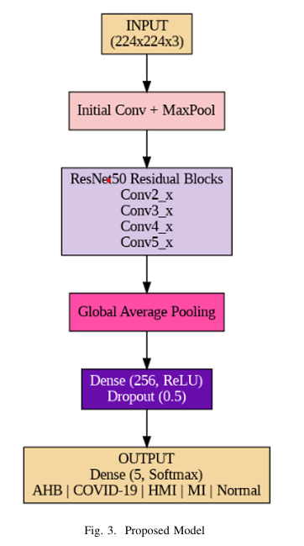
Proposed Solution

Slide 8
Dataset description
The dataset used is a publicly available ECG image dataset for heart disease classification.
It contains a total of 4568 ECG images collected from multiple patients.
The dataset is divided into three subsets: Training (70%), Testing (20%), and Validation (10%).
It includes five classes:
AHB (Atrioventricular Heart Block)
COVID-19 (cardiac-related cases)
HMI (History of Myocardial Infarction)
MI (Myocardial Infarction)
Normal
The dataset is imbalanced, making classification more challenging and realistic.
All images are in .jpg format and resized to 224 × 224 pixels during preprocessing.

Slide 9
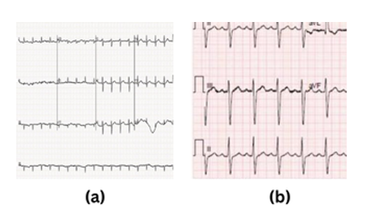
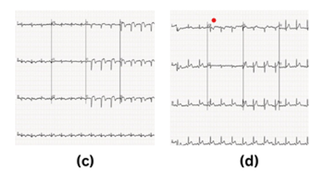
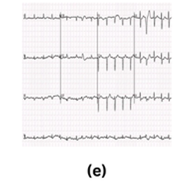
Sample Dataset images
AHB COVID 19
HMI MI
Normal

Slide 10
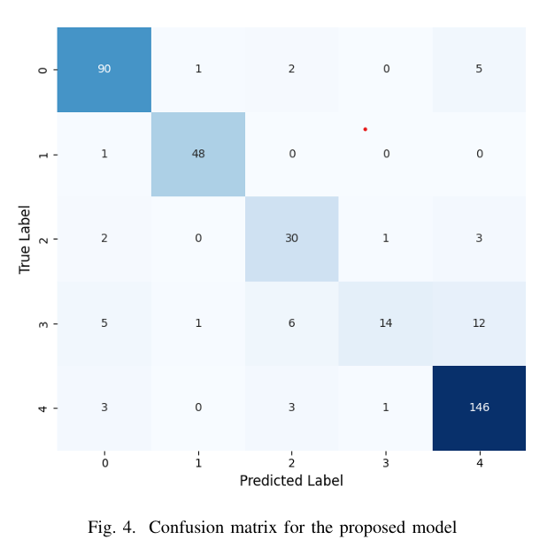
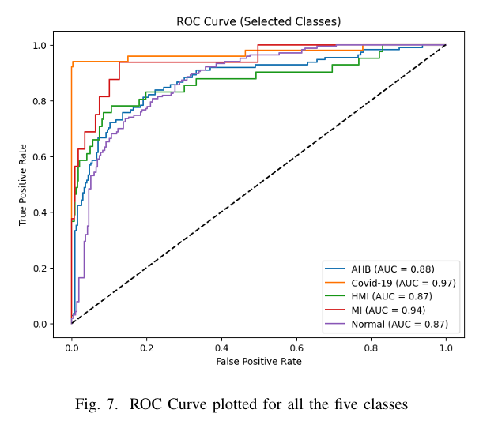
Results

Slide 11
References
Hybrid Deep Learning Framework for Heart Disease Prediction
Deep Learning for ECG-Based Cardiovascular Disease Diagnosis
Detecting Structural Heart Disease Using Deep Learning (Nature)
Deep Learning Approach for Early Detection of Cardiovascular Diseases
Automated ECG Classification Using CNN (Research Paper)
Deep Learning Methods for ECG-Based Heart Disease Prediction

Slide 12
Thank You
12

