Slide 1
Project Presentation On Spam Detection On Online Reviews
Submitted by:
Kawaldeep Kaur (9913103629) Prachi Gupta (9913103666)

Slide 2
INTRODUCTION
Online reviews are often the primary factor in a customer’s decision to purchase a product or service, and are a valuable source of information. Because of their impact, manufacturers and retailers are highly concerned with customer feedback and reviews.

Slide 3
What is Spam?
Relying on online reviews gives rise to the potential concern that wrongdoers may create false reviews to artificially promote or devalue products and services. This practice is known as Opinion (Review) Spam, where spammers manipulate and poison reviews i.e., making fake, untruthful, or deceptive reviews for profit or gain.
Spurious reviews that are fabricated to seem original.

Slide 4
OBJECTIVE
Our objective is to select appropriate features and eliminating redundant features from set of multiple features for detecting Spam and Non-spam in online reviews.

Slide 5
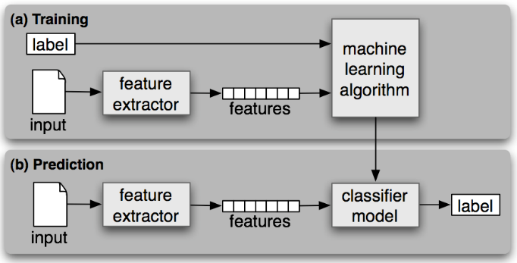
Background

Slide 6
Steps:
Make feature Set for training model from set of reviews
On labelled data set use Nature Inspired Algorithm for Feature selection
Machine learning algorithm used is SVM.
Features calculated are used to train classifier.

Slide 7
FEATURES SELECTED FOR DETECTING SPAM

Slide 8
Linguistic Characteristics as features
F1 : Quantity (Total Number of Words)
F2 : Complexity (Average number of words per sentence)
F3 : Diversity (Number of Unique words used)
F4 : Branding (Frequency of brand names used)
F5 : Average Word Length (Ratio of number characters to number of words)
F6 : Digits (Number of digits used)

Slide 9
POS Tagging as a feature
Frequency distribution of part-of-speech (POS) tags in a text often diﬀerentiates between informative and imaginative writing, namely that the former typically consists of more nouns, adjectives, prepositions, determiners, and coordinating conjunctions, while the latter consists of more verbs, adverbs, pronouns, and pre-determiners.
F7 : NN Number of Nouns
F8 : JJ Number of Adjectives
F9 : PRP Number of Prepositions
F10 : DT Number of Determiners
F11 : VB Number of Verbs
F12 : RB Number of Adverbs
F13 : PR Number of Pronouns

Slide 10
Unigram as a feature
Steps: 1 To model this behaviour we consider the unigram feature sets, with the corresponding features(words and expressions) and maintain a dictionary from the training set.
2 Each review was then broken into uni-gram and checked for the scores.
3 This score is calculated on the basis of presence or absence of an Uni-gram in the spam set or the non-spam set in terms of 1 or 0.
F16: SpamHitScore
F17: NonSpamHitScore

Slide 11
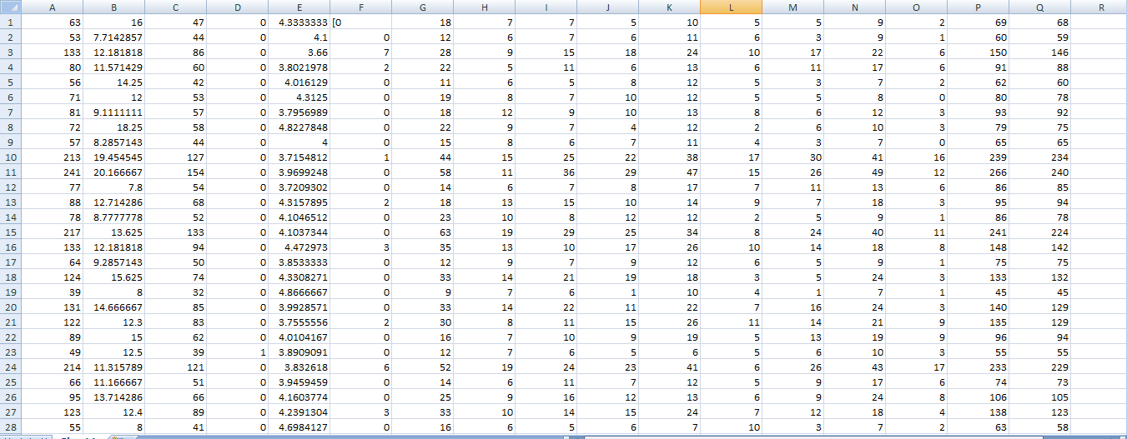
Features corresponding to reviews

Slide 12
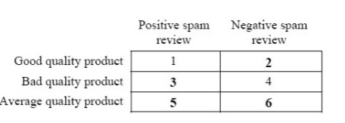
Purpose
we can infer that regions 1 and 4 are not very harmful. Regions
2 and 3 are very damaging for the reputation of a product. Regions 5 and 6 are mildly harmful but do bring about signiﬁcant losses or proﬁts for a brand or a product.

Slide 13
FEATURE SELECTION
A large feature set usually contains a number of irrelevant or redundant features, which may hide useful information from the relevant features . In order to deal with this problem, feature selection is proposed to select a small relevant feature subset by removing irrelevant and redundant features. It is expected that feature selection can shorten the training time and improve the classification performance over using all features.

Slide 14
Feature selection has two main objectives, which are to maximise the classification accuracy and minimise the number of selected features. Therefore, the following minimisation fitness function is used:
fitnessFS = α ∗ ErrorRate + (1 − α) ∗ #selected/#all
where ErrorRate means the classification error rate of the selected features, #selected represents the number of selected features and #all is the total number of original features. α is used to control the contributions of the classification performance and the number of selected features.

Slide 15
Techniques Used
Nature-Inspired Algorithm
Those that take inspiration from nature for the development of novel problem-solving techniques, those that are based on the use of computers to synthesize natural phenomenon and those that employ natural materials (e.g., molecules) to compute.

Slide 16
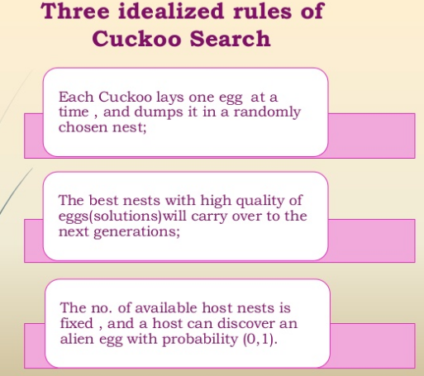
Cuckoo Search

Slide 17
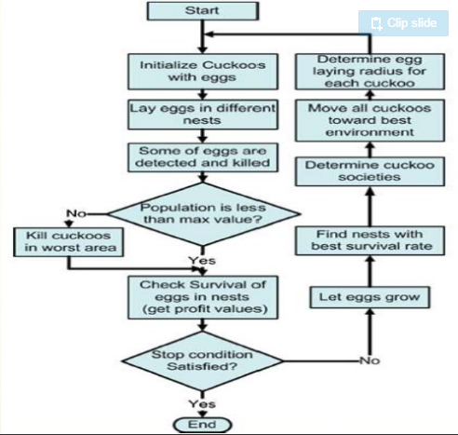

Slide 18
MACHINE LEARNING ALGORITHM
Support Vector Machine
In machine learning, support vector machines are supervised learning models with associated learning algorithms that analyze data used for classification and regression analysis.

Slide 19
An SVM model is a representation of the examples as points in space, mapped so that the examples of the separate categories are divided by a clear gap that is as wide as possible. New examples are then mapped into that same space and predicted to belong to a category based on which side of the gap they fall.

Slide 20
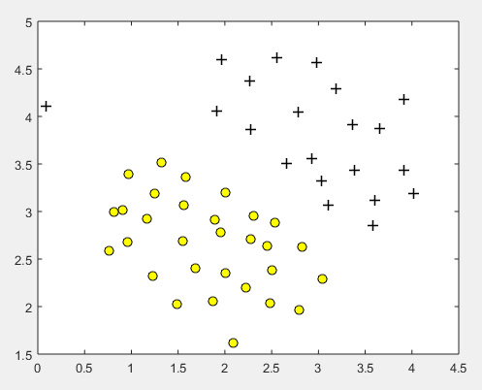
Results of SVM implementation

Slide 21
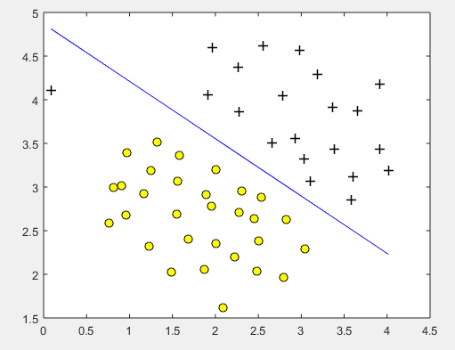
Separation of features by frontier line

Slide 22
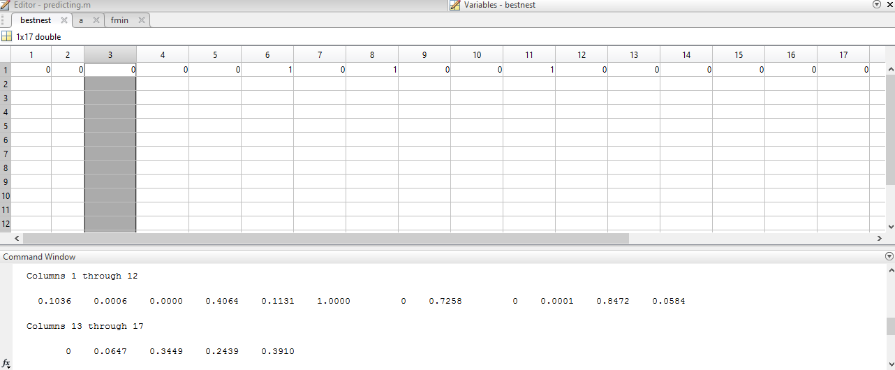
results

Slide 23
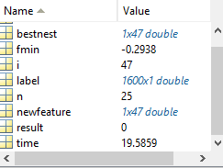
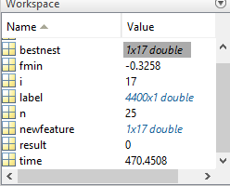
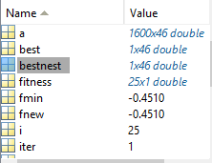
Value of fmin

Slide 24
-------END-------

