Slide 1


Project: Bike Rentals Sharing
Group Members:
Nagaram Cheedella
Prachi Gabani
Manoj H D
Chandana J
Harshitha M
Asha Rani K
Hemantha Kumar R

Slide 2
Problem Statement :- We have a dataset with bike rental data that contains several features including the time and date of the rental, season, week day, weather conditions, and number of rentals. The Aim is to build a model to predict the number of bike rentals based on the other features.
Steps:
Importing Libraries and Loading Data
Handling Missing Data
Visualizations and getting Insights
Handling Outliers
Feature Engineering
Feature Selection
Feature Encoding
Feature Scaling
Model Building
Hyperparameter Tuning
Pipeline building
Deployment

Slide 3
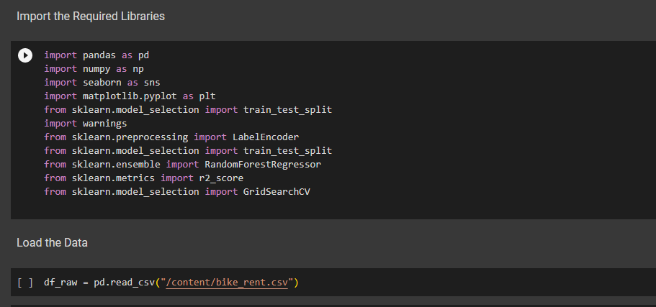
IMPORTING LIBRARIES AND DATA
Importing required libraries
Loading Data

Slide 4
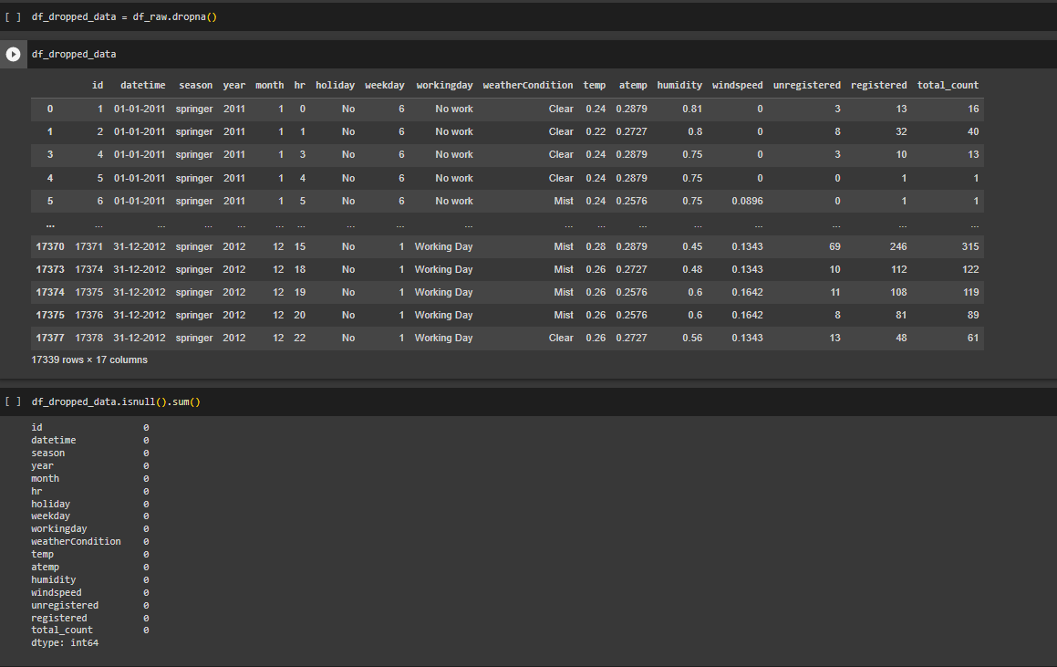
HANDLING MISSING DATA
In the given Data we have some corrupted/unknown data in the form of ‘?’
We have multiple ways to handle missing data like mean, median, mode, removing rows/cols etc..
Since missing data in our case is very few rows which is less than 3% of whole dataset, we are just dropping the missing rows.

Slide 5
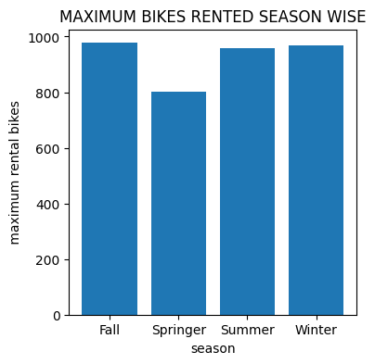
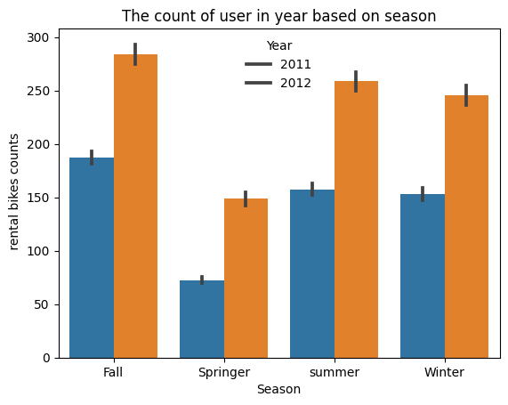
VISUALIZATIONS
We can get good insights and patterns of the different features with target variable using different visualizations
From Above Graph we can get info that More Bikes were rented in Fall season
Peak season was fall season since average rental bike was maximum in Fall season for both years

Slide 6
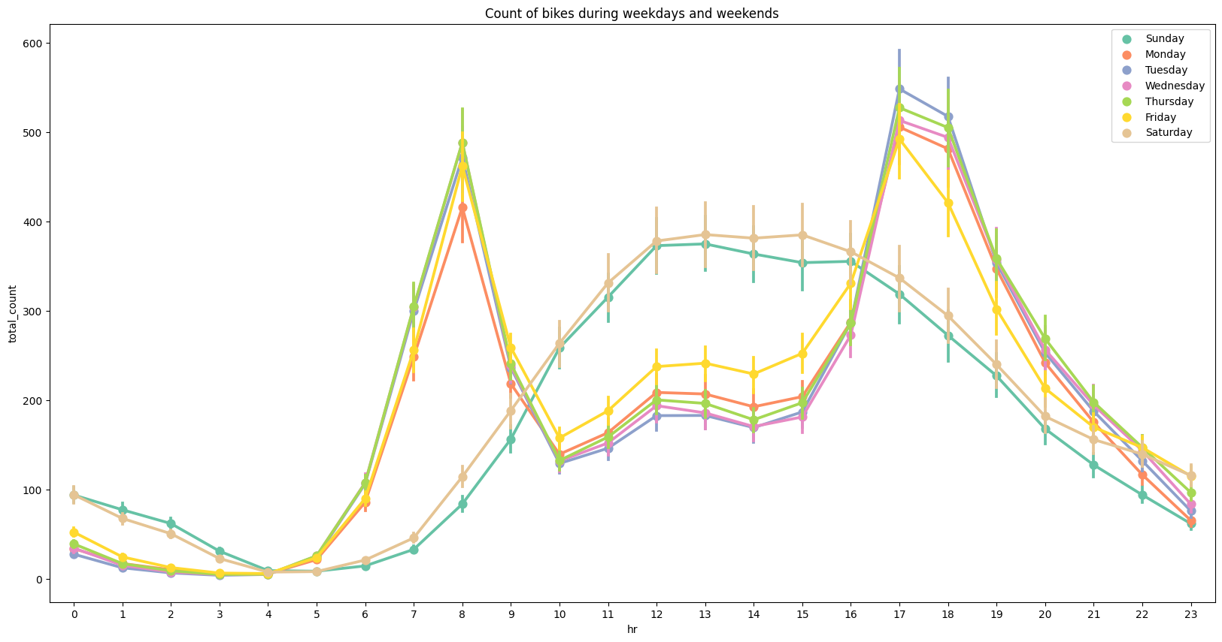
VISUALIZATIONS
Peak time is at around 7am and 5pm on Weekdays
Peak time for weekends is at afternoon between 12-01Pm

Slide 7
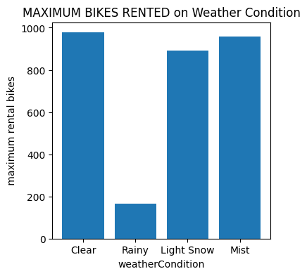
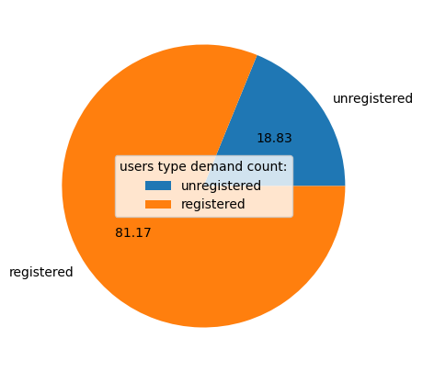
VISUALIZATIONS
It is observed that Bike Rentals are very high on Clear Weather conditions and very low on Rainy Conditions.
The demand of registered users were high as they were 81.17%
So Management should give some schemes to unregistered users in order to convert into registered users

Slide 8
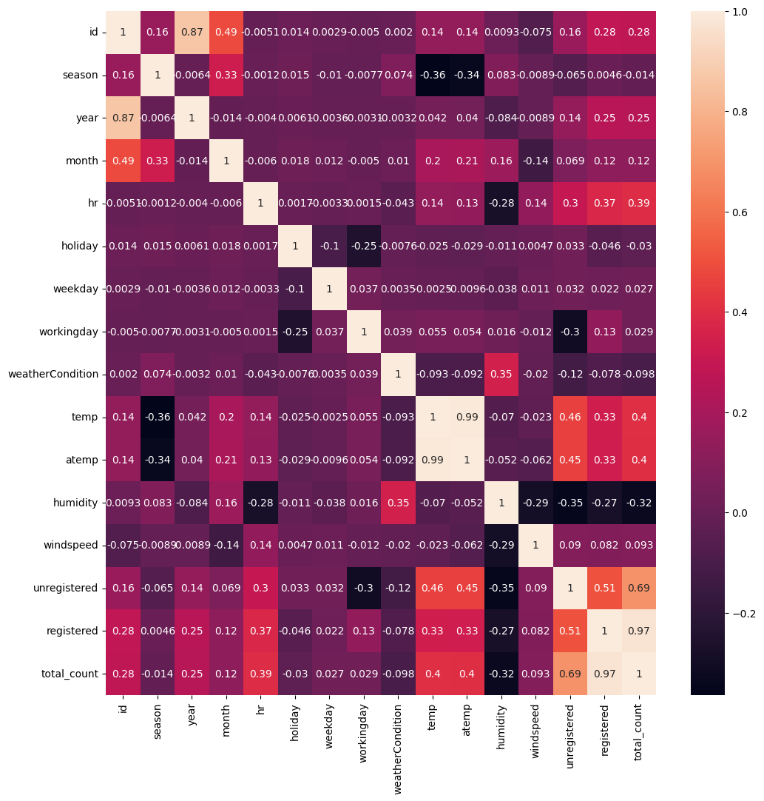
VISUALIZATIONS
Registered Users are very Strongly Corelated with total_count - 0.97
Unregisterd also Positively strong correlated with total_count - 0.69
hr is positively corelated with total_count - 0.39
temp is positively corelated with total_count - 0.4
Humidity is Negatively corelated with total_count - -0.32

Slide 9
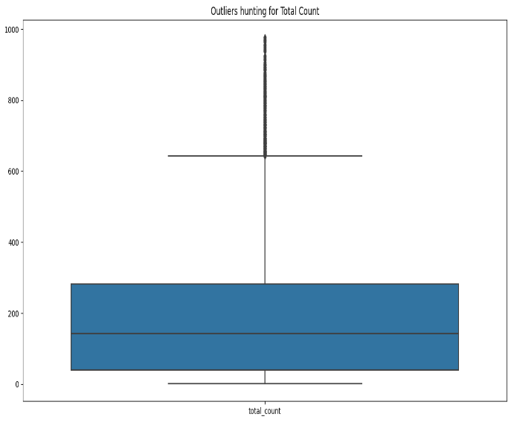
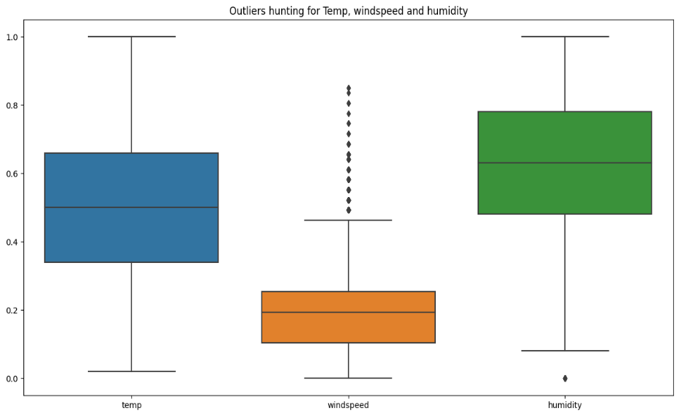
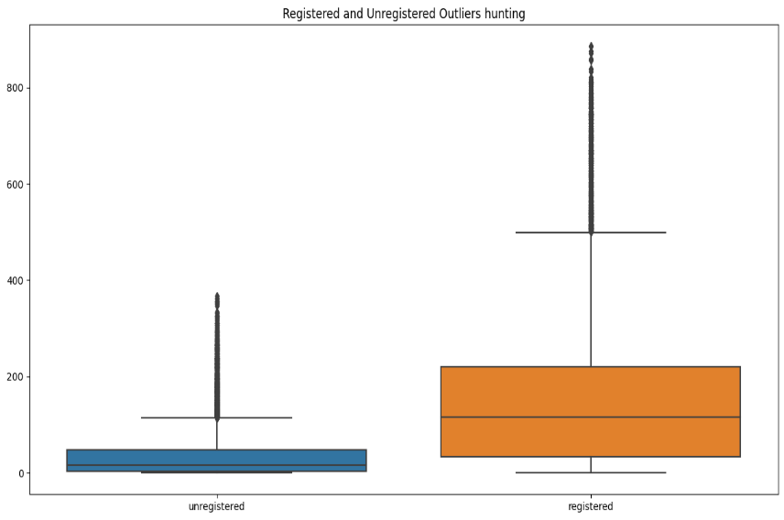
OUTLIERS
Total_count
Temp
Wind Speed
Humidity
unregistered
Registered
Observed that there are few outliers for Total_count, windspeed, Humidity, Registered and unregistered columns, we have to handle these columns and impute to main data set

Slide 10
OUTLIERS HANDLING
We have different methods to handle outliers:
Remove the outlier: If an outlier is due to an error in the data collection process, it may be appropriate to simply remove the outlier from the dataset. However, if the outlier is a legitimate data point, it may not be appropriate to simply remove it.
Winsorize the data: Winsorizing is a method that involves setting extreme values in the dataset to a specified percentile value. For example, you might set all data points above the 99th percentile to the value at the 99th percentile. This can help to reduce the impact of outliers without removing them entirely.
IQR: IQR method, we first calculate the 25th and 75th percentiles (q1 and q3) and then calculate the interquartile range (iqr) by subtracting q1 from q3. We then define the lower and upper bounds using the formula lower_bound = q1 - (1.5 * iqr) and upper_bound = q3 + (1.5 * iqr). Finally, we replace the outliers with the corresponding bounds.
Capping: we first define a percentage (c) of values to be capped (in this case, 5%). We then calculate the lower and upper bounds by taking the cth and (1-c)th percentiles of the data. Finally, we replace the outliers with the corresponding bounds.
Transform the data: Transformation methods, such as log transformation or square root transformation, can be used to reduce the impact of outliers. These transformations can help to make the distribution of the data more normal, which can make it easier to apply statistical methods.

Slide 11
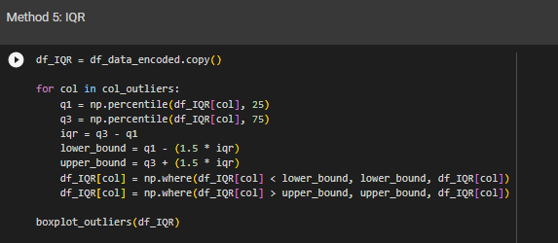

OUTLIERS HANDLING
Among all the mentioned methods capping and IQR performed well when applied basic Random Forest Algorithm.
Due to its easy interpretability and feasibility of usage, let us consider IQR method for handling Outliers in our dataset.

Slide 12
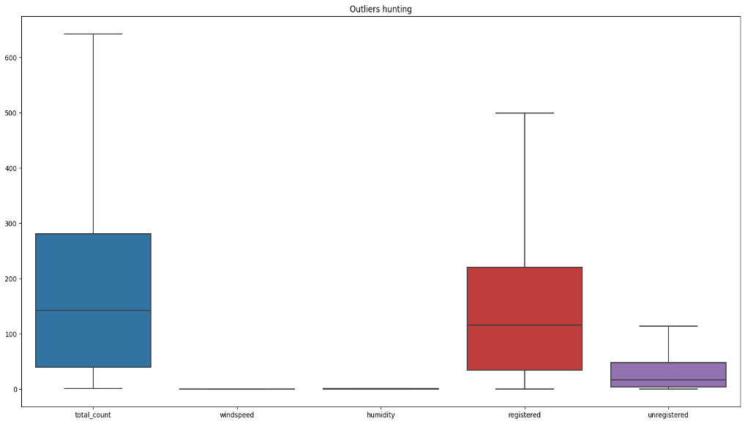
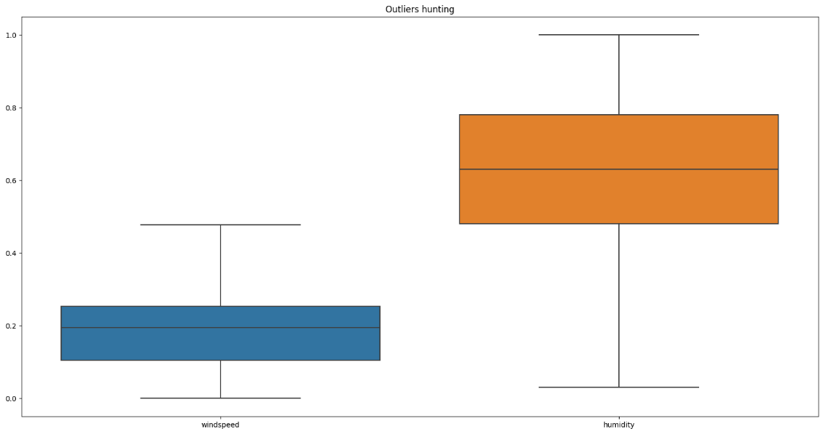
OUTLIERS HANDLING
Data without Outliers after performing IQR method
Total_count
Registered
unregistered
Wind Speed
Humidity

Slide 13
FEATURE SELECTION
We have different methods to perform feature selection.
1. Mutual Information (MI)
2. Recursive Feature Elimination (RFE)
3.Lasso
4. VIF ( Variance Inflation Factor)
5. Tree Based
After Performing the above methods we concluded the following features are more important for our model building.
['season', 'month', 'hr', 'weekday', 'working day', 'registered', 'unregistered' , 'date', 'weather Condition', 'total_count']

Slide 14
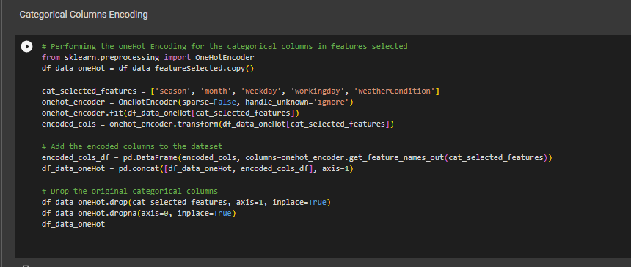
FEATURE ENCODING
We used One Hot Encoding for Categorical Data

Slide 15
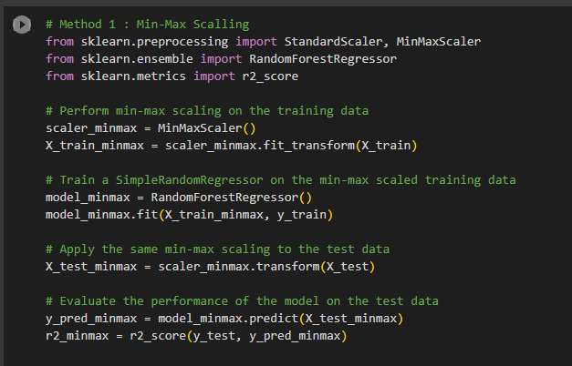
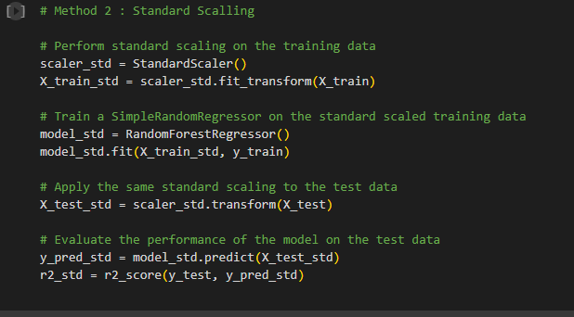

FEATURE SCALING
We used 2 methods for feature scaling:
Min-Max Scaling
Standard Scaling
Based on the r2 we can say that both methods are good for our dataset. Since we have narrow range of values we can consider using standardScaler.

Slide 16
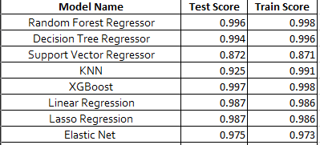
MODEL BUILDING
We have different Algorithms to build a predictive model for our data set.
Random Forest Regressor
Decision Tree Regressor
Support Vector Regressor
KNN
XGBoost
MLR
Linear Regression
Lasso Regression
Elastic Net etc..
We have performed Model Building on Multiple Algorithms and obtained model scores as below:
Note: Performed GridSearchCV for some models wherever required.

Slide 17
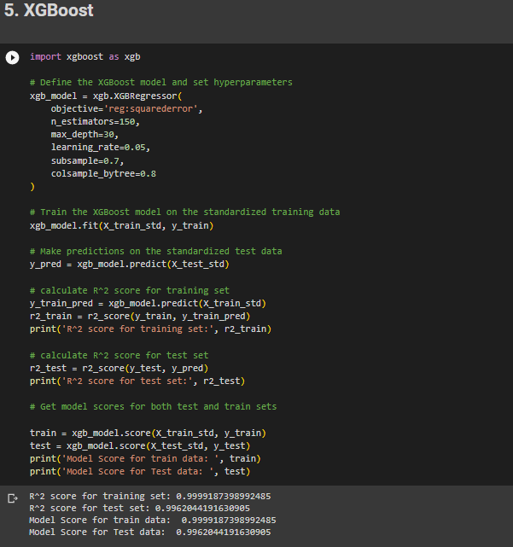
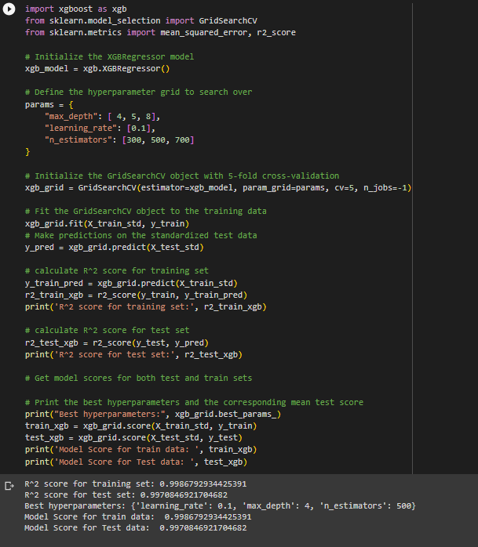
MODEL BUILDING
Although all models performed well and obtained good and approximate Test and Train data, we finalized a XGBoost model as it performed well after Cross Validation.

Slide 18
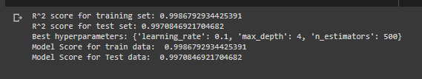
MODEL BUILDING
We got the best parameters and Model scores as below:

Slide 19
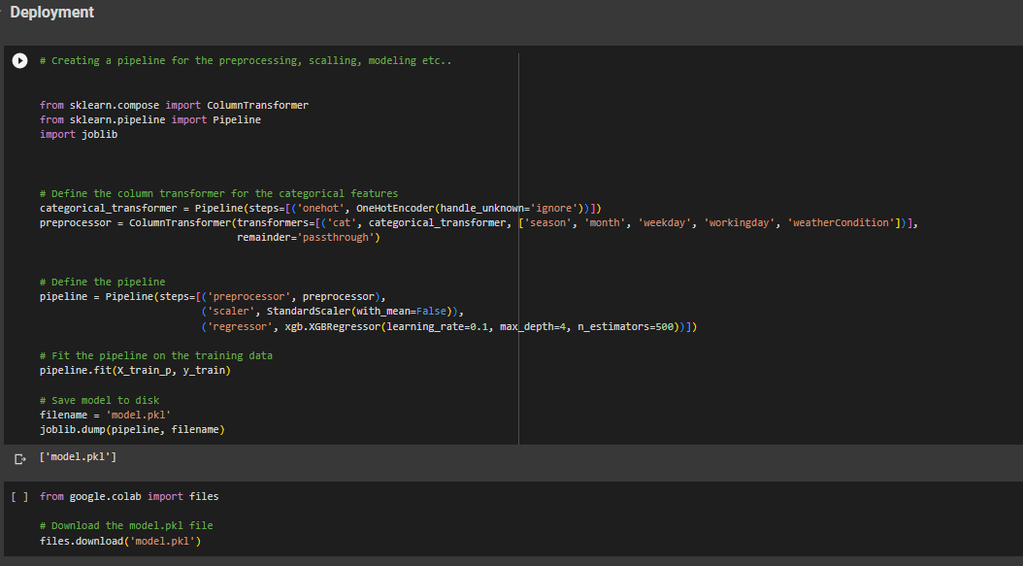
DEPLOYMENT
Created a Pipeline for Preprocessing, Scaling, Model

Slide 20
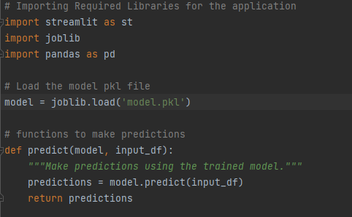
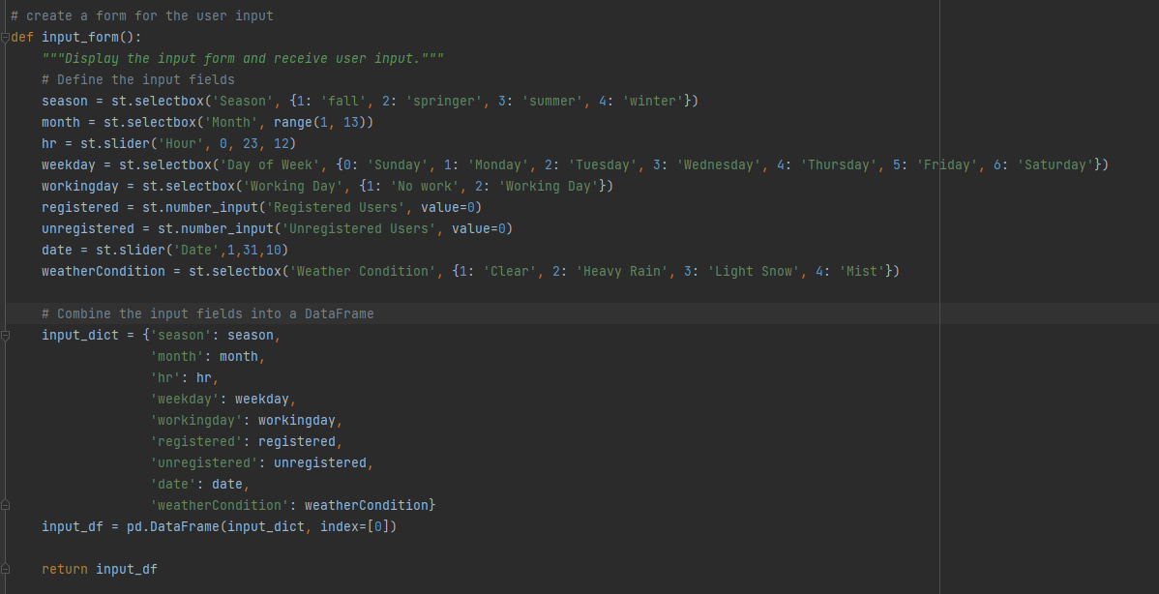
DEPLOYMENT
We Deployed our model using Streamlit Web Application
model
Input From

Slide 21
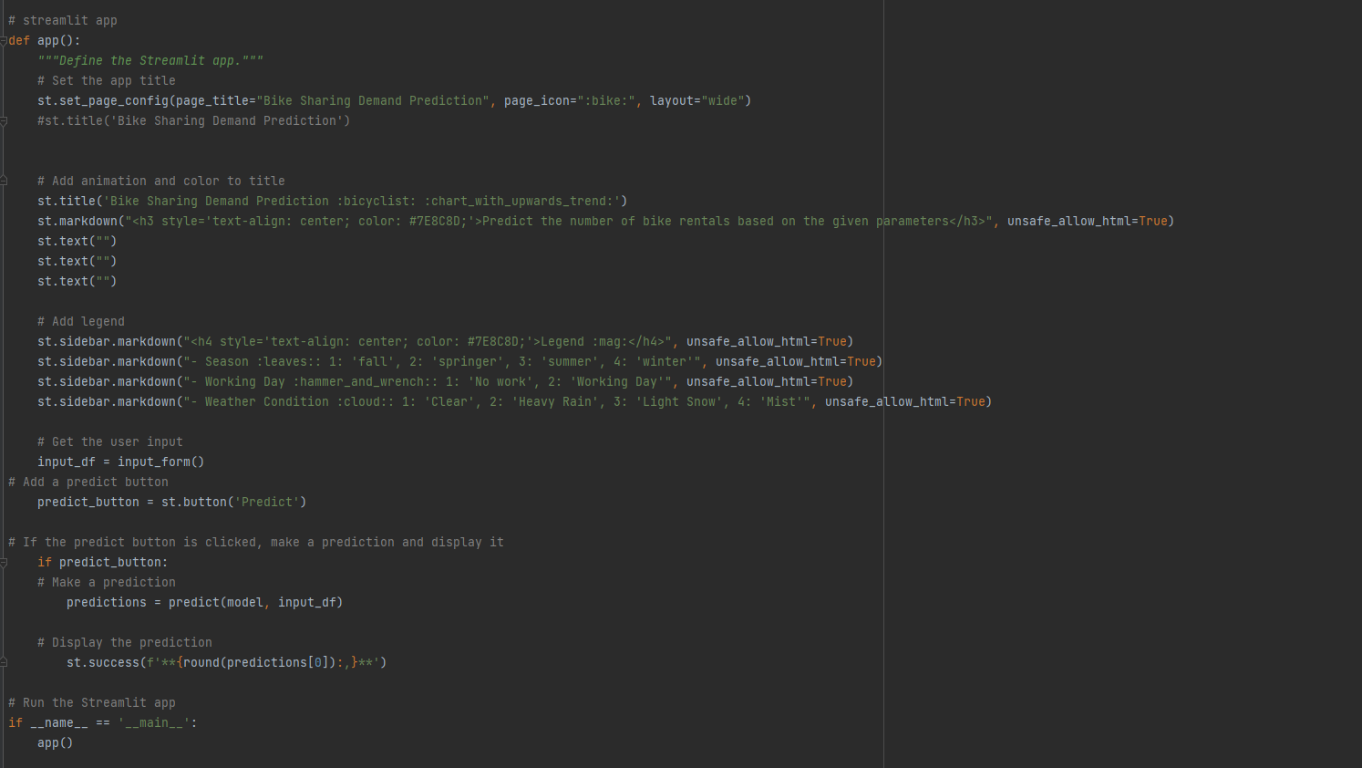
DEPLOYMENT
Main() block, predict button and page title/animations

Slide 22
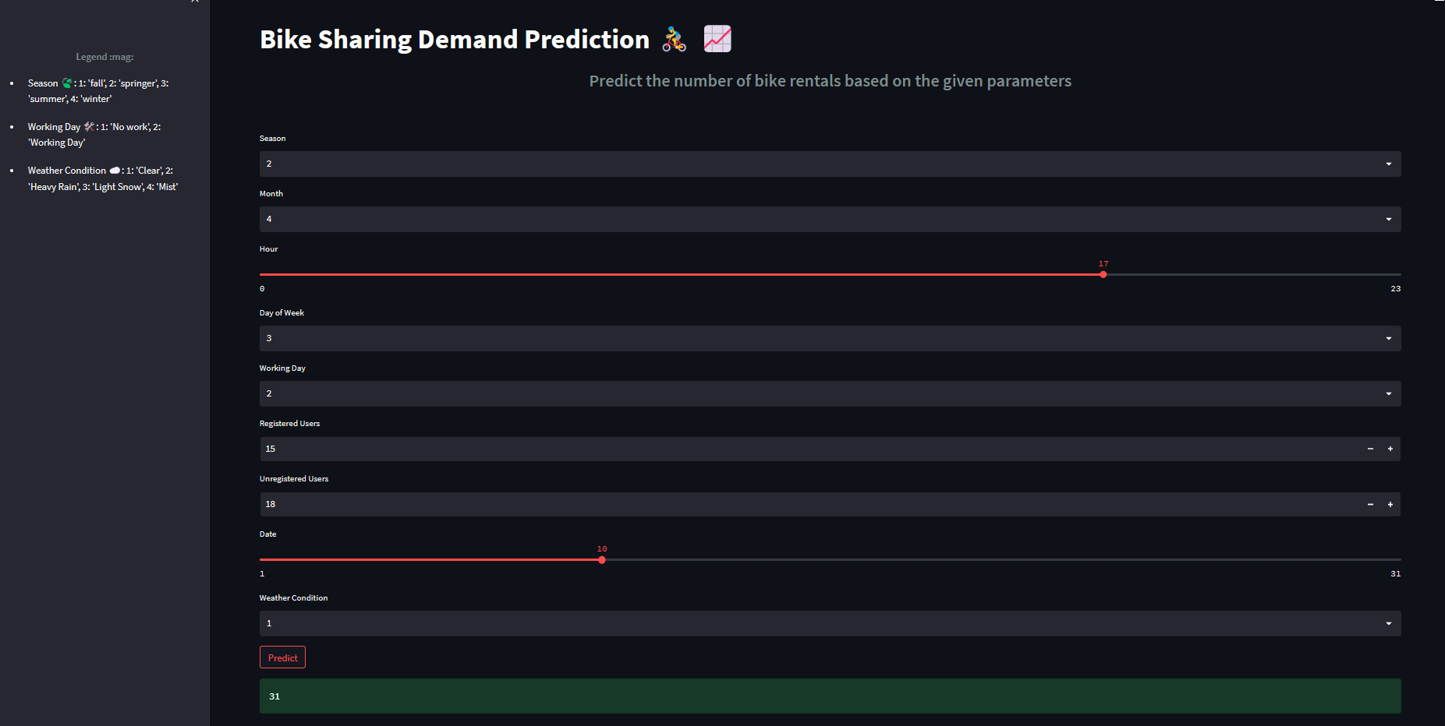
DEPLOYMENT
Sample Predicted output using Streamlit Web App

Slide 23


